Slide 1
1/20
eSASS pipeline
Data from Moscow ground tests
Calbration data base
eSASS documention
New eSASS users release, demo script
User feedback, bug reports, feature requests, etc.
Recent activities: SRCTOOL flux corrections
Astrometric correcitons
eSASS pipeline
All-sky survey SIXTE simulations & pipeline testing
H. Brunner eSASS pipeline eROSITA Consortium meeting, Potsdam March 4th, 2019

Slide 2
2/20
Data from Moscow ground tests
Testing campaigns in Moscow Dec. 2018 + Jan. 2019
Dual data reception via socket connection +
file based via IKI data exchange server
Analysis via EGSE by eROSITA hardware team +
FITS conversion for eSASS pipeline and NRTA
(tmsplit, Ingo Kreykenbohm/Bamberg)
H. Brunner eSASS pipeline eROSITA Consortium meeting, Potsdam March 4th, 2019

Slide 3
2/20
Data from Moscow ground tests
Testing campaigns in Moscow Dec. 2018 + Jan. 2019
Dual data reception via socket connection +
file based via IKI data exchange server
Analysis via EGSE by eROSITA hardware team +
FITS conversion for eSASS pipeline and NRTA
(tmsplit, Ingo Kreykenbohm/Bamberg)
H. Brunner eSASS pipeline eROSITA Consortium meeting, Potsdam March 4th, 2019

Slide 4
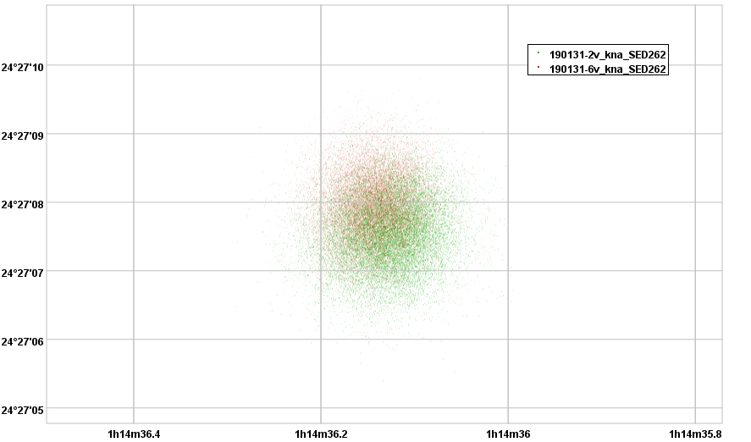
2/20
Data from Moscow ground tests
Testing campaigns in Moscow Dec. 2018 + Jan. 2019
Dual data reception via socket connection +
file based via IKI data exchange server
Analysis via EGSE by eROSITA hardware team +
FITS conversion for eSASS pipeline and NRTA
(tmsplit, Ingo Kreykenbohm/Bamberg)
Georg Lamer
H. Brunner eSASS pipeline eROSITA Consortium meeting, Potsdam March 4th, 2019

Slide 5
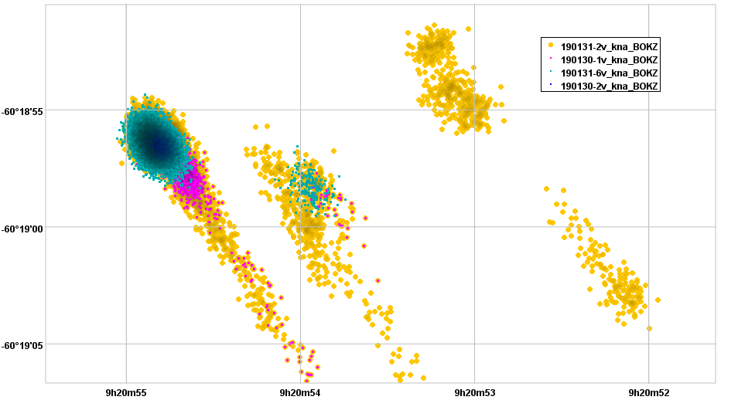
2/20
Data from Moscow ground tests
Testing campaigns in Moscow Dec. 2018 + Jan. 2019
Dual data reception via socket connection +
file based via IKI data exchange server
Analysis via EGSE by eROSITA hardware team +
FITS conversion for eSASS pipeline and NRTA
(tmsplit, Ingo Kreykenbohm/Bamberg)
Georg Lamer
Georg Lamer
H. Brunner eSASS pipeline eROSITA Consortium meeting, Potsdam March 4th, 2019

Slide 6
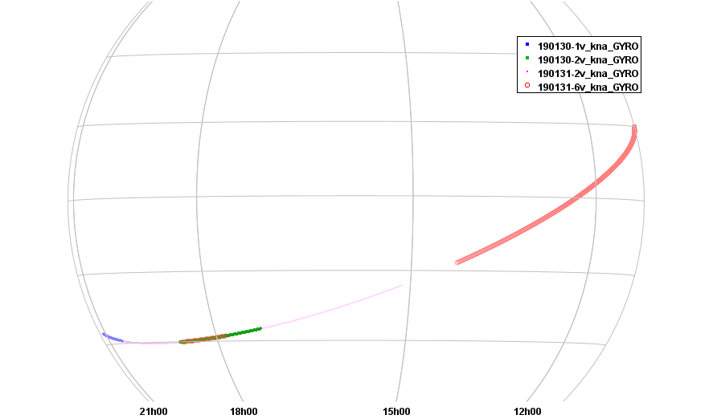
2/20
Data from Moscow ground tests
Testing campaigns in Moscow Dec. 2018 + Jan. 2019
Dual data reception via socket connection +
file based via IKI data exchange server
Analysis via EGSE by eROSITA hardware team +
FITS conversion for eSASS pipeline and NRTA
(tmsplit, Ingo Kreykenbohm/Bamberg)
Georg Lamer
Georg Lamer
Georg Lamer
H. Brunner eSASS pipeline eROSITA Consortium meeting, Potsdam March 4th, 2019

Slide 7
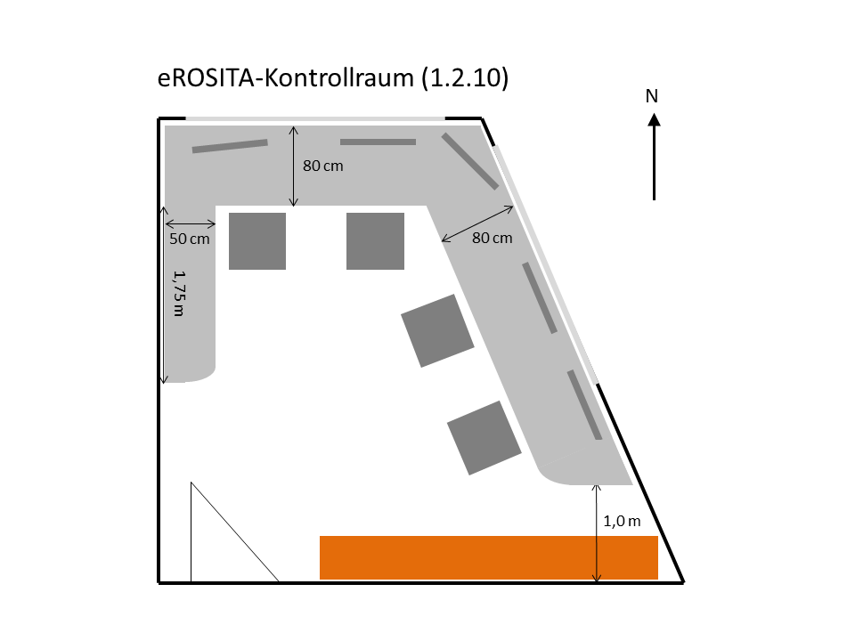
2/20
Data from Moscow ground tests
Testing campaigns in Moscow Dec. 2018 + Jan. 2019
Dual data reception via socket connection +
file based via IKI data exchange server
Analysis via EGSE by eROSITA hardware team +
FITS conversion for eSASS pipeline and NRTA
(tmsplit, Ingo Kreykenbohm/Bamberg)
Georg Lamer
Georg Lamer
Georg Lamer
H. Brunner eSASS pipeline eROSITA Consortium meeting, Potsdam March 4th, 2019

Slide 8
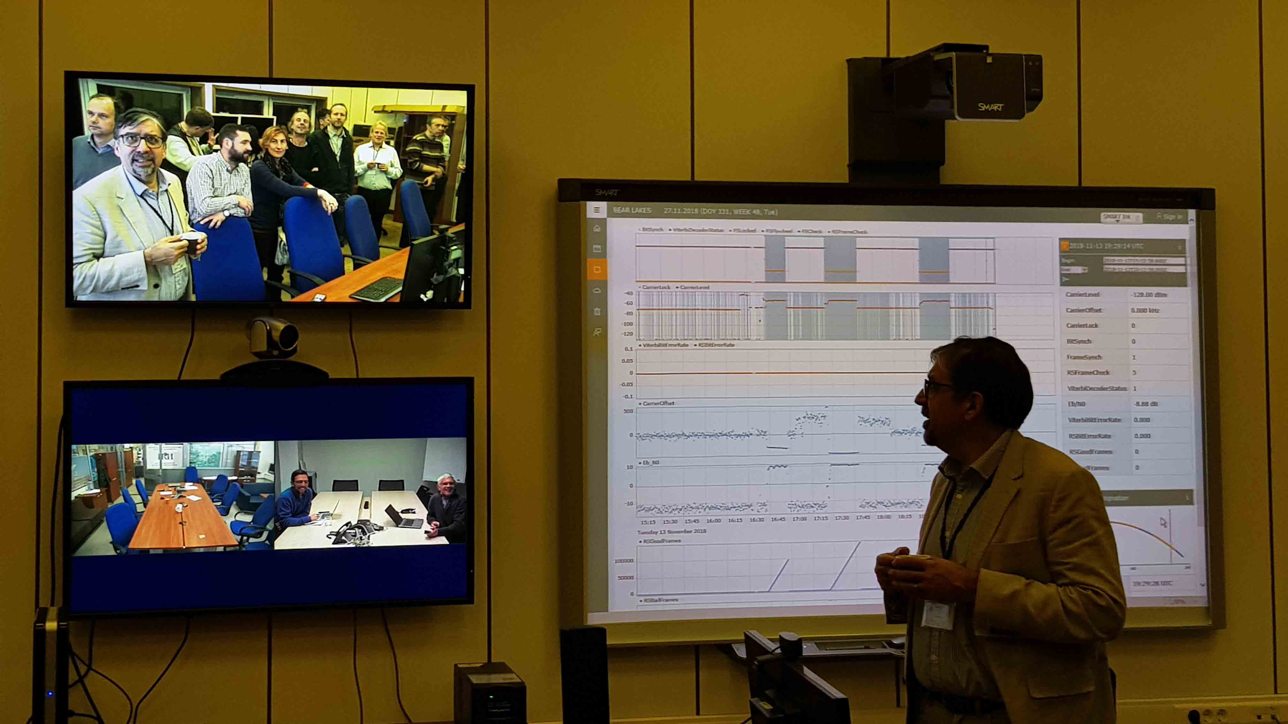
Data from Moscow ground tests
Testing campaigns in Moscow Dec. 2018 + Jan. 2019
Dual data reception via socket connection +
file based via IKI data exchange server
Analysis via EGSE by eROSITA hardware team +
FITS conversion for eSASS pipeline and NRTA
(tmsplit, Ingo Kreykenbohm/Bamberg)
H. Brunner eSASS pipeline eROSITA Consortium meeting, Potsdam March 4th, 2019

Slide 9
3/20
eRoSITA calibration databas (caldb)
caldb (HEASARC standard) calibration database with additional indexing scheme to support different calibration versions for each eSASS release – NEW: change logs in caldb directory
Telescopes
2DPSF (P/S)
ERBOX
ERMLDET
SRCTOOL
SLET_PSF
ERMLDET
APETOOL
ERSENSMAP
TVIGNET
EXPMAP
SRCTOOL
Detectors
ENERGY
ENERGY
BADPIX
FTFINDHOTPIX
PATTERN
EXPMAP
SRCTOOL
OFFSETS
EVPREP
MIPSMAP
EXPOSURE
EXPMAP
Cal file type
eSASS task
H. Brunner eSASS pipeline eROSITA Consortium meeting, Potsdam March 4th, 2019

Slide 10
4/20
Spectra
RMF (STD/FINE)
SRCTOOL
ARF (STD/FINE)
SRCTOOL
Timing
TIMECORR
EVPREP
ATTPREP
TIMECORR
Spatial
FOVMAP
EXPMAP
SRCTOOL
BACKGRND
DETMAP
EXPMAP
SRCTOOL
BACKGRND
Attitude
SED1/2
BOKZ
GYRO
ATTPREP
General
INSTPAR
TELATT
EVATT
Cal file type
eSASS task
H. Brunner eSASS pipeline eROSITA Consortium meeting, Potsdam March 4th, 2019

Slide 11
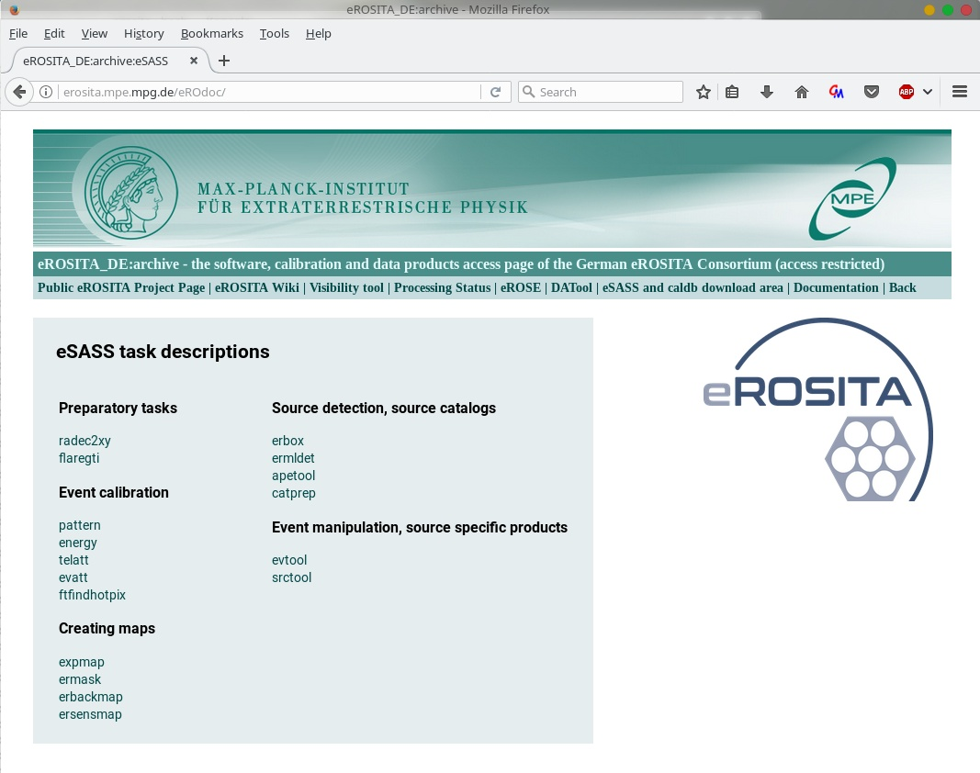
5/31
eSASS documentation
H. Brunner eSASS pipeline eROSITA Consortium meeting, Potsdam March 4th, 2019

Slide 12
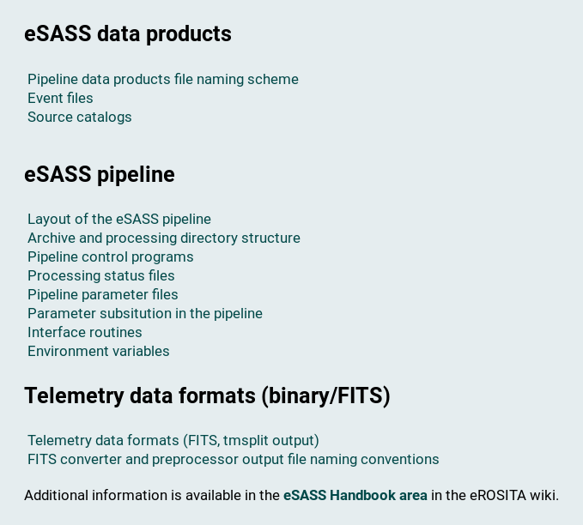
eSASS documentation
5/20
H. Brunner eSASS pipeline eROSITA Consortium meeting, Potsdam March 4th, 2019

Slide 13
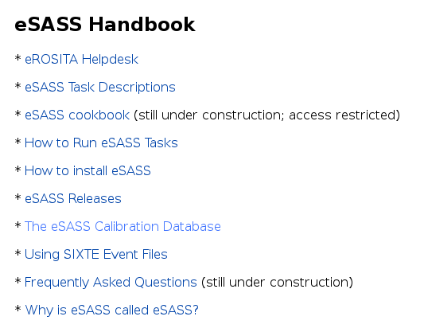
eSASS documentation
5/20
H. Brunner eSASS pipeline eROSITA Consortium meeting, Potsdam March 4th, 2019

Slide 14
eSASS documentation
5/20
Work flows, scripts
(inputs by Adam Malyali)
H. Brunner eSASS pipeline eROSITA Consortium meeting, Potsdam March 4th, 2019

Slide 15
eSASS documentation
5/20
Work flows, scripts
(inputs by Adam Malyali)
H. Brunner eSASS pipeline eROSITA Consortium meeting, Potsdam March 4th, 2019

Slide 16
7/20
Working with eSASS – new users release
eSASS releases
using eSASS
eSASS releases
using eSASS
Installing and working with eSASS:
https://wiki.mpe.mpg.de/eRosita/eSASS
eSASS info pages (interactive + pipeline):
http://erosita.mpe.mpg.de/eROdoc
eSASS download area (follow instructions in wiki):
http://erosita.mpe.mpg.de/eSASS-download/
eSASS helpdesk: eROSITA-helpdesk@mpe.mpg.de
Mailing list: eROcat@lists.mpe.mpg.de
NEW: monthly eSASS user telecons!
Interactive analysis
Interactive analysis
EVTOOL
SRCTOOL
FLAREGTI
EXPMAP
ERBACKMAP
ERMASK
ERSENSMAP
ERBOX
ERMLDET
APETOOLL
CATPREP
TIMECORR
BARYCORR
eSASSdevel
PATTERN
ENERGY
EVATT
RADEC2XY
eSASSusers_YYMMDD
eSASSpipe_YYMMDD
eSASSusers_190220 (beta testing)
eSASSpipe_181017
(new autoconf by Philipp Weber – experimental)
H. Brunner eSASS pipeline eROSITA Consortium meeting, Potsdam March 4th, 2019

Slide 17
eSASS demo script
8/20
calibrated event list
(SIXTE)
EVTOOL
filtering,merging,
Image creation
exposure maps
EXPMAP
ERMASK
detection mask
ERBOX local
background maps
ERBACKMAP
source detection
ERBOX map
ERMLDET
sensitivity maps
ERSENSMAP
aperture photometry
PSF + sensitivity maps
APETOOL
source catalogs
CATPREP
spectra, lightcurves, ARFs, RMFs
SRCTOOL
Christoph Großberger
H. Brunner eSASS pipeline eROSITA Consortium meeting, Potsdam March 4th, 2019

Slide 18
6/20
User feedback, bug reports, feature requests, …
SIXTE/eSASS flux inconsistencies (SRCTOOL, ERMLDET fluxes)
Florian Pacaud + Bonn team
MPE: Teng Liu and others
Thomas Dauser + Bamberg SIXTE team
Mostly solved (ongoing) a eSASS Q+A splinter
Suggestions for eSASS upgrades
Miriam Ramos + Bonn team
Teng Liu
Alexis + Team
eSASS Q+A splinter
eSASS science requirements meetings a monthly eSASS user telecons
eSASS Q+A splinter session
Wed. 9:00 – 10:30
Feedback, bugs, feature requests,
new eSASS users release, etc.
H. Brunner eSASS pipeline eROSITA Consortium meeting, Potsdam March 4th, 2019

Slide 19
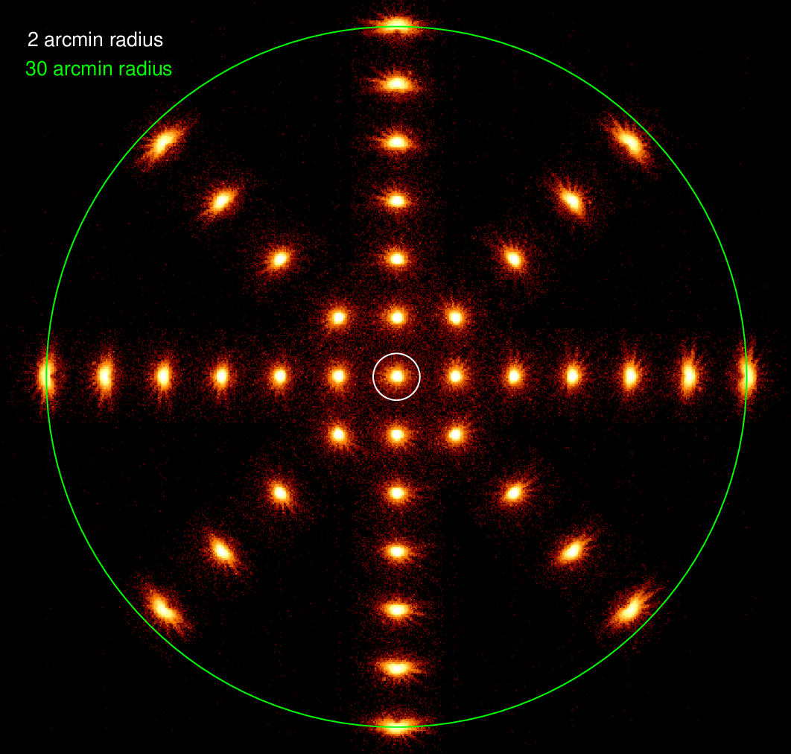
Fluxes of SRCTOOL extracted spectra as a function of position
9/20
19
29
47
SRCTOOL was using an old PSF
based on ray-tracing simulations
4
26
14
44
10
13
PSF provided by Konrad Dennerl
7
2
1
8
38
20
32
41
35
25
Jeremy Sanders

Slide 20
Fluxes of SRCTOOL extracted spectra as a function of position
10/20
19
Updated SRCTOOL PSF using PANTER images to better match SIXTE PSF:
now agrees to around 5%
29
47
4
26
14
44
10
13
PSF provided by Konrad Dennerl
7
2
1
8
38
20
32
Tests with scanned observations also give similar agreement
41
35
25
Details:
eSASS Q+A splinter session
Wed. 9:00 – 10:30
Also: feedback, bugs, feature requests,
new eSASS users release, etc.
Jeremy Sanders

Slide 21
11/20
Astrometric corrections
Mara Salvato (catalogs, NWAY)
Long Ji (NWAY based algorithm)
Georg Lamer (testing, eSASS implementation)
3XMM in XMM-XXL field south as input list
SIXTE simulation of eROSITA sky tile
After source detection +10 arcsec offset to the DEC positions
NWAY based astrometric correction algorithm with
GAIA optical reference and
NWAY weights from position in WISE W2 vs. W1-W2 plane
Result:
-9.25" in DEC and -0.69" in RA correction
Remaining offset: 1.03“

Slide 22
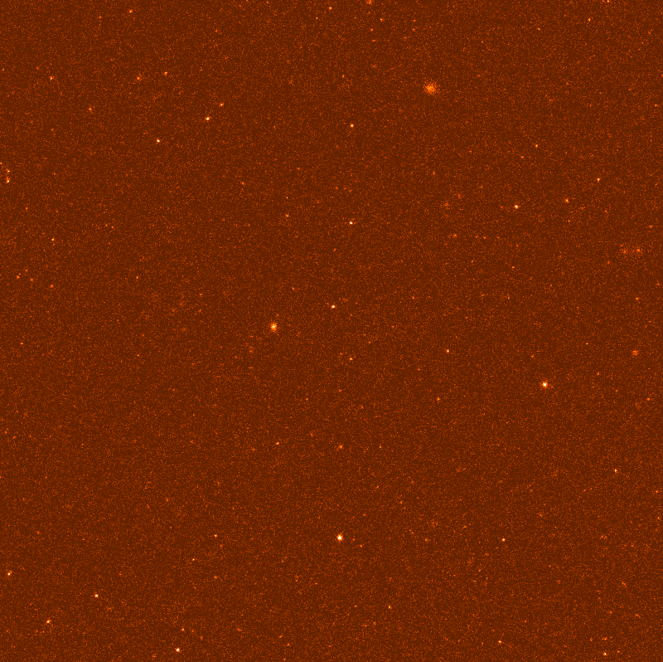
12/20
Georg Lamer
H. Brunner eSASS pipeline eROSITA Consortium meeting, Potsdam March 4th, 2019

Slide 23
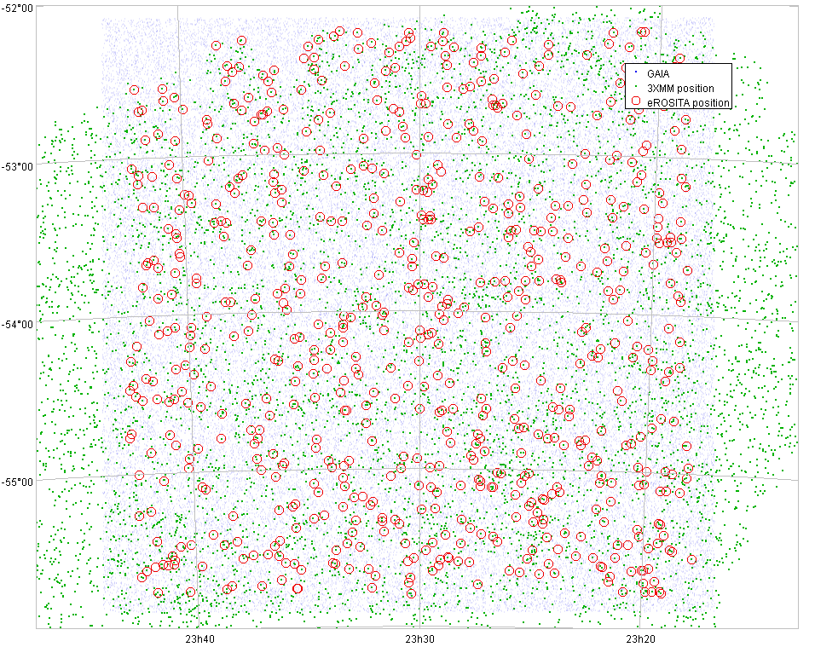
13/20
Georg Lamer
H. Brunner eSASS pipeline eROSITA Consortium meeting, Potsdam March 4th, 2019

Slide 24
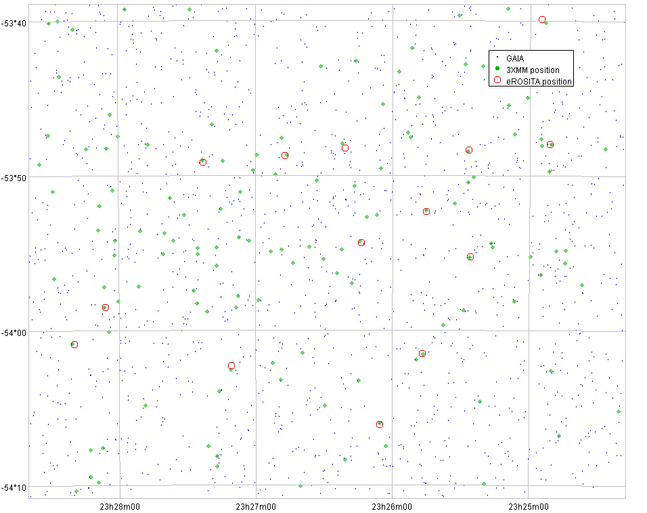
14/20
Georg Lamer
H. Brunner eSASS pipeline eROSITA Consortium meeting, Potsdam March 4th, 2019

Slide 25
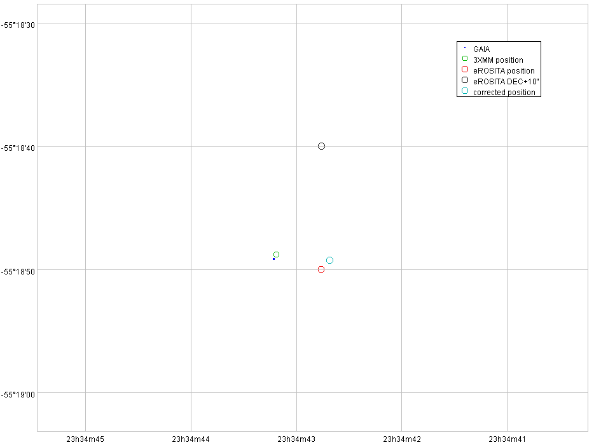
15/20
Georg Lamer
H. Brunner eSASS pipeline eROSITA Consortium meeting, Potsdam March 4th, 2019

Slide 26
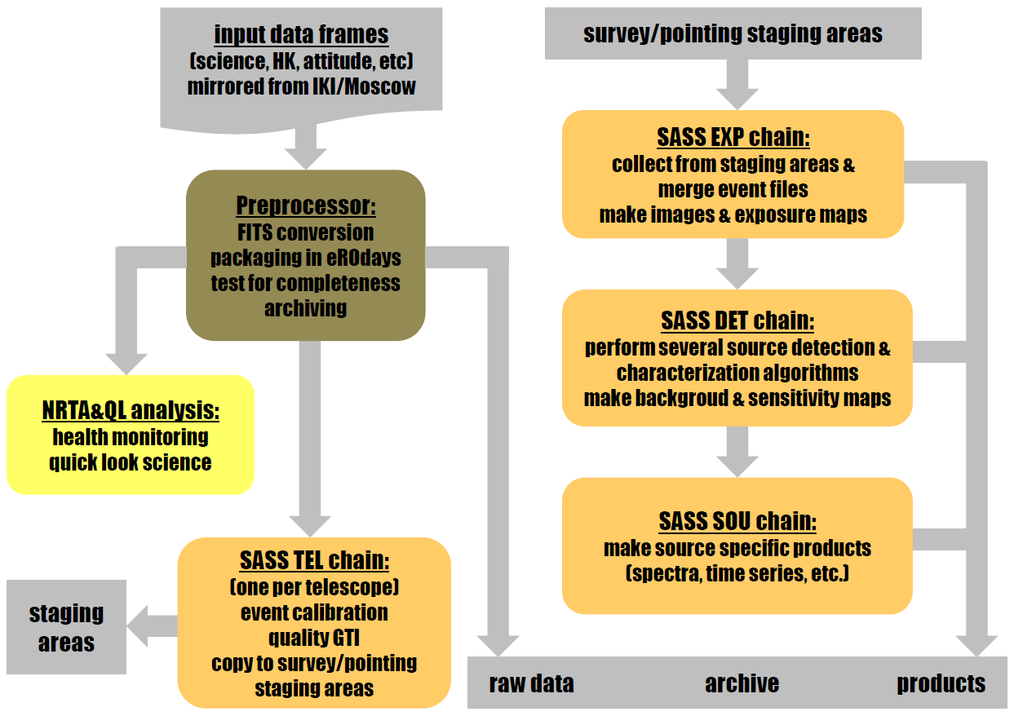
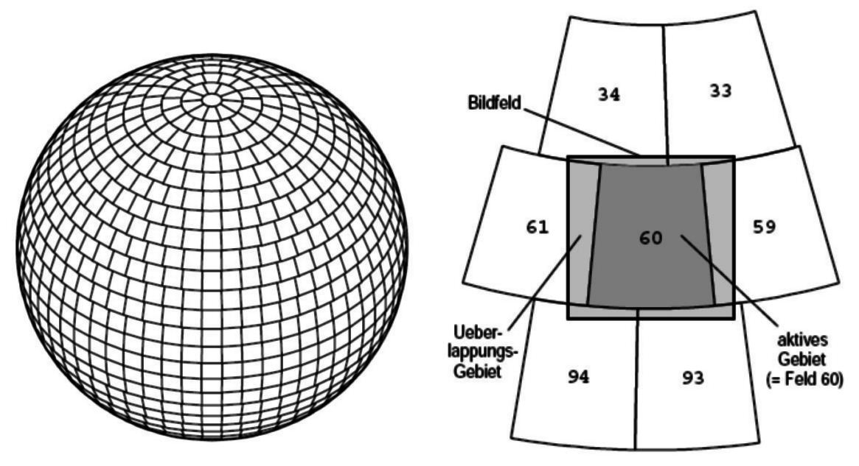
Pipeline processing
16/20
EROPIPE
triggers pipeline chains, updates pipeline status,
load balancing
H. Brunner eSASS pipeline eROSITA Consortium meeting, Potsdam March 4th, 2019

Slide 27
17/20
Pipeline control
EROPIPE
Pipeline control program: initiates processing of task chains, prepares chain parameter files, updates and reads processing status files
TEL
S/P/C EXP
S/P DET
S/P SOU
PROC
PROC
PROC
PROC
PROC
PROC
PROC
PROC
PROC
PROC
PROC
PROC
PROC
PROC
PROC
PROC
PROC
PREXEC PROC
PREXEC PROC
PREXEC PROC
PREXEC PROC
200+ processing chains are executes concurrently on eROSITA servers, several pipeline configurations (and eSASS releases) may be be active in parallel
H. Brunner eSASS pipeline eROSITA Consortium meeting, Potsdam March 4th, 2019

Slide 28
18/20
SIXTE simulations for pipeline testing
Christoph Großberger, Philipp Weber + Bamberg SIXTE team
One year all-sky survey simulation
Inputs for SIMPUT: AGN (Nicolas Clerc)
Cluster images (Jermy Sanders)
New all-sky survey simulation after
SIXTE/eSASS coordinate system corrections:
RAWX/RAWY, roll angles – Thomas Dauser, Georg Lamer
Improved SIMPUT, inputs by Johan Komparat, Jeremy Sanders, Joe Mohr + team
New attitude file (Jan Robrade)
Full CalPV simulation (same simput + targets)
Example dataset: eRASS1 simulation of deep all-sky survey tile:
exposure map – photon image – ERMLDET source map
movies: 20 eROdays/s - processing+movies by Christoph Großberger
H. Brunner eSASS pipeline eROSITA Conortium meeting, Potsdam March 4th, 2019

Slide 29
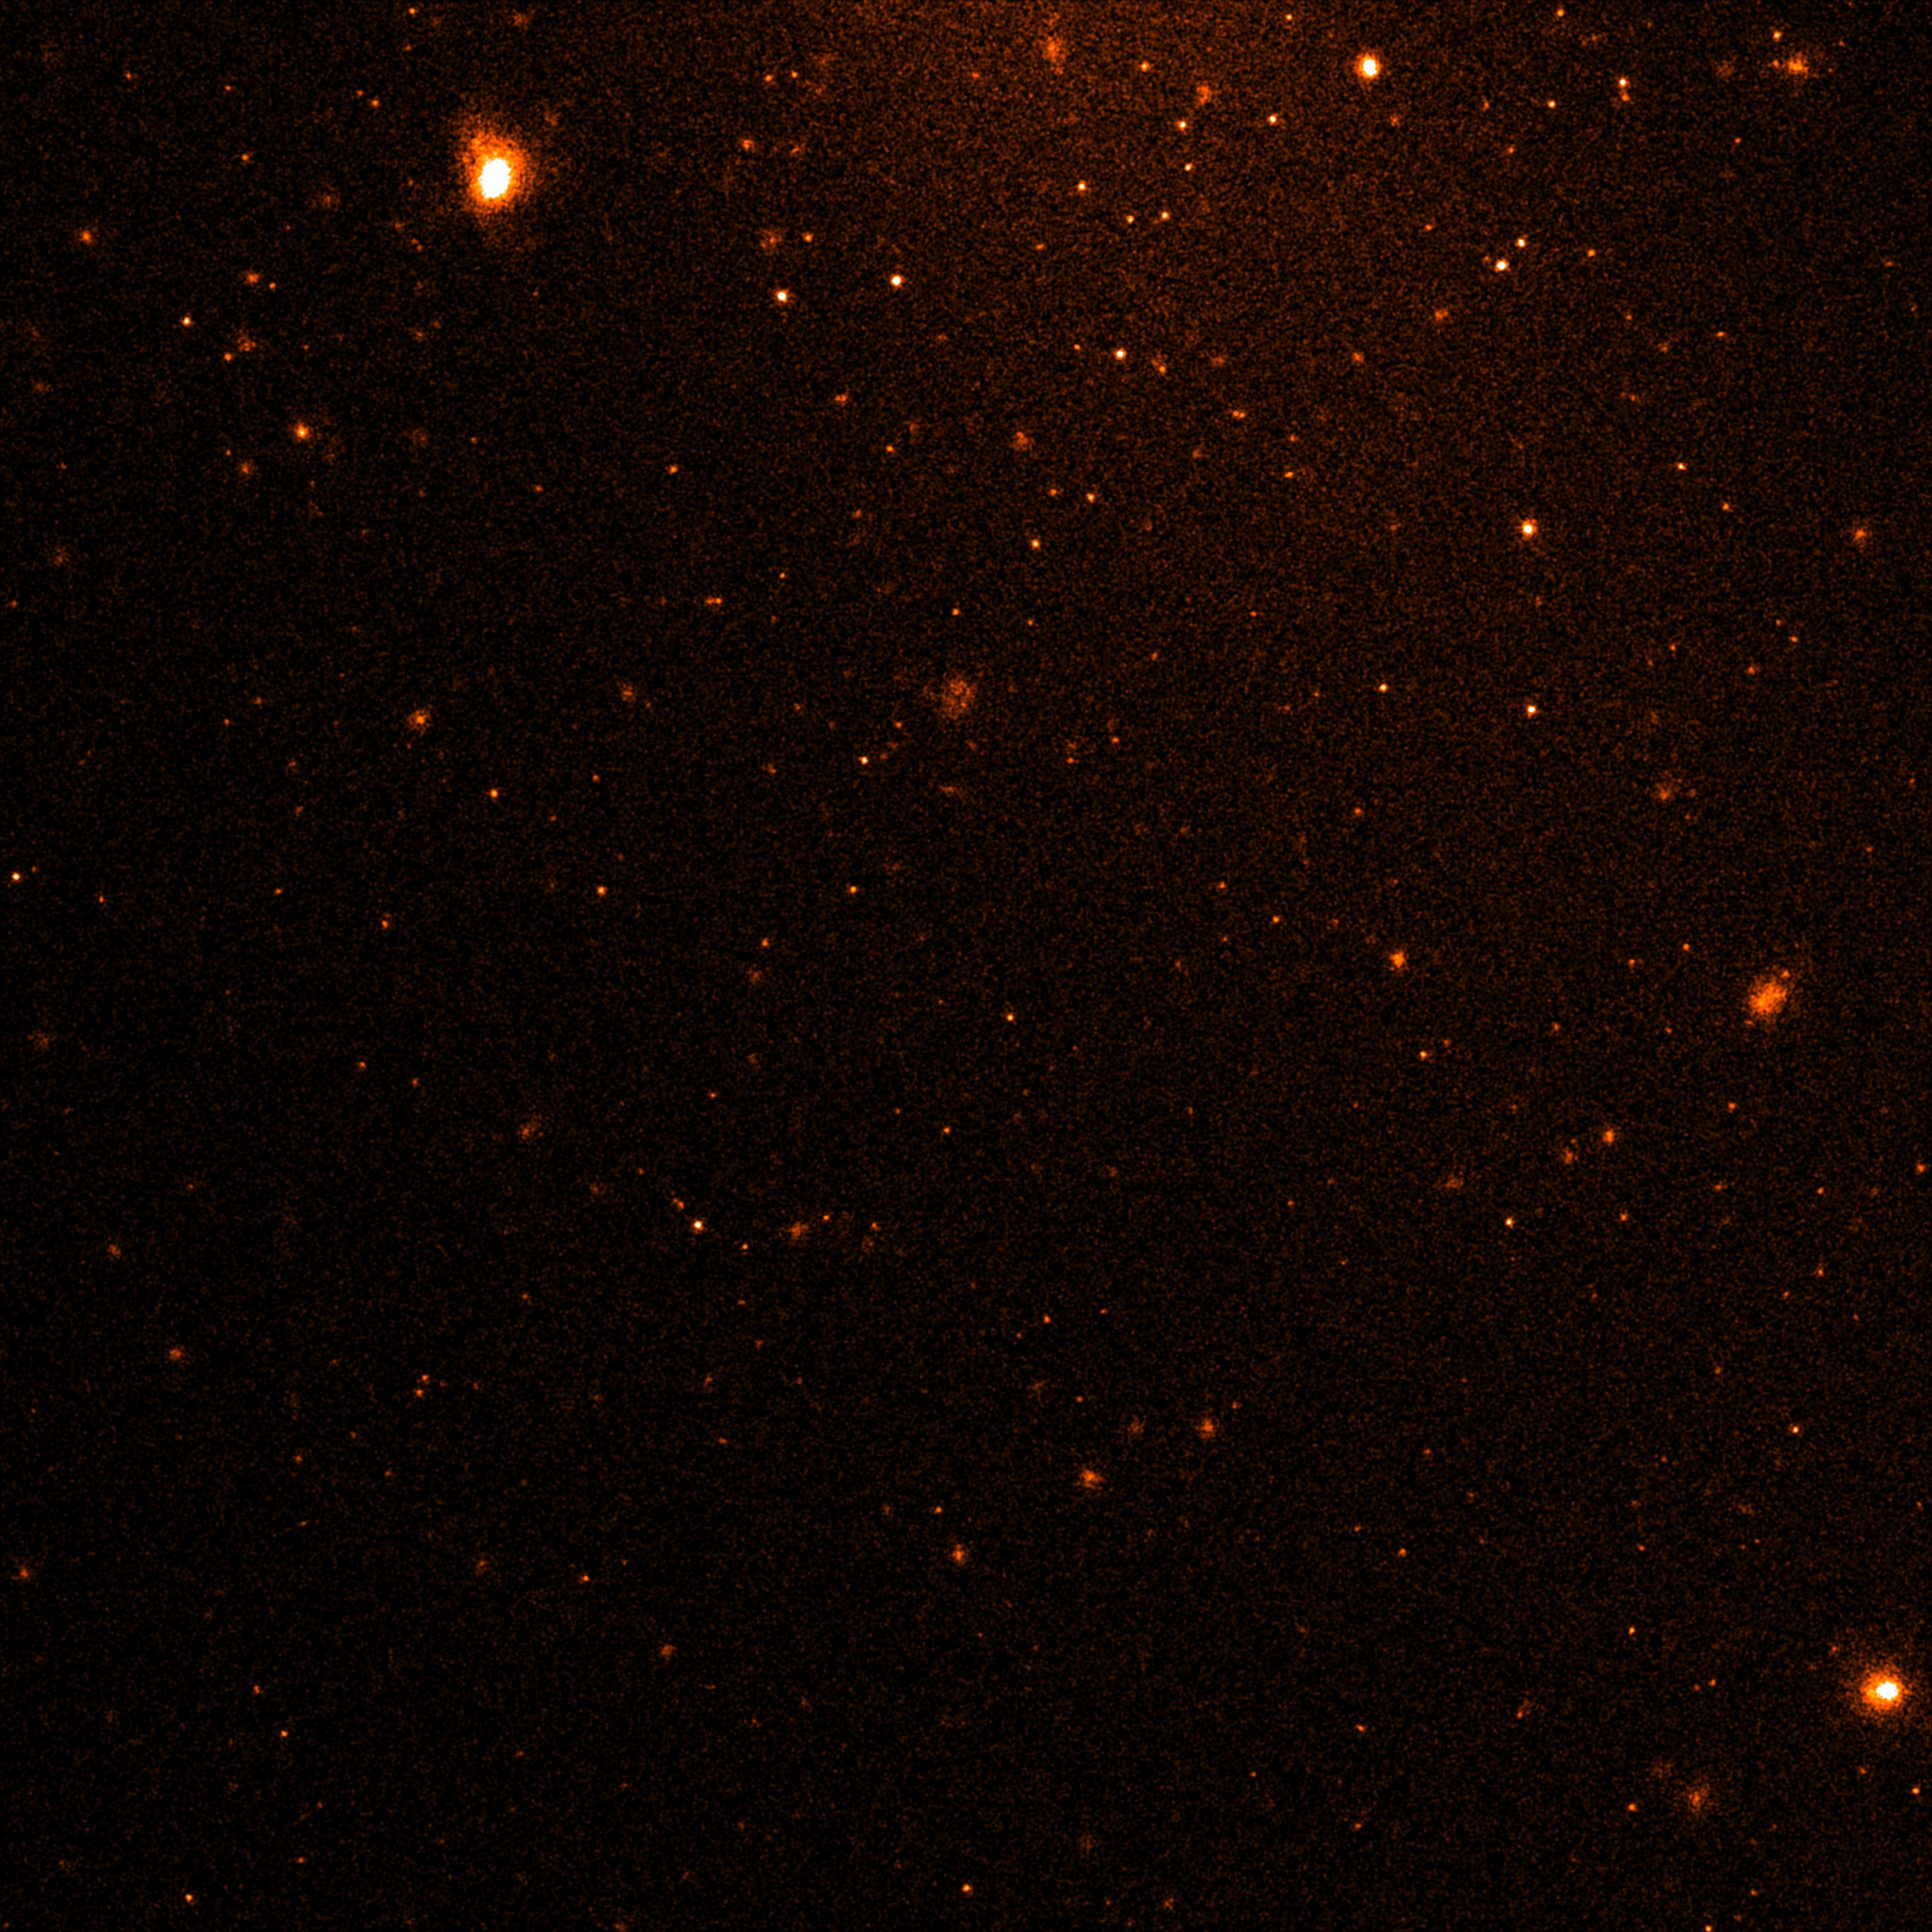
19/20
H. Brunner eSASS pipeline eROSITA Consortium meeting, Potsdam March 4th, 2019

Slide 30
19/20
H. Brunner eSASS pipeline eROSITA Consortium meeting, Potsdam March 4th, 2019

Slide 31
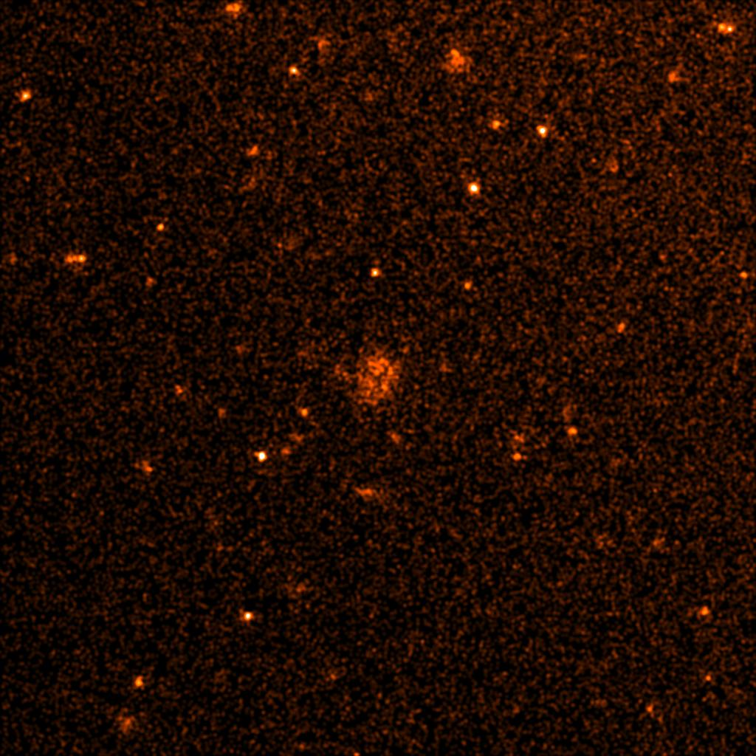
20/20
H. Brunner eSASS pipeline eROSITA Consortium meeting, Potsdam March 4th, 2019

Slide 32
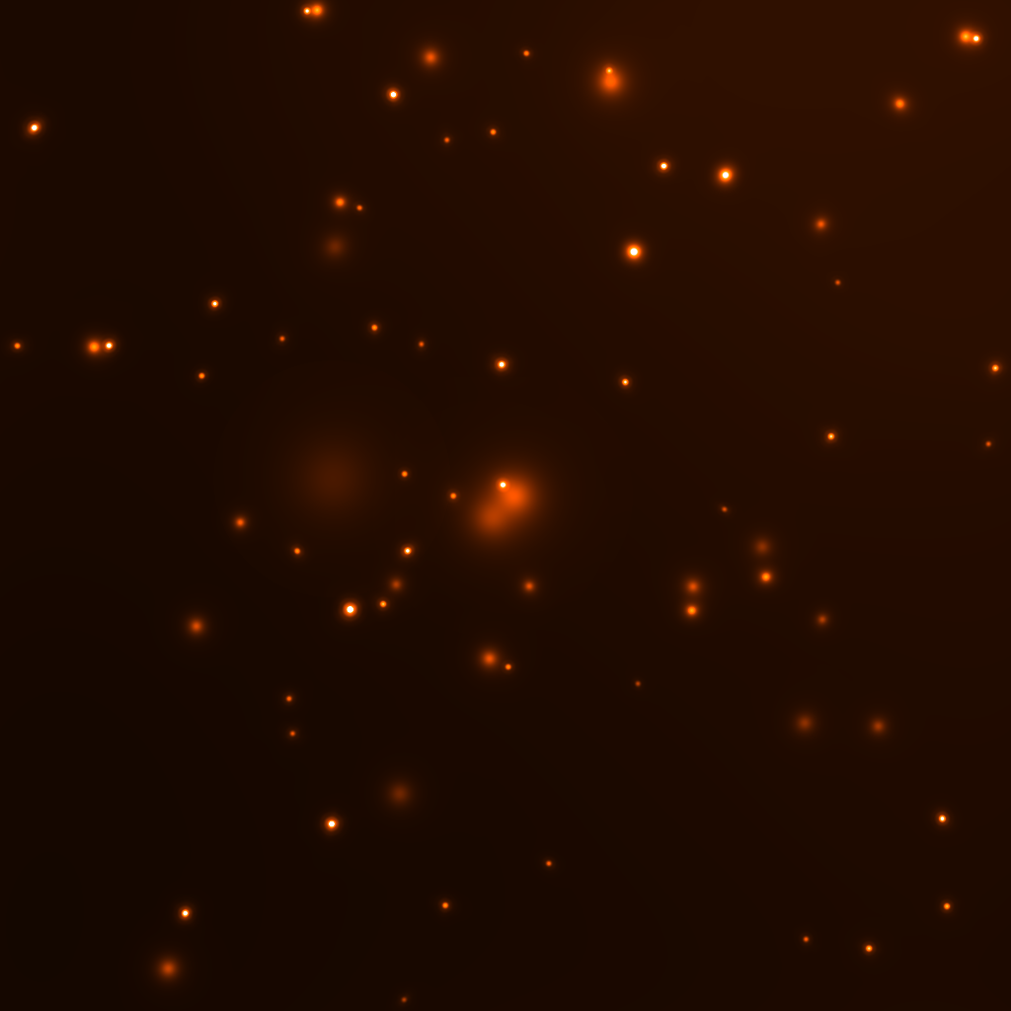
20/20
H. Brunner eSASS pipeline eROSITA Consortium meeting, Potsdam March 4th, 2019

Slide 35
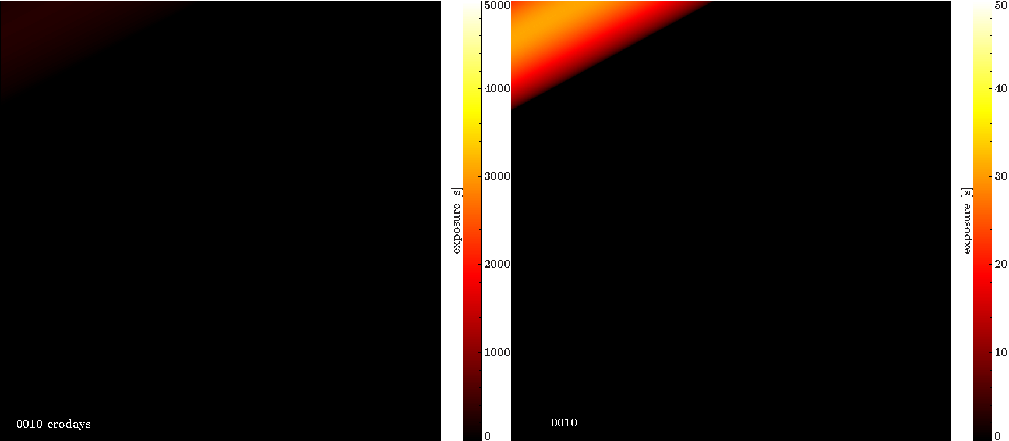

Slide 36
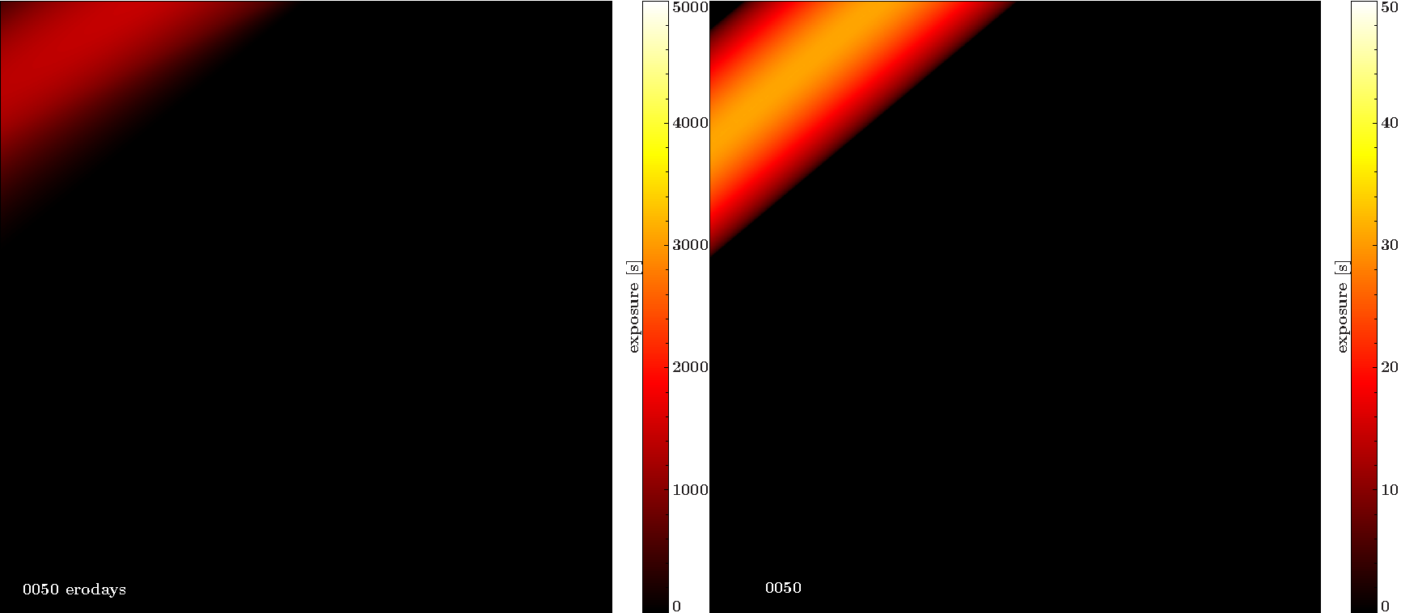

Slide 37
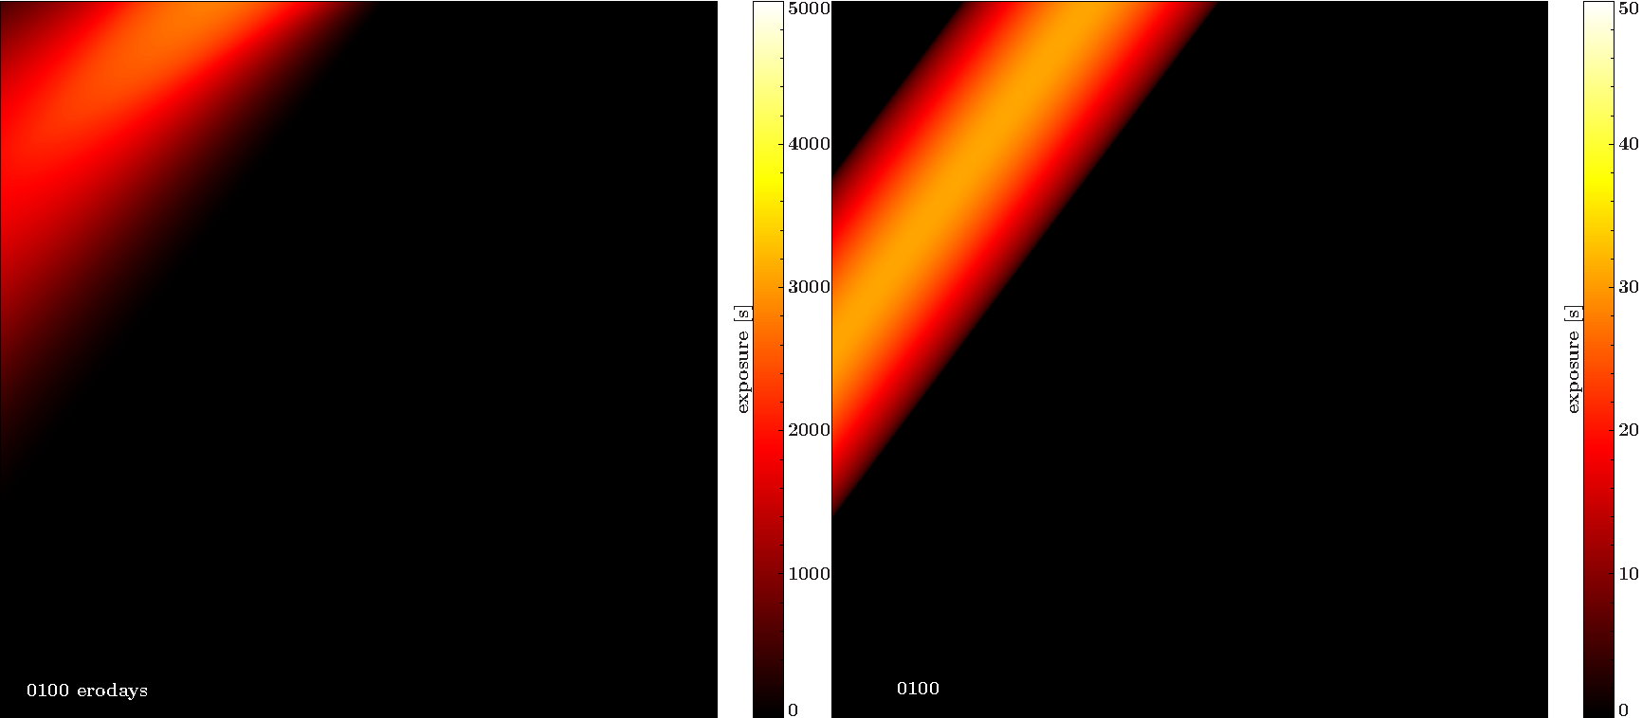

Slide 38
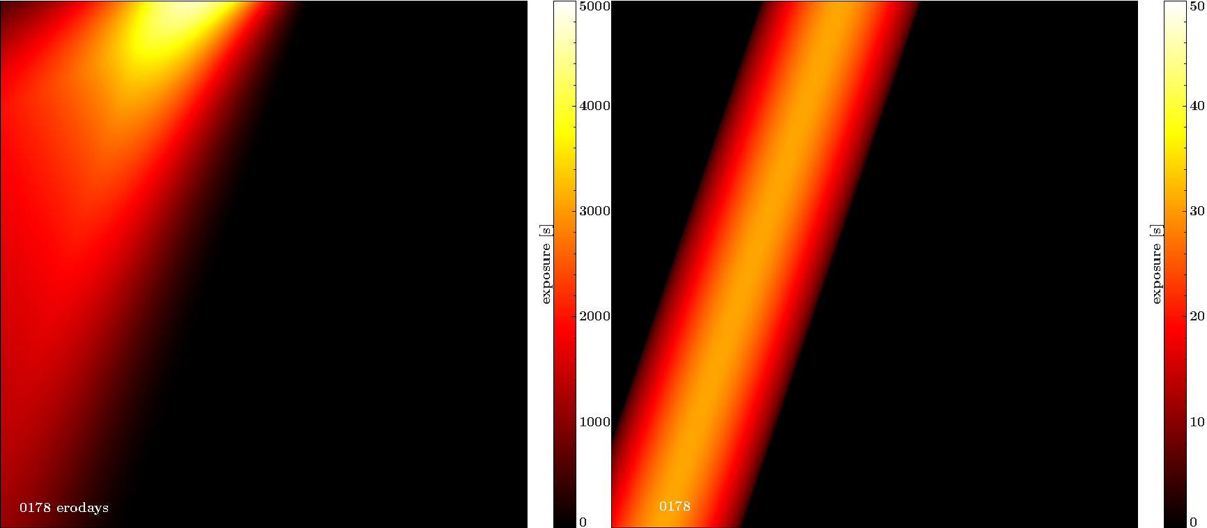

Slide 39
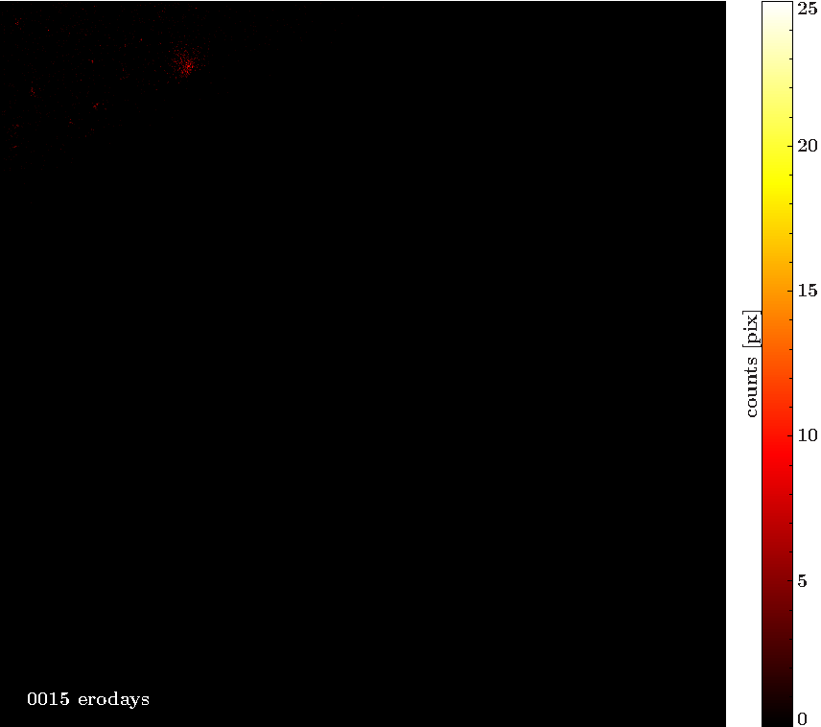

Slide 40
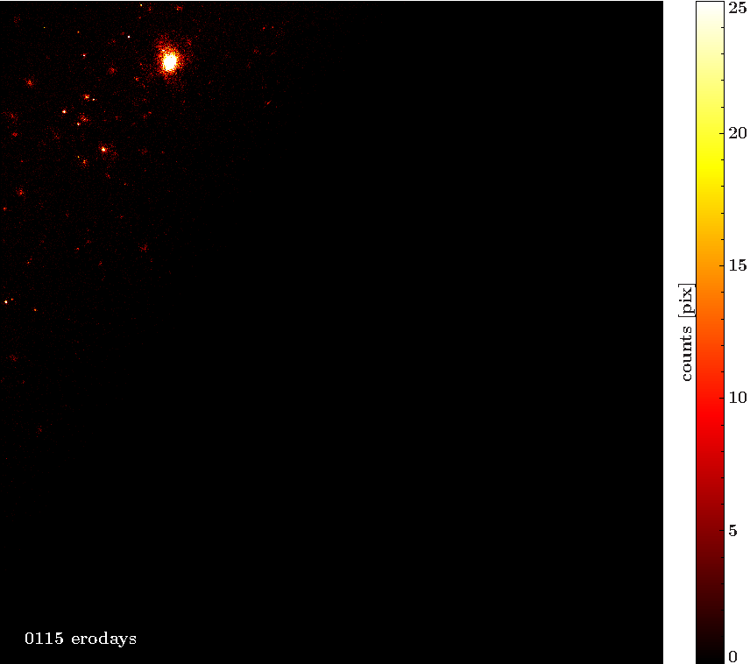

Slide 41
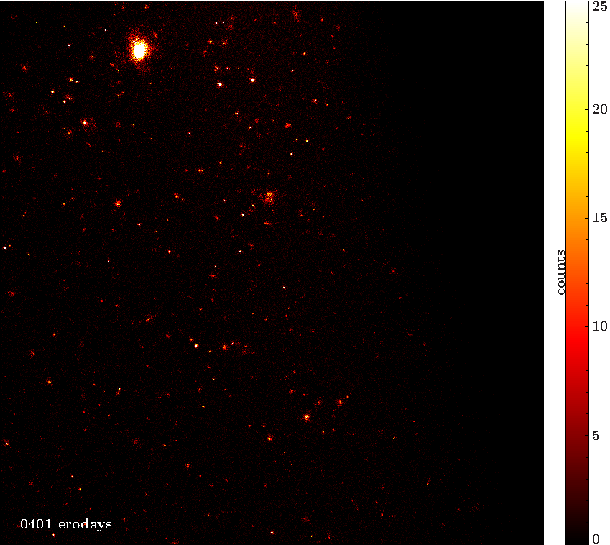

Slide 42
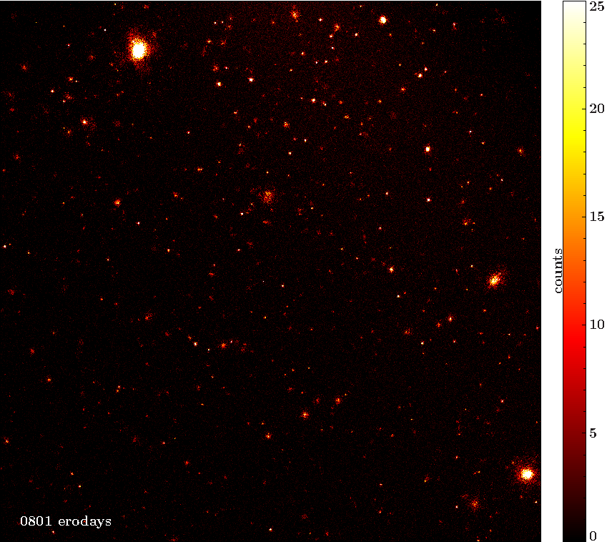

Slide 43
