Slide 1
eROSITA Status and Launch Campaign
Thomas Mernik

Slide 2
SRG Progress Meeting 20.02.19
Launch postponed from 01.04.19 to 21/22.06.19 (12/13.07.19)
Thermal tests and complex tests of SRG/eROSITA/ART-XC completed
Problems with BKU, gyroscopes, solar panels fixed
Minor issues with electronic box of eROSITA fixed
Awaiting vibration test
Proton and Block DM upper stage shipped to Baikonur

Slide 3
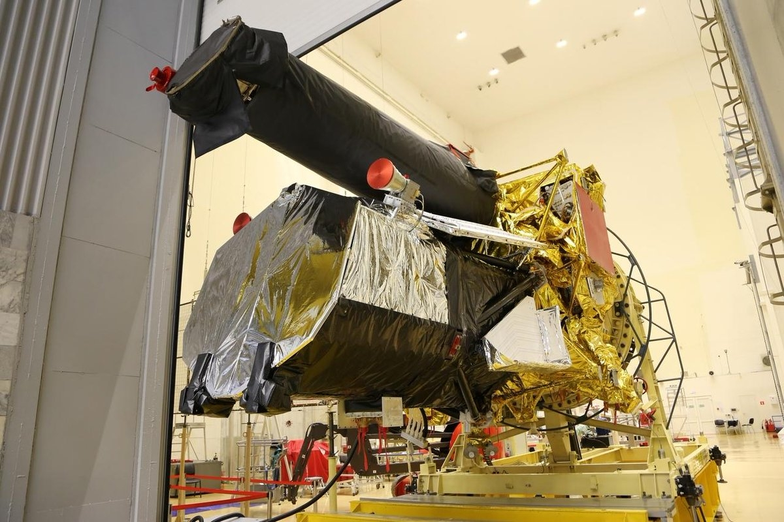
SRG during progress meeting 20.02.19

Slide 4
SRG Timeline
Action | Participants | Start | End
Installation ART-XC | NPOL, IKI |  | 24.10.18
Alignment measurements ART-XC | NPOL |  | 25.10.18
Assembly of electrical scheme for testing | NPOL | 26.10.18 | 27.10.18
Complex tests of the assembled S/C | NPOL, IKI, MPE | 29.10.19 | 22.12.19
Integration solar panels | NPOL | 12.02.19 | 23.02.19
CoG definition | NPOL | 24.02.19 | 26.02.19
Vibration tests | NPOL, MPE | 27.02.19 | 11.03.19
Control checkups, final operations, etc. | NPOL | 05.03.19 | 12.04.19
Documentation preparation, certification, etc. | NPOL |  | 28.03.19
Last test session | NPOL, MPE |  | 13.04.19
SRG progress meeting | all |  | 10.04.19
TSNIImash pre-shipment review | TSNIImash |  | 18.04.19
State commission review | NPOL, MPE, DLR? | 20.04.19 | 20.04.19
Transport to Baikonur (flight) | NPOL | 24.04.19 | 25.04.19
Activities at Baikonur | NPOL,MPE | 26.04.19 | 21.06.19
Launch | all | 21.06.19 | 22.06.19

Slide 5
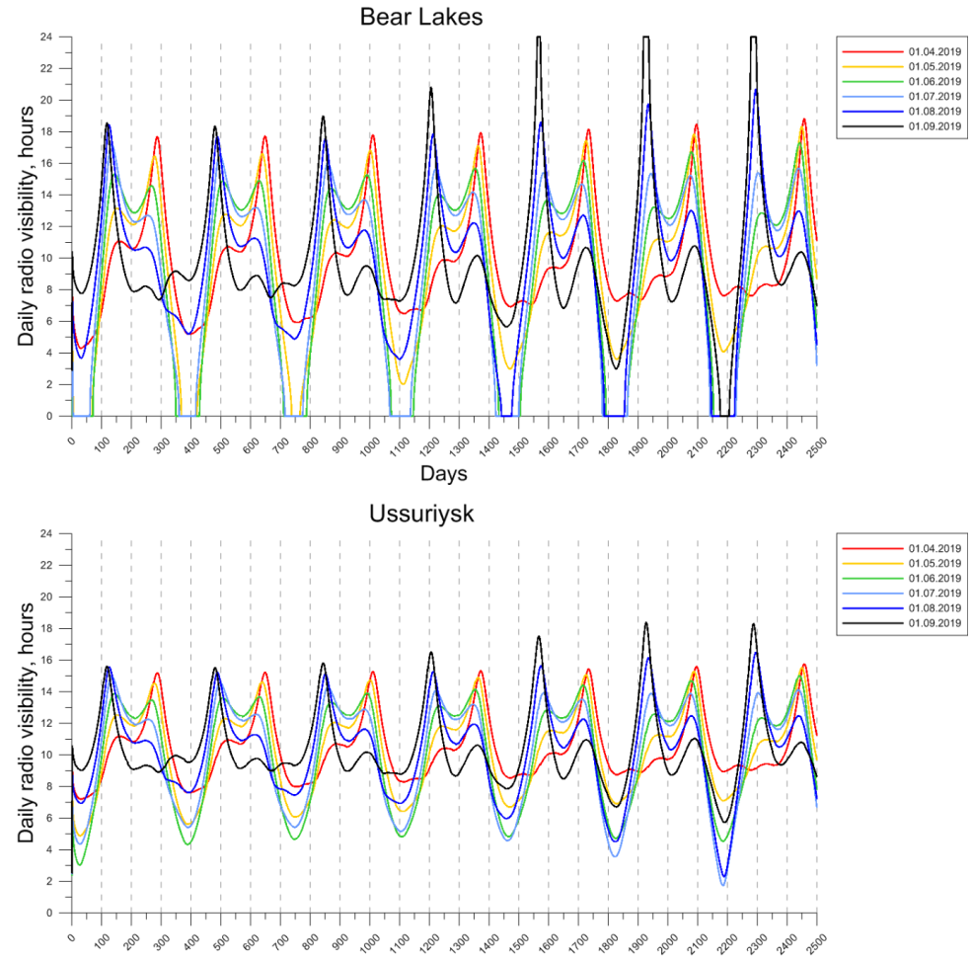
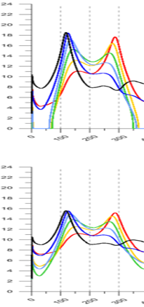
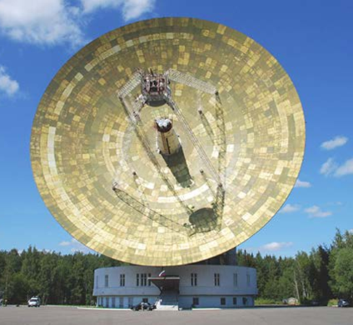
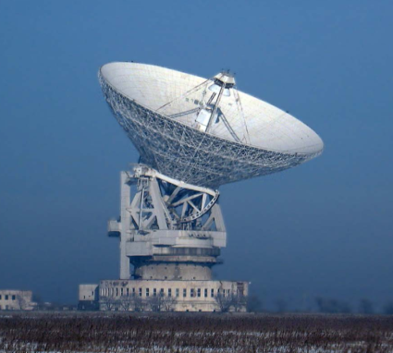
L2 visibility from the envisaged Russian antennas
[NPOL, 2018]
Ideally…

Slide 6
However, due to thermal limitations, restricted to a max of 4 h…?
[NPOL, 2018]

Slide 7
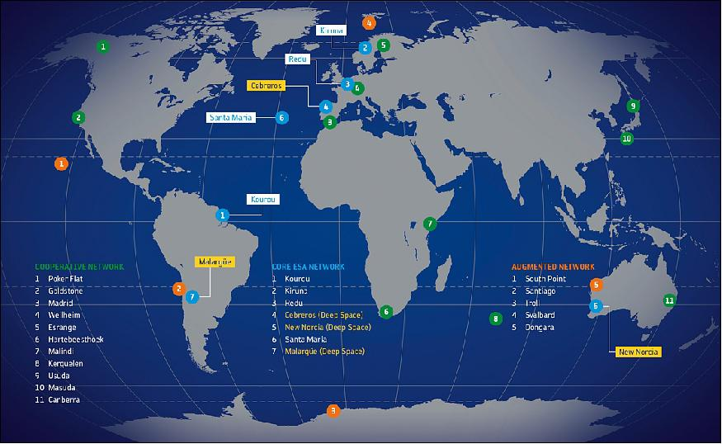
ESA antennas as a potential mitigation
Bear Lakes
Ussurijsk
[ESTRACK, 2017]

Slide 8
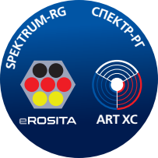
ESA antennas as a potential mitigation
Option already explored in 2014 → „feasible!“
Ongoing talks since last autumn:
Good visibility all year round confirmed by Marcus Kirsch
Based upon information available, ESTRACK specialists checked compatibility
DLR letter to ROSCOSMOS: positive answer, antenna data sheets provided
Feb. 2019: DLR received confirmation from NPOL: Utilization of ESA antennas possible. Ready to set up ICD and training of operators together with ESA.
SRG progress meeting Feb 20th: Roskosmos: Will use only Russian antennas!

Slide 9
Launch campaign: German delegation to Baikonur
List of participants complete and submitted to Roscosmos for security screening
Currently the German delegation are 51 participants, including ~10 journalists and media specialists (Spiegel, Deutschlandfunk, DW, DLR) + guests (ESA,BMWi)
DLR to provide visa support
Press and VIP programme in preparation
Different options of travel
Preferred option: joint delegation (IKI, German institutes and DLR) from Moscow to Baikonur and back
Backup option: charter flight from Germany directly to Baikonur

Slide 10
Public Outreach
NPOL is preparing ESA style mission brochure, inviting the German side to contribute
~April 20th: press conference at NPOL before shipment
live stream of launch available via Roscosmos website and Russia Today,
general support for press coordination
DLR PR unit to prepare official programme for the German media, assisting with press permits
Launch will be covered by a number of Russian TV teams. Perhaps German participation.
After launch: press conference in Moscow (IKI)

Slide 11
SRG Stickers, Pins, etc.
All parties involved have agreed to produce a number of items for public outreach
Polo shirts
Pins
Key chains
Pens
Baseball caps

Slide 12
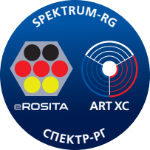
Proposed SRG Logo

