Slide 1
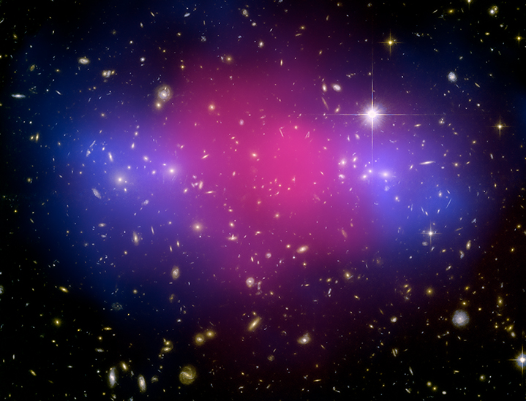
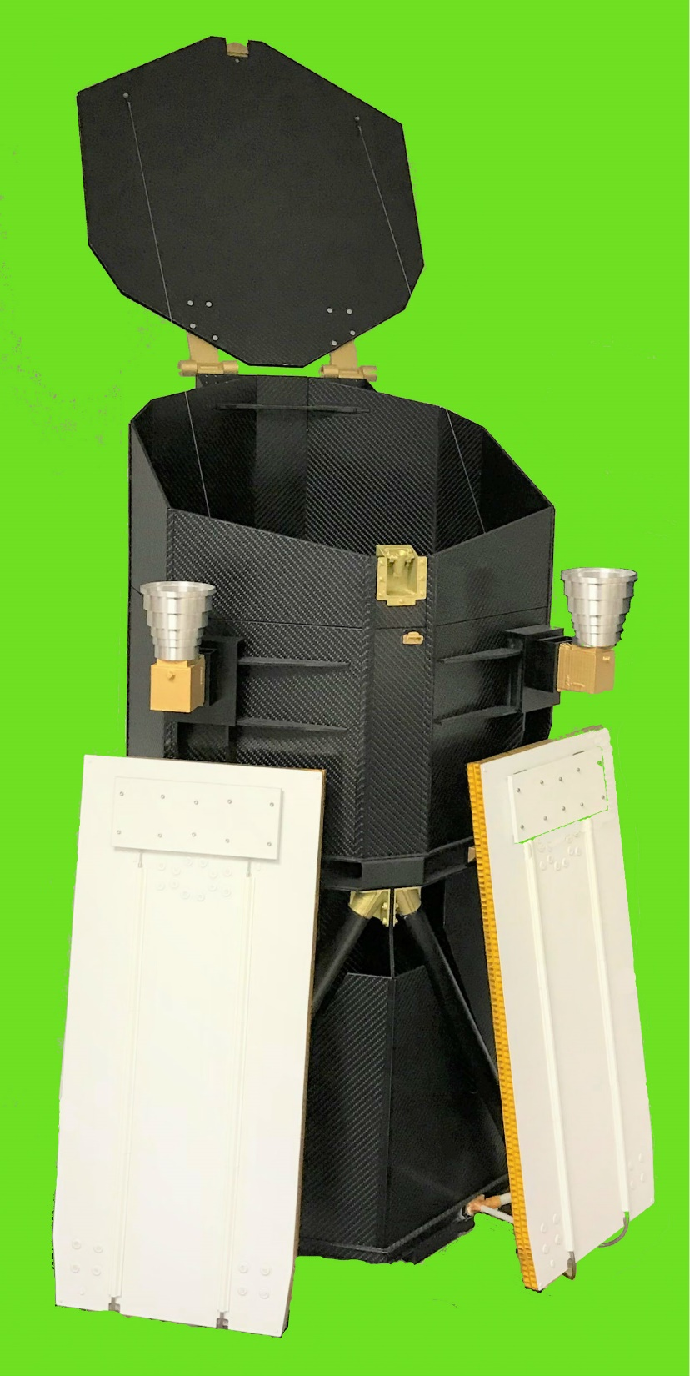
eROSITA
Peter Predehl
Max-Planck-Institut für extraterrestrische Physik

Slide 2
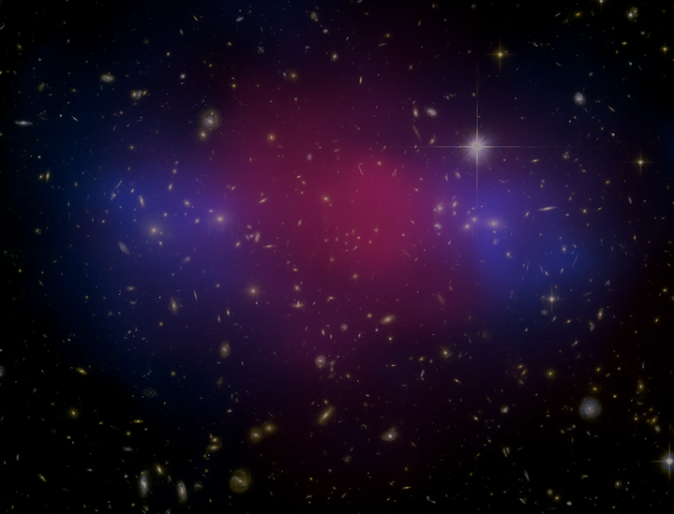
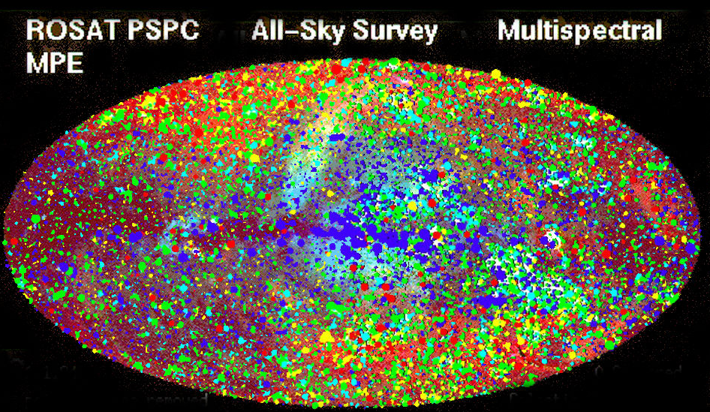
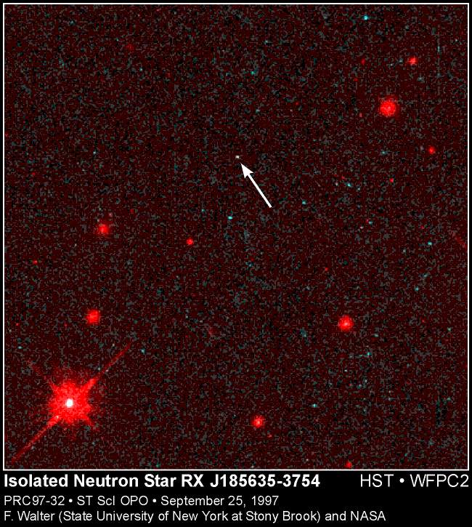
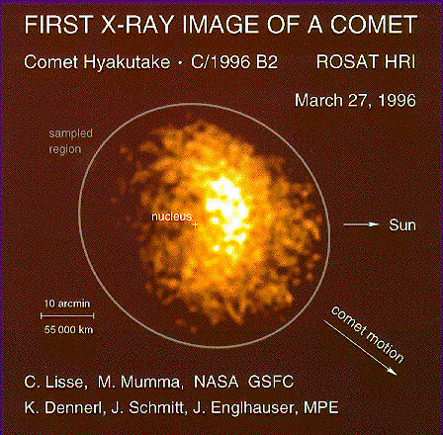
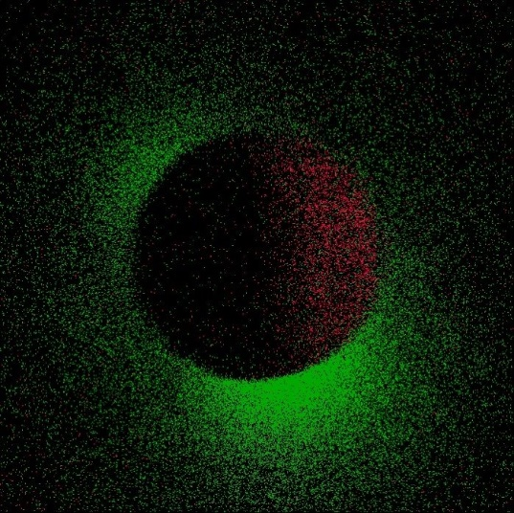
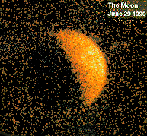


Slide 3
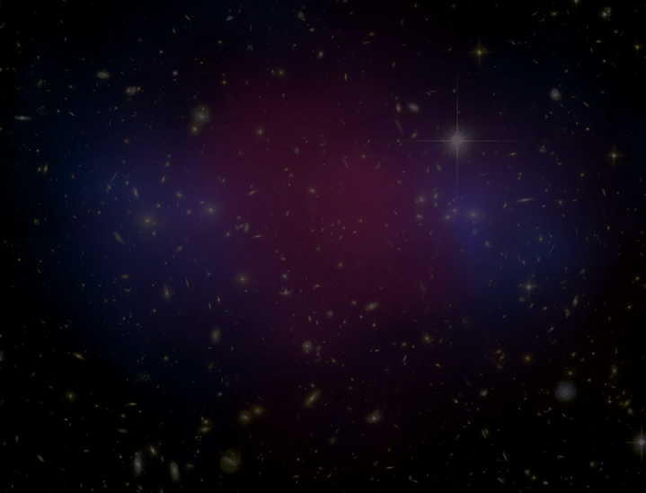
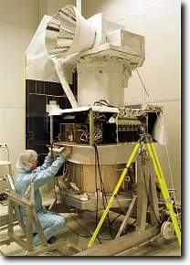
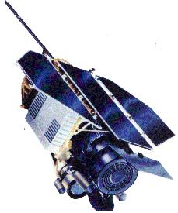
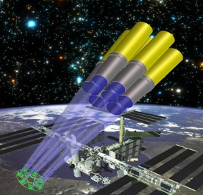
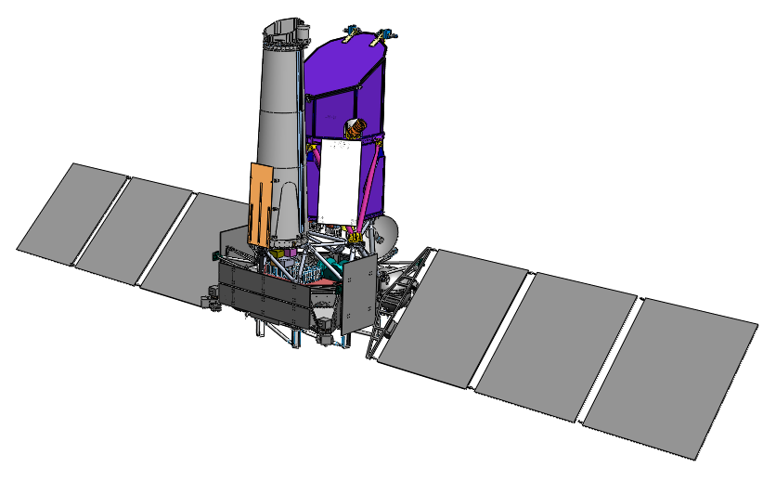
History
Bundle of 7 small telescopes
To extend the all-sky survey
towards higher energies
failed shortly after launch
ABRIXAS
1999
ROSAT
1990-1998
First X-ray all-sky survey
with an imaging telescope
ABRIXAS science on the
International Space Station
not realised due to Shuttle schedule
ROSITA
2002
eROSITA
on German/Russian
SRG Mission
10⁵ Clusters of Galaxies
7 bigger mirror modules
extended field of view
Dark Energy
10⁴ Clusters of Galaxies
SMEX-proposal
lost against NuStar
DUO
2004
Launch in March 2019

Slide 4
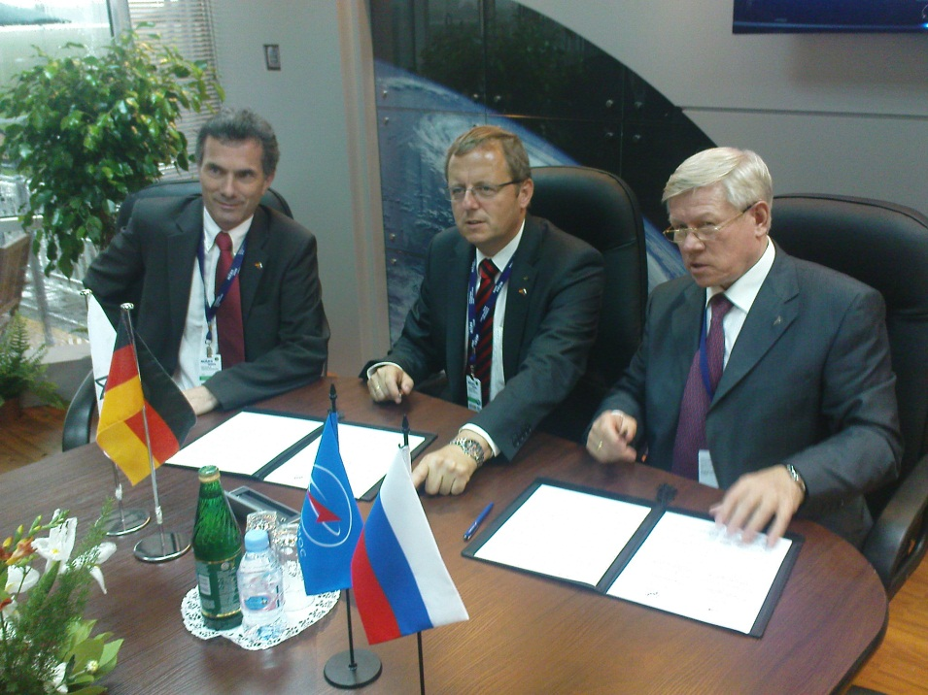
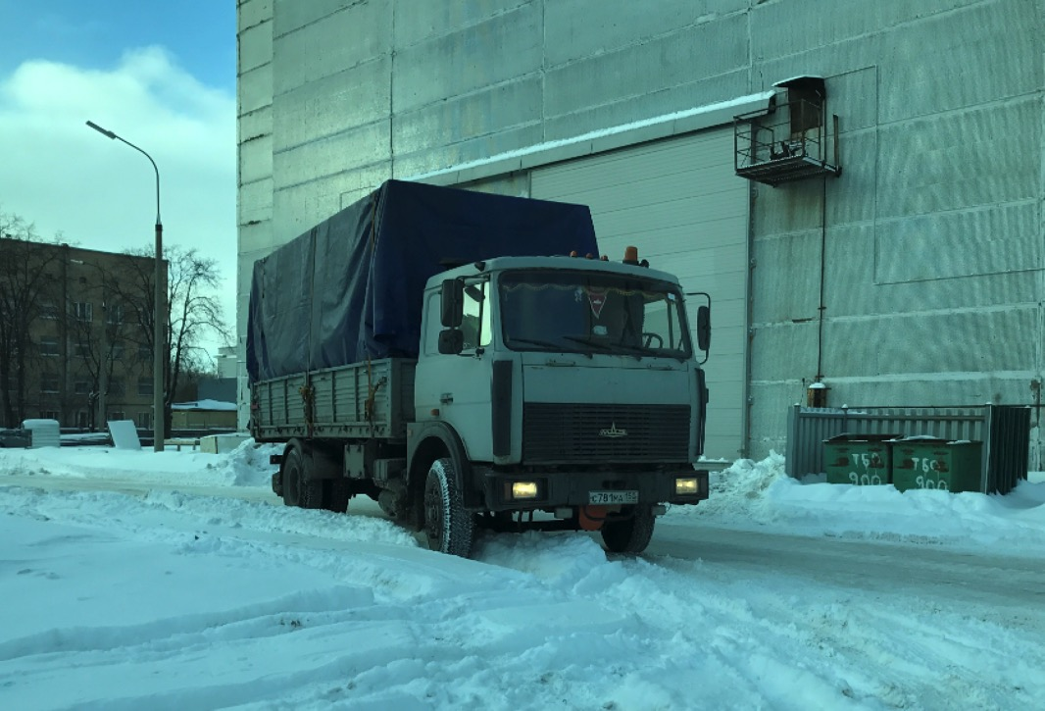
August 2009
Detailed Agreement
DLR and Roscosmos
January 2017
eROSITA Arrival in Russia

Slide 5
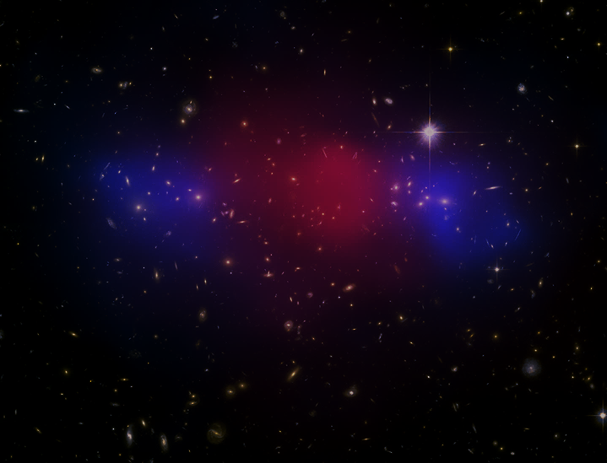
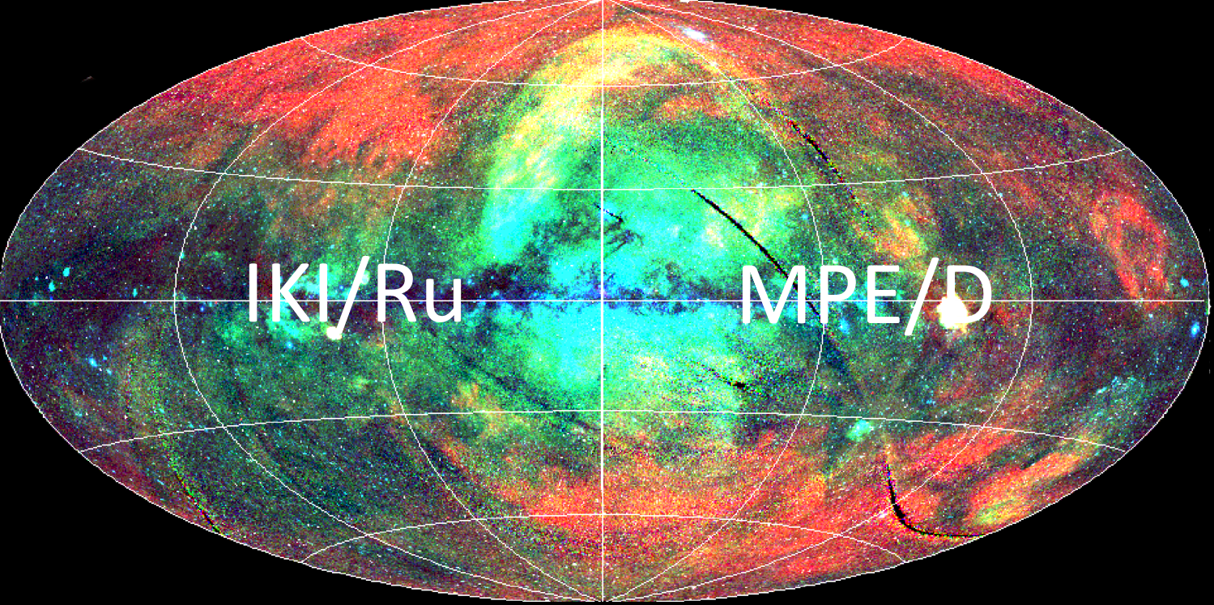
Data Share

Slide 6
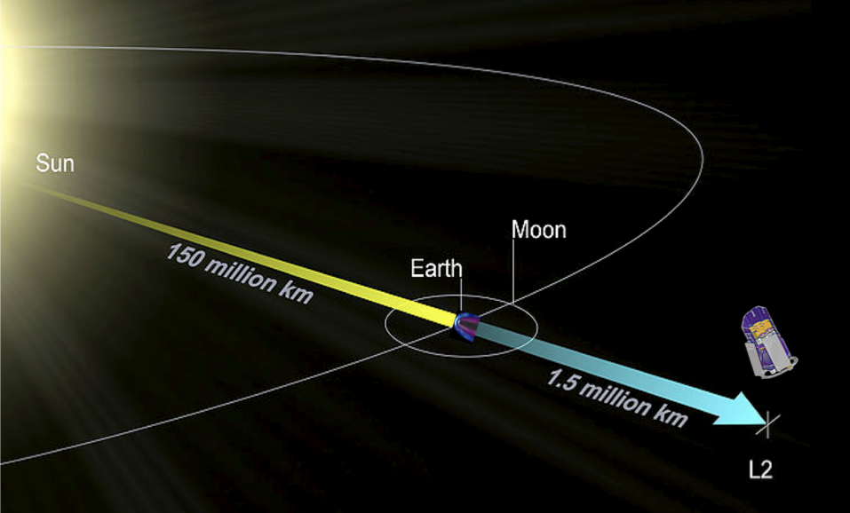

Mission Scenario
Launch with PROTON/BLOK-DM from Baikonur
Cruise to Lagrange 2
4 years survey, continuous rotation (~4hr)
3 years pointed observations

Slide 7
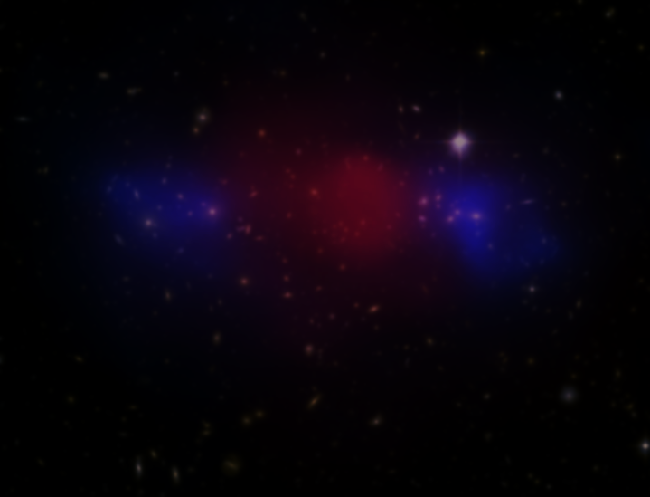
eROSITA Collaboration
Core Institutes (DLR funding):
MPE, Garching
Universität Erlangen-Nürnberg
IAAT (Universät Tübingen)
SB (Universität Hamburg)
Leibniz-Institut für Astrophysik Potsdam
Associated Institutes:
USM (LMU München)
AIFA (Universität Bonn)
Russian Partner Institute:
IKI, Moscow
Industry:
Media Lario/I Mirrors, Mandrels
Kayser-Threde/D Mirror Structures
Carl Zeiss/D ABRIXAS-Mandrels
Invent/D Telescope Structure
pnSensor/D CCDs
IberEspacio/E Heatpipes
RUAG/A Mechanisms
HPS/D,P MLI
+ many small companies
MPE: Scientific Lead Institute, Project Managment
Instrument Design, Manufacturing, Integration & Test
Data Handling & Processing, Archive etc.

Slide 8
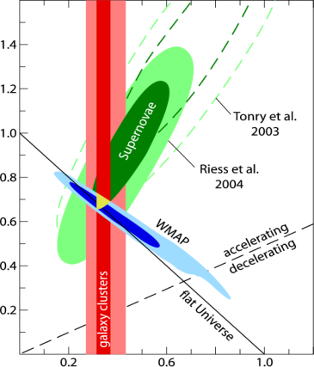
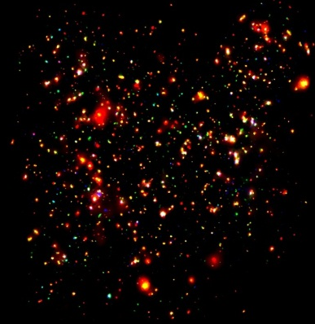
“Design Driving Science”
Cluster Cosmology
+
+
Ω_{Λ}
COSMOS Field
XMM-Newton
Vikhlinin et al., 2009
Ω_{m}
Detectability of 100.000 Clusters of Galaxies, z < 1.5:
  All-sky survey with sensitivity 6×10⁻¹⁴ erg cm⁻² s⁻¹
  Deep survey field(s) (~100 sqdeg) with 1×10⁻¹⁴ erg cm⁻² s⁻¹
  Individual pointed observations
  Moderate angular resolution (< 28 arcsec, aver. over FoV)
  Large collecting area (> 2000 cm² @ 1keV)
  Large FoV (1° Ø)
  Long duration (survey 4 years ← → 1/2 year (ROSAT)
WMAP: Spergel et al. 2003
ROSAT: Schuecker et al. 2003
Clusters of galaxies are the largest gravitationally bound entities in the universe.
In X-rays we see clusters as one continuous entity.

Slide 9
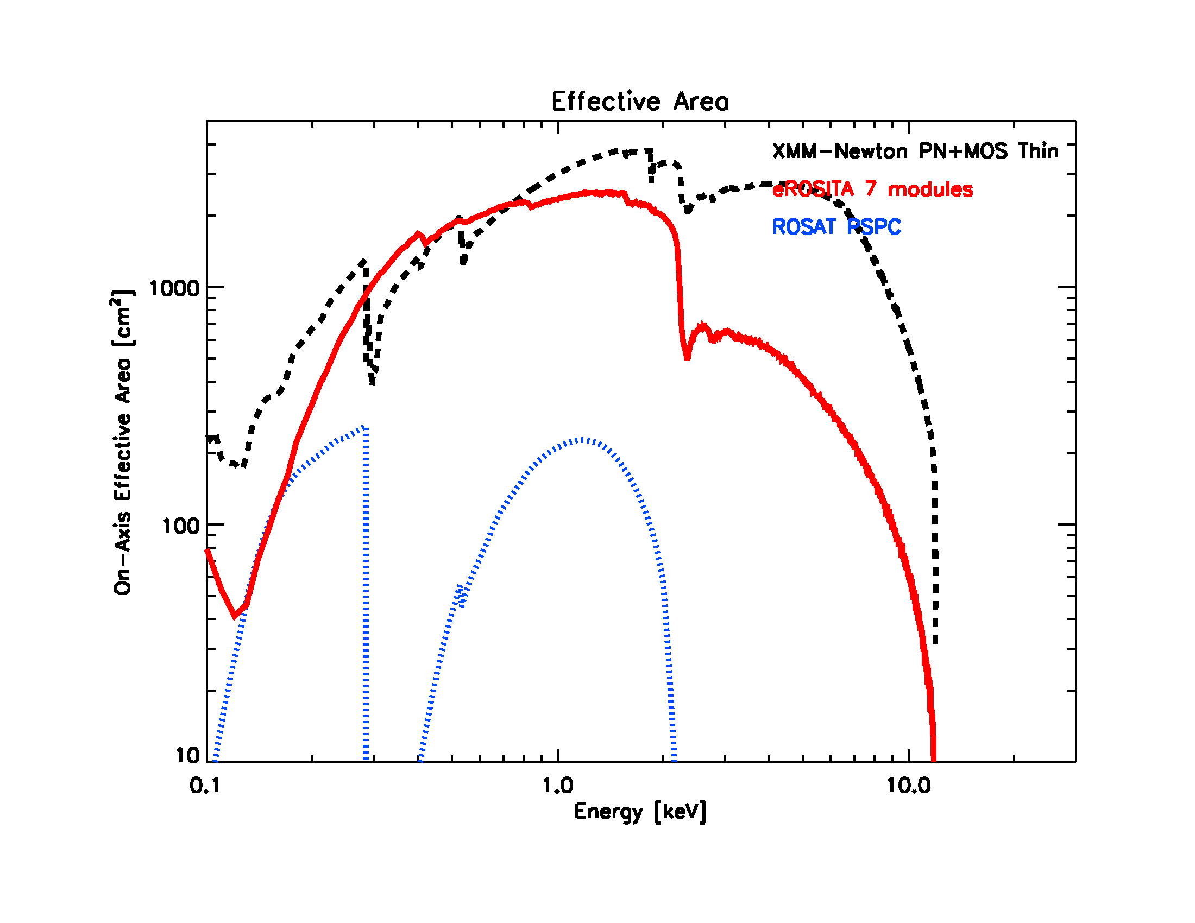
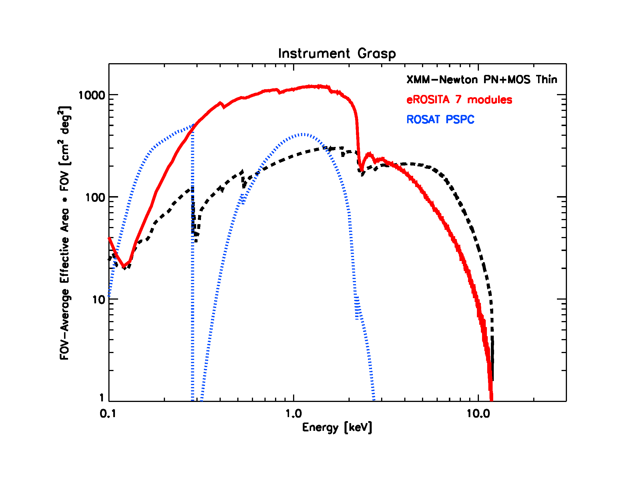
Effective Area and Grasp
Effective area at 1keV [cm²] ~ XMM-Newton (1 telescope)
Grasp [cm² x deg²] ~ 2 x XMM-Newton (3 telescopes)

Slide 10
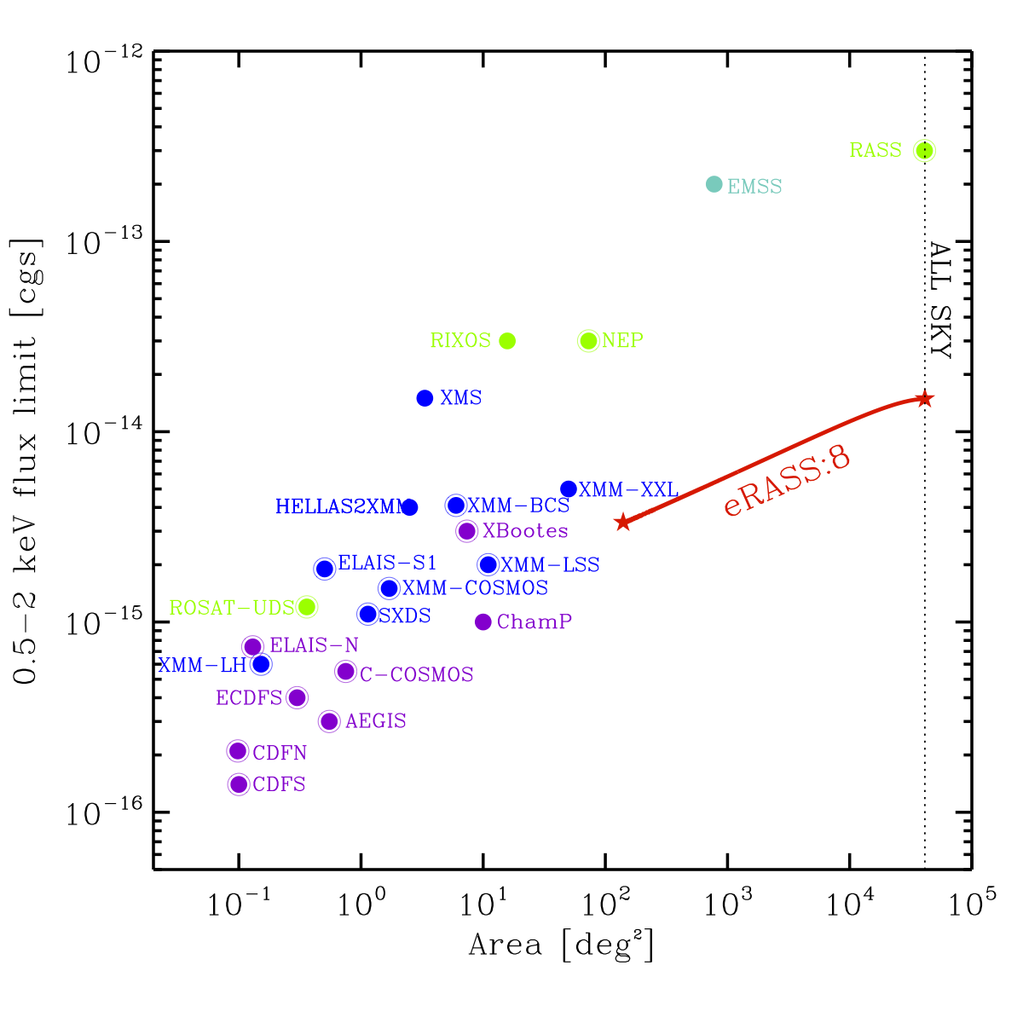
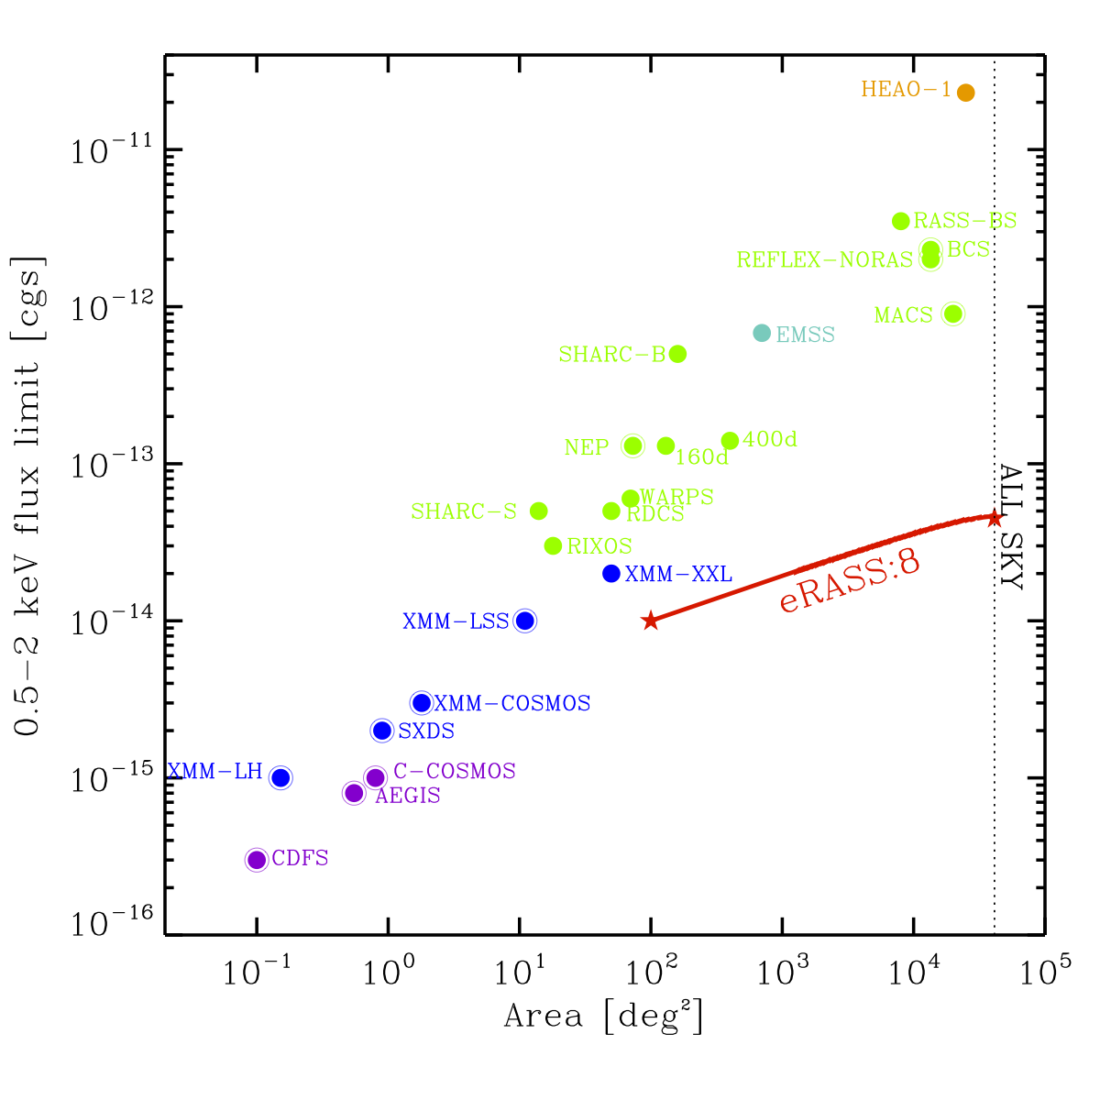
eROSITA Performance
Point source
Extended source
Point source sensitivity:
~25 times better than ROSAT (soft band 0.5-2 keV)
~100 times better than HEAO/RXTE (hard band 2-10 keV)

Slide 11
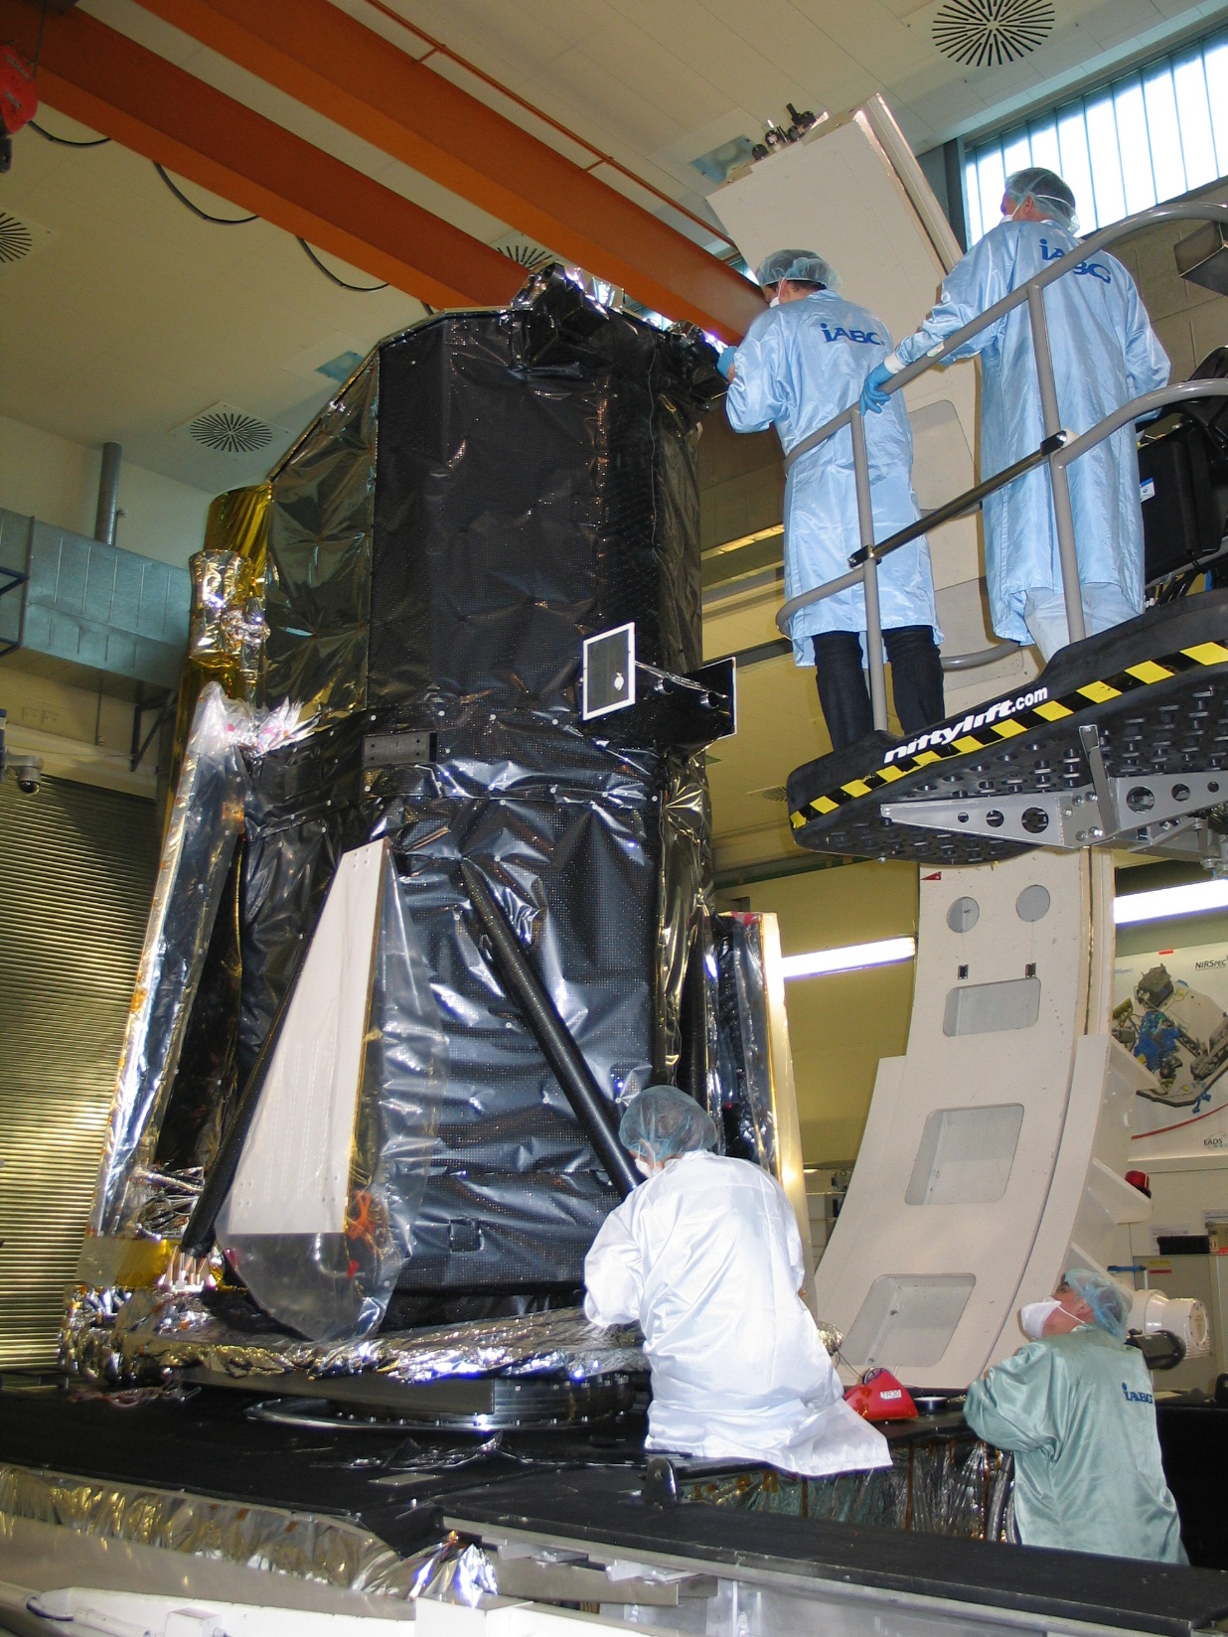

Slide 12
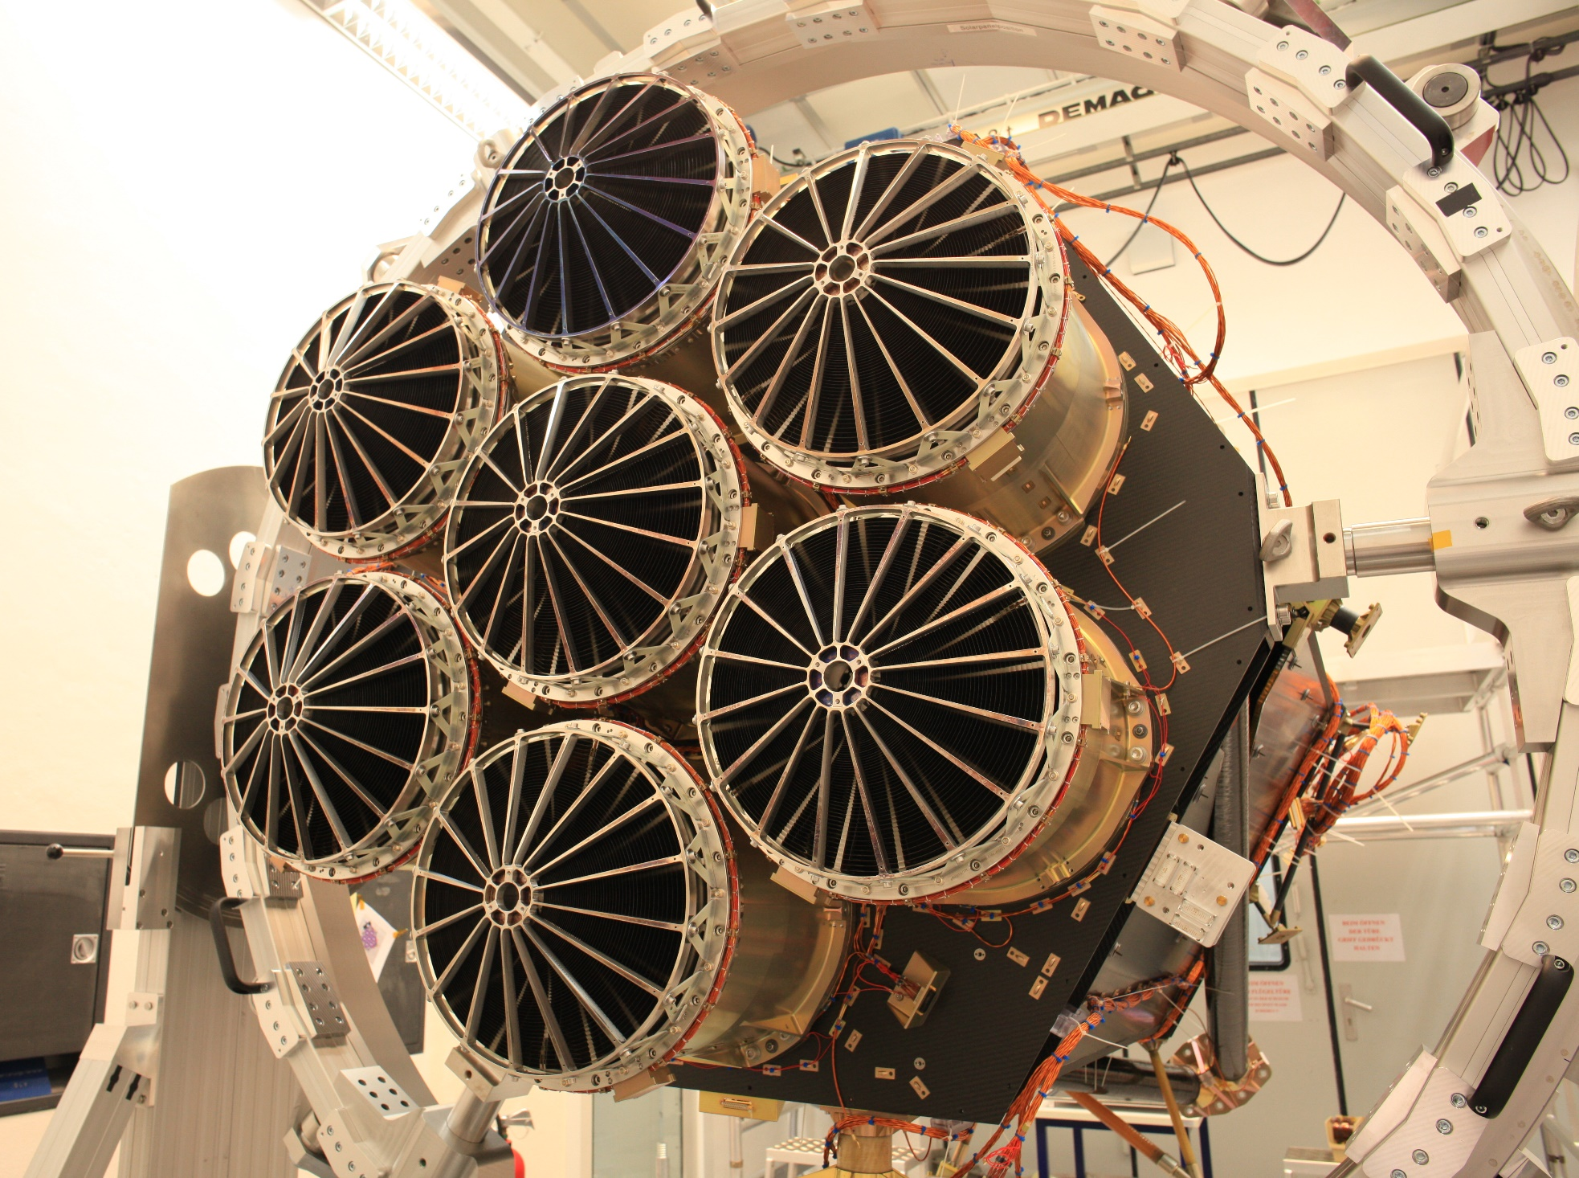

Slide 13
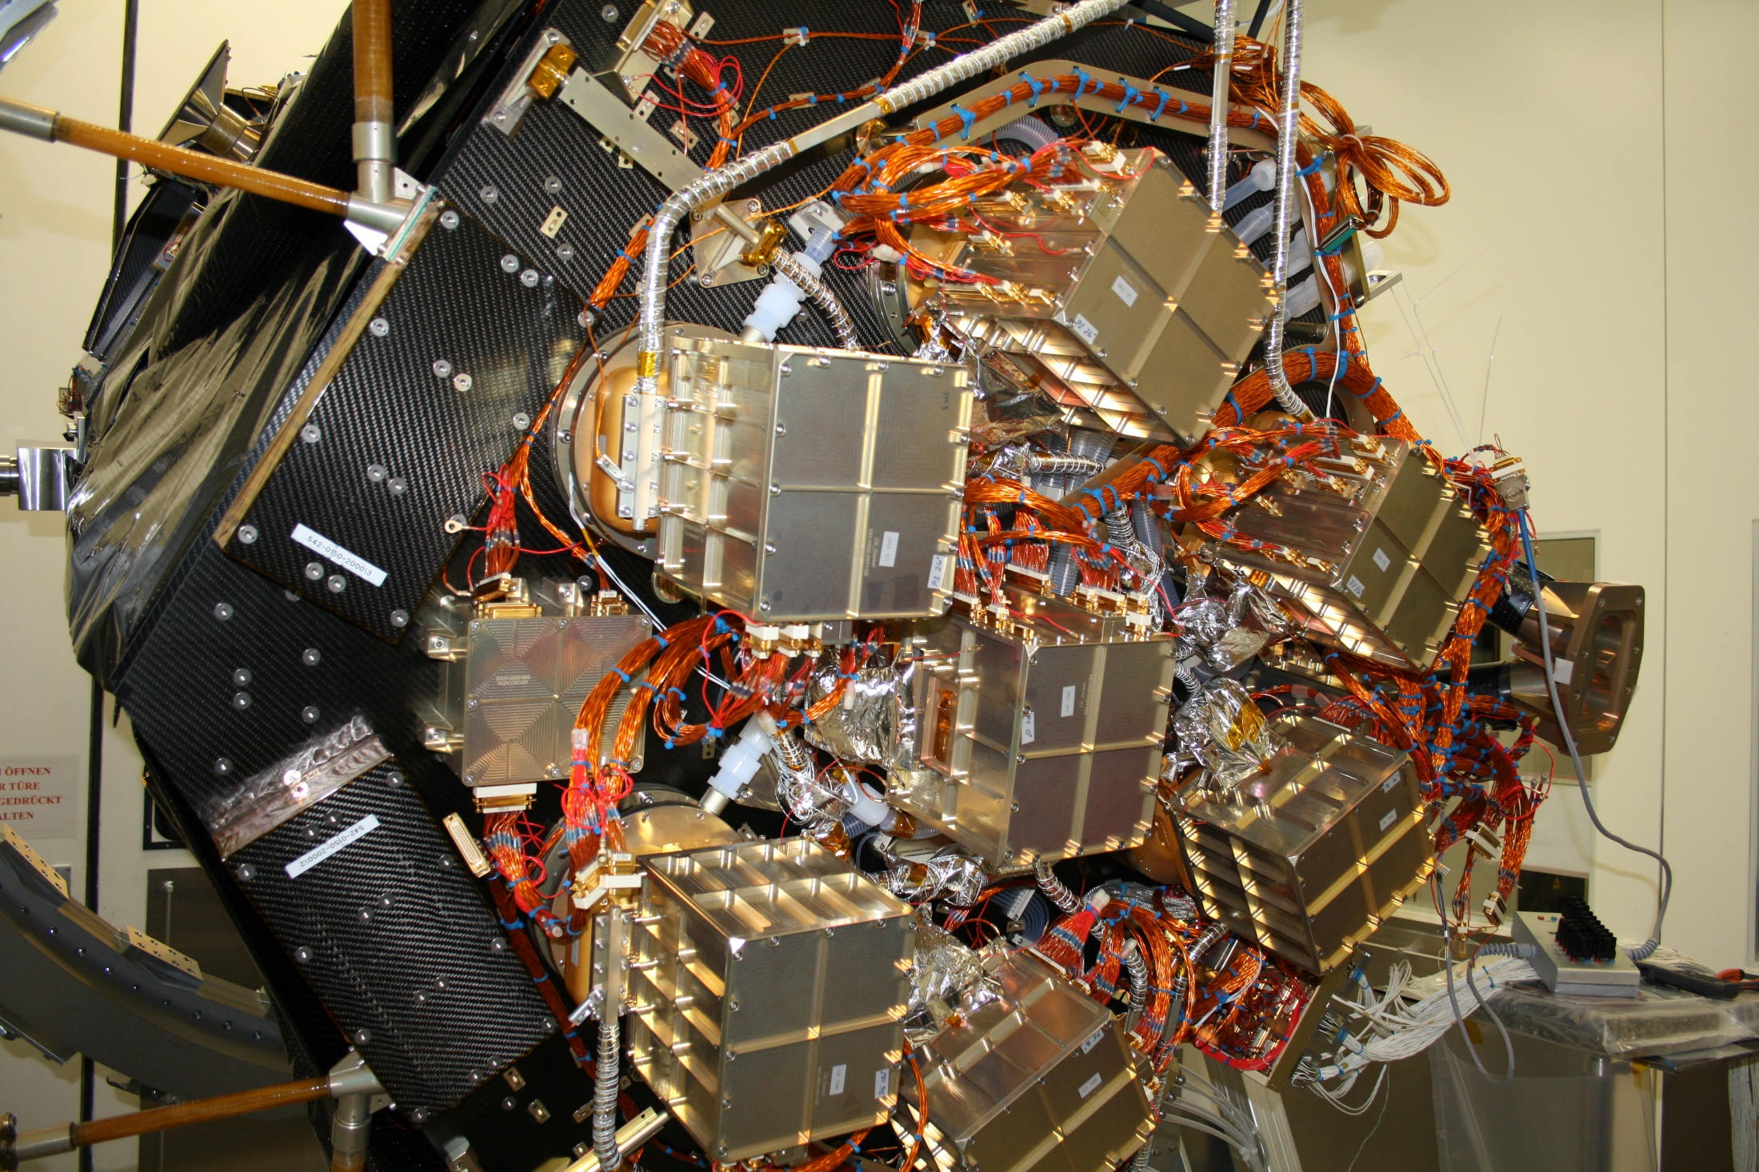

Slide 14
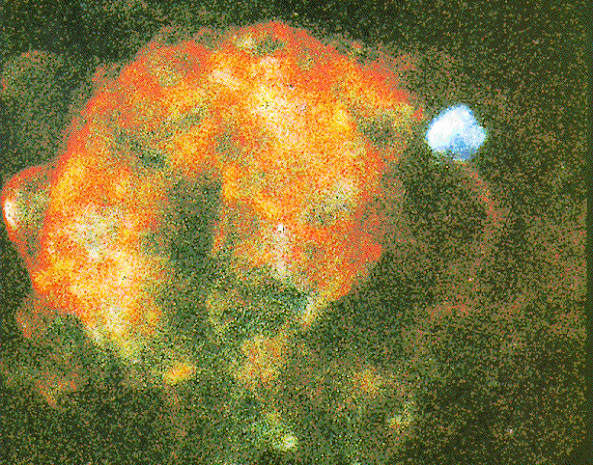
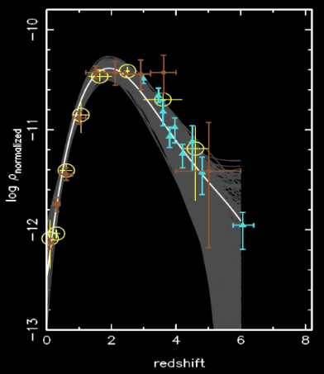
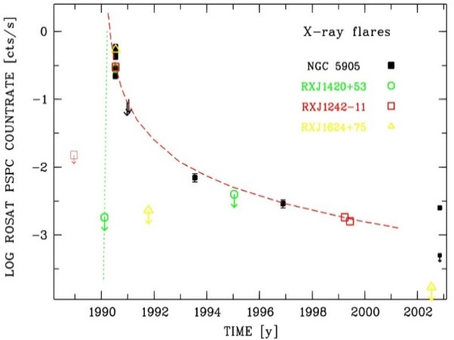
eROSITA & Hot Universe
0.7 Mill. Stars
  O, B, WR, wind shocks
  stellar pop. studies
  SFR / galactic structure
SNR
  search radio quiet/absorbed
  Large (=local) SNRs
ISM
  Shocks, T, densitities, ion. stages,
  chem. abund., NE effects
Compact Objects
  > 100 INS?
  Pulsars (spin down)
  Accretion
  Magnetic fields, Magnetars
  Cyclotron line features
  .....
3 Mill. AGN z < 6
  XLF, Accretion History
  Variability, e.g. Tidal Disruption
  Spectra (iron lines)

Slide 15
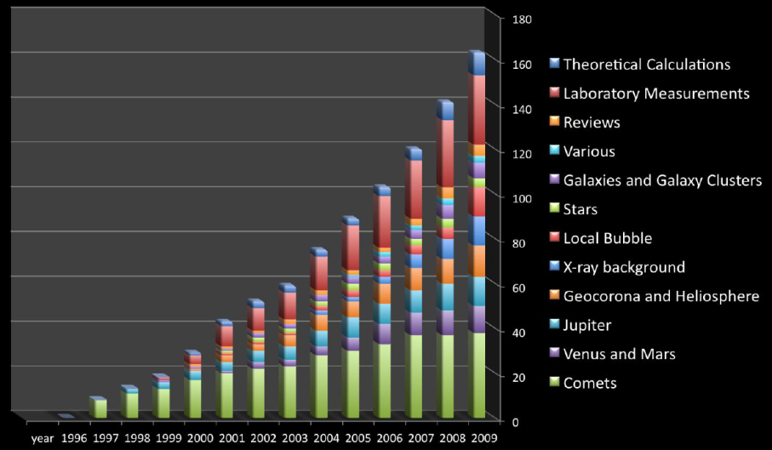
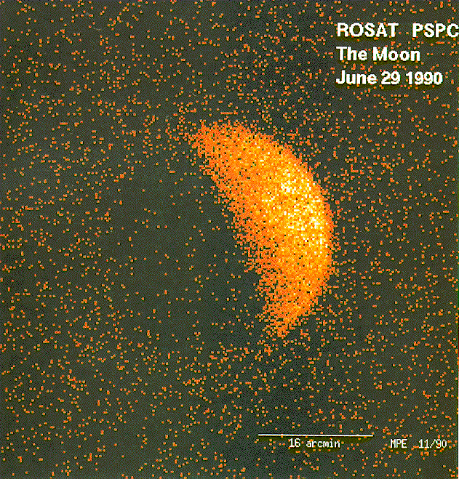
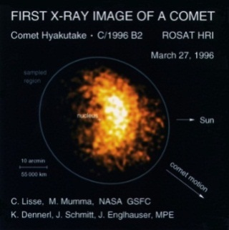
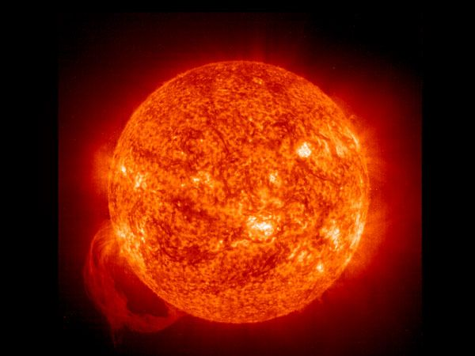
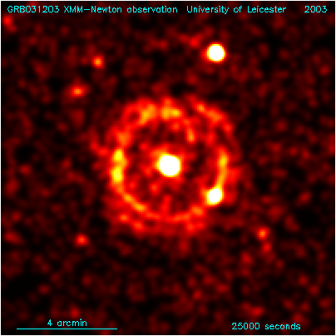
eROSITA & Cold Universe
Charge Exchange
Schmitt et al. 1990
court. K. Dennerl
Cool Stars
magnetic activity
coronae
Interstellar Dust
scattering
spectroscopy
chemistry
Costantini et al., 2005
Vaughan et al., 2003

Slide 16
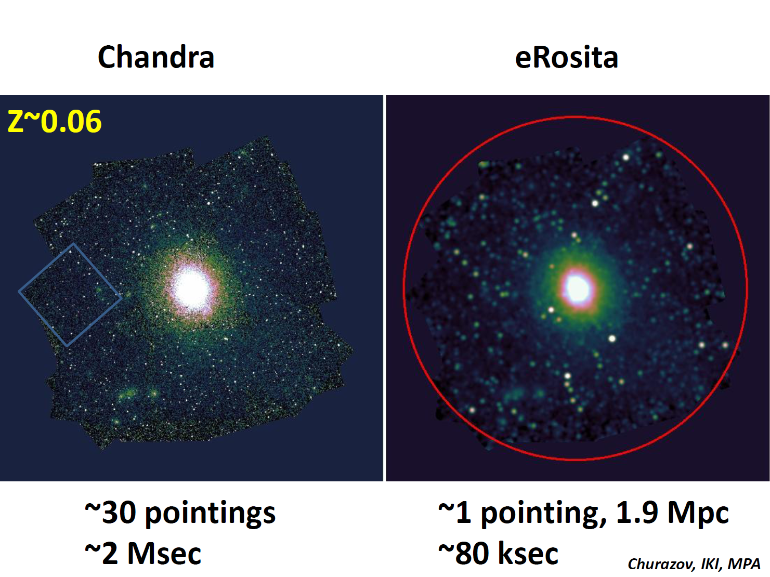
Fast Survey Machine
100 kpc
[0.5” HEW]
[26” HEW (FoV avg)]

Slide 17
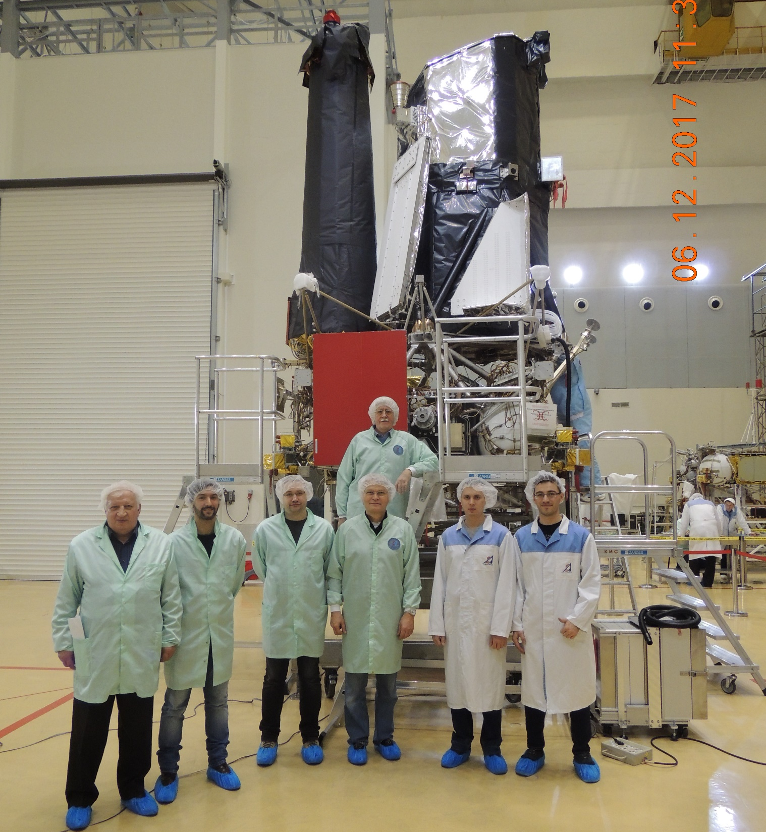

Slide 18
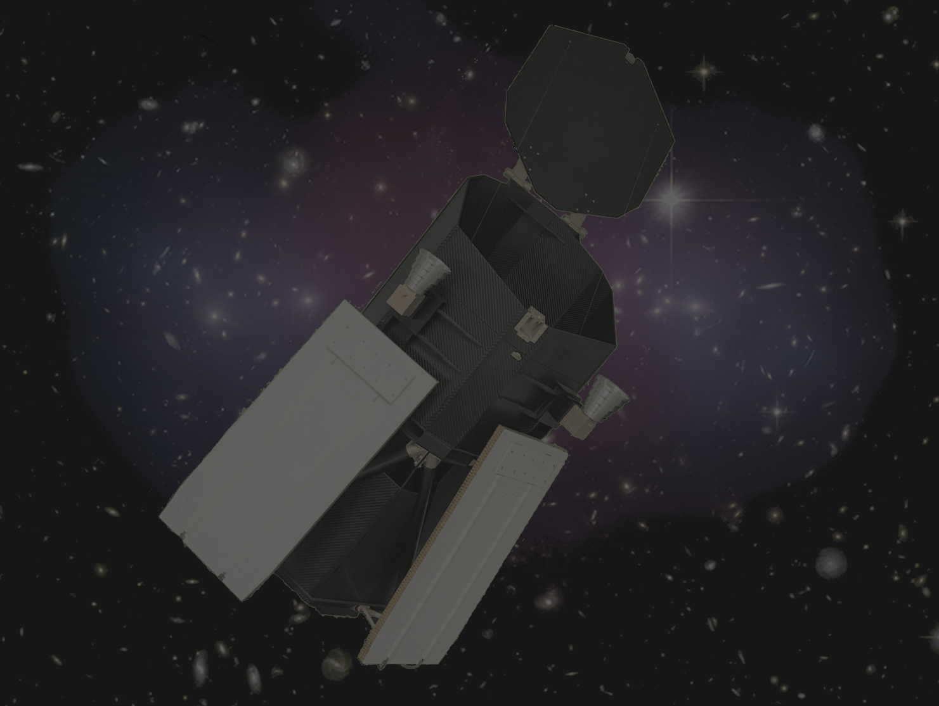
SRG Milestones
Instruments delivered 01/2017
Instruments integrated & Complex Test 12/2017
Radiocomplex delivered 03/2018
Complex Tests 05/2018
S/C TV Test 06/2018
PROMs into ITCs same period
SRG Vibr. Test 09/2018
Packing, Transportation 01/2019
Launch Window 03/2019

Slide 19
eROSITA Fact Sheet
Instrument
Size 1,9m Ø x 3.5m
Weight 810kg
Power 522W
Data volume 600MB/day
lifetime > 7 years
Launcher PROTON/BLOK-DM
Launch March 2019
Mission Orbit around L2
7 Camera Assemblies
pnCCD + Filterwheel + E-Box
3 x 3 cm ², pixelsize 75µm x 75µm
Time Resolution 50msec
Energy Resolution (1keV) ~ 70eV
Quantum Efficiency (1keV) ~ 95%
Performance
Energy Range 0.3-7keV
Point Source Sensitivity 1.2E-14
P.S. Sensitivity at poles 2.9E-15
Extended Source Sens 3.4E-14
ES. Sensitivity at poles 1.0E-14
7 Mirror Assemblies
Wolter-I + X-ray Baffle + Electr. Div.
Diameter of outer shell 358mm
Number of shells 54
focal length 1600mm
PSF/HEW on axis (1.5keV) 16 arcsec
HEW average FoV 26 arcsec
Effective Area (1.5keV) 350 cm²
eROSITA_DE
12 working Groups
135 Members
+ External Collaborators

Slide 20
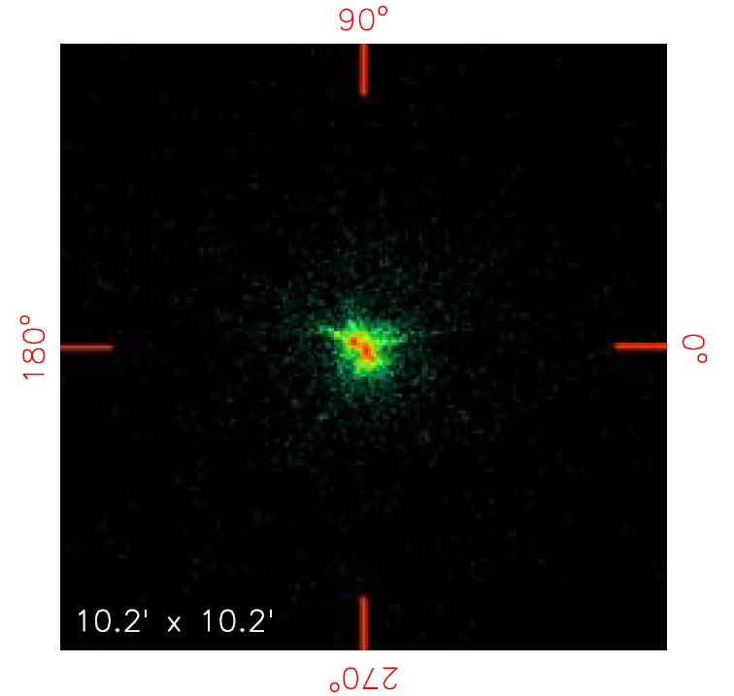
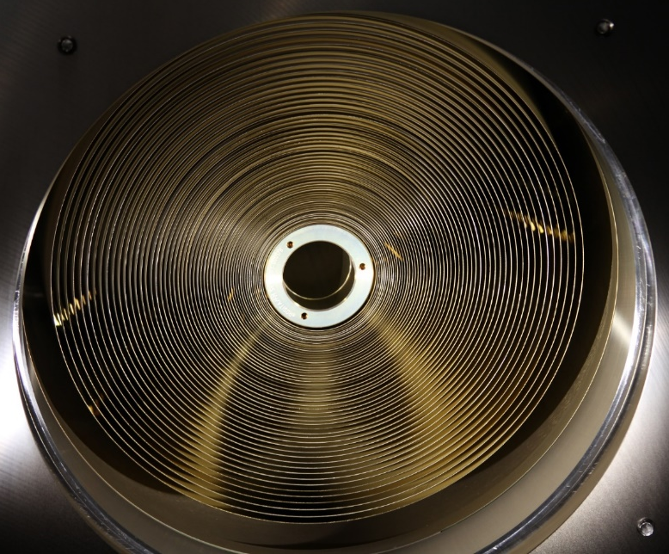
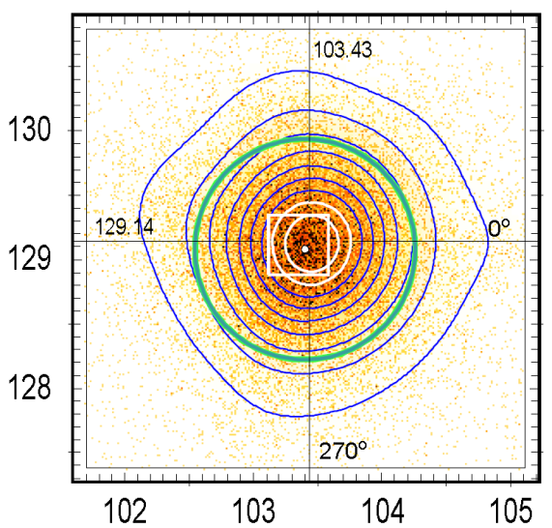
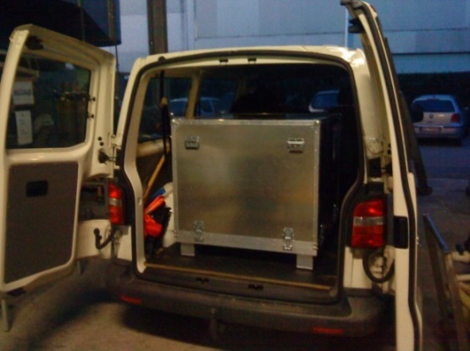
Flight Model, 2013
16 arcsec
Engineering Model, 2009
42 arcsec
Via Mala
We know all bumps and road holes between Monza and Garching

Slide 21
