Slide 1

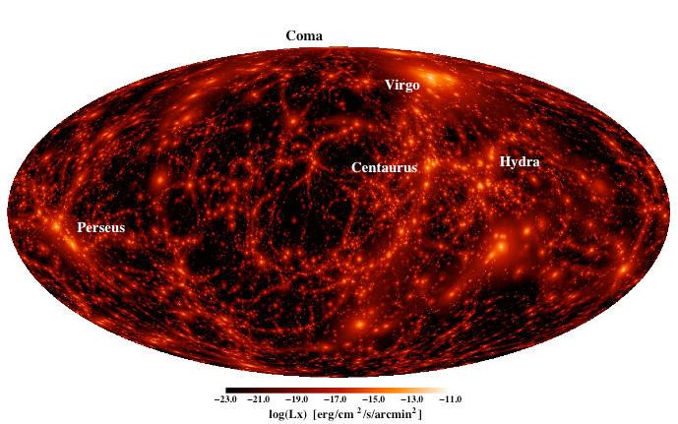
eROSITA (early) Science
Andrea Merloni (MPE)

Slide 2


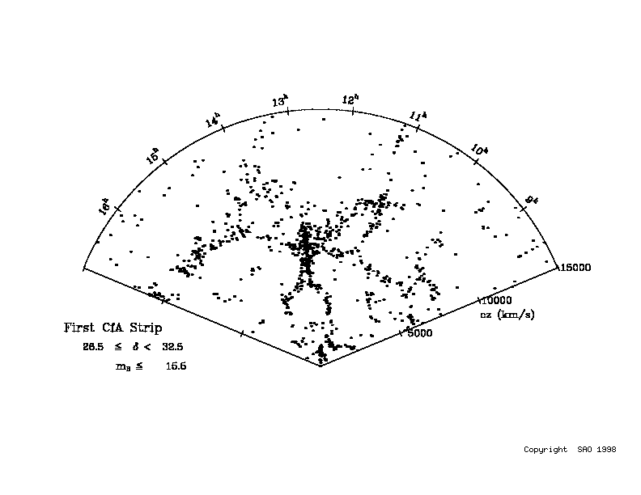
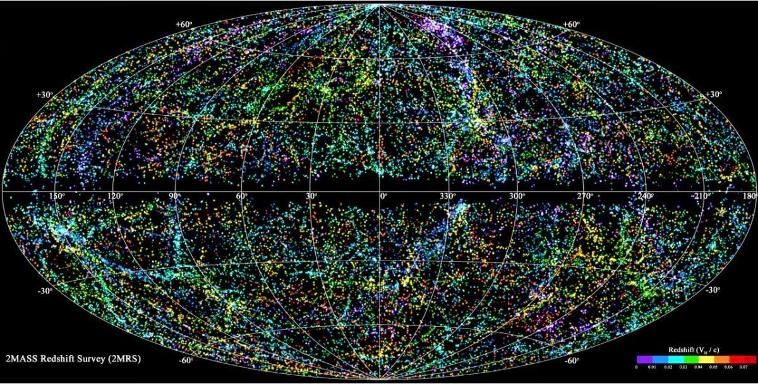
Mapping the Universe
“Constrained”
Hydro simulations
e.g. J. Sorce+2016 Courtesy of K. Dolag (LMU)

Slide 3

RASS vs. eROSITA vs. XMM

Slide 4
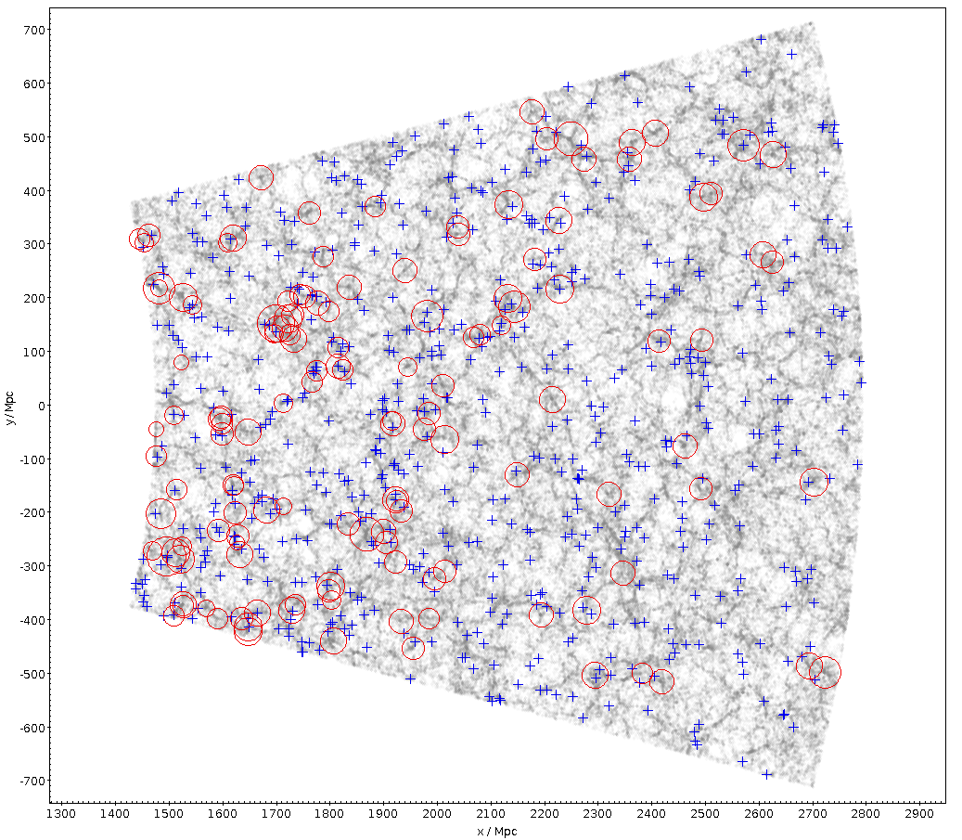
eROSITA and LSS
Courtesy of J. Comparat, MPE
Z=0.3
Z=0.7

Slide 5
eROSITA surveys in context
Logarithmic scale!
Approx. Number of X-ray sources detected per year (from published catalogs, not corrected for duplications)

Slide 6
eROSITA surveys in context
Linear scale!
Approx. Number of X-ray sources detected per year (from published catalogs, not corrected for duplications)

Slide 7
eROSITA surveys in context
Cumulative numbers
At the end of its first year of operations, eROSITA will have detected as many new sources as have been catalogued in 50 years of X-ray astronomy

Slide 8

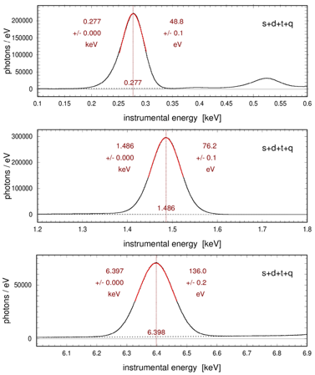
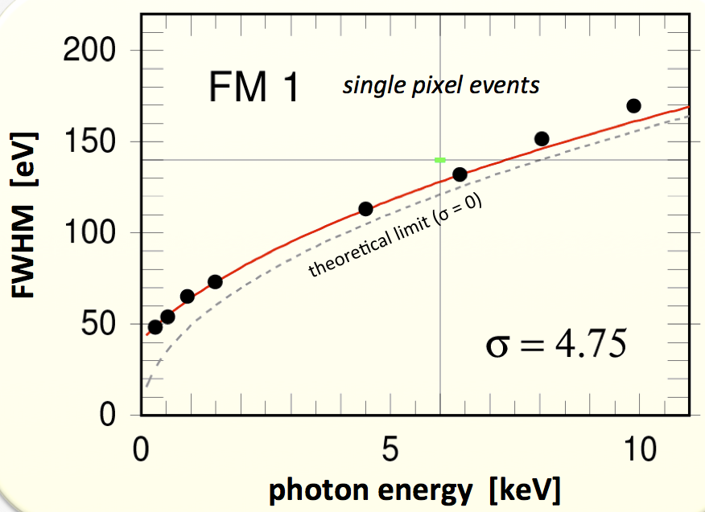
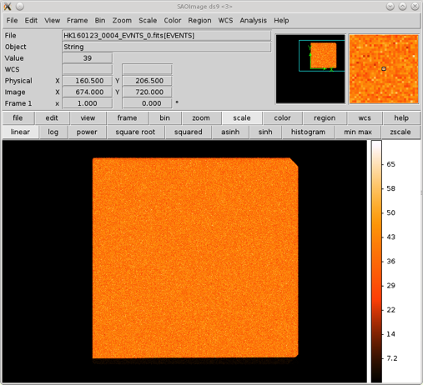
Cameras Calibration
3.3 Billion calibrated events! (K. Dennerl, N. Meidinger)
Spectral resolution at all measured energies within specs (R~20 @1.5keV)
Extremely good uniformity
Only weak dependence on CCD and electronics temperature (unlike XMM)
Very accurate absolute energy reconstruction (<0.06%)
ΔE=49eV @0.28keV
=77eV @1.5keV
=136eV @6.4keV

Slide 9
Effective Area and Grasp
Effective Area: ~1700 cm² (FoV avg. @1keV)
Effective area at 1keV comparable with XMM-Newton
Factor ~7-8 larger surveying speed (and 4 years dedicated to all sky survey)
Survey FoM≈A_{eff}*FoV/(θ*Bkgn) (courtesy of Wik & Hornshemeier)
Notes:
Pileup significant above ~0.2-1 x 10^-10 erg/s/cm2 (a few mCrab)

Slide 10
eROSITA Performance Verification
Goals of the PV phase:
  to demonstrate the ability of eROSITA to achieve its foremost scientific goals;
  to make both the eROSITA scientific teams and the scientific community at large aware of the instrument capabilities and of the forecasted impact of the mission.
“It is expected that the eROSITA PV phase will enable highly competitive early scientific programs, which will lead to a series of publications in refereed scientific journals.”
The Ru-De Joint committee agreed to dedicate ~20 days (~1.73Ms) to PV observations, with half of the observations led by Russian PIs, half by German PIs

Slide 11
List of German-led PV projects recommended by the German Consortium and approved by the JC
PI | Title | WG | Time | Approved target | Observing mode | Hemisphere | Visibility
Boller | eROSITA PV Studies using Ultrasoft NLS1 | AGN | 40ks | 1H0707 | PO | De | Always
Dennerl | Observing Mars | Solar System | 40ks (TBC) | Mars | PO | De & Ru | 15.4.–26.7.
Freyberg | Utilizing the new window to carbon-line astrophysics of the Local Interstellar Medium | SNR, Diffuse Emission | 60ks | Cha III | PO | De | mid-Jul.-mid-Oct.
Georgakakis & Finoguenov | The eROSITA Final Equatorial-Depth Survey (eFEDS) | AGN & Clusters | 350ks | 2 fields, ~116deg² | FS 2x[58 deg²] | De | 6.4.–20.5. 1.6.–20.7.
Rau | Testing the NRTA Transient Detection during the CalPV phase | Time Domain Astrophysics | N/A | N/A | N/A | De (& Ru; TBD) | N/A
Reiprich | eROSITA’s First Galaxy Cluster Outskirts and WHIM Detection | Clusters | 100ks | A3391/3395 | FS [2.5x2.5 deg²] | De | Always
Robrade | The nearby stellar cluster η Chamaeleontis | Stars | 150ks | η Chamaleontis | FS [5x5 deg²] | De | Always
Schwope | Phase-resolved spectroscopy of the isolated neutron star RBS1223 | Compact Objects | 100ks | RBS1223 | PO | De | 6.6-19.7
Wilms | An eROSITA PV observation of an ultraluminous X-ray pulsar | Time Domain Astrophysics | 60ks | NGC 7793 P13 | PO | De | 13.5.–30.6.

Slide 12


eFEDS
14.5hr: visible if launch within Sep.15<T_0< Dec.15 or Mar.15<T_0<Jun.15 [4 weeks window]
12hr: visible if launch within Jul.15<T_0<Oct.15 or Jan.15<T_0<Apr.15 [full 6 weeks launch windows are covered]
9hr: visible if launch date within Jun.15<T_0< Sep.15 or Dec.15<T_0<Mar.15 [2 weeks window for]
  Main goals: Clusters Mass calibration (HSC lensing, dynamics)
  AGN evolution, luminous AGN host properties
  Projects under discussion:
    Radio coverage (LOFAR, ASKAP)
    Spectroscopic coverage
    Spitzer proposal submitted (PI A. Stanford)

Slide 13
SPIDERS for eFEDS
eBOSS will be completed in Feb.2019 -> projected area coverage for SPIDERS ~6000 deg² (2.3x existing one)
  ~10k RASS and 1200 XMM Slew sources’ spectra
  Next Public release DR16 (July 2019)
  Approved a dedicated SPIDERS/eFEDS program to cover 60deg² (12 plates) of the 12h eFEDS/GAMA field (TBC); To be observed in Spring 2019 or 2020
  Full eRASS:8 depth, about 100 AGN and 3-4 clusters /deg²
  Up to ~6000 X-ray AGN spectra

Slide 14
Russian-led PV project (TBC)
One ~100deg² field at ~5-8ks (TBC) depth coincident with a deep SZ field (either ACT or SPT)
Additonal pointed observations under discussion

Slide 15
German-Russian collaboration on PV projects (draft)
Each team will lead a number of projects based on observations on its half of the proprietary all-sky survey
Members of both teams can propose to join an existing project “on the other side”
Details (manamgement of proposals, etc.) TBD

