Slide 1


CWG Splinter Summary
and Status Update
Joe Mohr
eROSITA Collaboration Mtg – MPE
Ludwig-Maximilians-Universität Faculty of Physics
Max Planck Institute for Extraterrestrial Physics

Slide 2
Splinter Talks (17x)
A. Finoguenov (MPE) eROSITA cluster selection function.
D. Eckert (MPE) Measuring Mgas and core-excised Lx in survey data
S. Grandis (LMU) Number counts with RASS-DES
J. Ider Chitham (MPE) Optical galaxy cluster identification with PS1 and CODEX
N. Clerc (IRAP) SPIDERS update
G. Erfanianfar (MPE) DECaLS Red Sequence
J. Comparat (MPE) Joint Cluster and AGN Simulations
M. Klein (MPE/LMU): The MCMF confirmed 2RXS cluster catalog over the full DES survey
Maria Paulus (LMU) Studying cluster scaling relations with RASS and DES weak lensing
S. Bocquet (LMU) Cluster-Cosmo Pipeline requirements

Slide 3
Splinter Talks (cont)
T. Schrabback (AIFA) VLT weak lensing data sets for the high-z mass calibration
Romy Rehmann (LMU) WL mass determinations of Xray & SZ clusters with the Wendelstein 2m
Jeremy Sanders (MPE) eROSITA thermodynamic profiles of SPT clusters
W. Xu (AIFA) A New X-ray Selected Sample of Very Extended Galaxy Groups from RASS
A. Pérez (AIFA) eROSITA simulations of extended clusters
K. Migkas (AIFA) L-T anisotropy study with eeHIFLUGCS
M. Costanzi (LMU) "Modeling of the redMaPPer DES selection function"

Slide 4
Topics
Cluster selection
eROSITA cluster mocks
Mass proxy measurements
Mass calibration
Photometric and Spectroscopic followup
Cosmology Pipeline Requirements/Tests
Studies of nearby clusters and isotropy

Slide 5
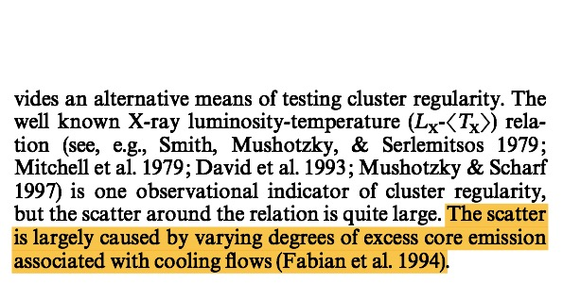
Cluster Selection
Clusters selected through X-ray signature
  eROSITA count rate, cgs flux, detection significance, etc
Lx-mass-z relation is key for modeling selection
  It has higher scatter (~30-40%) than, for example the SPT SZE-mass-z relation (~20%)
At fixed mass-z the Lx is correlated with morphology: cool core clusters are more luminous
  Established for 20+ years
Key question: How can we use this information to improve models of cluster selection?
From Mohr & Evrard 1997:
An X-ray Size-Temperature Relation for Clusters

Slide 6
Multi-scale Cluster Selection
Florian Kaefer: studying these effects using flux limited cluster sample
Alexis Finoguenov: proposing a multi-scale cluster selection that for low redshift sample can entirely exclude the cool core region
Weiwei Xu: Applying wavelet based technique to identify new, low redshift group sample in RASS

Slide 7
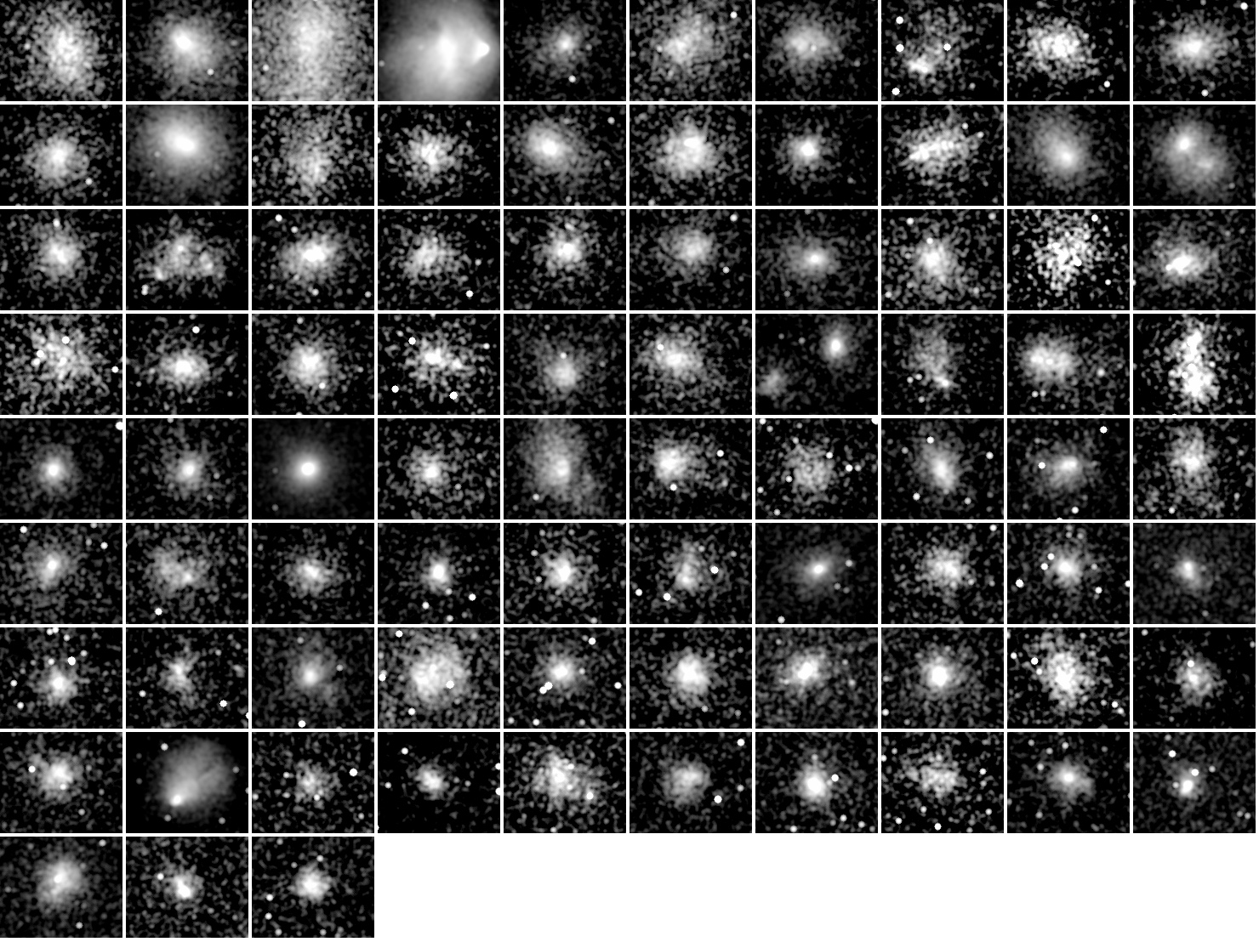
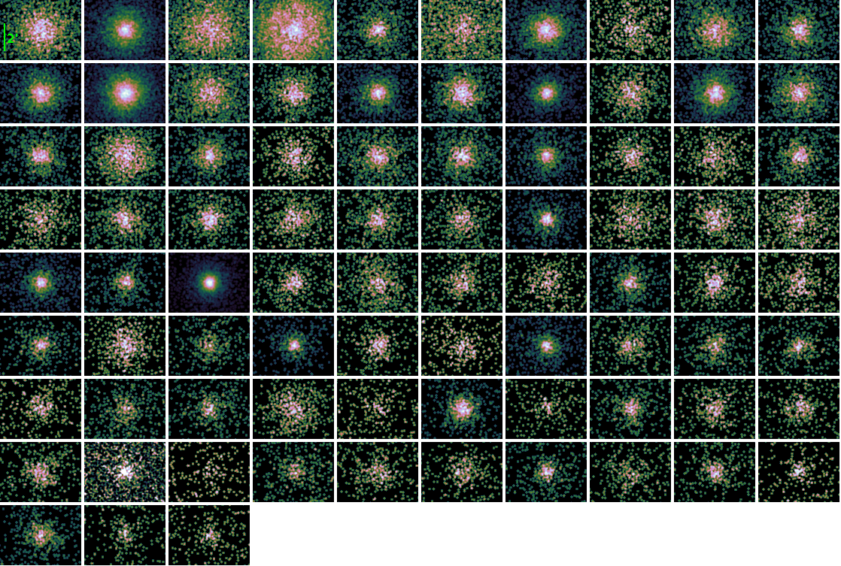
Simulations to Test Selection
Expect to test selection tools using mocks soon
  Dominik Eckert: produce realistic eROSITA cluster mocks using Planck XMM subsample as “truth”
  Jeremy Sanders: produce realistic eROSITA cluster mocks using SPT-SZ Chandra subsample to z~1.2 as “truth”
John Comparat: provided update on simulations of mocks to support eROSITA related spectroscopic surveys (4MOST)

Slide 8
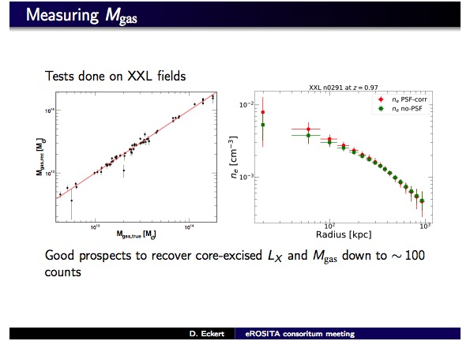
Mass Proxy Estimation
J. Sanders
ICM masses provide low scatter mass proxies
  Cannot be extracted accurately using beta model
Jeremy Sanders: analysis of mock eROSITA observations of SPT-SZ Chandra subsample shows ICM masses can be extracted out to z~1.2 with better than 10% measurement uncertainty!
Dominique Eckert: showed results from new non-parametric analysis of XMM XXL based sample that also show good ICM mass measurements

Slide 9
Mass Calibration
Tim Schrabback: VLT observations in IR useful for weak lensing of high-z clusters (competitive with HST obs)
Maria Paulus: DES weak lensing data used for studying scaling relations of 2RXS+DES cluster sample
Romy Rehmann: Wendelstein weak lensing of 3 Planck clusters
Raffaella Capasso: Lambda-mass-z relations of CODEX clusters calibrated using dynamical masses calculated using SPIDERS data

Slide 10
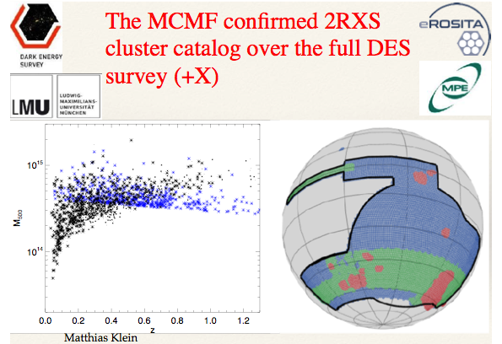
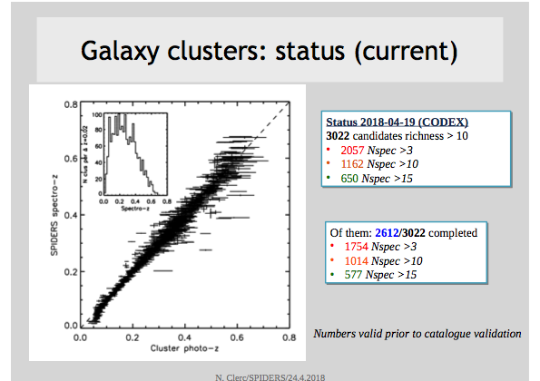
Optical Followup
Nicolas Clerc: update on SPIDERS spectroscopic followup of the CODEX sample
Matthias Klein: DES followup of 2RXS (Boller+16) sample produces cosmology validation sample of ~1000 clusters extending to z~1
Jacob Iter Chitham: PS1 followup of CODEX sample coming together with goal of 10000 cluster sample!
Ghazaleh Erfanianfar: DECaLS followup of CODEX sample shows ability to identify clusters to z>1
G. Erfanianfar

Slide 11
Cosmology Pipeline
Sebastian Bocquet: discussion of requirements for eROSITA cosmology pipelines
Sebastian Grandis: study of 2RXS+DES sample within context of eROSITA optimized SPT-like cosmology pipeline (counts, weak lensing)
Matteo Costanzi: study of RM samples in SDSS and DES and the associated selection function

Slide 12
Local Clusters and Isotropy
Antonio Peréz: modeled eROSITA observation of Virgo cluster and tested ability to recover the temperature profile to large radius
Konstatinos Mikgas: showed intriguing results suggesting that the L-T relation normalization varies with galactic longitude

Slide 13
Status
Lots of activity/good successes in all critical areas needed for cluster and cosmology studies
Still much to do
  Study cluster selection in realistic mocks
  Complete optical surveys over DE sky (DeROSITAS)
  Build collaboration with HSC on WL mass calibration
  Work through remaining details of eROSITA cosmo pipelines
  Push through cosmology validation with CODEX and 2RXS samples
  …

