Slide 1
Data analysis of RX J0520.5-6932
Bi-weekly meeting on Magellanic Clouds
Haonan Yang
2024-04-18

Slide 2
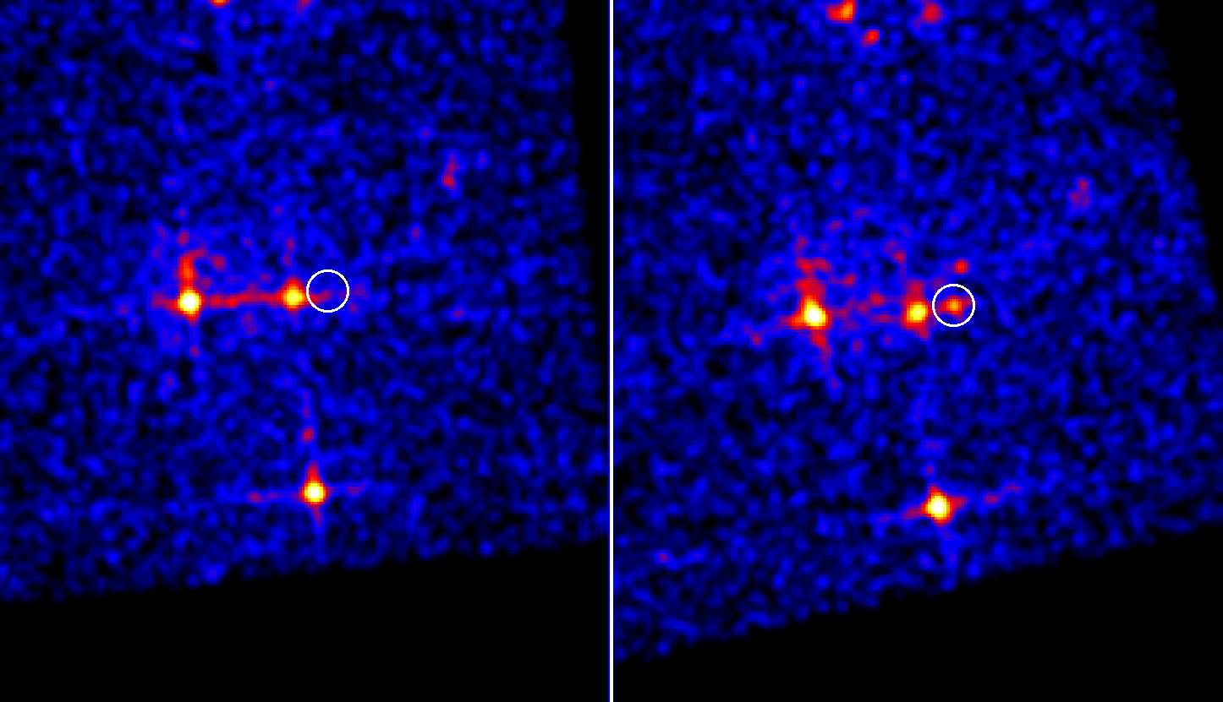
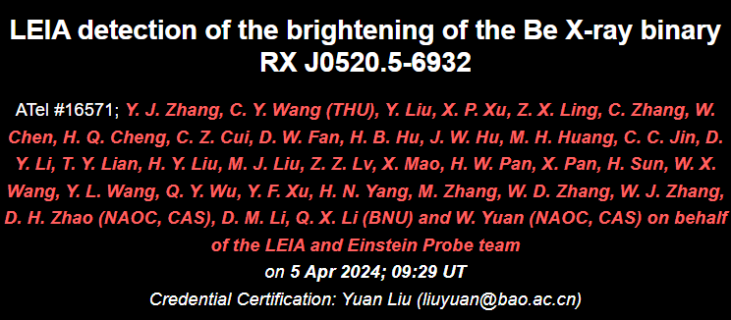
RX J0520.5-6932
Be/XRB
New giant outburst
Previously happened in 2014
2024-03-21T11:03:20
2024-03-29T07:51:55

Slide 3
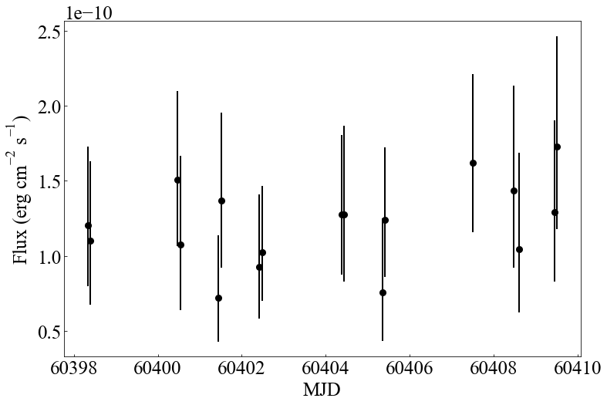
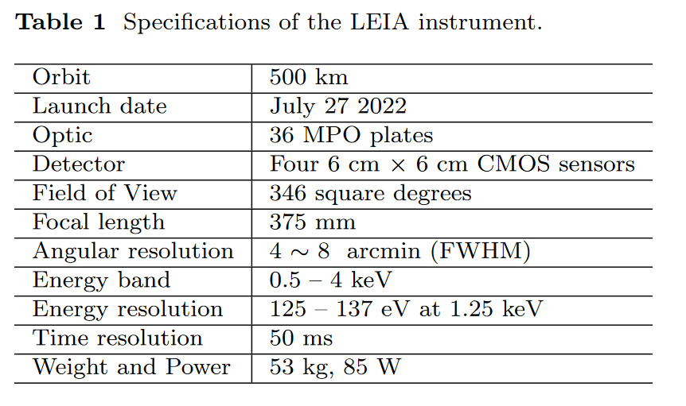
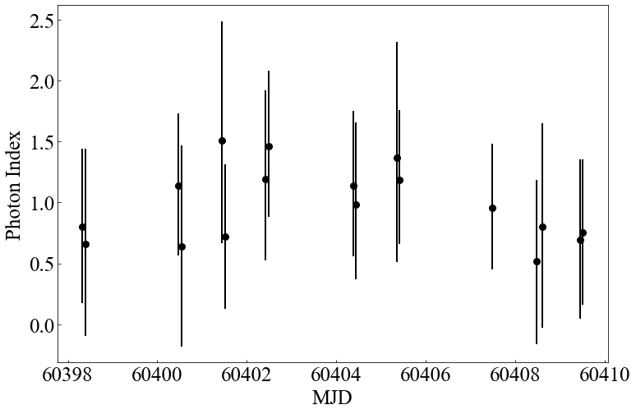
RX J0520.5-6932
LEIA light curve
Flux ~ 1.2e-10
Cheng+2024

Slide 4
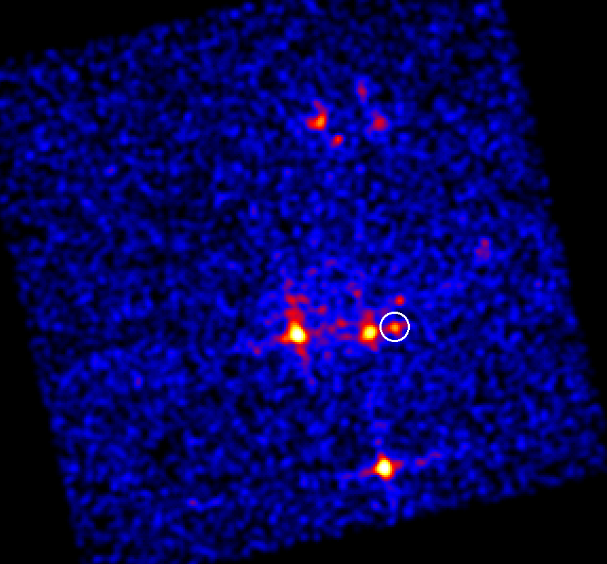
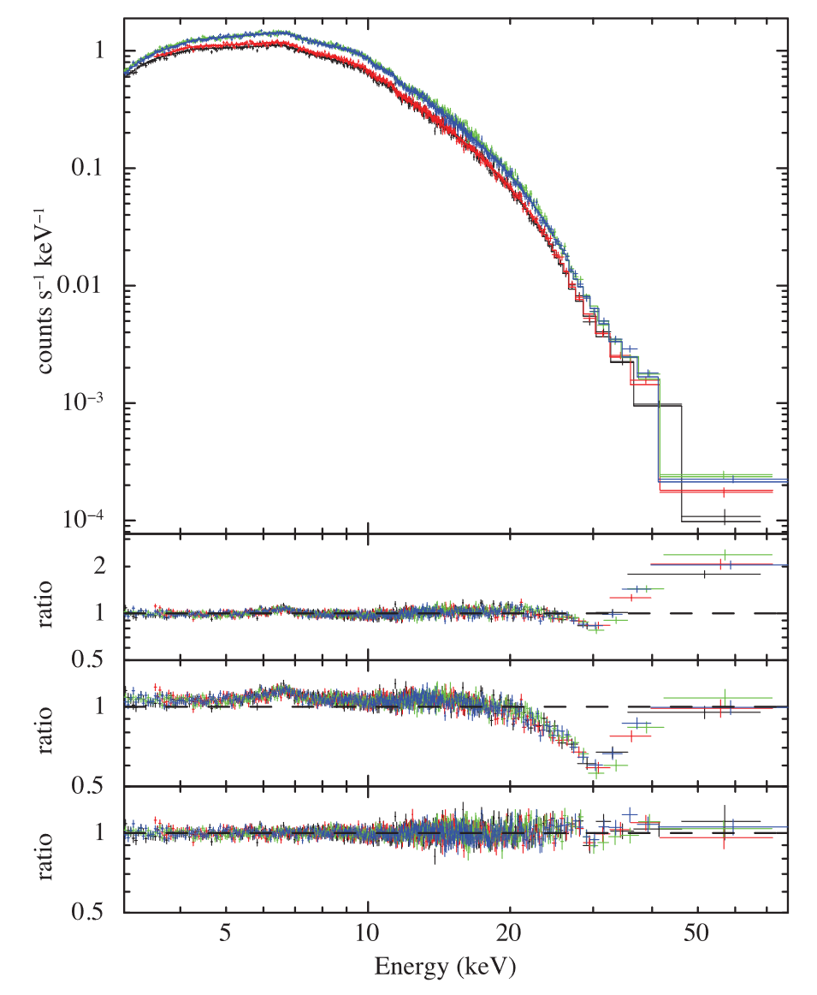
RX J0520.5-6932
Nearby bright source
Hard photons (Tendulkar+2014)
Request for NuSTAR & Swift ToO: NuSTAR (50ks) approved, Swift (4ks) partially approved

Slide 5
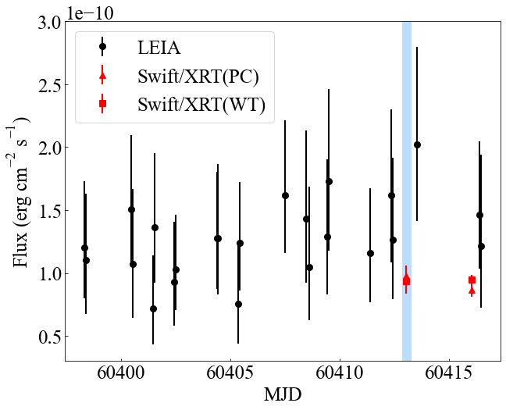
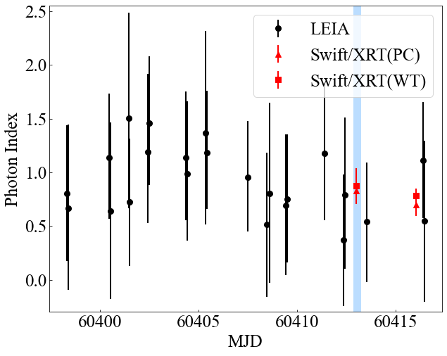
RX J0520.5-6932
LEIA & Swift/XRT

Slide 6
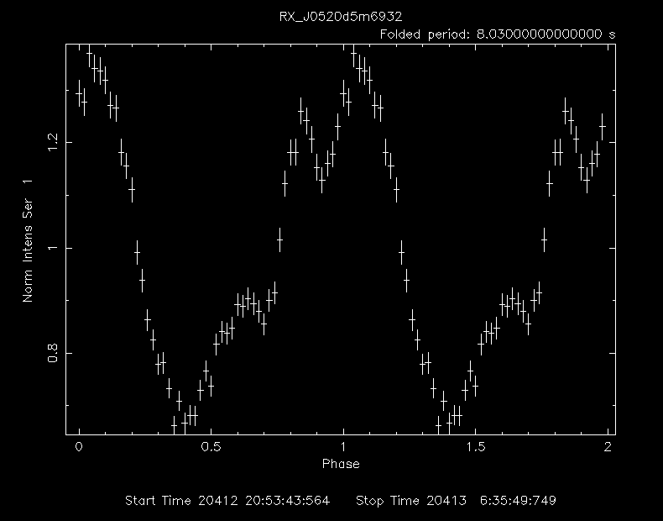
RX J0520.5-6932
8.03s pulsation, detected using efsearch & LS periodogram
consistent with Vasilopoulos+2014, Tendulkar+2014
NuSTAR data: basic fitting and analysis
Cyclotron line
central energe ~30.7 keV

