Slide 1
HOORNAERT Adrien 04/04/2024
Bi-weekly meeting on Magellanic Clouds
Study of an X-Ray source (MC Bridge) : eRASSU J031038.2-734935 eROSITA / XMM / NuSTAR
LMC- NASA/ESA HST

Slide 2
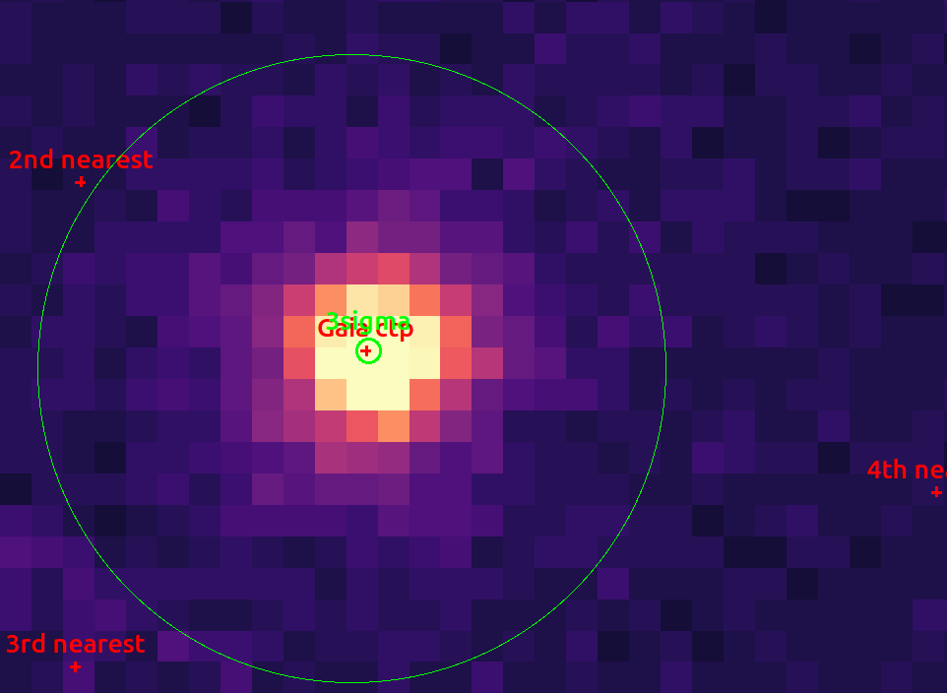
Gaia DR3
Gaia counterpart
One within 3σ error circle (1.53 arcsec) :
Gaia DR3 4640596753263650560
@ 0.288'' parallax S/N : 0.6076 PM : 0.3864 mas/yr Gmag : 20.61
Catalogs
GAIA DR3 (and DR2), WISE, VHS, TESS, USNO, GSC, …
Bmag : 20.22 Rmag : 18.27 Vmag : ~20.8 ?
PN Image Gaia DR3 nearest counterparts circle : 40 arcsec radius
Gaia Collab. Structure and properties of the Magellanic Clouds 2021 → Red Giant ?

Slide 3
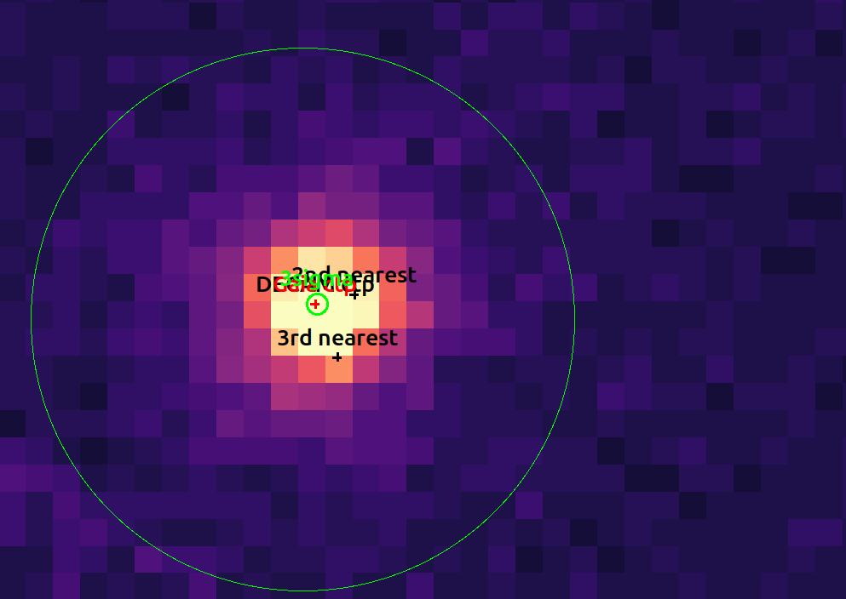
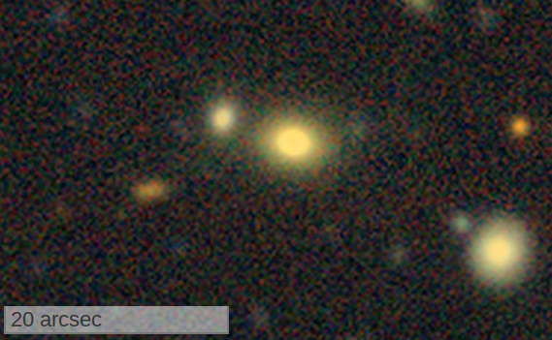
DECAM Legacy Survey
PN Image DECAM counterparts circle : 40 arcsec radius
DECAM Legacy Survey DR10

Slide 4
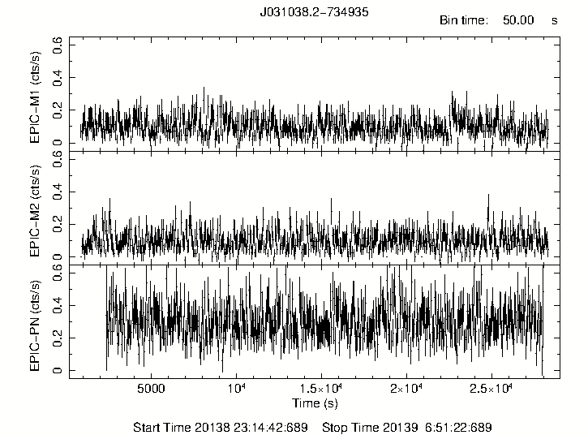
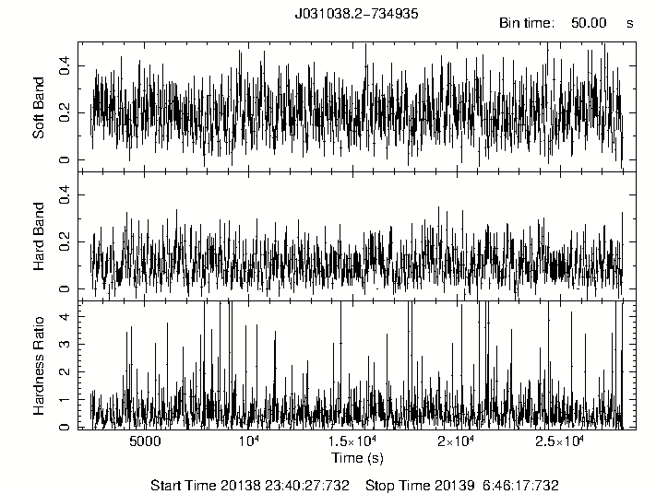
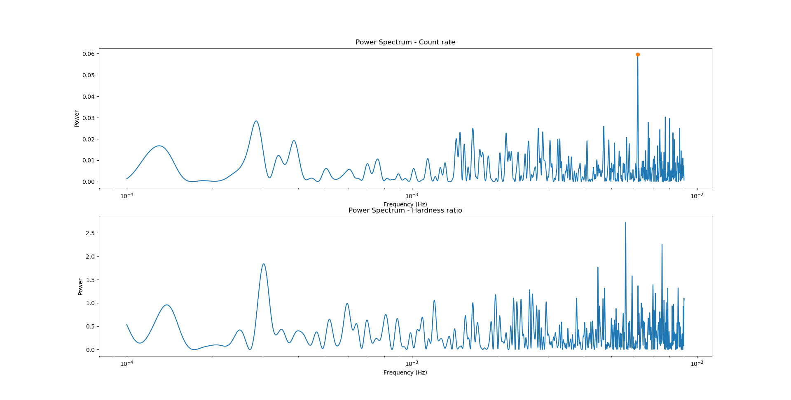
XMM Temporal Analysis
Acq Time : ~7h Counts : ~1000/h ~0.3/s
Resolution : 100ms
No Variability found

Slide 5
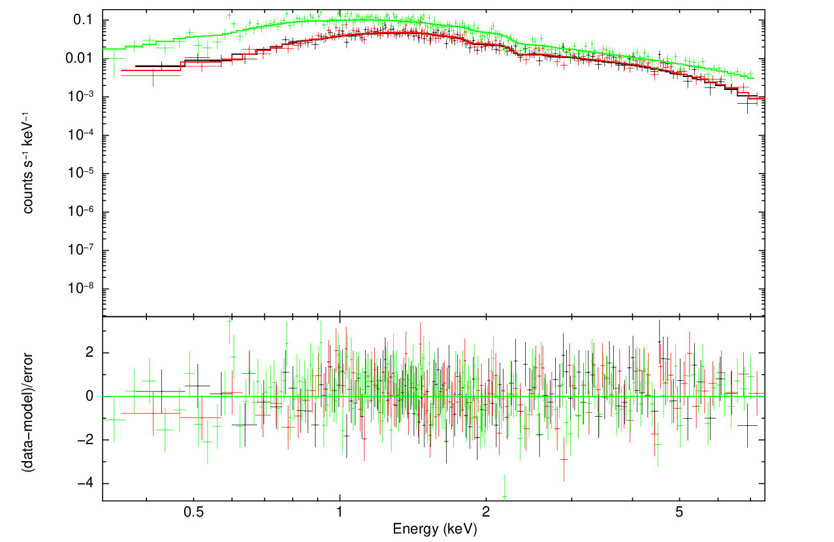
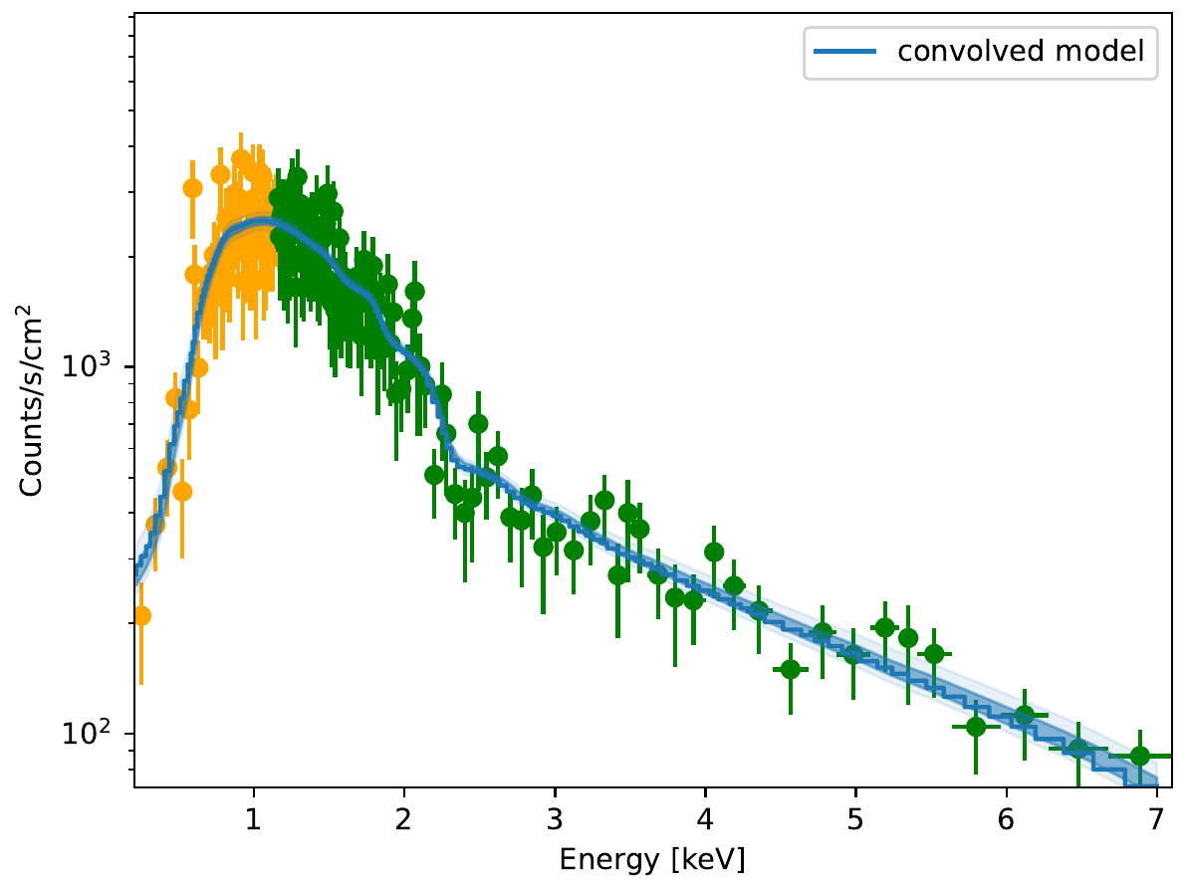
XMM Spectral Analysis
Extraction : 0.2 - 8 keV
Fitting in XSPEC (single and simultaneous)
Bayesian fitting (PN Spectrum)
Absorption : foreground absorption fixed (Dickey & Lockman), fit for nH around source
Models : absorbed powerlaw or absorbed powerlaw + diskbb

