Slide 1
Work with LEIA Data
Haonan Yang
2024-04-04

Slide 2
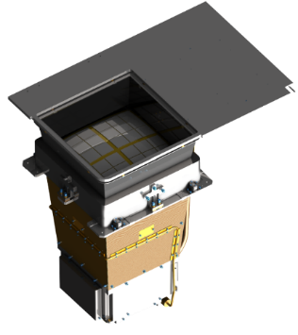
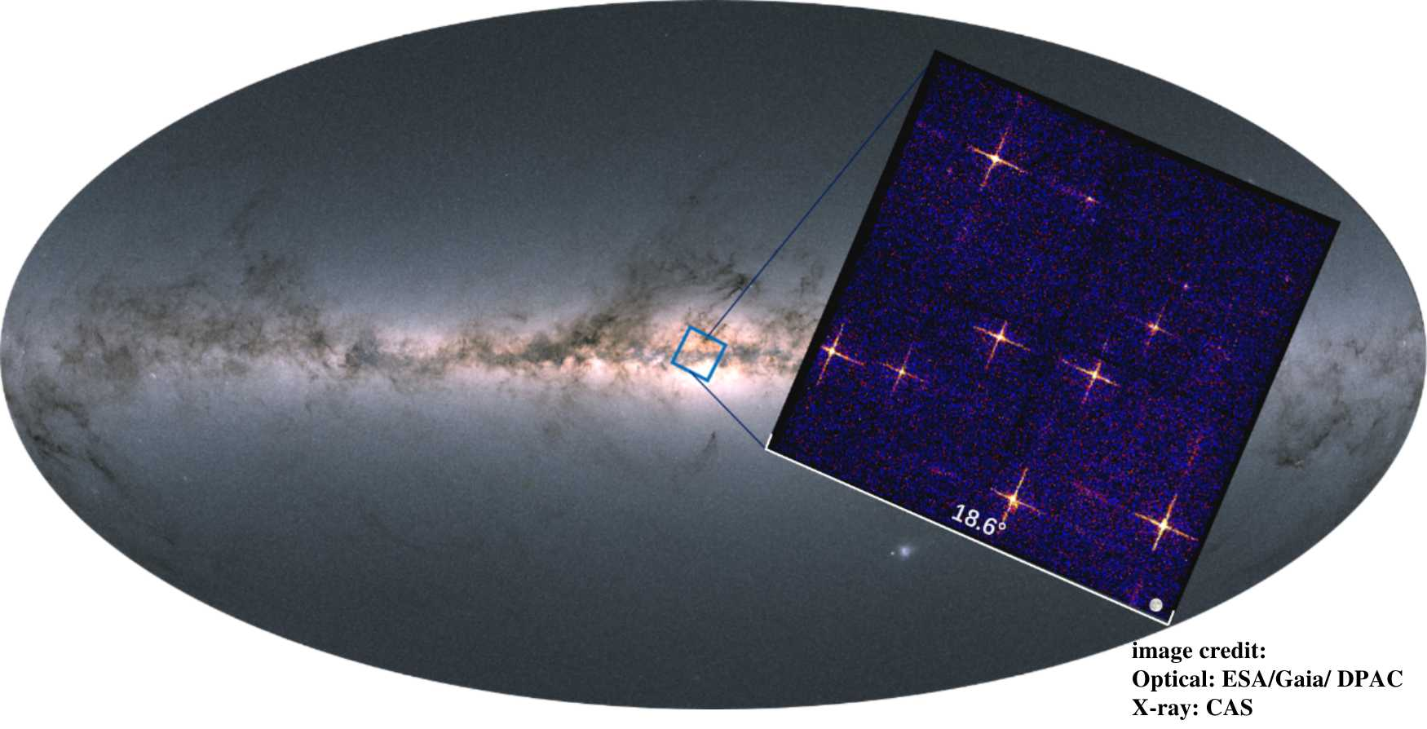
Brief Introduction
LEIA
Lobster Eye Imager for Astronomy
Launched on 2022 July 27
The first lobster-eye wide field imager
EP-WXT pathfinder
4 CMOS sensors
0.5-4 keV
FoV: 18.6° × 18.6°
PSF: ~5’
Haonan Yang
Ph.D. student
National Astronomical Observatories, Chinese Academy of Sciences (NAO, CAS; NAOC)
High Energy Astrophysics Group (Einstein Probe science team)
Variability of AGN
LEIA data analysis
Zhang et al. 2022 ApJL 941 L2

Slide 3
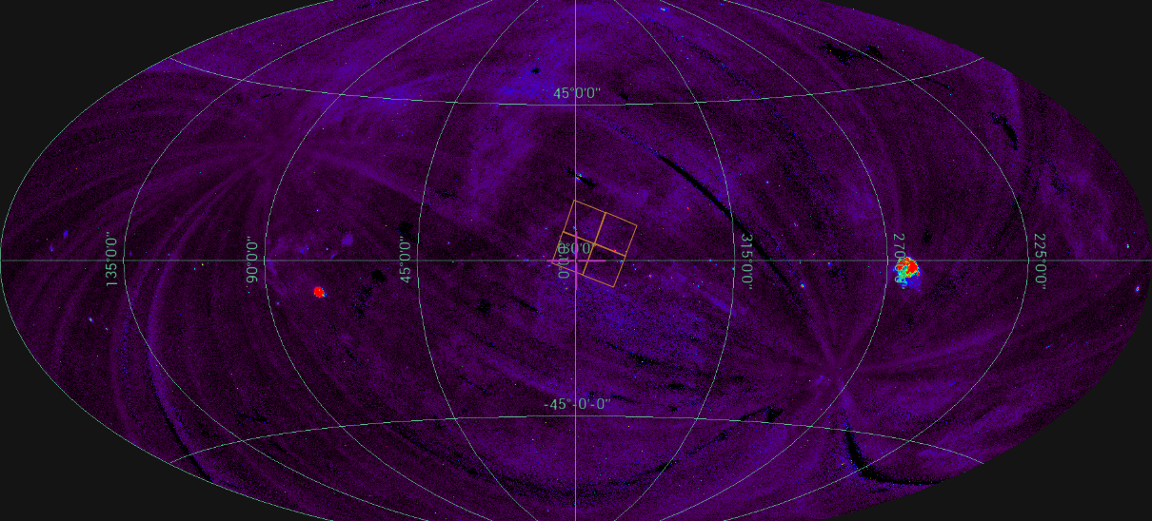
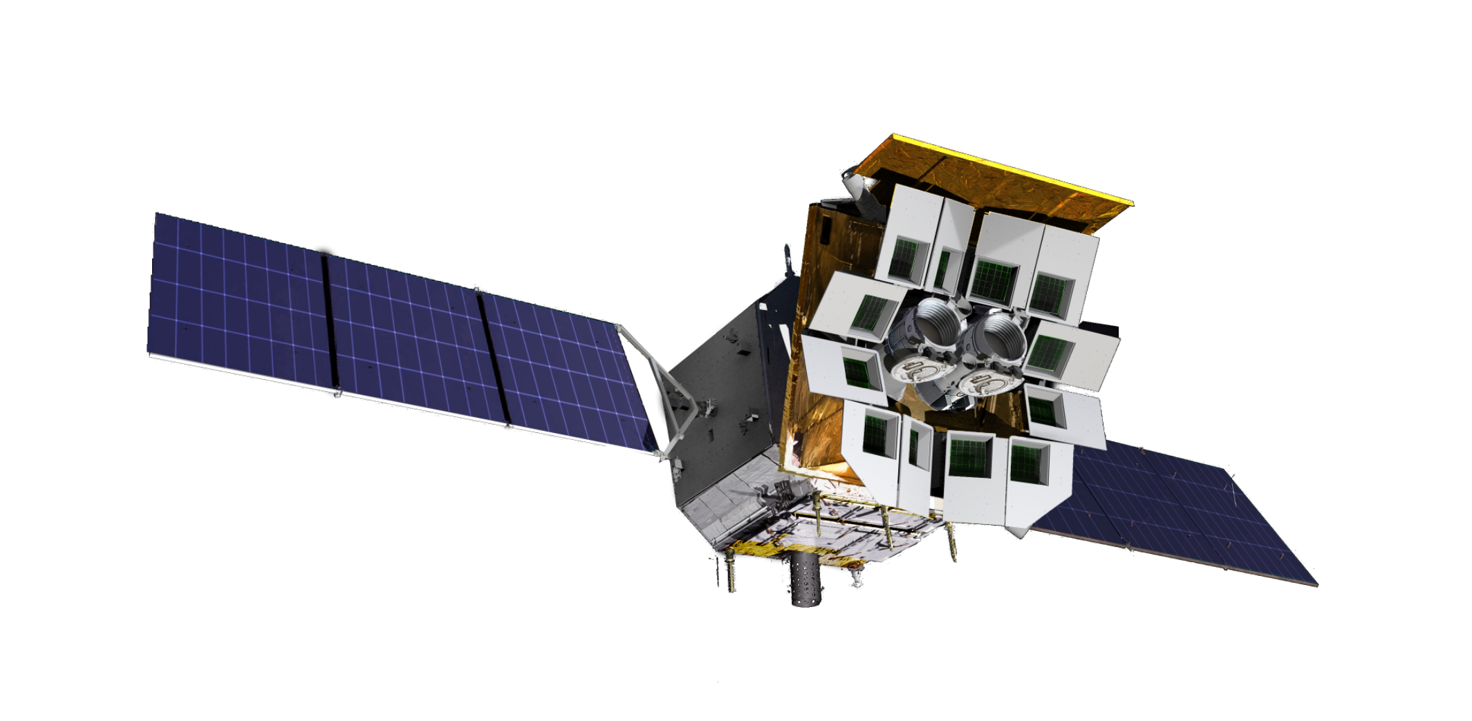
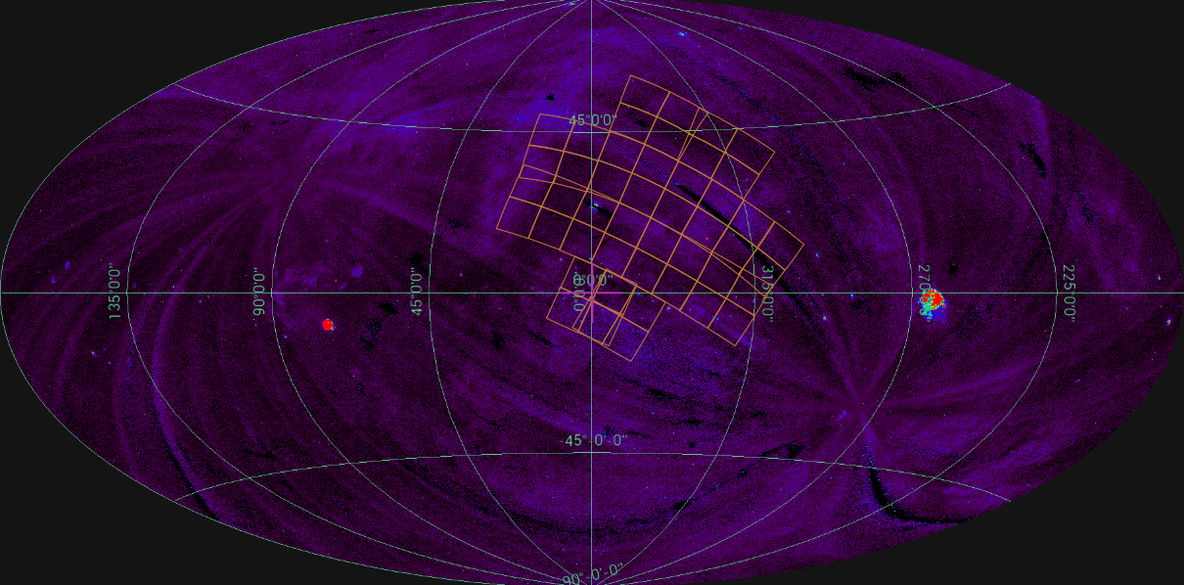
LEIA as EP-WXT pathfinder
FoV comparison
LEIA & EP-WXT

Slide 4
LMC monitor
LEIA use 1 CMOS (CMOS15) to monitor LMC with a cadence of 1-2 times per day.
Single observation of LMC by LEIA could looks like:
After smoothing the image:
Notes:
The bright sources with a flux over about ten to the power of negative eleven can be detected in one single observation.

Slide 5
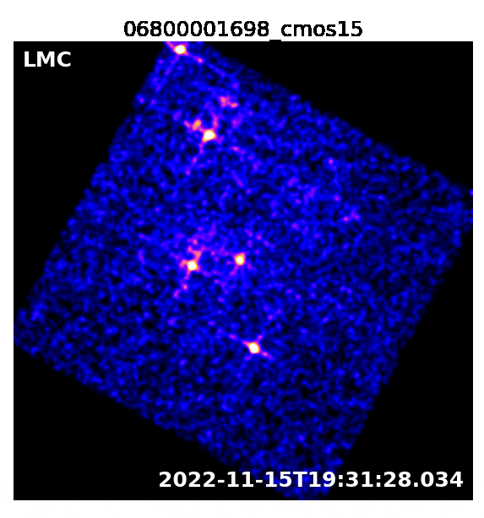
LMC monitor
Bright sources (F > ~3e-11 erg/s/cm²) can be detected in single observations.
The variability of these bright sources could be easily observed in the daily monitoring.
Data stacking is needed for the faint sources.
We also tried to find some new transients.
Notes:
The bright sources with a flux over about ten to the power of negative eleven can be detected in one single observation.

Slide 6
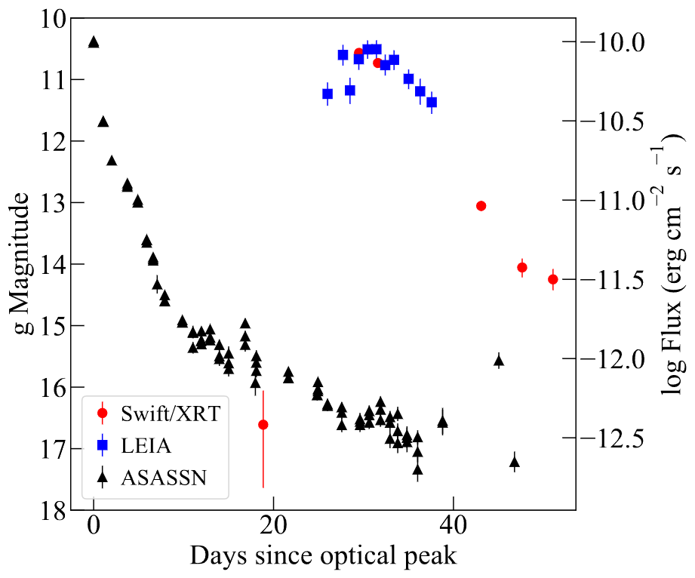
LMC monitor
ASASSN-23hd
A nova found in October 2023 and detected by LEIA ~a month after the optical peak.
Monitored by LEIA during its supersoft X-ray source (SSS) phase.
paper in prep.

Slide 7
LMC monitor
After merge all the observations before 2024-01-01
Variable sources: XRB, SSS
Faint sources could be detected after data stacking.
The likelihood of detecting a source could be increased if we merge data during its high-flux periods.
Long-term timing analysis
Start from catalogues of XMM-Newton
Divide and merge data in time segments with different time span (1d, 5d, 10d, 20d…)
Calculate the rate based on the given coordinates and check the timing properties

Slide 8
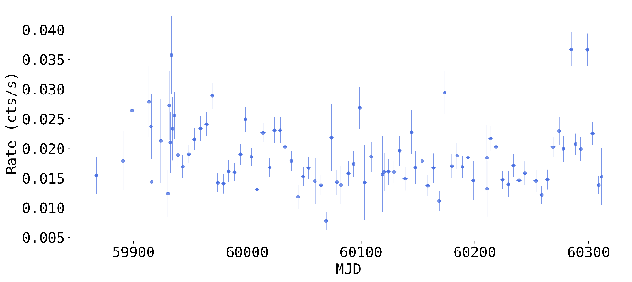
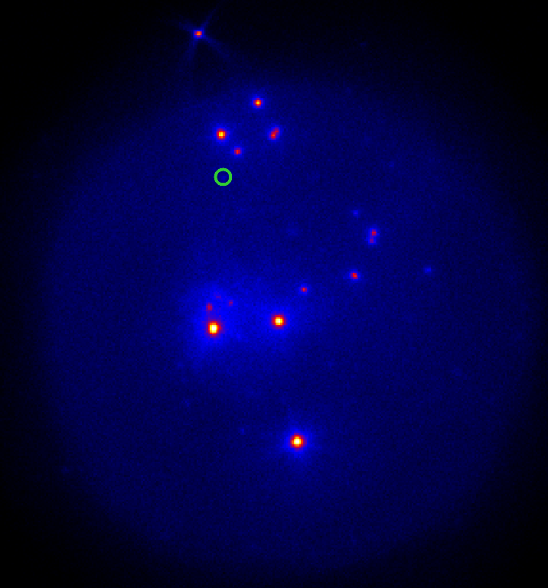
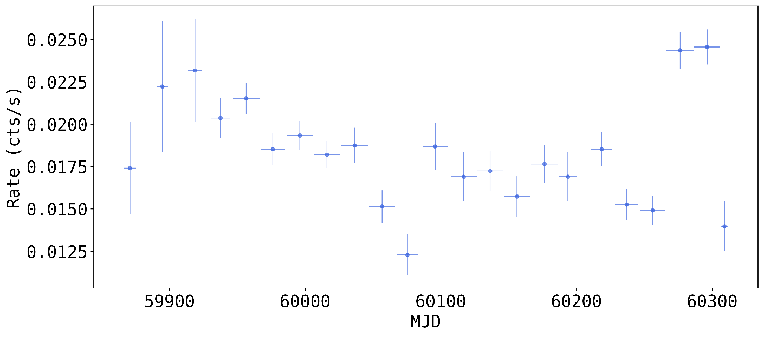
LMC monitor
seqno. 1 1A 0535-66
5d segments
20d segments
Next: Check the light curves & images

