Slide 1
WG Compact sources
Summary

Slide 2
Census people
CVs | ADS, IT, VB, RSC
Novae | FH, WNP
LMXBs | ASa, SP, LD
HMXBs (incl Be) | DK, IK, LD, ASa, FH
BHCs | JW, WP, FH,
WDs | KW, VB, ADS
NS (Pulsars, XDINS, CCOs, Magnetars, AXPs, PWN) | WB, FH, MS, GP, ASa, VD, AP, ADS, Tobias Prinz
ULXs and pops of compact objects in MCs, M31... | Strong interest in MCs, Collaboration with the GWG
Others | GRBs (?) SNe (?)
Interested groups and people identified
Many different source classes: Relation between source class and groups/individuals (tentatively) established
Overlap/synergies between ‚Compact/Galaxies‘ and ‚Compact/SNR‘ identified
IWGs: Compact objects → time-domain
Current break-down into WGs ok
Synergies with corresponding Russian WG strongly encouraged, but tbd, needs identification of contact person

Slide 3
Next steps – Science goals
eROSITA: SAMPLES!!! & Time Base
Will be developed in detail over the next 0.5 yrs per source class
Prepare input catalogues (current census)
eROSITA predictions and expectations
Face-to-face meeting of WG envisaged (→ science symposium)
Survey vs. pointed phase

Slide 4
Multi-lambda needs
Gaia correlation
Deep optical imaging all-sky (minimum 1 optical, 1 IR-band)
Complete flux-limited spectroscopic follow-up down to fx (0.5-2.0 keV)=1e-14

Slide 5
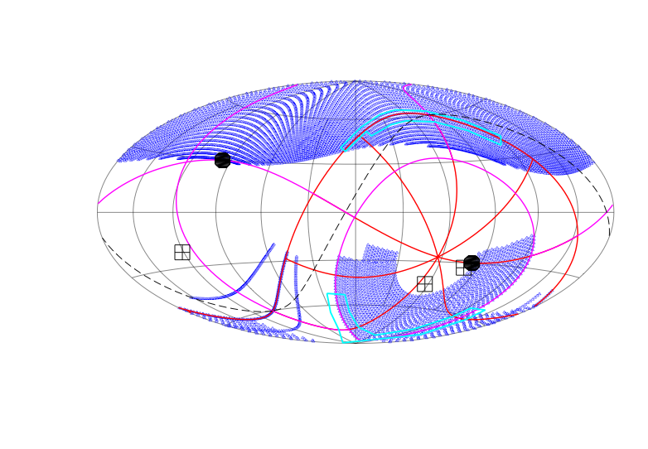
Sky division

Slide 6
Issues
Source types not assigned yet:
GRBs (→ ?)
SNe (→ ISM, SNR etc.)
TOOs:
Need to develop a policy & technical implementation
Detailed variability information as standard data product (inner-scan, scan-to-scan, survey-to-survey)
Timing precision → calibration
Bright sources: implement fast readout mode (msec) feasible?
Central XID-DB?

