Slide 1
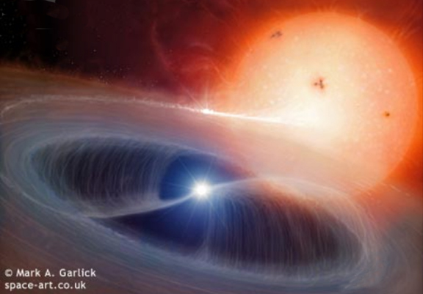
Astrophysics WIth COMPACT Objects
Axel Schwope & Andrea Santangelo with input from A. Pires and D. Klochkov

Slide 2
Object classes by powering mechanism
Accretion
via RLOF (CVs, LMXBs, BHCs of many flavours, ULX)
via stellar wind (HMXBs)
via disk (Be)
from the interstellar medium (INS, isolated BH)
via core collapse (SN)
Thermonuclear
Novae, Bursts
Cooling, remnant heat
White dwarfs, Neutron stars (XDINS)
Magnetic fields
AXPs, Magnetars
Spin-down
Pulsars
Other

Slide 3
CVs Dwarf novae, nova-like, IPs, polars, SSS, double degenerates, Novae, Recurrent novae, Symbiotics
Issues:
Space density and scale height (close binary evolution, magnetic braking)
GRXE synthesis
SNIa progenitors (DDs, SSS, RN, hard symbiotics,...)
LISA calibration sources
Planets in long orbits
Large-scale optical identification program,
Synergy with GAIA

Slide 4
4MOST: 4-meter Multi-Object Survey Telescope
Proposal in response to ESO call for high-multiplex spectroscopic instrument (PI: Roelof de Jong, AIP), CD prop due March 1, 2011
Consortium: AIP, MPE, LMU, ZAH, IoA, Oxford, GEPI, Groningen
Main science drivers follow-up of Gaia, eROSITA
2000 CVs within 900 pc with L_{X} > 10³⁰ erg/s
200 – 5000 CVs within 300 pc with L_{X} > 10²⁹ erg/s
Specification | Baseline | Goal
Field-of-View (FoV) | 2 degree² | >3 degree²
Multiplex fiber positioner | 1500 | >3000
Fields per night | 5 | 10
Spectrographs | 420-900 nm | 370-950 nm
Efficiency full system (M1-to-detection) | >15% | >20%
IFU mode |  | >1 arcmin² FoV
Survey area (5 year) | 10,000 degree² | 2x15,000 degree²

Slide 5
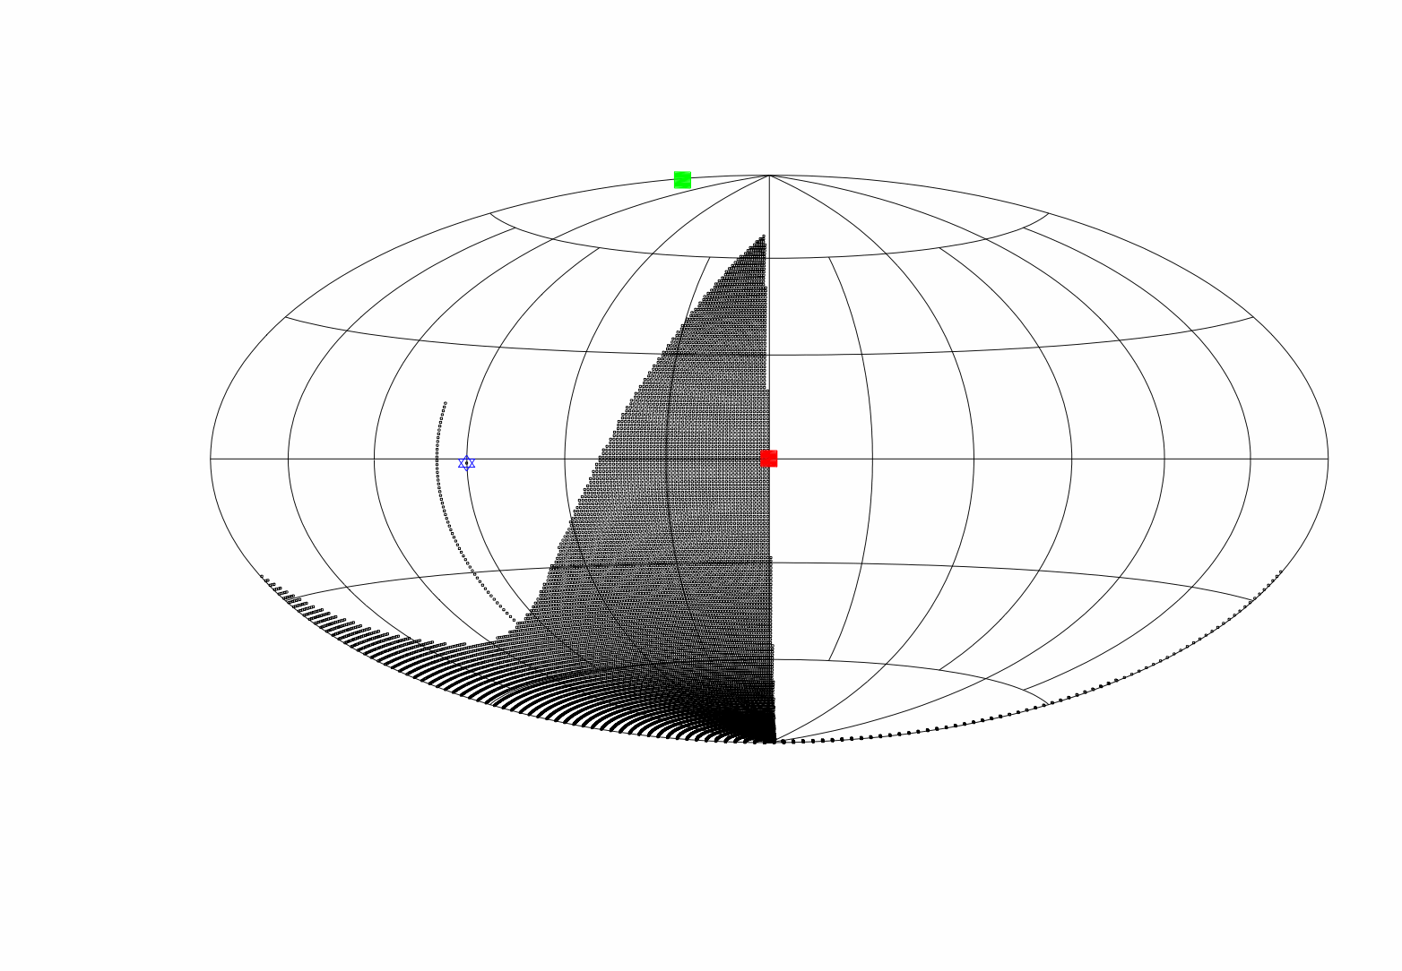
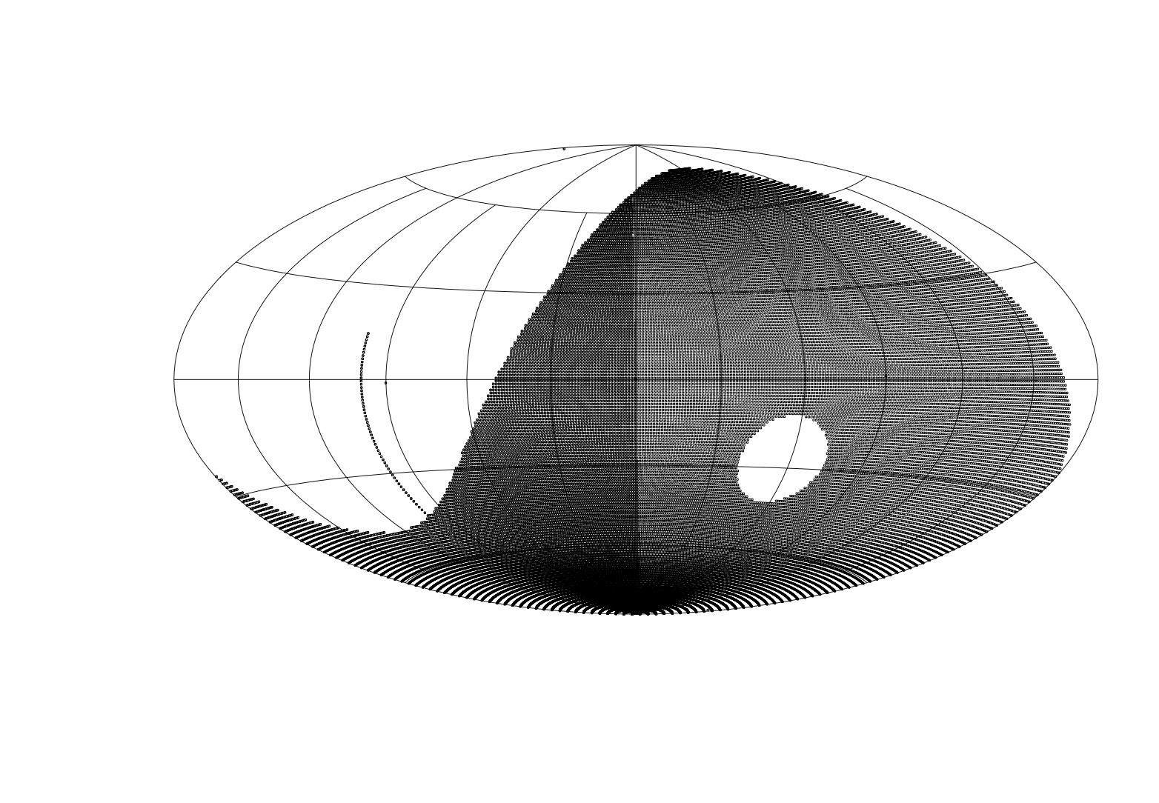
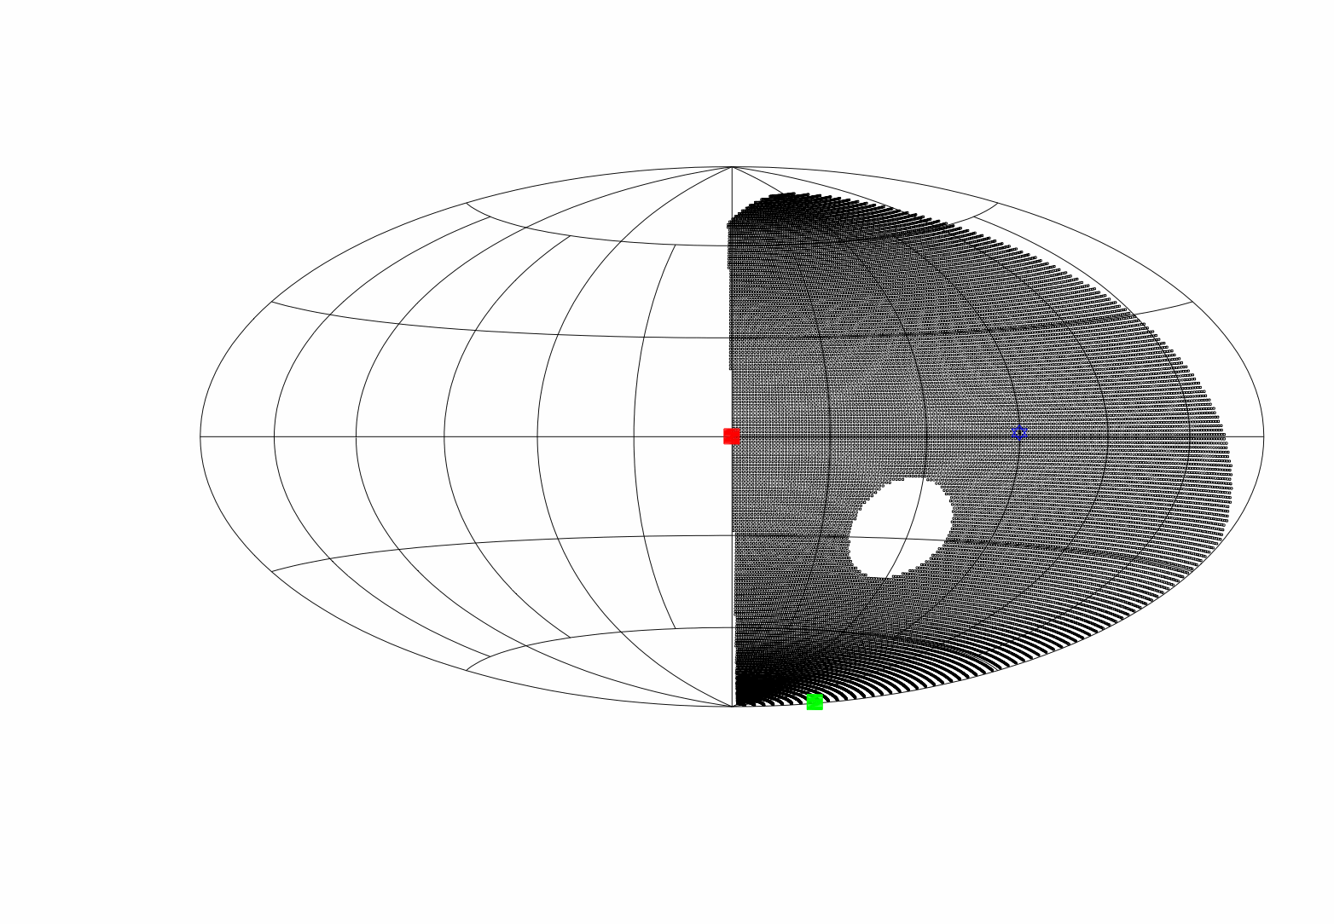
Division of the sky – 4MOST
N: 8000 deg²?
S:18000 deg²?
All-sky: 26000 deg²!

Slide 6
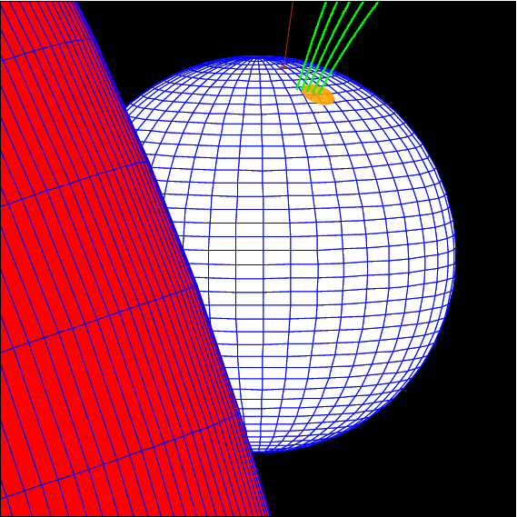
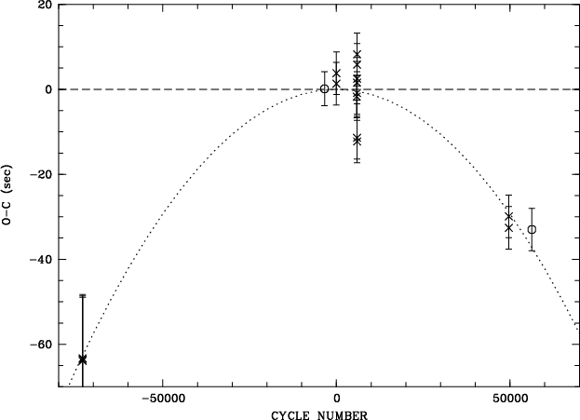
Eclipse delay times in DP Leo
HST
ROSAT
XMM
OPTIMA
Einstein
Quadratic term (Schwope+01):
Angular momentum loss?
3rd body?

Slide 7
Discovery of a wide planetary systems around compact binaries Beuermann et al 2011, A&A (DP Leo) Nasiroglu, Beuermann, Schwope, et al in preparation (HU Aqr)
Beginning with XID work ...
... ‚ending by finding planetary systems‘

Slide 8
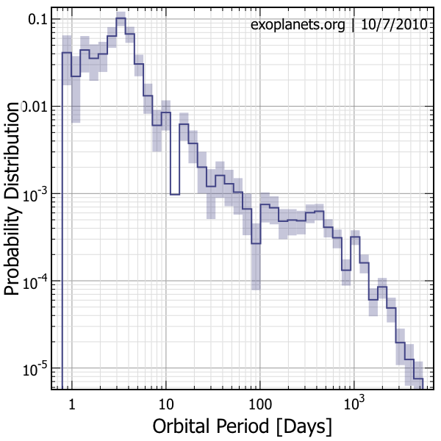
White spot in the exo-planets landscape
HU Aqr 22yrs
DP Leo 28yrs

Slide 9
M7 (+1) – ‚HRD‘
Do Magnetars, AXPs, XDINs, RRATs form an evolutionary sequence?
Will we find isolated NS/BH accreting from the ISM?

Slide 10
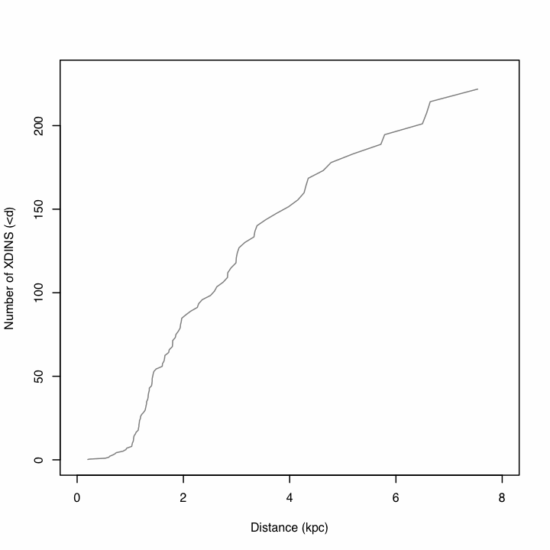
M7– eROSITA forecast A. Pires
Population synthesis
birth rate
Progenitor spatial distribution
kick velocity at birth
cooling/temperature
Aeff
survey exposure
detection limit (100 photons)
10² objects conservative 10³ optimistic
Need deep optical imaging, huge F_{x}/F_{opt}~10⁴

Slide 11
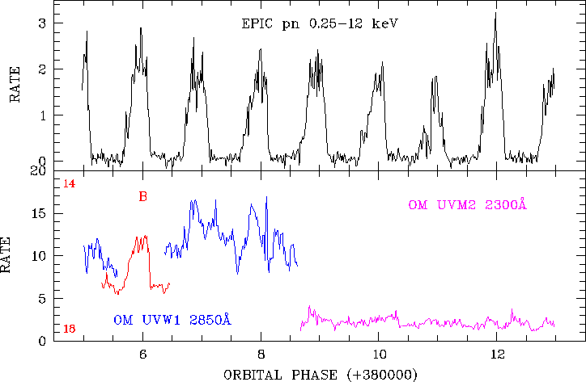
Synergies with other WGs
Time domain astrophysics

Slide 12
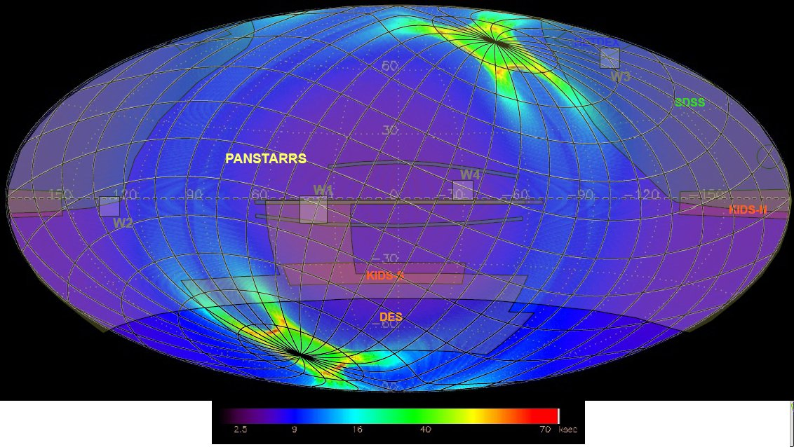
Some XRB in LMC fall into the area of higher exposure (>40 ksec)
Exposure map from M. Fürmetz and P. Friedrich, 2010
From Liu+ catalog (trunc.)
Name | Type
LMC X-4 | HMXB, pulsar
LMC X-1 | HMXB, BHC
CAL E | HMXB, Pulsar, Transient
LMC X-3 | HMXB, BHC
J0544.1-7199 | HMXB, Transient, Pulsar
J0544-665 | HMXB
J0538-66 | HMXB, Pulsar, Transient
J0535.0-67.00 | HMXB, Transient
J0532.7-6926 | LMXB
LMC X-2 | LMXB, Z-source
J0748-676 | LMXB, Burster, Dipper
CAL E
For these sources multiple
observations are expected
during the survey phase,
allowing to study long-term
variability/duty-cycles etc.

Slide 13
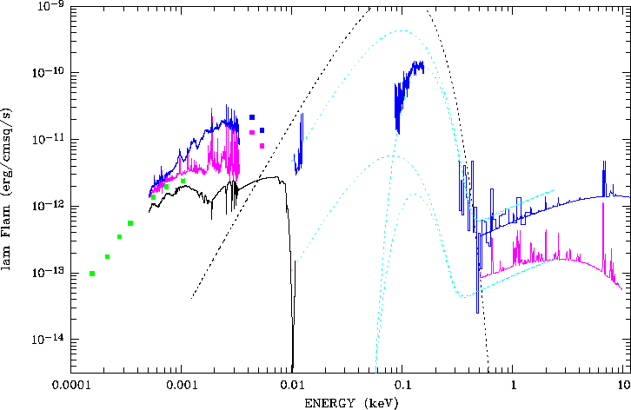
Synergies with other WGs
Multiwavelength

Slide 14
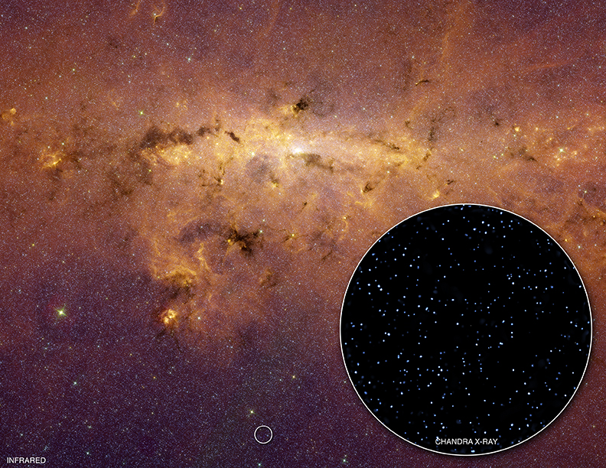
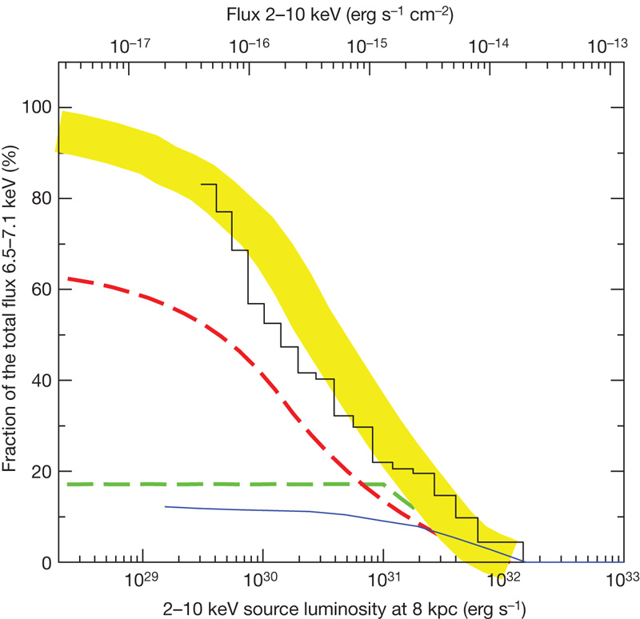
Synergies with other WGs Stars & compact sources → GRXE (Galaxies) Revnivtsev et al. 2009, Nature

Slide 15
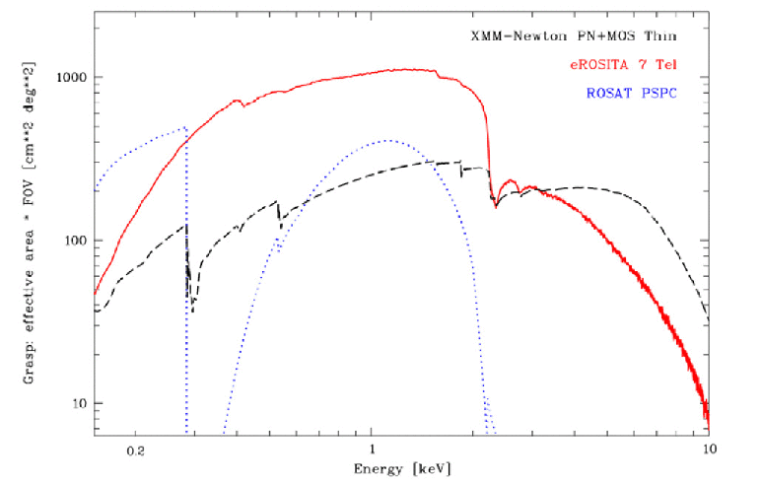
Observations of XRBs: Pointed phase
study of thermal emission during Type-I X-ray bursts in LMXBs → mass/radius of neutron stars → EoS
study of the black-body component in accreting pulsars (time-/pulse-phase resolved) → emission from the magnetospheric boundary / from the heated NS surface
high-time-resolved spectral studies of SFXTs (fast growing population of HMXBs)
spectral study of accretion discs in BHCs → GR effects, BH spins

Slide 16
Object classes – who takes care some proposals
CVs | ADS, IT, VB
Novae | FWH, WNP
LMXBs | ASa, SP, LD
HMXBs (incl Be) | DK, IK, LD, ASa, FWH
BHCs | JW, WNP
WDs | KW(?), VB, ADS
NS (Pulsars, XDINS, CCOs, Magnetars/AXPs, PWN) | WB, FWH, MS, GP, Asa, VD, AP, ADS, Tobias Prinz
ULXs → galaxies Pops of compact objects in MCs, M31... | WG galaxies? MS
SN Predehl 2015 | PP et al.
CVs | ADS
Novae | MPE?
LMXBs | ASa
HMXBs (incl Be) | DK
BHCs | JW
WDs | KW
NS (XDINS, CCOs, Magnetars, AXPs) | AIP, KC, MPE
ULXs and pops of compact objects in MCs, M31... | WG galaxies? tbd
Others

