Slide 1
1/31
eSASS: interactive analysis &
pipeline processing
Data proessing pipeline
Data products
Calibration database
Processing status & data access
Working with eSASS
Downloading & documentation
Activities till launch
H. Brunner eSASS: interactive analysis and pipeline processing Oct. 24th, 2018

Slide 2
2/31
Data flow: operations to
data processing
to data access
data access tool
(DATool)
sky explorer
(eRose)
eROSITA instrument team
raw archive
products archive
processing status viewer
IKI Ground Segment
Preprocessor
eSASS pipeline
Mission Planning
notify PI
H. Brunner eSASS: interactive analysis and pipeline processing Oct. 24th, 2018

Slide 3
3/31
Preprocessor (Bamberg):
TM archive
manual
raw archive
eSASS pipeline
display results
(browser)
TM2FITS
merge/sort/split
archiving
TM spec
specs
staging
NRTA/health
limits
alerts
next talk by Sebatian Falkner
H. Brunner eSASS: interactive analysis and pipeline processing Oct. 24th, 2018

Slide 4
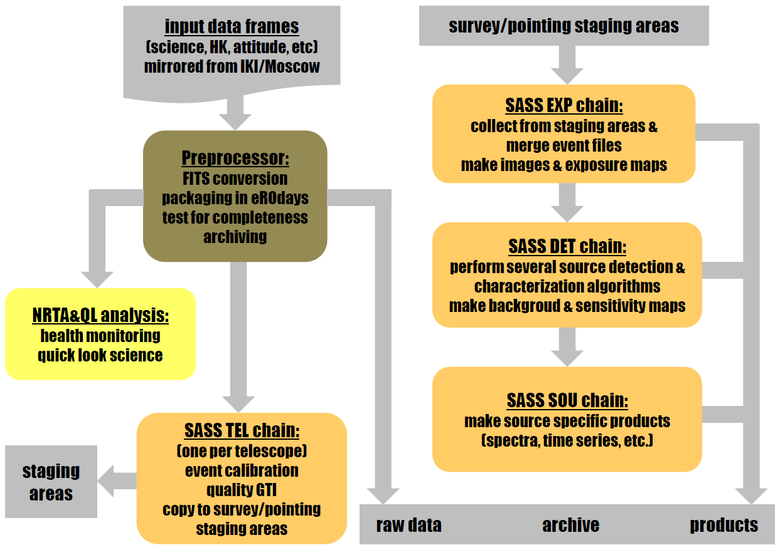
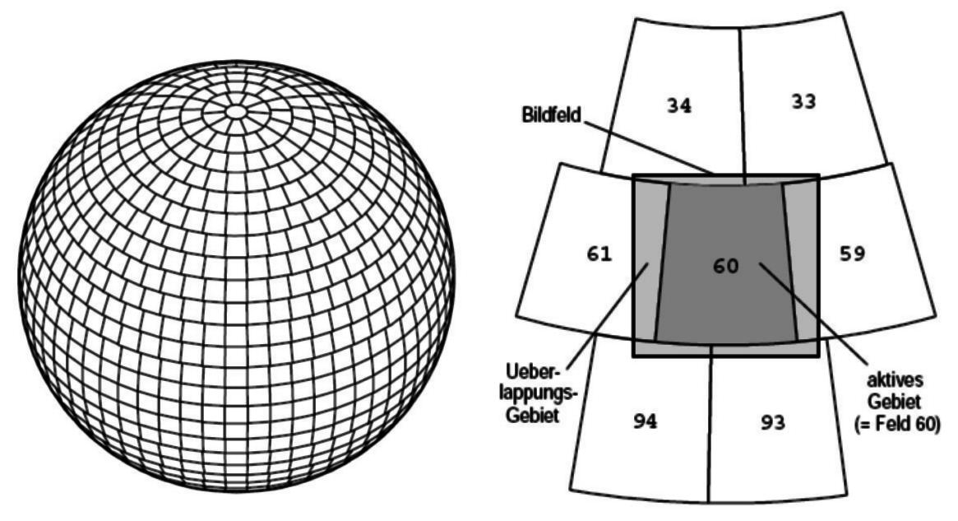
Pipeline processing
4/31
EROPIPE
triggers pipeline chains, updates pipeline status,
load balancing
H. Brunner eSASS: interactive analysis and pipeline processing Oct. 24th, 2018

Slide 5
5/31
EROPIPE
Hermann Brunner
FLAREGTI
Jeremy Sanders
pipeline
PROC
EXPMAP
Hermann Brunner
interactive
PREXEC
EVTOOL
Chr. Großberger
both
TMSPLIT
Ingo Kreykenbohm
Sebastian Falkner
ERMASK
Georg Lamer
(shapelet PSF:
A. Georgakakis)
discussion/
design stage
PREPROC
ERBACKMAP
EVPREP
Michael Freyberg
ERSENSMAP
EXPOSURE
ERBOX
BACKGRND
ERMLDET
FTFINDHOTPIX
Ingo Kreykenbohm
APETOOL
A. Georgakakis
PATTERN
Konrad Dennerl
CATPREP
Chr. Großberger
ENERGY
SRCTOOL
J. Sanders
QUALGTI
Ingo Kreykenbohm
SPECFIT
Thomas Bolller
(DPVALP with
Michael Freyberg)
ATTPREP
Georg Lamer
VARICHCK
TELATT
DPVALP
EVATT
DPVALV
TELGTI
DATOOL
Osterhage/Großb.
TELSELECT
eROSE
J. Sanders
TELSTAGE
Hermann Brunner
TIMECORR
Michael Freyberg
EXPMERGE
BARYCORR
Ingo Kreykenbohm
RADEC2XY
H. Brunner eSASS: interactive analysis and pipeline processing Oct. 24th, 2018
SRCTOOL

Slide 6
6/31
Pipeline control
EROPIPE
Pipeline control program: initiates processing of task chains, prepares chain parameter files, updates and reads processing status files
TEL
S/P/C EXP
S/P DET
S/P SOU
PROC
PROC
PROC
PROC
PROC
PROC
PROC
PROC
PROC
PROC
PROC
PROC
PROC
PROC
PROC
PROC
PROC
PREXEC PROC
PREXEC PROC
PREXEC PROC
PREXEC PROC
200+ processing chains are executes concurrently on eROSITA servers, several pipeline configurations (and eSASS releases) may be be active in parallel
H. Brunner eSASS: interactive analysis and pipeline processing Oct. 24th, 2018

Slide 7
6/31
Pipeline control
EROPIPE
Pipeline control program: initiates processing of task chains, prepares chain parameter files, updates and reads processing status files
2016
2018…
TEL
S/P/C EXP
S/P DET
S/P SOU
33 TB
33 TB
60 TB
60 TB
60 TB
60 TB
PROC
PROC
PROC
PROC
PROC
PROC
PROC
PROC
PROC
PROC
PROC
10 Gbit
PROC
PROC
PROC
PROC
PROC
PROC
PREXEC PROC
PREXEC PROC
PREXEC PROC
PREXEC PROC
ds53
40 cores
dsxx
64 cores
dsxx
64 cores
+ 12 x 8 core
200+ processing chains are executes concurrently on eROSITA servers, several pipeline configurations (and eSASS releases) may be be active in parallel
2016
2018…
H. Brunner eSASS: interactive analysis and pipeline processing Oct. 24th, 2018

Slide 8
7/31
Processing status files
active:
TEL_<eROday>_t_ccc
START_TEL_<eROday>_t_ccc
ERROR_TEL_<eROday>_t_ccc
done:
TEL_<eROday>_t_ccc
Four types of status files, indicating that
Data are ready for processing
A dataset is currently being processed
A chain ended with an error condition
A dataset was successfully processed
15´ off-axis
30´off-axis
eROday: four hour intervals
counted from start of mission.
One eROday corresponds to
approx. one full survey scan.
active:
EXP_<eROday_last>_<eROday_first>_nnnnnn_ccc
START_ EXP_<eROday_last>_<eROday_first>_nnnnnn_ccc
ERROR_ EXP_<eROday_last>_<eROday_first>_nnnnnn_ccc
done:
EXP_<eROday_last>_<eROday_first>_nnnnnn_ccc
1 keV
Camera day: data
From one camera
of one eROday
active:
DET_<eROday_last>_<eROday_first>_nnnnnn_ccc
START_ DET_<eROday_last>_<eROday_first>_nnnnnn_ccc
ERROR_ DET_<eROday_last>_<eROday_first>_nnnnnn_ccc
done:
DET_<eROday_last>_<eROday_first>_nnnnnn_ccc
4 keV
active:
SOU_<eROday_last>_<eROday_first>_nnnnnn_ccc
START_ SOU_<eROday_last>_<eROday_first>_nnnnnn_ccc
ERROR_ SOU_<eROday_last>_<eROday_first>_nnnnnn_ccc
done:
SOU_<eROday_last>_<eROday_first>_nnnnnn_ccc
H. Brunner eSASS: interactive analysis and pipeline processing Oct. 24th, 2018

Slide 9
8/31
Running the processing, load averaging,
triggering processing chains
ERO_ARCHIVE
CONFIG
PARFILES
DS53
DSxx
DSxx
LOG
five load classes, each chain configuration is assigned
to a load class
maximum permitted load average for each load class can be
set for each machine
a chain (or a task inside a chain) is started if the load average of
the machine is below its permitted maximum
H. Brunner eSASS: interactive analysis and pipeline processing Oct. 24th, 2018

Slide 10
9/31
Eight types of processing chains:
TEL, SEXP, PEXP, CEXP, SDET, PDET, SSOU, PSOU
H. Brunner eSASS: interactive analysis and pipeline processing Oct. 24th, 2018

Slide 11
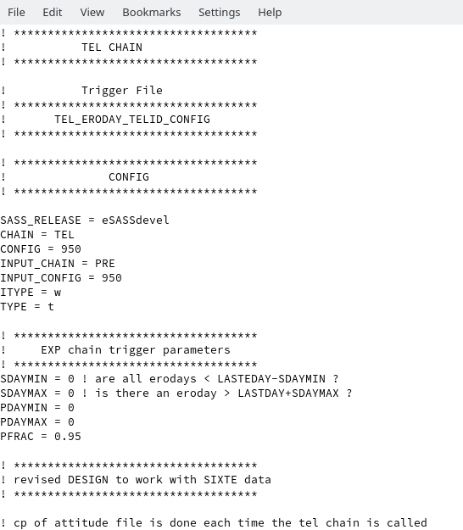
9/31
Eight types of processing chains:
TEL, SEXP, PEXP, CEXP, SDET, PDET, SSOU, PSOU
H. Brunner eSASS: interactive analysis and pipeline processing Oct. 24th, 2018

Slide 12
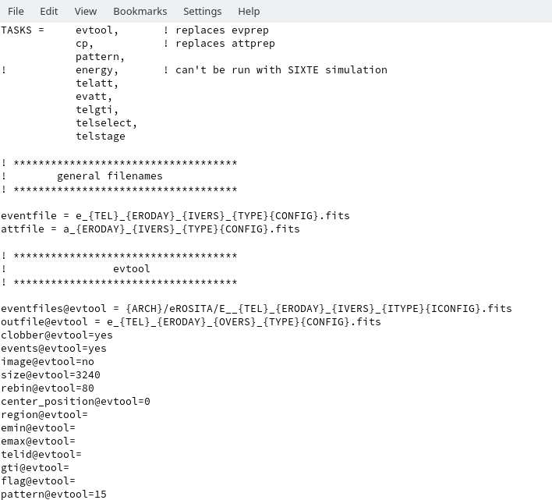
9/31
Eight types of processing chains:
TEL, SEXP, PEXP, CEXP, SDET, PDET, SSOU, PSOU
H. Brunner eSASS: interactive analysis and pipeline processing Oct. 24th, 2018

Slide 13
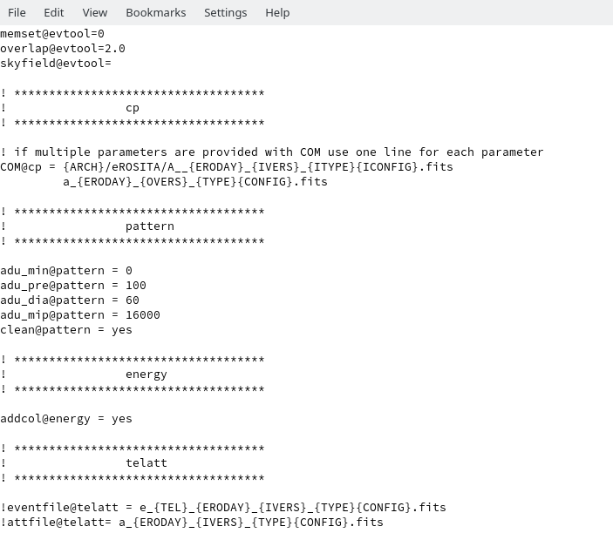
9/31
Eight types of processing chains:
TEL, SEXP, PEXP, CEXP, SDET, PDET, SSOU, PSOU
H. Brunner eSASS: interactive analysis and pipeline processing Oct. 24th, 2018

Slide 14
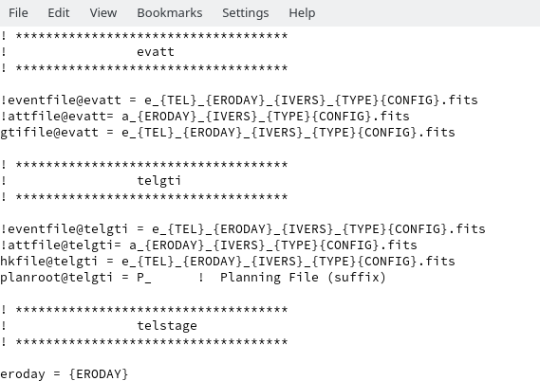
9/31
Eight types of processing chains:
TEL, SEXP, PEXP, CEXP, SDET, PDET, SSOU, PSOU
H. Brunner eSASS: interactive analysis and pipeline processing Oct. 24th, 2018

Slide 15
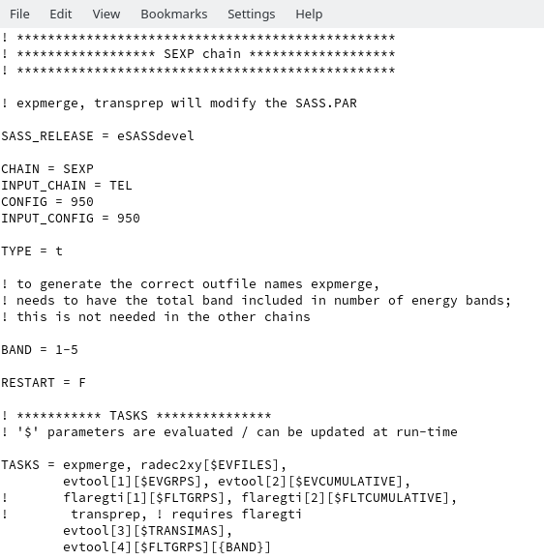
10/31
Eight types of processing chains:
TEL, SEXP, PEXP, CEXP, SDET, PDET, SSOU, PSOU
H. Brunner eSASS: interactive analysis and pipeline processing Oct. 24th, 2018

Slide 16
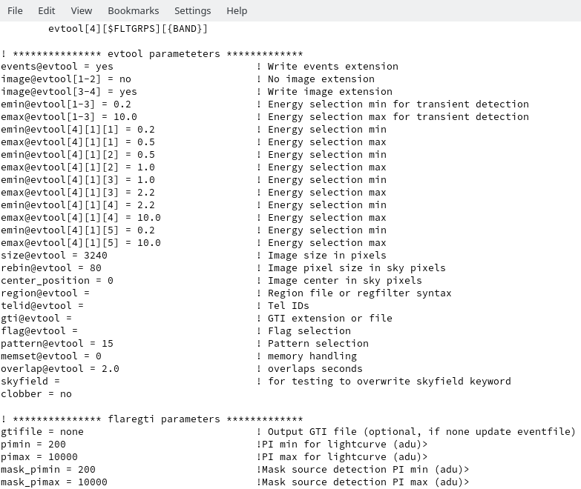
10/31
Eight types of processing chains:
TEL, SEXP, PEXP, CEXP, SDET, PDET, SSOU, PSOU
H. Brunner eSASS: interactive analysis and pipeline processing Oct. 24th, 2018

Slide 17
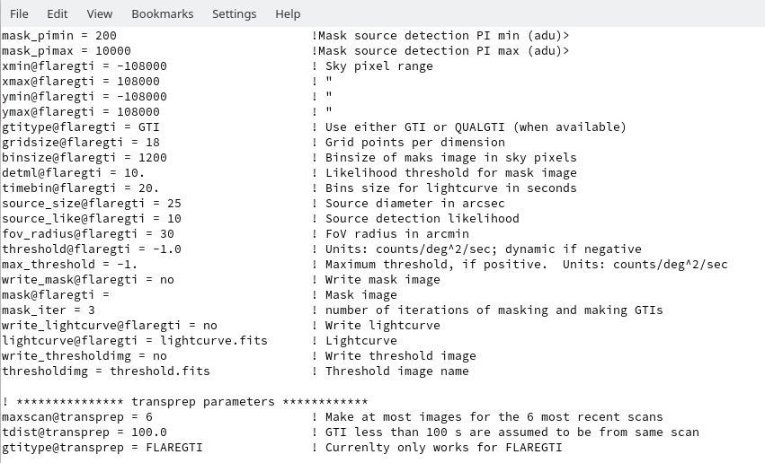
10/31
Eight types of processing chains:
TEL, SEXP, PEXP, CEXP, SDET, PDET, SSOU, PSOU
H. Brunner eSASS: interactive analysis and pipeline processing Oct. 24th, 2018

Slide 18
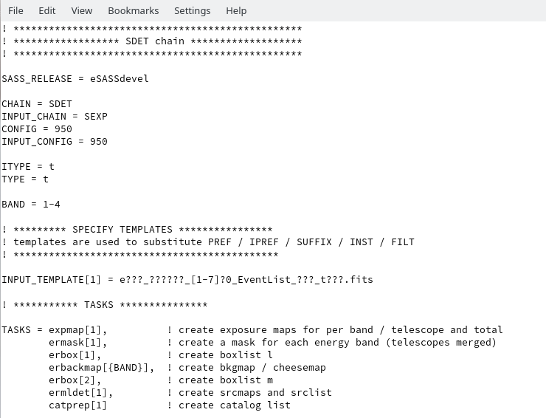
11/31
Eight types of processing chains:
TEL, SEXP, PEXP, CEXP, SDET, PDET, SSOU, PSOU
H. Brunner eSASS: interactive analysis and pipeline processing Oct. 24th, 2018

Slide 19
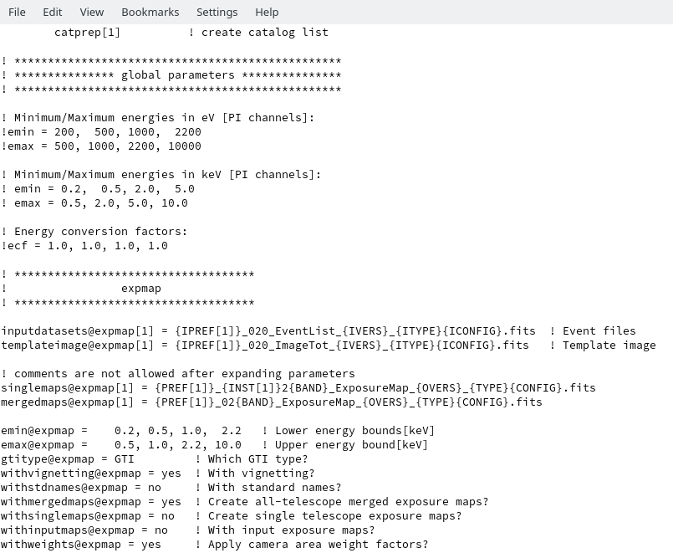
11/31
Eight types of processing chains:
TEL, SEXP, PEXP, CEXP, SDET, PDET, SSOU, PSOU
H. Brunner eSASS: interactive analysis and pipeline processing Oct. 24th, 2018

Slide 20
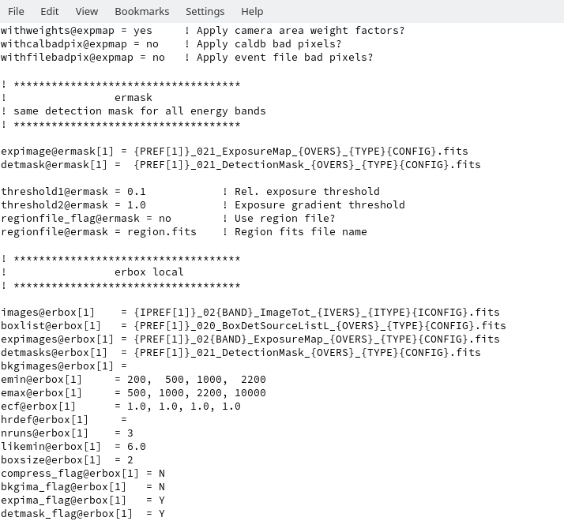
11/31
Eight types of processing chains:
TEL, SEXP, PEXP, CEXP, SDET, PDET, SSOU, PSOU
H. Brunner eSASS: interactive analysis and pipeline processing Oct. 24th, 2018

Slide 21
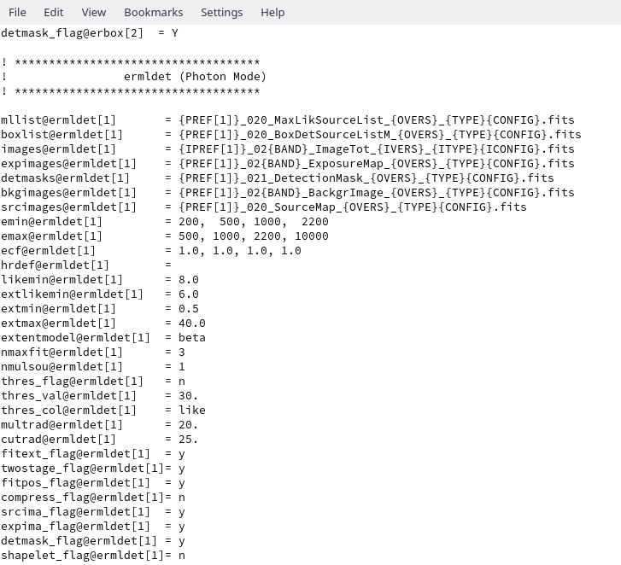
11/31
Eight types of processing chains:
TEL, SEXP, PEXP, CEXP, SDET, PDET, SSOU, PSOU
H. Brunner eSASS: interactive analysis and pipeline processing Oct. 24th, 2018

Slide 22
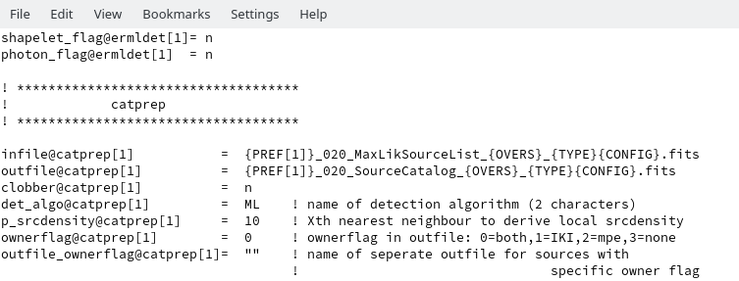
11/31
Eight types of processing chains:
TEL, SEXP, PEXP, CEXP, SDET, PDET, SSOU, PSOU
H. Brunner eSASS: interactive analysis and pipeline processing Oct. 24th, 2018

Slide 23
12/31
Archive and processing directory structure:
configuration & raw archive
Processing status files
config
Processing status files
Pipeline configuration
planning
Processing status files
Processing status files
Planning files
raw
Processing status files
binary
<eROday*>
Processing status files
Raw archive: binary
Processing status files
FITS
<eROday*>
Processing status files
Raw archive: FITS
Processing status files
proc
Processing status files
Processing status files
*eROday: four hour intervals
counted from start of mission.
One eROday corresponds to
approx. one full survey scan.
H. Brunner eSASS: interactive analysis and pipeline processing Oct. 24th, 2018

Slide 24
13/31
Directory structure: calibrated data products
products
calibrated
<eROday*>
TEL_ccc
stage_ccc
survey
proprietary
<skyField>
EXP_ccc
DET_CCC
SOU_ccc
public
<skyField>
EXP_ccc
DET_CCC
SOU_ccc
stage_ccc
pointing
proprietary
<PInumber>
EXP_ccc
DET_CCC
SOU_ccc
public
<obsID>
EXP_ccc
DET_CCC
SOU_ccc
stage_ccc
closed
CAL_ccc
ccc: pipeline configuration
H. Brunner eSASS: interactive analysis and pipeline processing Oct. 24th, 2018

Slide 25
14/31
Archive structure: status files
proc
calibrated
Processing status files
Processing status files
Processing status files
survey
Processing status files
Processing status files
Processing status files
Processing status files
pointing
Processing status files
Processing status files
H. Brunner eSASS: interactive analysis and pipeline processing Oct. 24th, 2018

Slide 26
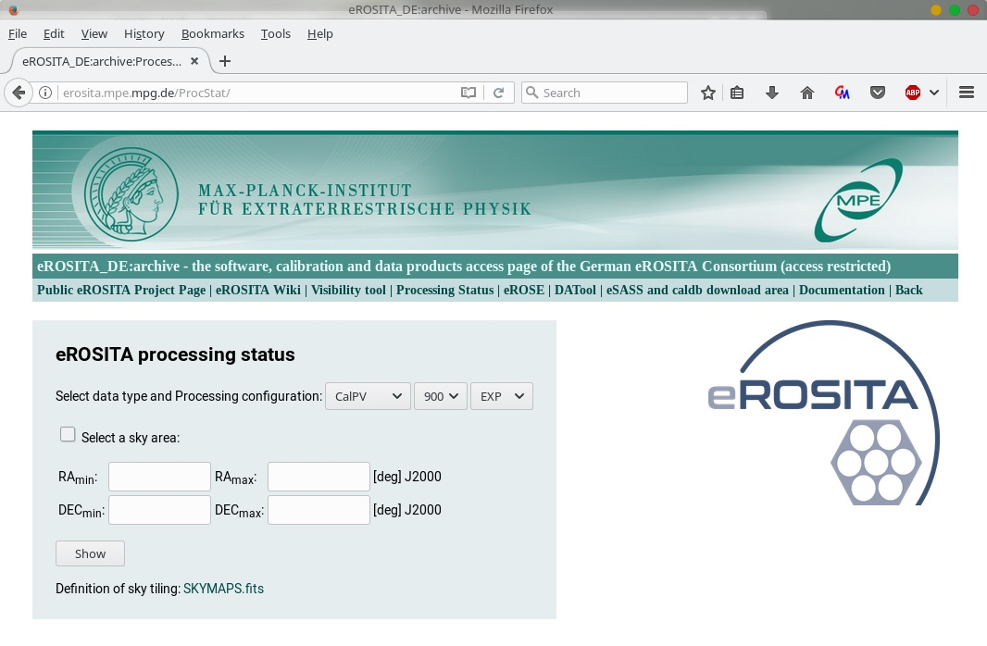
15/31
Processing status viewer:
H. Brunner eSASS: interactive analysis and pipeline processing Oct. 24th, 2018

Slide 27
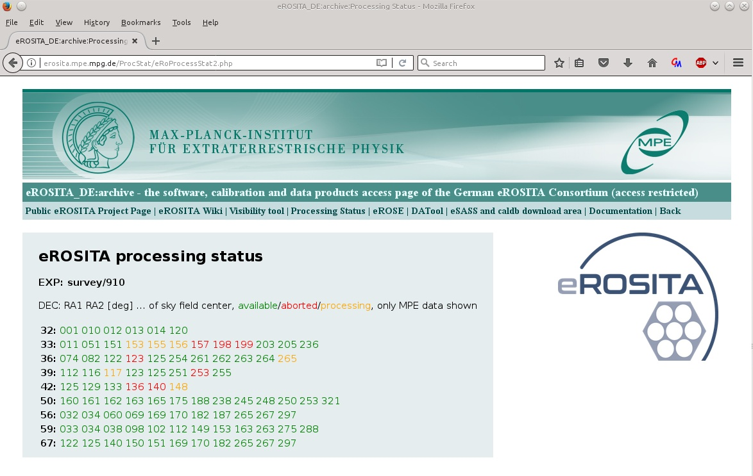
16/31
H. Brunner eSASS: interactive analysis and pipeline processing Oct. 24th, 2018

Slide 28
17/31
Pipeline data products
Calibrated event file
EVENTS
GTIn
QUALGTIn
FLAREGTI
BADPIXn
em01_002090_110_EventFile_001_r003.fits
em01_002090_810_EventFile_001_r003.fits
em01_002090_010_EventFile_001_r003.fits
sm02_002090_110_EventFile_001_r003.fits
em01_002090_810_ScreenedEvents_001_r003.fits
…
pc00_700001_110_EventFile_001_r003.fits
DEADCORn
CORRATTn
HKn
H. Brunner eSASS: interactive analysis and pipeline processing Oct. 24th, 2018

Slide 29
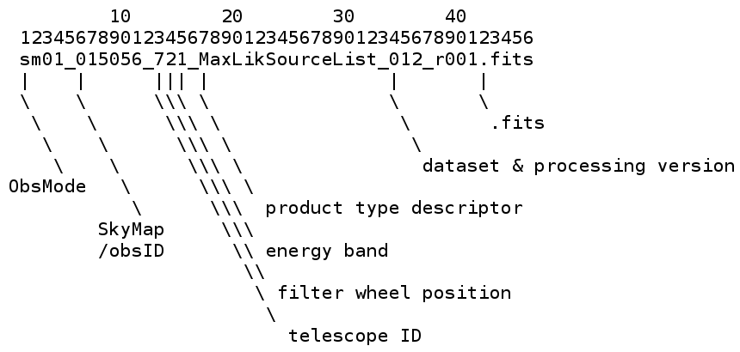
17/31
Pipeline data products
Calibrated event file
EVENTS
GTIn
QUALGTIn
FLAREGTI
BADPIXn
em01_002090_110_EventFile_001_i003.fits
em01_002090_810_EventFile_001_r003.fits
em01_002090_010_EventFile_001_r003.fits
sm02_002090_110_EventFile_001_r003.fits
em01_002090_810_ScreenedEvents_001_r003.fits
…
pc00_700001_110_EventFile_001_r003.fits
DEADCORn
CORRATTn
HKn
H. Brunner eSASS: interactive analysis and pipeline processing Oct. 24th, 2018

Slide 30
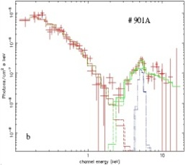
18/31
Images, exposure, background, sensitivity, source maps,
six (?) energy bands, per telescope group, with filter/open,
per eRASS & cumulative (810 images per field, 3.8e6 all sky)
em01_002090_811_Image_001_r003.fits
…
em01_002090_816_Image_001_r003.fits
spectra and lightcurves of detected objects
sm02_002090_010_SourceSpec_00001_001_r003.fits
…
sm02_002090_010_LightCurve_00001_001_r003.fits
H. Brunner eSASS: interactive analysis and pipeline processing Oct. 24th, 2018

Slide 31
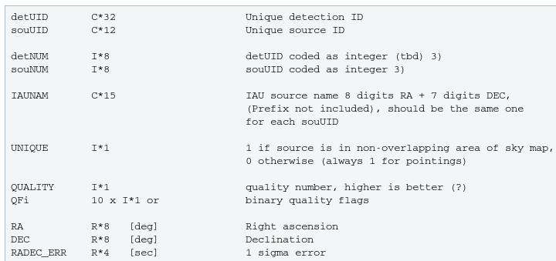
19/31
Source catalogs
sm08_002090_000_SourceCatalog_001_r001.fits
H. Brunner eSASS: interactive analysis and pipeline processing Oct. 24th, 2018

Slide 32
20/31
Data ownership / access control
MPE/IKI ownership is tacked by:
Data products header keywords
Per event via event flags
Per source via source catalog column
H. Brunner eSASS: interactive analysis and pipeline processing Oct. 24th, 2018

Slide 33
20/31
Data ownership / access control
MPE/IKI ownership is tacked by:
Data products header keywords
Per event via event flags
Per source via source catalog column
Data access control:
Full archive access is limited to pipeline,
calibration, and hardware teams
Access of authorised user via Web interface
H. Brunner eSASS: interactive analysis and pipeline processing Oct. 24th, 2018

Slide 34
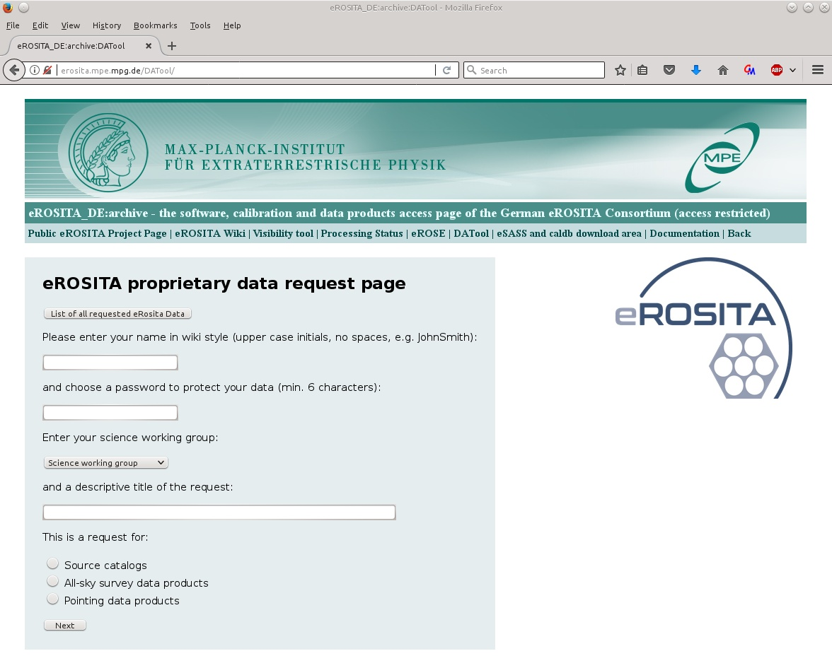
21/31
Data access tool:
H. Brunner eSASS: interactive analysis and pipeline processing Oct. 24th, 2018

Slide 35
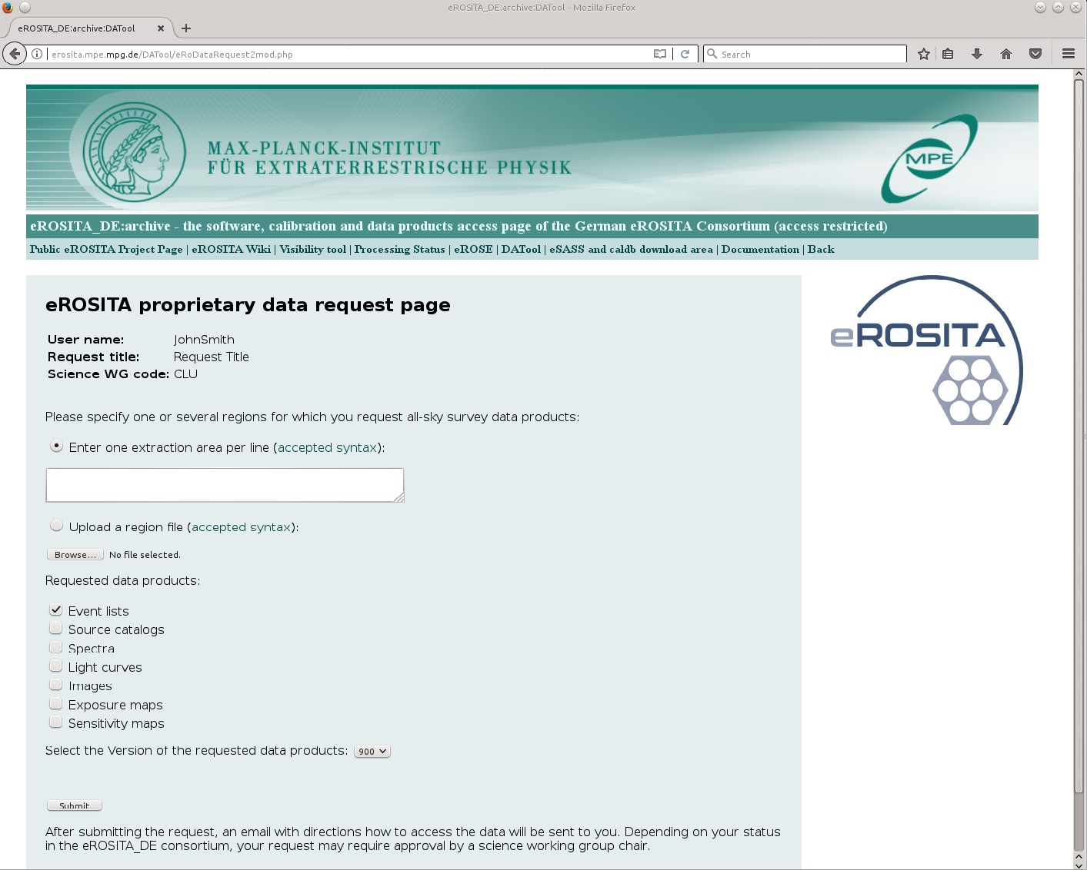
21/31
H. Brunner eSASS: interactive analysis and pipeline processing Oct. 24th, 2018

Slide 36
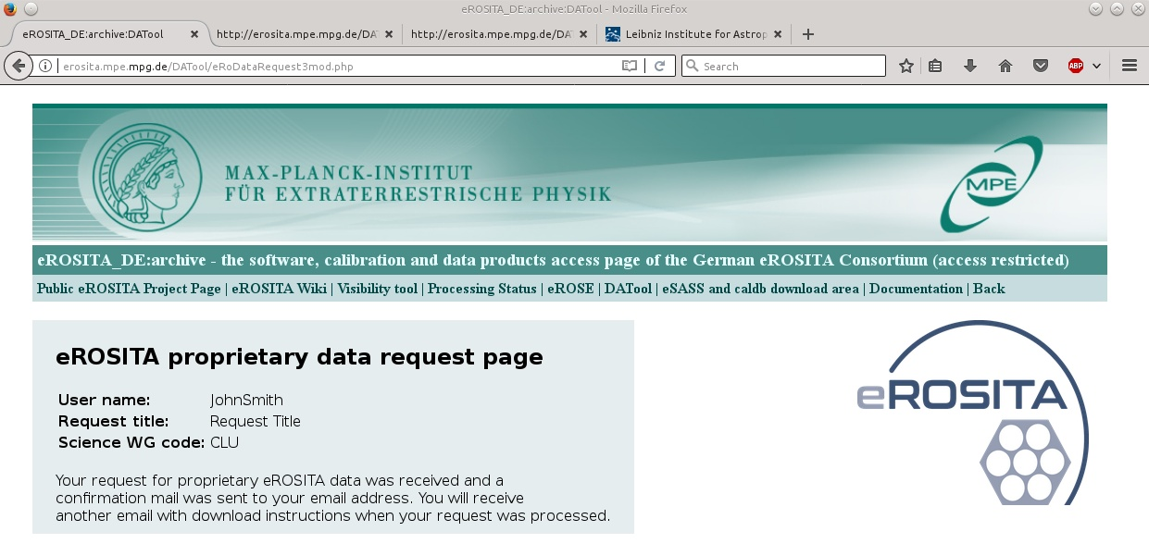
21/31
H. Brunner eSASS: interactive analysis and pipeline processing Oct. 24th, 2018

Slide 37
22/31
eRoSITA calibration databas (caldb)
caldb (HEASARC standard) calibration database with additional indexing scheme to support different calibration versions for each eSASS release
Telescopes
2DPSF (P/S)
ERBOX
ERMLDET
SLET_PSF
ERMLDET
APETOOL
ERSENSMAP
TVIGNET
EXPMAP
SRCTOOL
Detectors
ENERGY
ENERGY
BADPIX
FTFINDHOTPIX
PATTERN
EXPMAP
SRCTOOL
OFFSETS
EVPREP
MIPSMAP
EXPOSURE
EXPMAP
Cal file type
eSASS task
H. Brunner eSASS: interactive analysis and pipeline processing Oct. 24th, 2018

Slide 38
23/31
Spectra
RMF (STD/FINE)
SRCTOOL
ARF (STD/FINE)
SRCTOOL
Timing
TIMECORR
EVPREP
ATTPREP
TIMECORR
Spatial
FOVMAP
EXPMAP
SRCTOOL
BACKGRND
DETMAP
EXPMAP
SRCTOOL
BACKGRND
Attitude
SED1/2
BOKZ
GYRO
ATTPREP
General
INSTPAR
TELATT
EVATT
Cal file type
eSASS task
H. Brunner eSASS: interactive analysis and pipeline processing Oct. 24th, 2018

Slide 39
24/31
Working with eSASS:
eSASS releases
using eSASS
eSASS releases
using eSASS
Interactive analysis
Interactive analysis
Installing and working with eSASS:
https://wiki.mpe.mpg.de/eRosita/eSASS
eSASS info pages (interactive + pipeline):
http://erosita.mpe.mpg.de/eROdoc
eSASS download area (follow instructions in wiki):
http://erosita.mpe.mpg.de/eSASS-download/
EVTOOL
SRCTOOL
FLAREGTI
EXPMAP
ERBACKMAP
ERMASK
ERSENSMAP
ERBOX
ERMLDET
FOOLS like command line tools, OGIP complient
FITS files, caldb (Heasarc) calibration database
APETOOLL
CATPREP
TIMECORR
BARYCORR
PATTERN
ENERGY
eSASSdevel
EVATT
RADEC2XY
eSASSusers_YYMMDD
eSASSpipe_YYMMDD
eSASSusers_180416 (patched)
eSASSpipe_181017
H. Brunner eSASS: interactive analysis and pipeline processing Oct. 24th, 2018

Slide 40
25/31
eSASS demo script
calibrated event list
(SIXTE)
EVTOOL
filtering,merging,
Image creation
exposure maps
EXPMAP
ERMASK
detection mask
ERBOX local
background maps
ERBACKMAP
source detection
ERBOX map
ERMLDET
sensitivity maps
ERSENSMAP
source catalogs
CATPREP
spectra, lightcurves, ARFs, RMFs
SRCTOOL
H. Brunner eSASS: interactive analysis and pipeline processing Oct. 24th, 2018

Slide 41
26/31
Selects by:
region file, GTI,
camera nr., energy,
pattern, event flags
event file 1
Image
event file 2
EVTOOL
…
event file
event file n
single or multi-camera event files
H. Brunner eSASS: interactive analysis and pipeline processing Oct. 24th, 2018

Slide 42
27/31
Selects by:
region file, GTI,
camera nr., energy,
pattern, event flags
spectrum 1
RMF1
ARF1
source list
spectrum 2
RMF2
ARF2
event file 1
…
…
…
event file 2
spectrum m
RMFm
ARFm
SRCTOOL
…
lightcurve 1
event list 1
event file n
lightcurve 2
event list 2
From CALDB:
RMFs, ARFs, PSFs, fovmaps, detmaps,
bad pixels, vignetting
…
…
lightcurve m
event list m
single or multi-camera
H. Brunner eSASS: interactive analysis and pipeline processing Oct. 24th, 2018

Slide 43
28/31
H. Brunner eSASS splinter session April 24th, 2018

Slide 44
28/31
H. Brunner eSASS splinter session April 24th, 2018

Slide 45
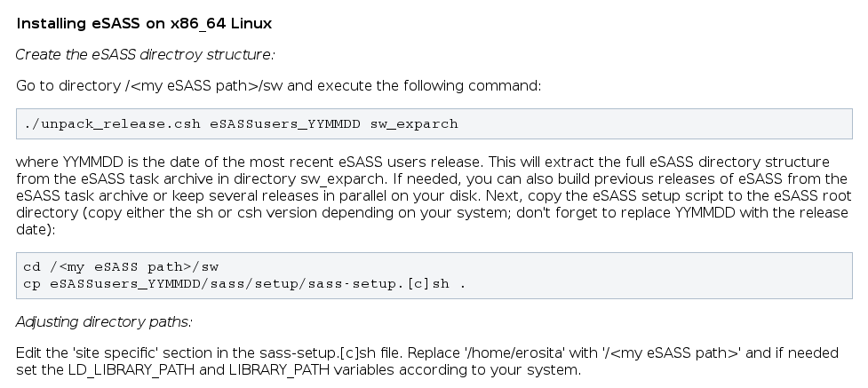
28/31
H. Brunner eSASS splinter session April 24th, 2018

Slide 46
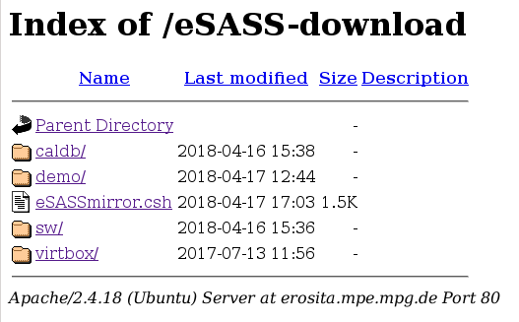
29/31
H. Brunner eSASS splinter session April 24th, 2018

Slide 47
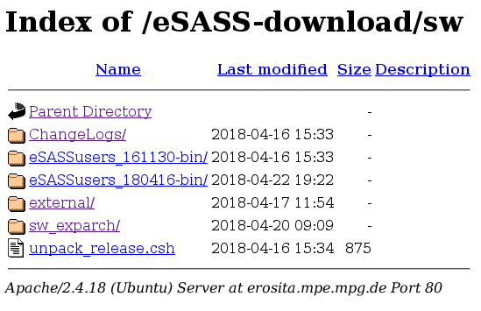
29/31
H. Brunner eSASS splinter session April 24th, 2018

Slide 48
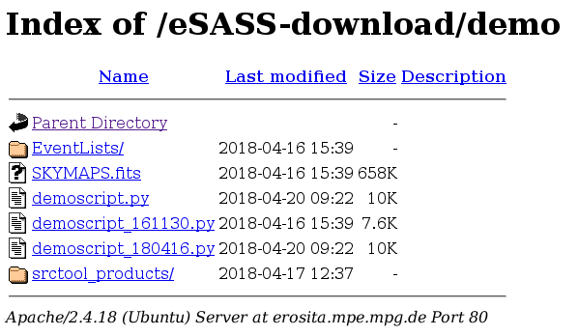
29/31
H. Brunner eSASS splinter session April 24th, 2018

Slide 49
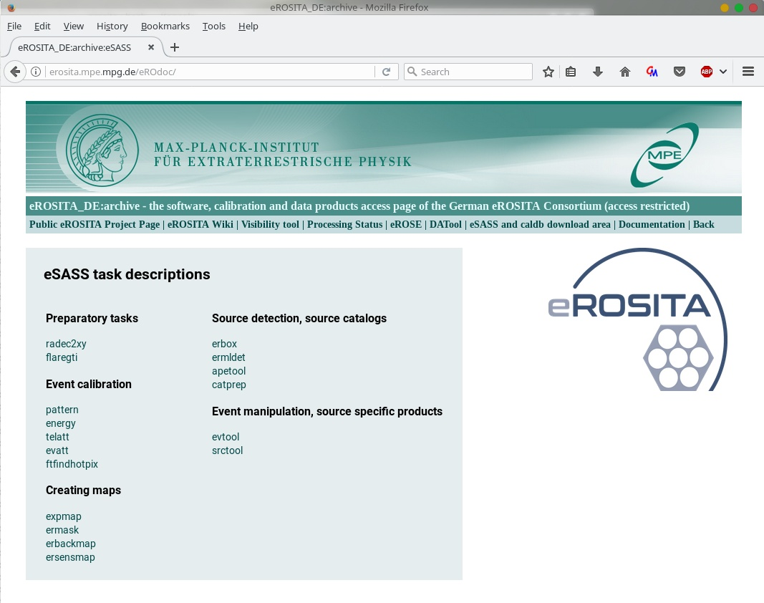
30/31
eSASS documentation
H. Brunner eSASS: interactive analysis and pipeline processing Oct. 24th, 2018

Slide 50
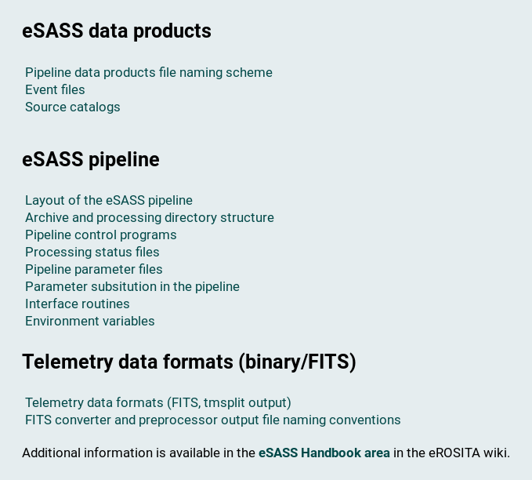
30/31
eSASS documentation
H. Brunner eSASS: interactive analysis and pipeline processing Oct. 24th, 2018

Slide 51
31/31
Activities till launch:
Update HK-data processing to final formats (EVPREP, QUALGTI, EVTOOL)
Updating pipeline chains to flight-like configuration
Pipeline testing (using fully built out eROSITA cluster):
Processing one year all-sky survey simulation (SIXTE/Bamberg)
Processing simulated CalPV observing program
Joint tests of preprocessor and eSASS pipeline
Testing catalog creation (CATPREP, tracking of source IDs, etc.)
Testing data access (DATOOL) with fully populated archive
eROSE: ingestion of eROSITA catalogs, limited function beta user release
Coding/testing: BARYCORR, TIMECORR, DPVAL, astrometric corrections
H. Brunner eSASS: interactive analysis and pipeline processing Oct. 24th, 2018

