Slide 1
Spectrum Röntgen Gamma
Science Ground Segment: current status
24-26.X.2018 MPE, Ringberg

Slide 2
Two main parts of the SGS.
Science Ground Segment (SGS)
Engineering
level
procedures
Science
level
procedures
Center of
Science
Operations
Center of
Science
Data

Slide 3
Interactions in the field of the science operations.
Science Ground Segment (SGS)
Ground Control Segment (GCS)
Mission Operation
Center
Center of
Science
Operations
Center of
Science
Data
Council
Chief Designer

Slide 4
Levels of the science telemetry processing
Center of Science Operations
Center of Science Data

Slide 5
Levels of the data access

Slide 6
TCP socket connection

Slide 7
Data related activities of organizations

Slide 8
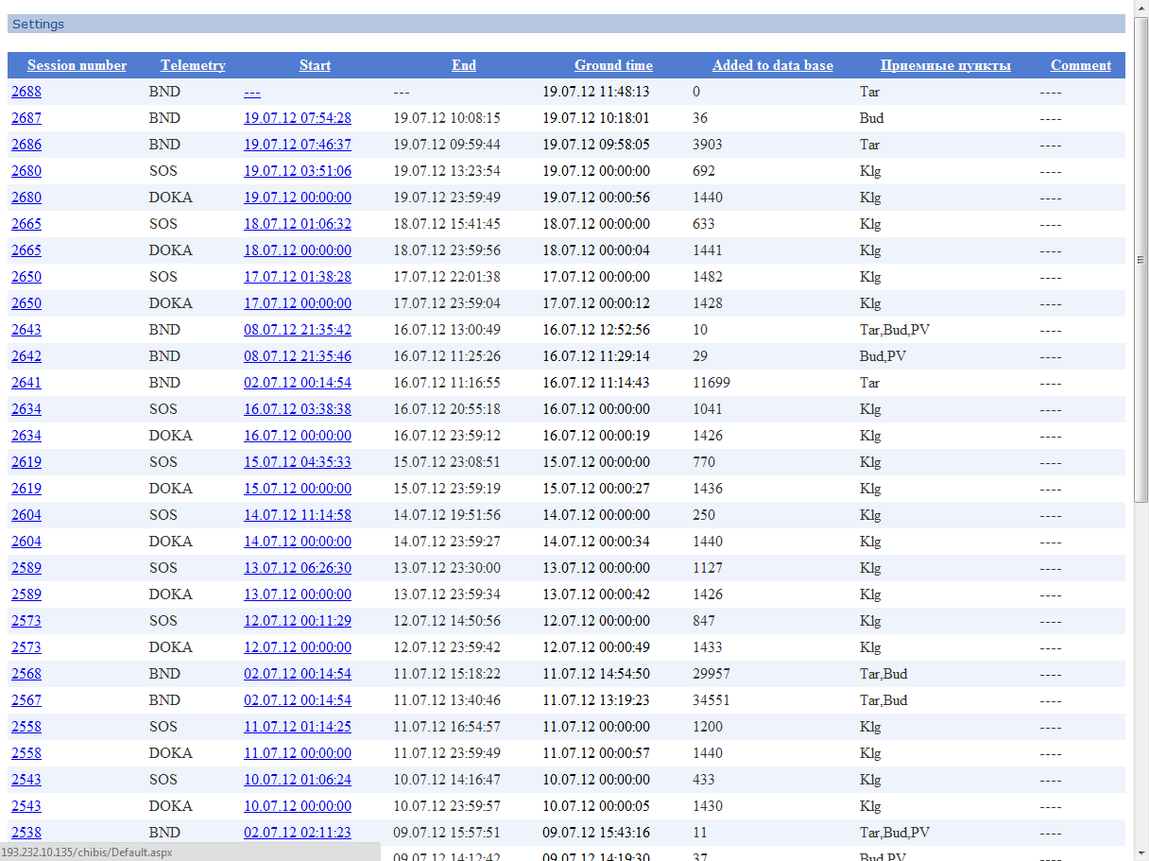
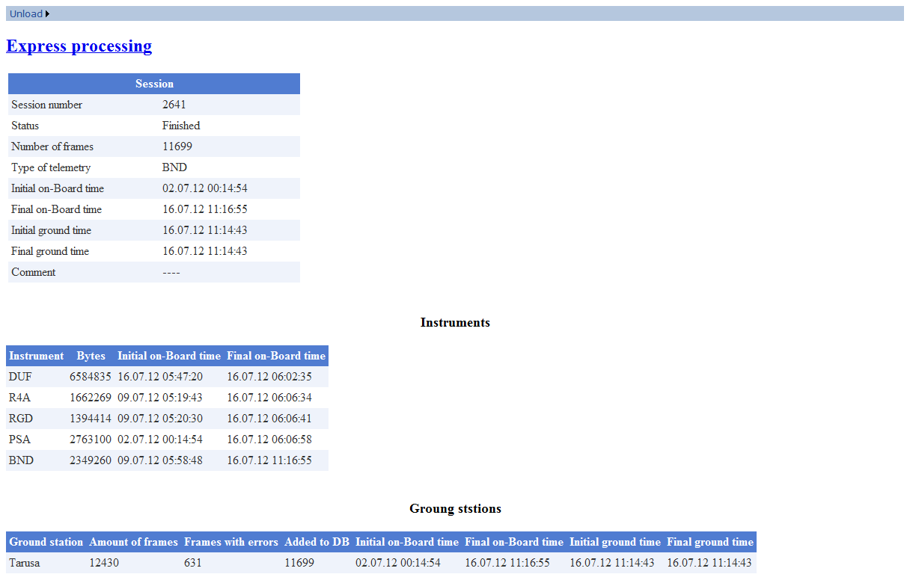
Telemetry dumping sessions

Slide 9
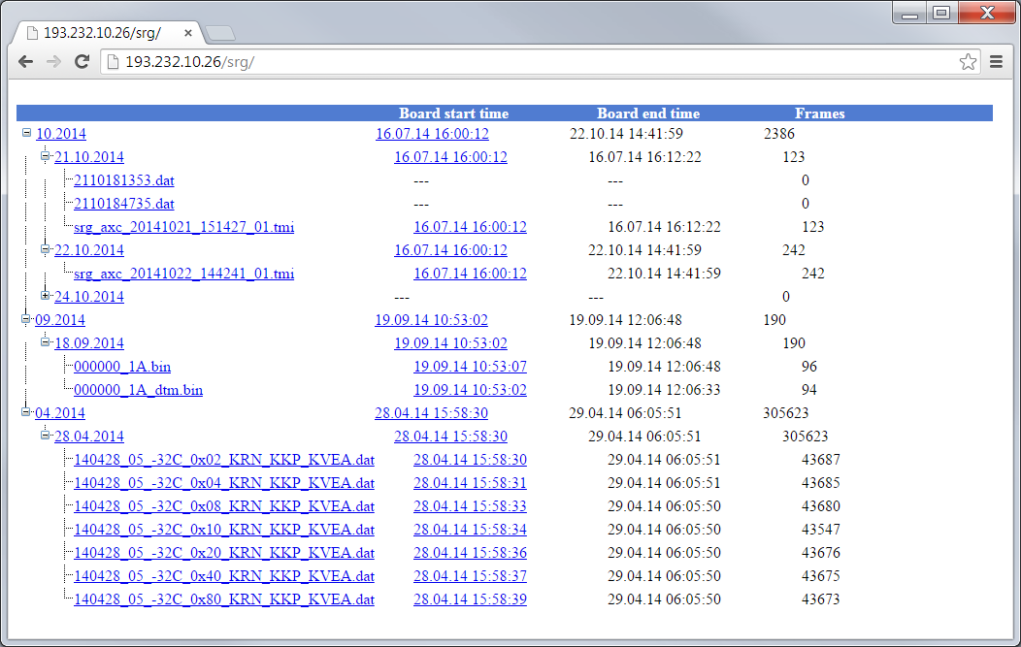
Upgrade for SRG

Slide 10
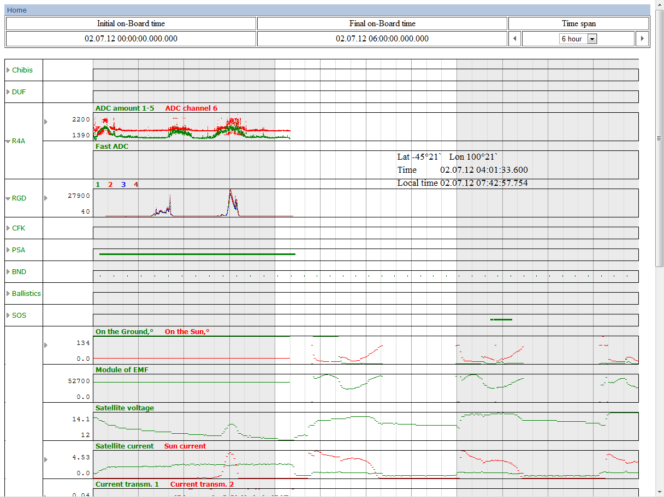
Express-processing visualization

Slide 11
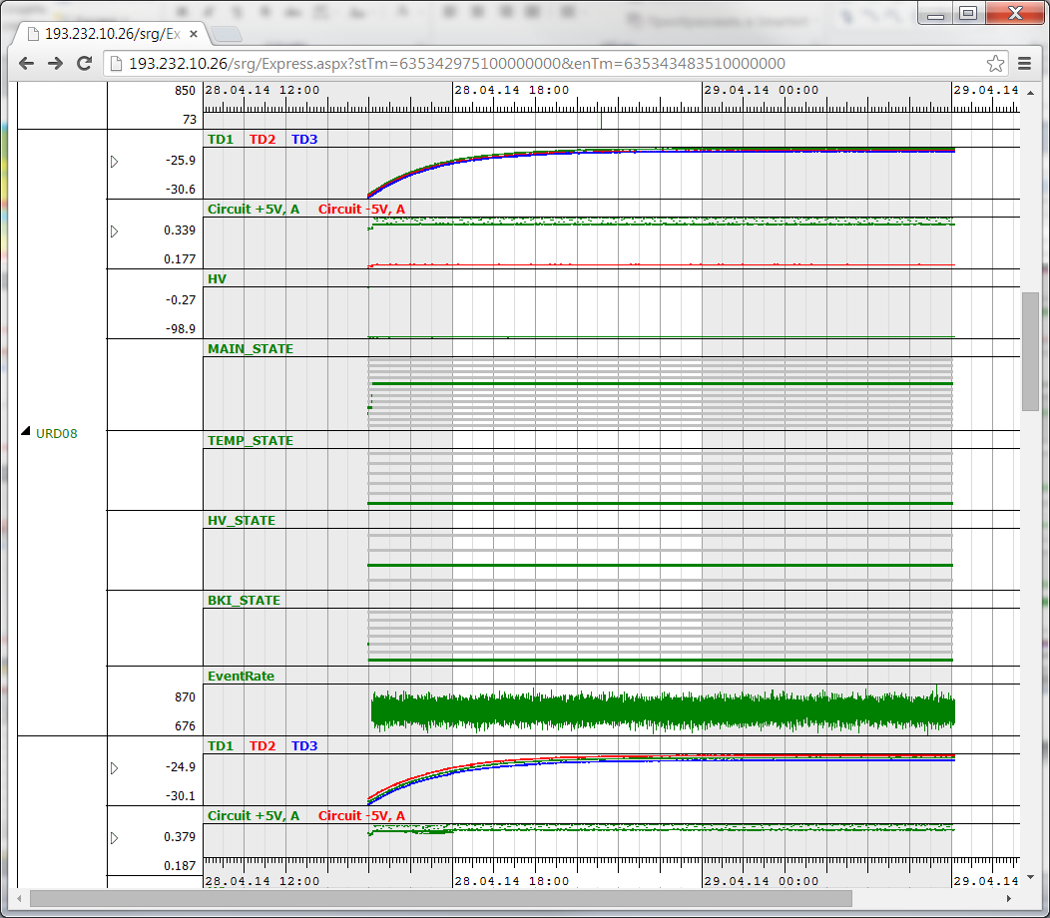

Slide 12
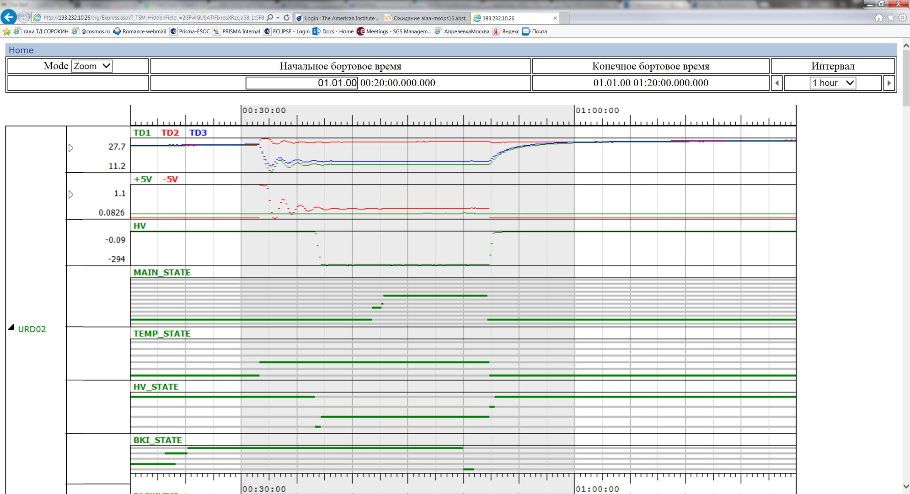

Slide 13
Center of Science Data
System of the quick data analysis (QDA)
System of the data processing and storing (DPS)
System of the users support (US)
Communication system (CS)
Center
Of Science
Operations
QDA
(ART-X)
US
DPS
CS
Ground observations,
catalogs
eROSITA
Data center

Slide 14
ART-XC pipeline
Data input flow (CofSO)
QLA
artpreproc
artpipeline
artproducts
artsrcdetect
Archive
L0
L2
L3

Slide 15
Main workflow of science operations.

Slide 16
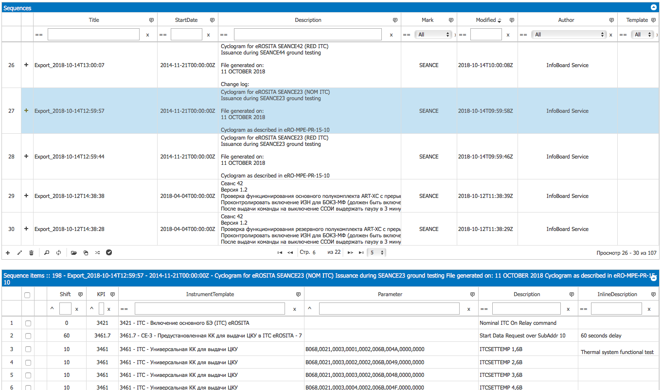
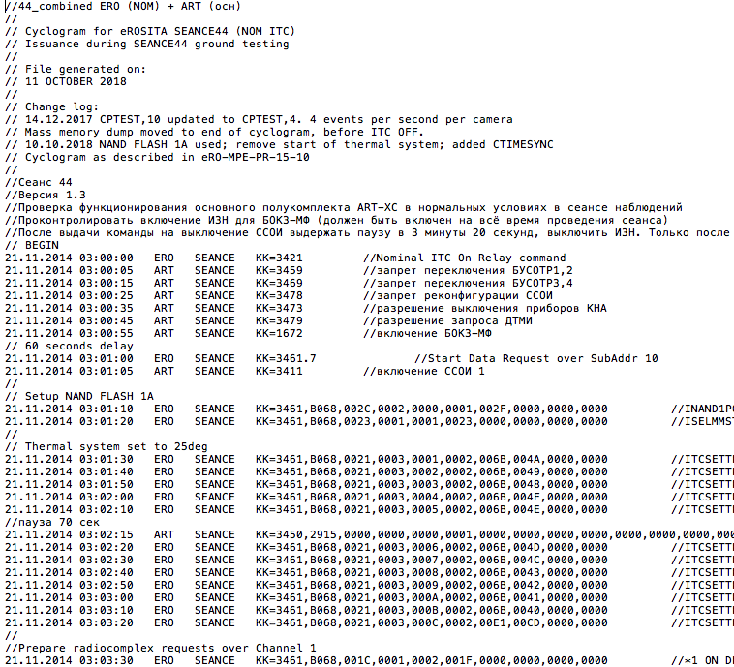
Example of short-term planning (1\2)

Slide 17
Example of short-term planning (2/2)

Slide 18
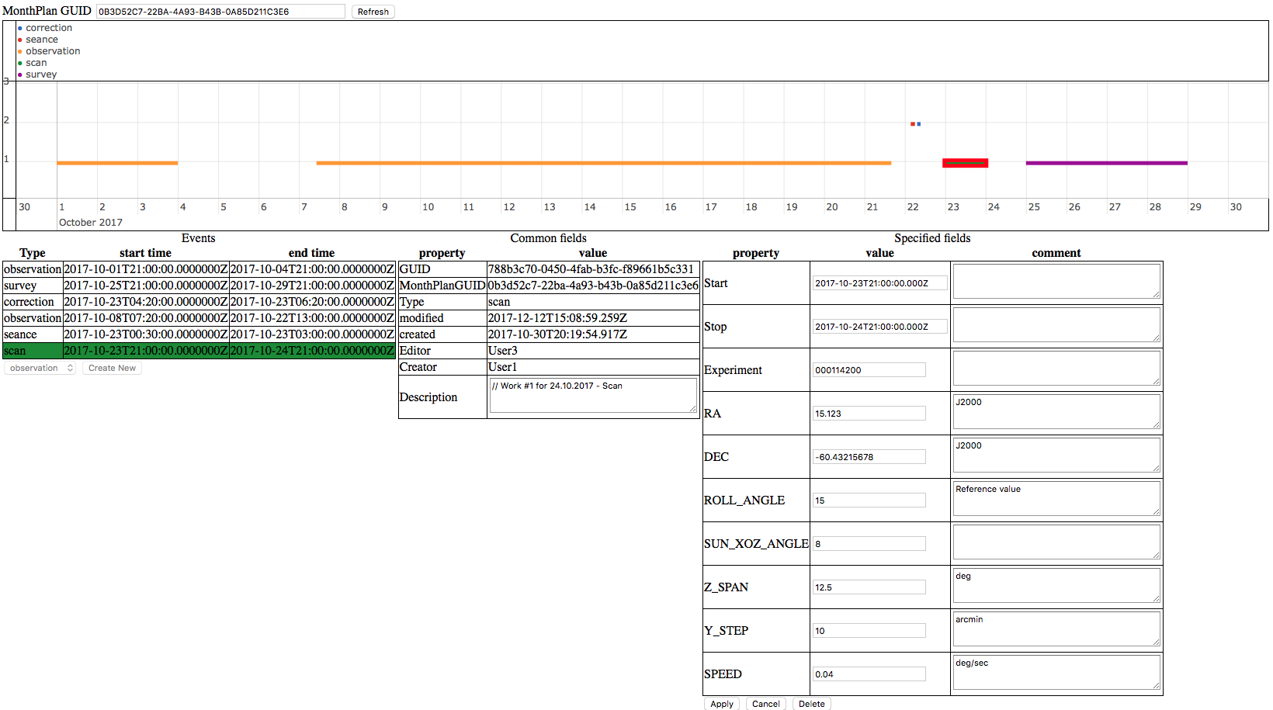
Example of the mid-term (1/2) planning (2/2)

Slide 19
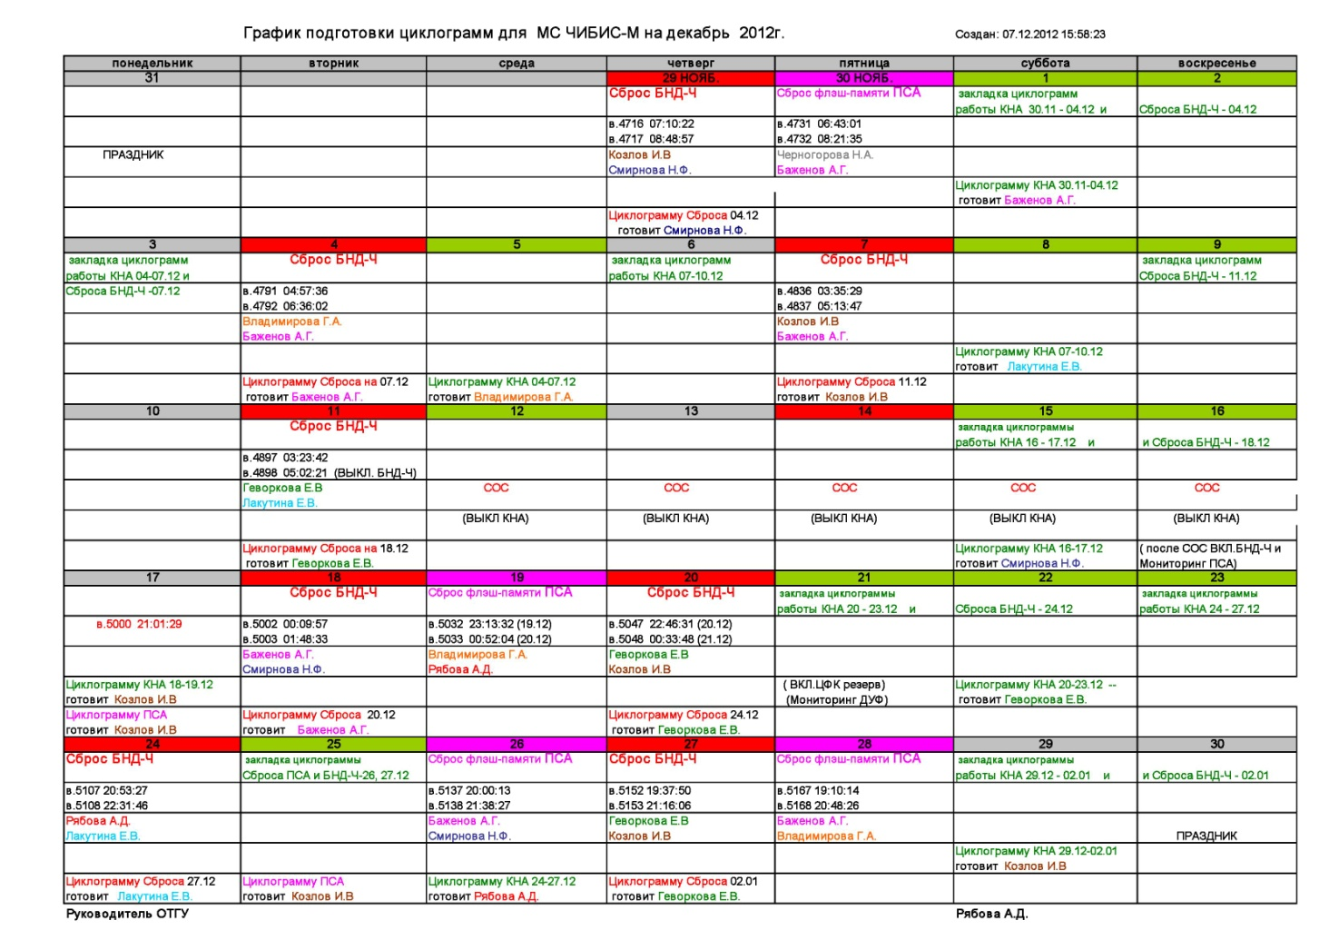
Example of the mid-term planning (2/2)

Slide 20
Interactions in the field of the science operations.
Science Ground Segment (SGS)
Mission Operation Center (MOC)
TsNIImash
MOC
Center of
Science
Operations
Center of
Science
Data
Sector
Chief Designer
Optical
Support
eROSITA
Data center(s)
Notes:
Переписать SOC итд

Slide 21
SGS status
Stages
Documentation | Procurements of means | Development of software | Installation | Tests
100% | 100% | 100% | 100% | 100%
100% | 100% | 100% | 100% | 100%
100% | doesn’t need | adjustment expected | doesn’t need | 100% except e2e
 | except spare parts |  |  | rehearsals planned
Trial model
Final
model
Now
Integration
&
Rehearsals

Slide 22
Science operations organization chart
Science committee
Analyses
(instrument)
Group
Science Operations Group
Data Processing
Group
Planning
Group
Navigation
Group
On duty operations group
Technical Service
Group

Slide 23
Dedicated meeting for Integration & Rehearsal & Operations
Participant | Sience
MPE | 28.11.2014
IKI RAN | 28.11.2014
Universität Hamburg | 02.04.2015
NPO Lavochkin | 14.05.2015 (19.01.2017)
Dr. Karl Remeis-Observatory (Bamberg) | 16.07.2015
Latest
07 Sep 2018
Actions
Total | 101
Open | 38
Closed | 63
IKI/MPE SRG technical operations ICD
v.4.13 of 2018-02-28

Slide 24
Open question (Instead of Conclusion)
Finaliz ing the e2e test procedures.
Define procedures and rules for telecomands merging
Rehearsals

