Slide 1
1) eSASS at IKI 2) SRG flight to L2 Planning tool Roman Krivonos
Space Research Institute (IKI), Moscow, Russia
Responsibility for SRG project:
Preparing SRG flight program to L2
In-flight tests, calibration sources, etc.
X-ray catalogs, cross-match with optical surveys, source detection
SRG Science Data Center at IKI
Deploying eSASS, eropipe, etc,. at IKI
Galactic X-ray surveys, all-sky survey, AGN population, etc.

Slide 2
SRG Ground Segment
Telemetry from spacecraft
Bear Lakes
Ussurijsk
?..
Operation Center at NPOL /
Operation Center at TSNIIMASH
SOC
Science Operations Center
Science Ground Segment at IKI
SDC
Science Data Center
MPE

Slide 3
eSASS at IKI
Current eSASS version: eSASSusers_180416
In preparing to complex tests we are working on deploying eropipe software and updated eSASS eSASSpipe_181017
SIXTE
latest SIXTE eRosita simulator, also with setup for ART-XC telescope
ART-XC mirror simulator
Paper 1: “A Deep Extragalactic Survey with the ART-XC Telescope of the Spectrum-RG Observatory: Simulations and Expected Results”, Mereminsky et al., 02/2018
Paper 2: “Galactic plane survey”, Mereminsky et al., 10/2018 (in press)

Slide 4
SRG flight plan to L2 (document RUS/ENG)
NPOL
Program
Day1: Launch
Day2: Switch to INO, On-board service system test
Day3:
…
Day10: First correction burn
…
?
RUS
MPE
IKI
ENG

Slide 5
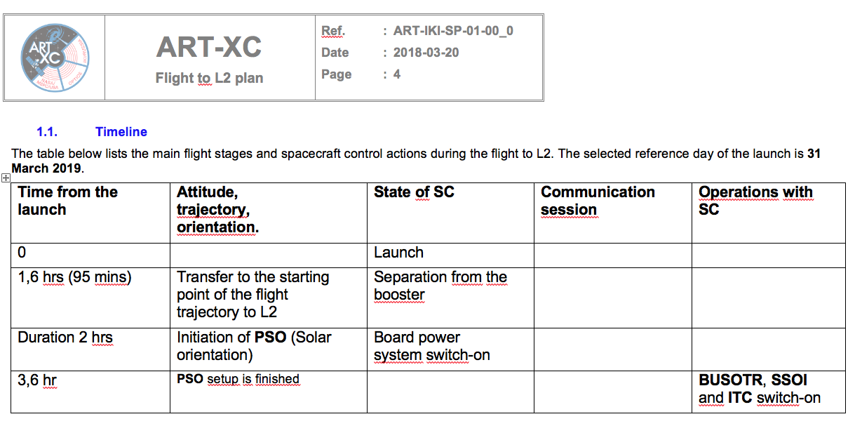
SRG flight plan to L2 point (RUS/ENG)

Slide 6
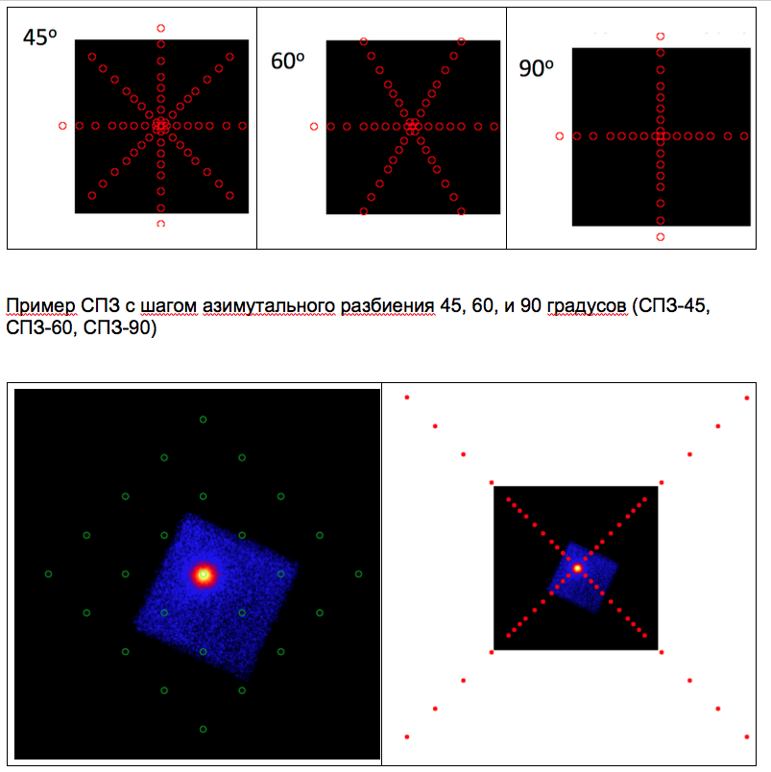
SRG flight plan to L2 point (RUS/ENG)
Possible calibration pattern

Slide 7
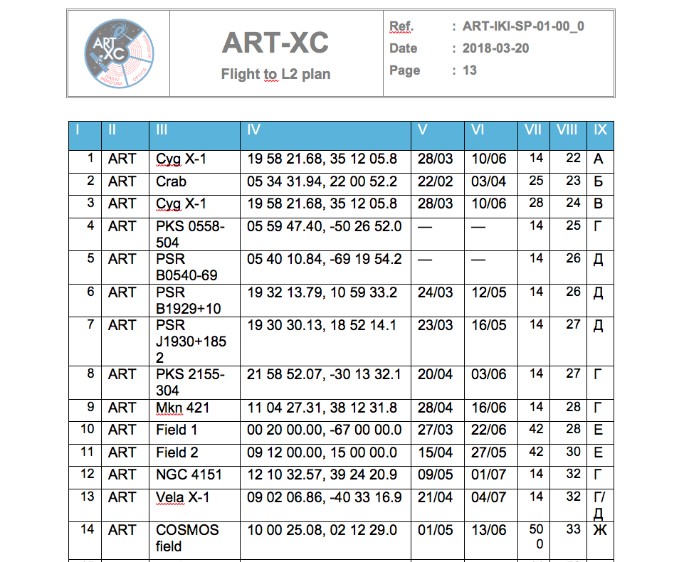
SRG flight plan to L2 point (RUS/ENG)
List of calibration sources

Slide 8
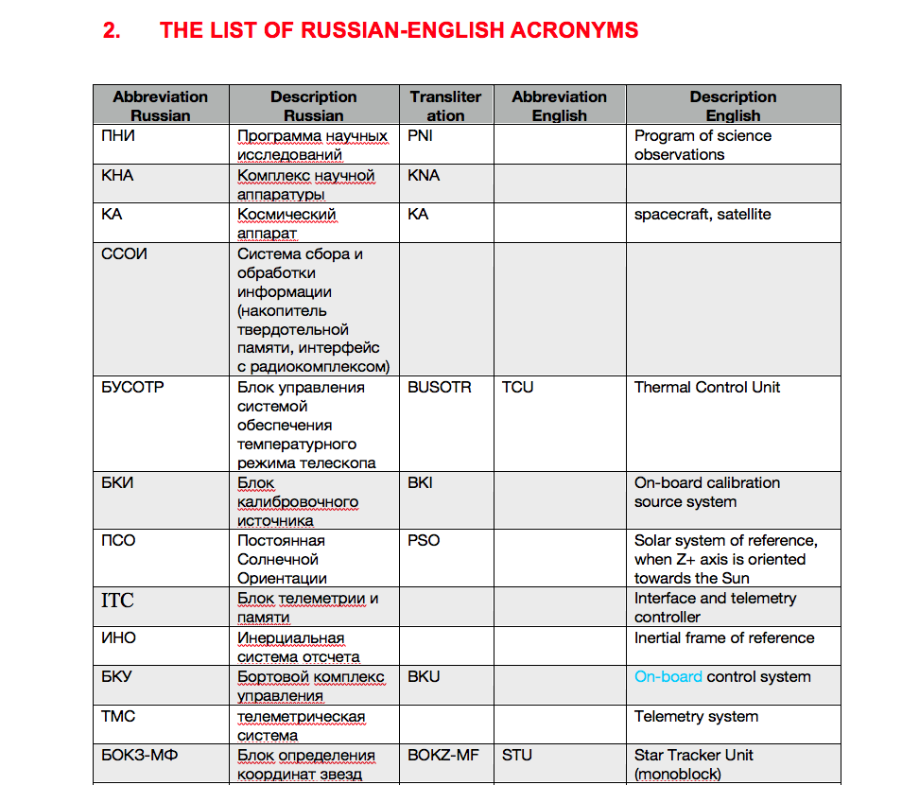
SRG flight plan to L2 point (RUS/ENG)
List of Russian-English acronims

Slide 9
SRG flight to L2 Planning tool
https://triton.iki.rssi.ru/srg/plan/
can be extended for normal operations after reaching L2 point

