Slide 1
eROSITA Working Group
Solar System

Slide 2
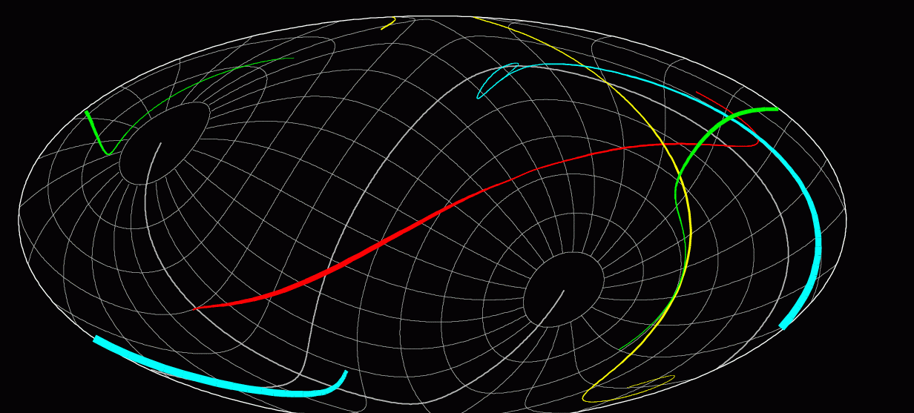
eROSITA and Comets
plans for early science
?

Slide 3
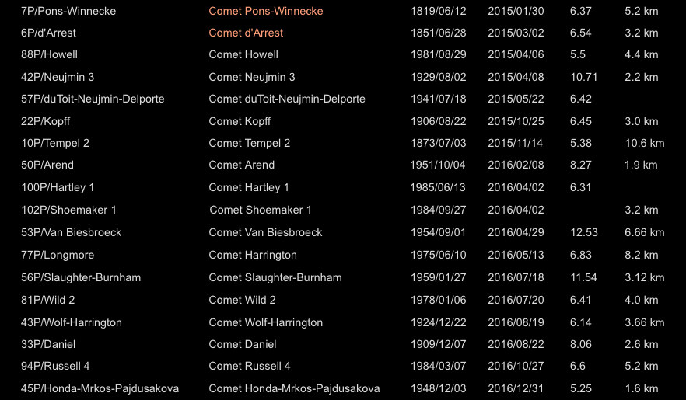
eROSITA and Comets
2015 - 2016

Slide 4
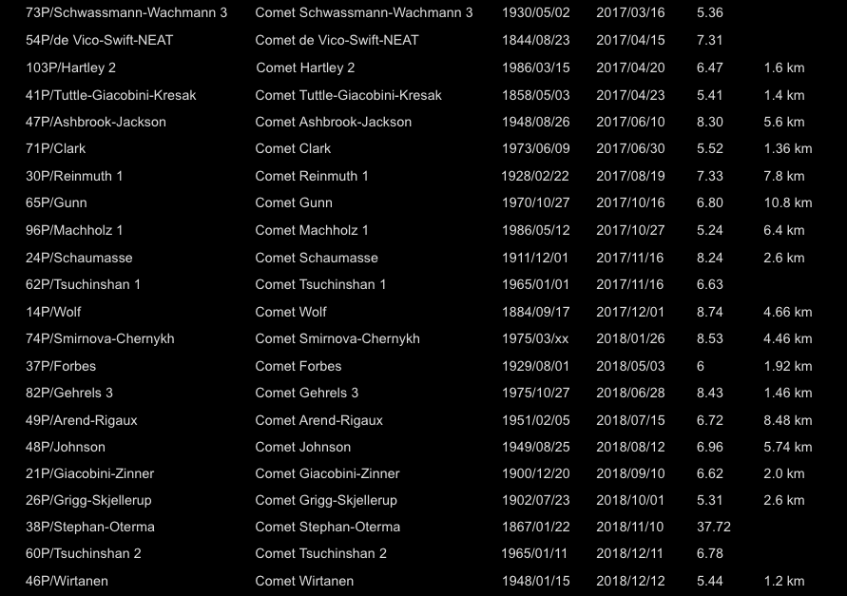
eROSITA and Comets
2017 - 2018

Slide 5
eROSITA and Planets
plans for early science
IKI/Ru
MPE/D
solar elongation: 70 – 110 deg

Slide 6
eROSITA and Planets
plans for early science
Mars 2016
IKI/Ru
MPE/D
solar elongation: 70 – 110 deg

Slide 7
eROSITA and Mars
plans for early science
solar elongation: 70 – 110 deg
relative X-ray flux from Mars
days since 1 Jan 2000

Slide 8
eROSITA and Planets
plans for early science
Mars 2016
IKI/Ru
MPE/D
solar elongation: 70 – 110 deg

Slide 9
eROSITA and Planets
plans for early science
Jupiter 2016
IKI/Ru
MPE/D
solar elongation: 70 – 110 deg

Slide 10
eROSITA and Planets
plans for early science
Jupiter 2017
IKI/Ru
MPE/D
solar elongation: 70 – 110 deg

Slide 11
eROSITA and Planets
plans for early science
Saturn 2016
IKI/Ru
MPE/D
solar elongation: 70 – 110 deg

Slide 12
eROSITA and Planets
plans for early science
Saturn 2017
IKI/Ru
MPE/D
solar elongation: 70 – 110 deg

Slide 13
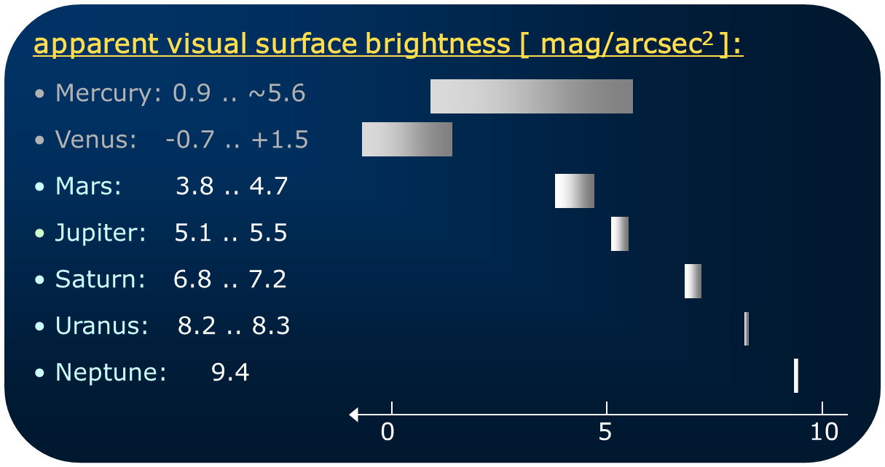
eROSITA and Planets
Sun, Earth, Moon: not observable
Reasonable exposure time
Optical blocking filter

Slide 14
What optical blocking filter is required for Mars* ?
*Mars is the optically brightest target in the allowed eROSITA solar angle range
XMM-Newton / EPIC pn thick filter:
mirror effective area: ~3000 cm²
HEW: ~15 arcsec
pixel size: 4.1 x 4.1 arcsec²
integration time (LW) : 48 ms
eROSITA:
mirror effective area: ~400 cm²
HEW: ~16 arcsec
pixel size: 10 x 10 arcsec²
integration time: 50 ms
„eROSITA/XMM“ for extended sources:
effective area: 0.13
pixel size: 5.9
integration time: 1.04
→ 0.13 * 5.9 * 1.04 = 0.80 optical load
Mars observable with EPIC pn thick LW → Mars observable with eROSITA F2, maybe even with F1

Slide 15
F1
F2
on filter wheel
on filter wheel
200 nm PI
200 nm PI
100 nm Al
on CCD
200 nm Al
CCD
CCD
5 x
2 x

Slide 16
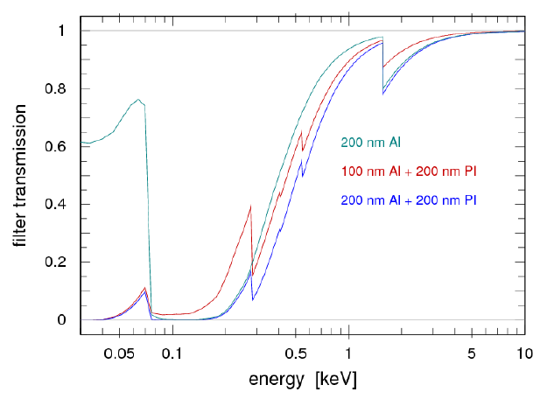
filter transmissions from henke.lbl.gov

Slide 17
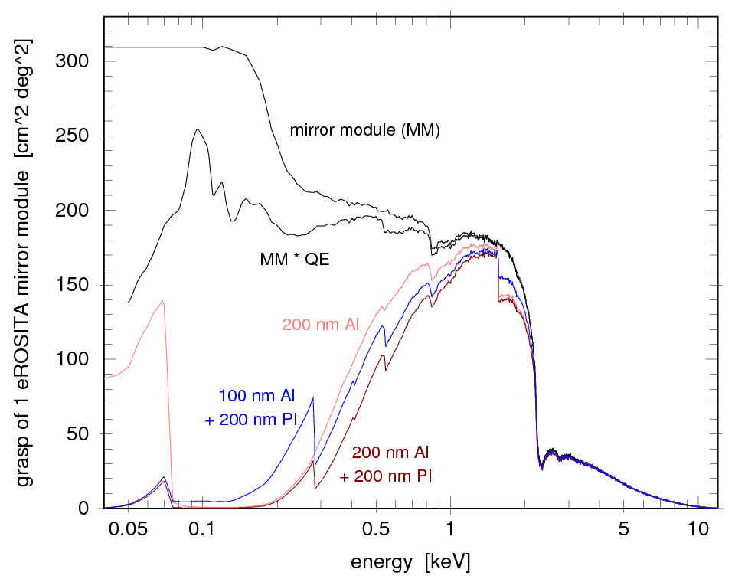
QE from EPIC pn, filter transmissions from henke.lbl.gov

Slide 18
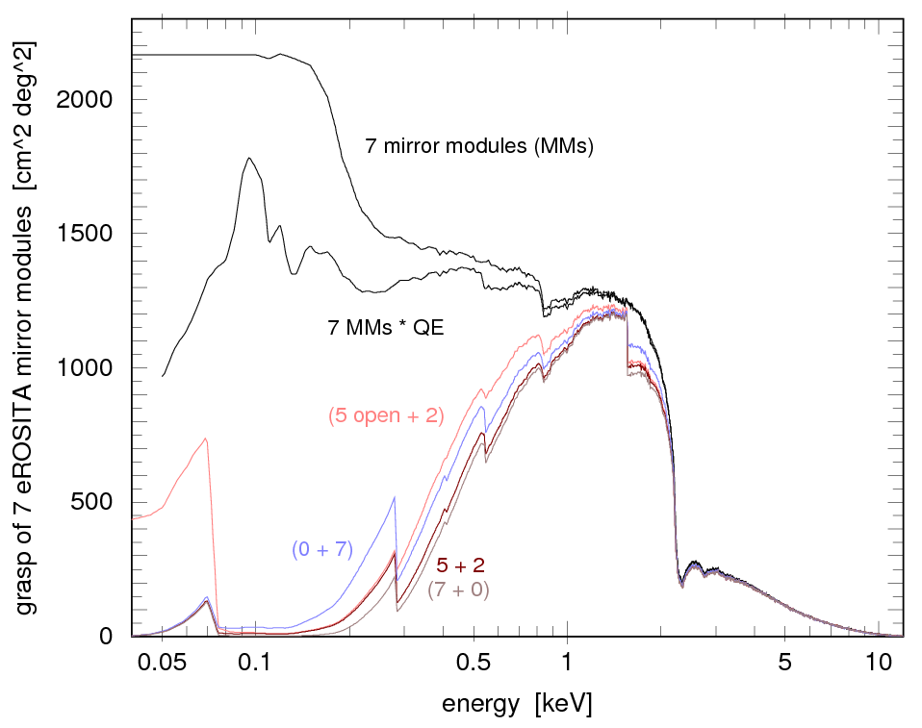
„ 5 + 2 “
QE from EPIC pn, filter transmissions from henke.lbl.gov

Slide 19
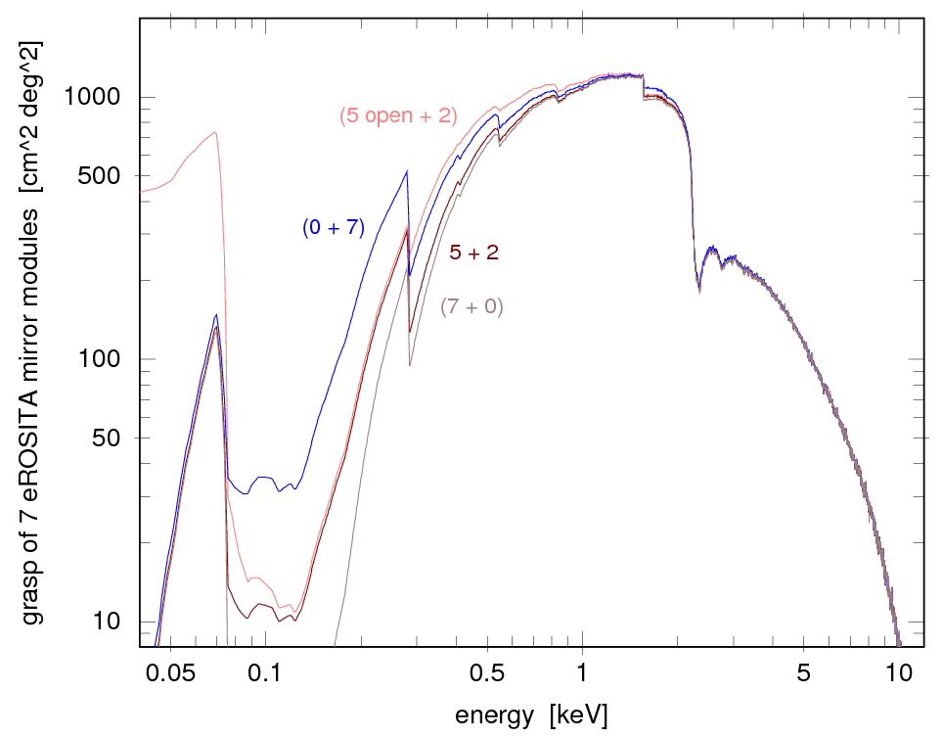
filter transmissions from henke.lbl.gov

Slide 20
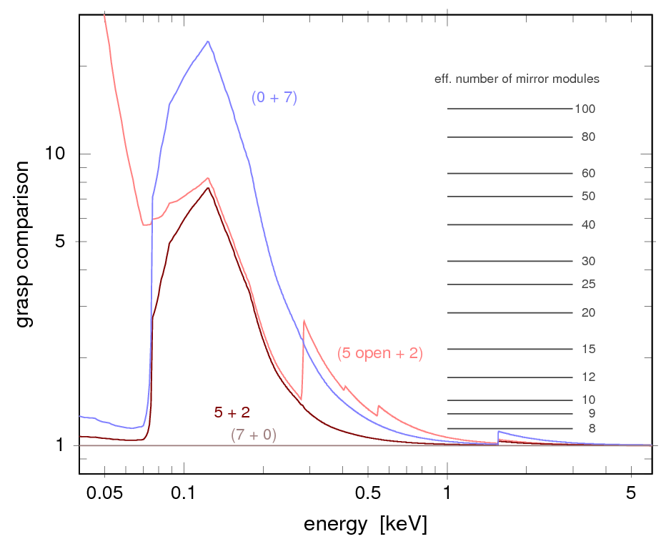
filter transmissions from henke.lbl.gov

Slide 21
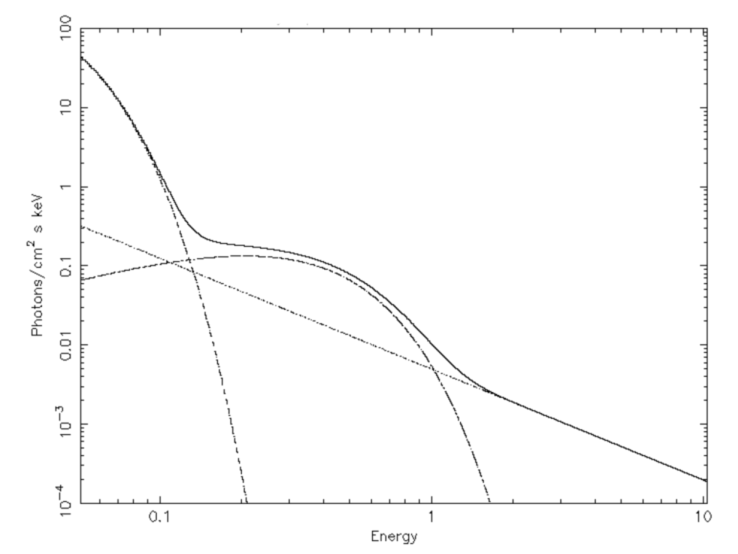

Slide 22
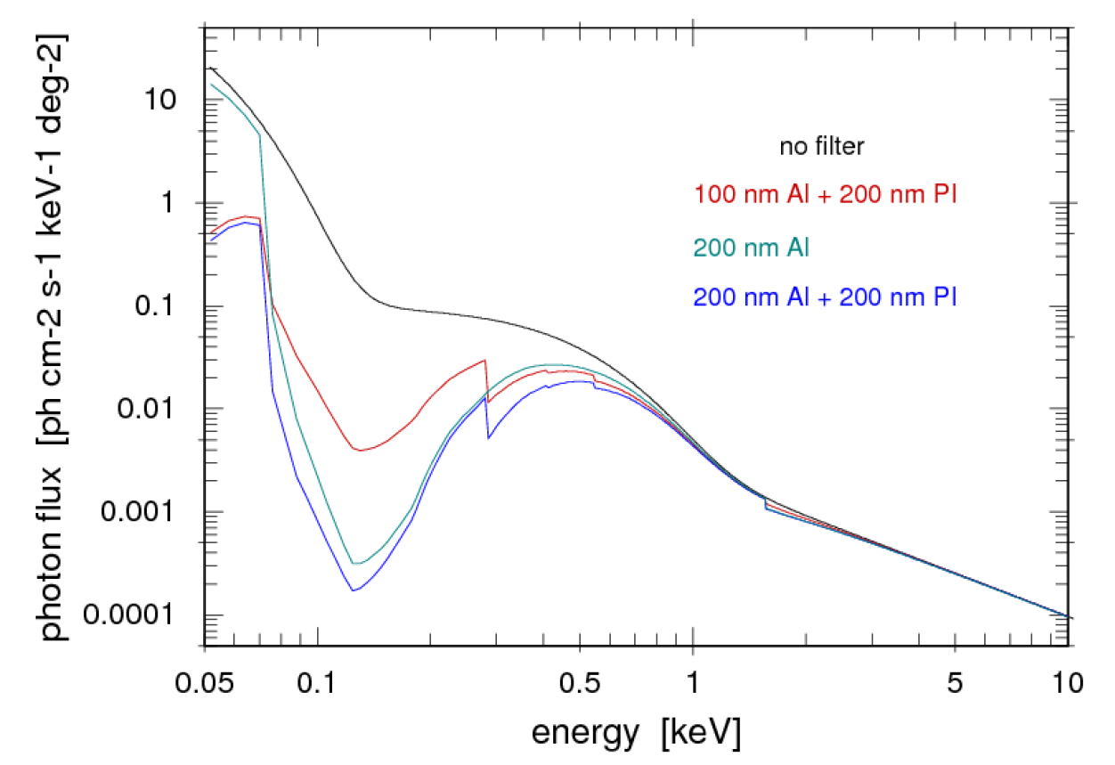

Slide 23
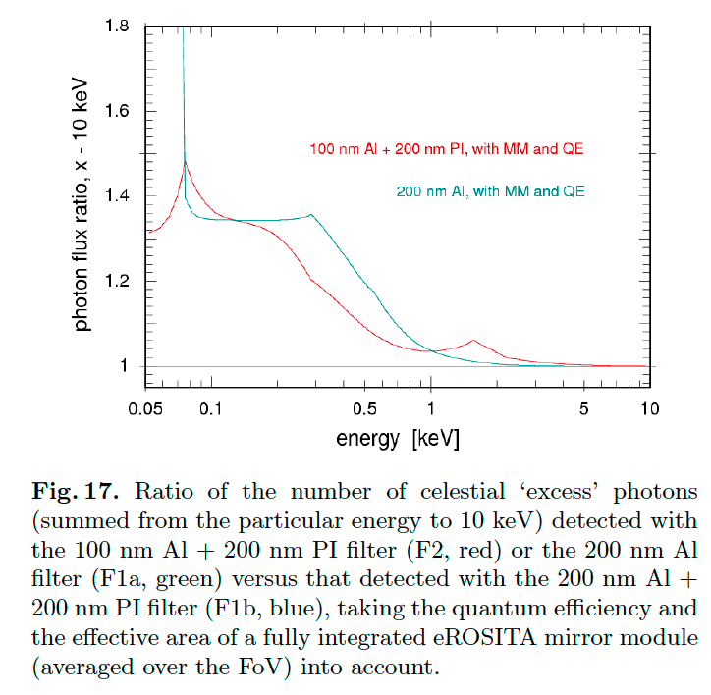
F2 yields 30%-35% more all-sky photons than F1
F2
~ 2.3 additional Mirror Modules
F1
5 * F1 + 2 * F2 yields ~10% more all-sky photons than 7 * F1
~ 0.7 additional Mirror Modules

Slide 24
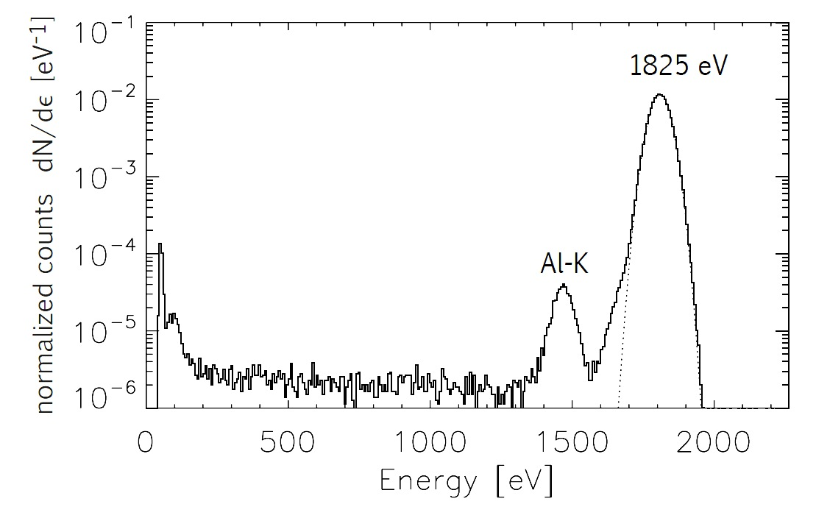
Consequences of the „5 F1+2 F2“ choice for eROSITA science
Granato 2012 (PhD Thesis)
E > 1.5 keV
Al
E > 1.5 keV
Al-K
different RMFs required → two groups of data sets
Al
Al-K
CCD
CCD
localized Al-K fluorescence emission at the position of the X-ray source spectroscopy at 1.5 keV degraded
diffuse Al-K fluorescence emission as an additional background component

Slide 25
Consequences of the „5 F1+2 F2“ choice for eROSITA science
Cyclic calibration of the detectors leads to inhomogeneous survey stripes like:
4 F1 + 2 F2 („F1a“ in calibration mode)
4 F1 + 2 F2 („F1b“ in calibration mode)
4 F1 + 2 F2 („F1c“ in calibration mode)
4 F1 + 2 F2 („F1d“ in calibration mode)
4 F1 + 2 F2 („F1e“ in calibration mode)
5 F1 + 1 F2 („F2a“ in calibration mode)
5 F1 + 1 F2 („F2b“ in calibration mode)
different ARFs and RMFs → correct treatment: two groups of data sets, temporally and spatially variable
deviation from the original concept of one „telescope“ consisting of seven identical mirror modules and detectors

Slide 26
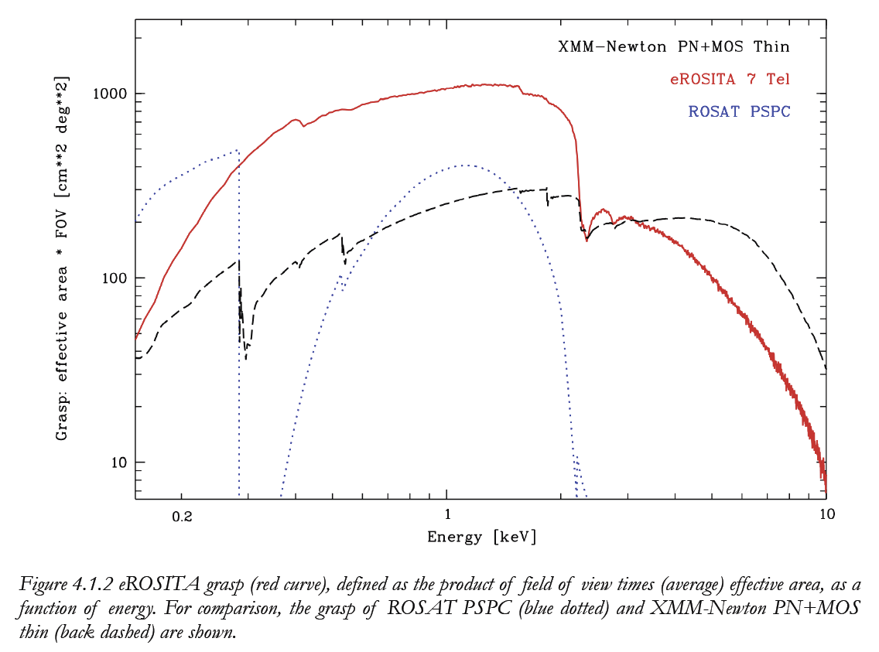
from the eROSITA Science Book

Slide 27
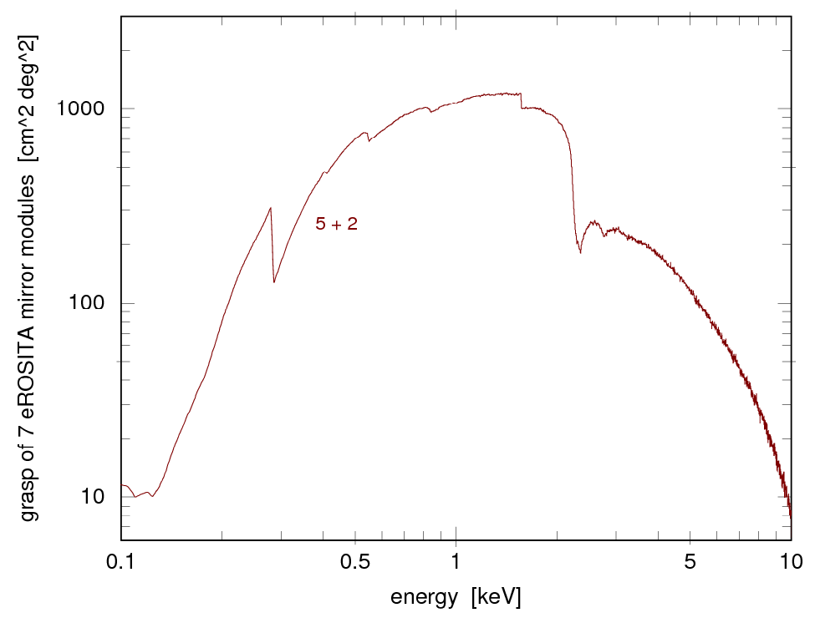
less sensitivity at low energies
(~30% less signal in the all-sky maps,
less accuracy for nH determination,
stronger coupling of spectral parameters)
from the eROSITA Science Book

Slide 28
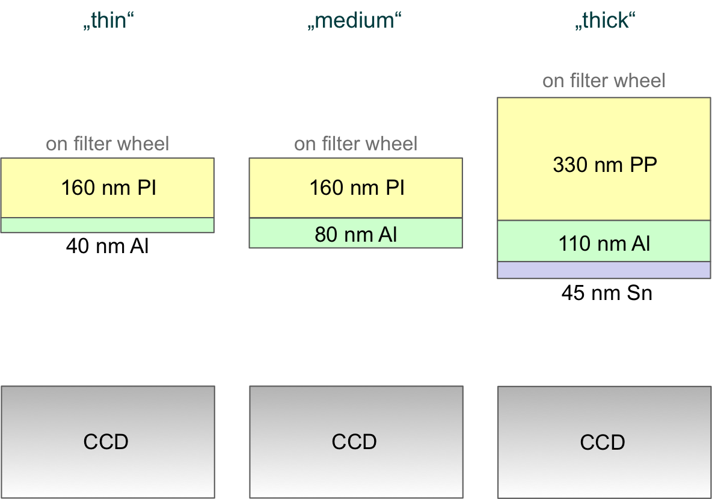
Optical blocking filter comparison: XMM-Newton eROSITA

Slide 29
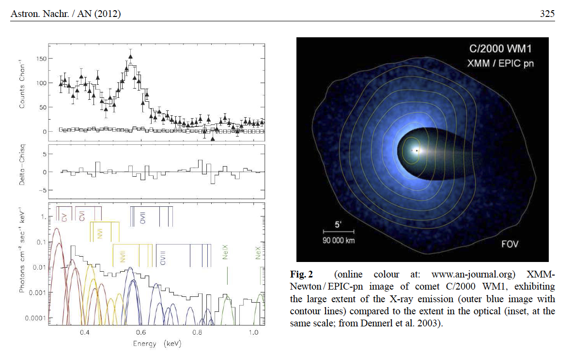
eROSITA and Comets
0.4 keV
1.0 keV
0.4 keV
1.0 keV
see EROSITAwiki: erosolar_documents: Solar System X-rays from Charge Exchange Processes

Slide 30
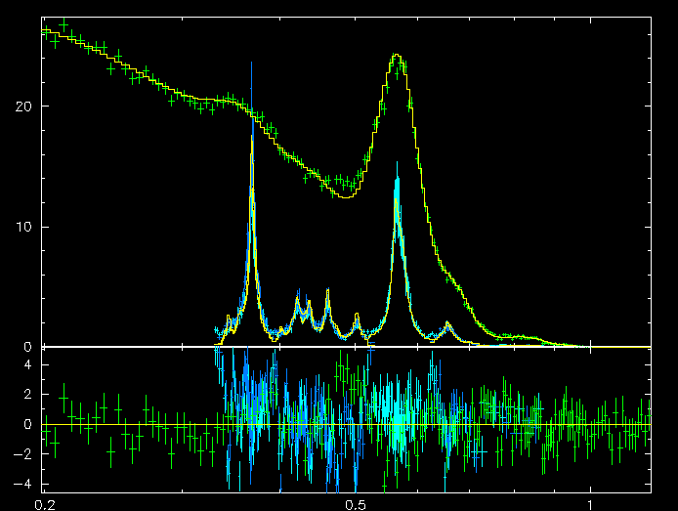
Comet C/2000 WM1: combined RGS + EPIC pn spectrum
eROSITA
EPIC pn
counts s⁻¹ keV⁻¹
RGS 1
RGS 2
183 eV
residuals
0.2 0.3 0.5 1.0
instrumental energy [keV]

Slide 31
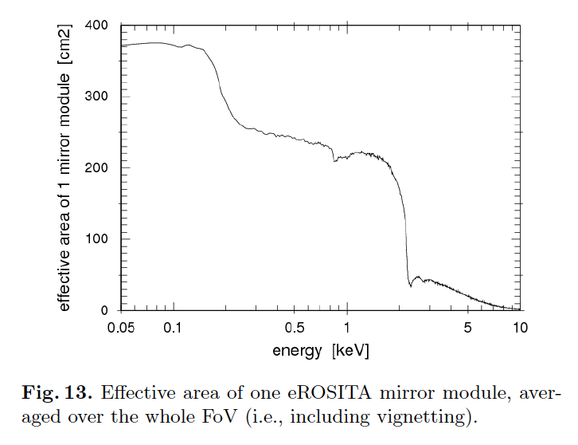
eROSITA and Comets

Slide 32
Charge Exchange and eROSITA
C V
N VI
C VI
eROSITA
C V and C VI astrophysics !
first all-sky survey in the 0.3-0.4 keV range!
non-dispersive low energy spectroscopy!
ROSAT PSPC
ROSAT PSPC
eROSITA
Notes:
eROSITA: extends RASS to higher energies (but less sensitive at E > 3 keV than XMM-Newton), but also at 0.3-0.5 keV, where it is also more sensitive than XMM-Newton (by almost one order of magnitude)!
low energy sensitivity also useful for nh determination!

Slide 33
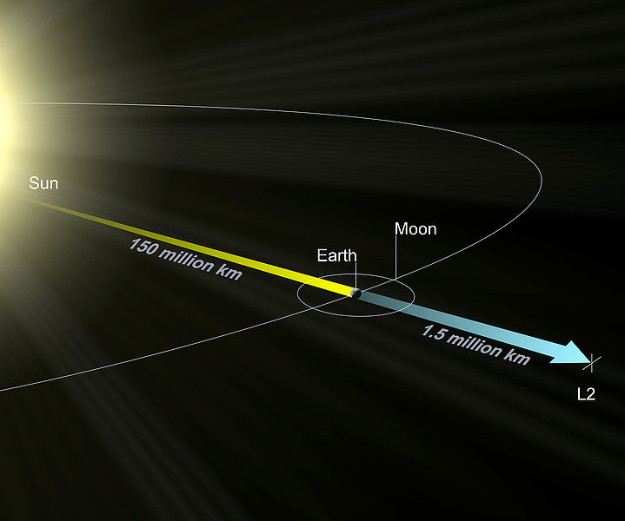
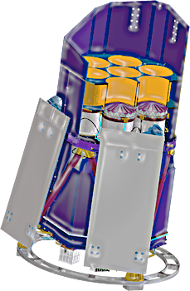
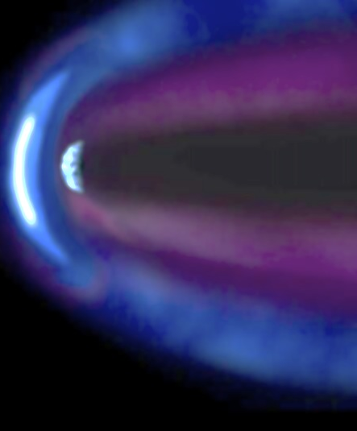
eROSITA and the Heliosphere
L2: CX contribution from geocorona negligible
8 all-sky surveys in 4 years (1/3 solar cycle)
→ possibility to disentangle heliospheric CX emission from diffuse galactic emission
Notes:
33

Slide 34
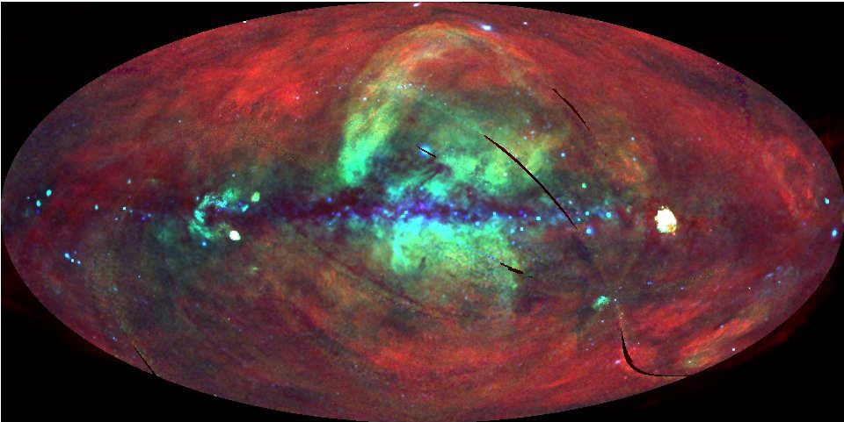
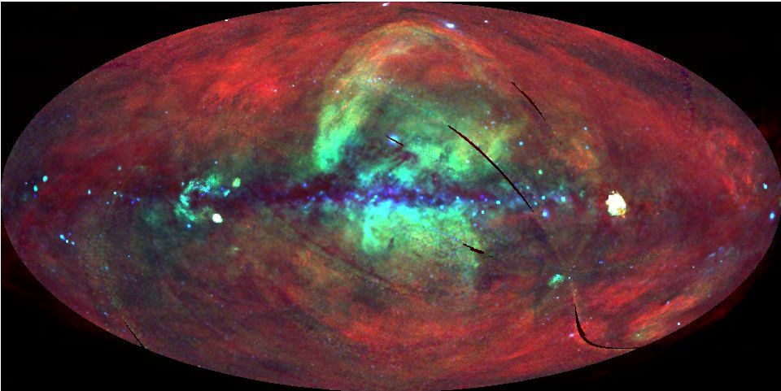
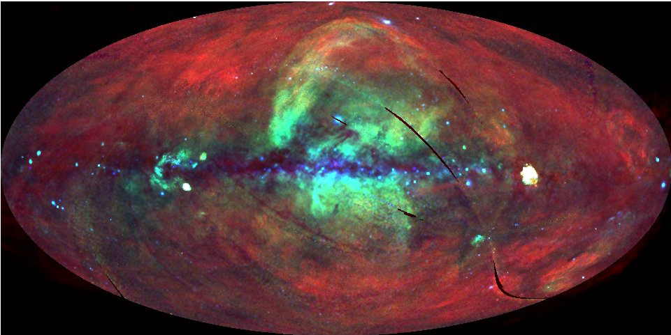
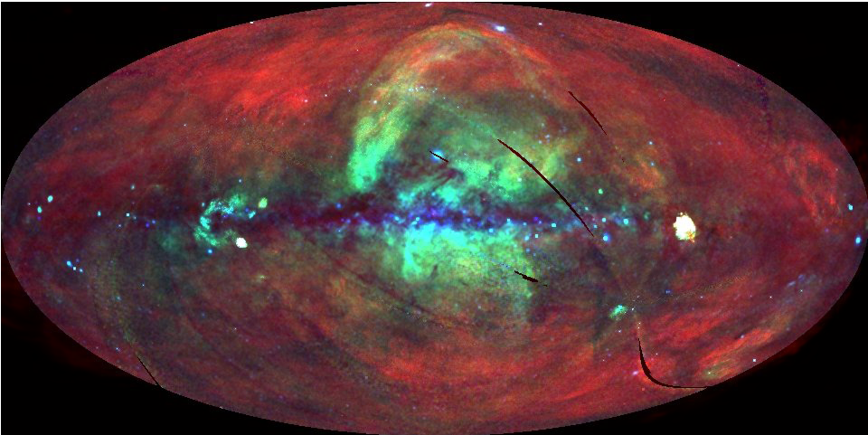
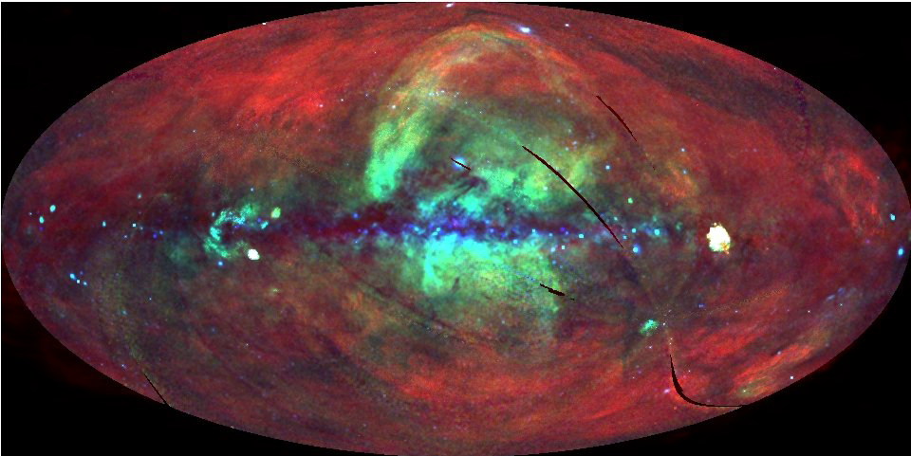
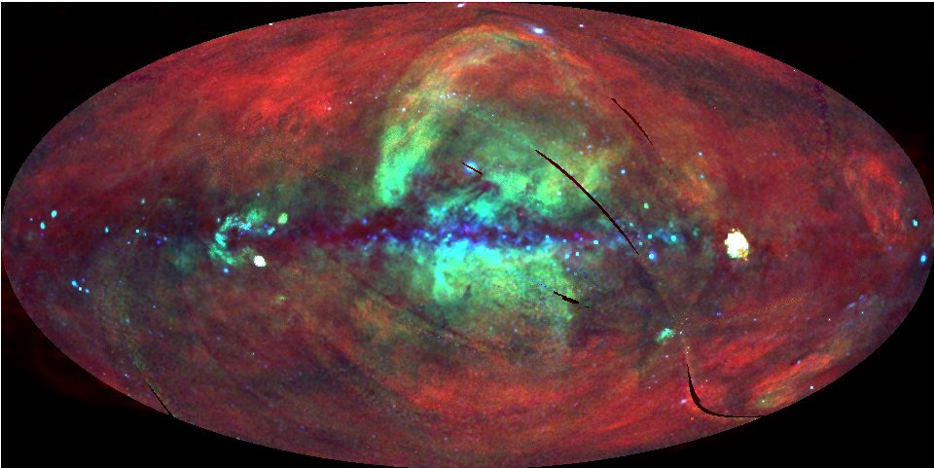
Heliospheric Charge Exchange Emission
not suited for early science
L2: CX contribution from geocorona negligible
8 all-sky surveys in 4 years (1/3 solar cycle)
X-ray CCD spectral resolution
possibility to disentangle heliospheric CX emission from diffuse galactic emission
reduced sensitivity with „5+2“ filter choice

Slide 35
eROSITA Working Group
Solar System

