Slide 1
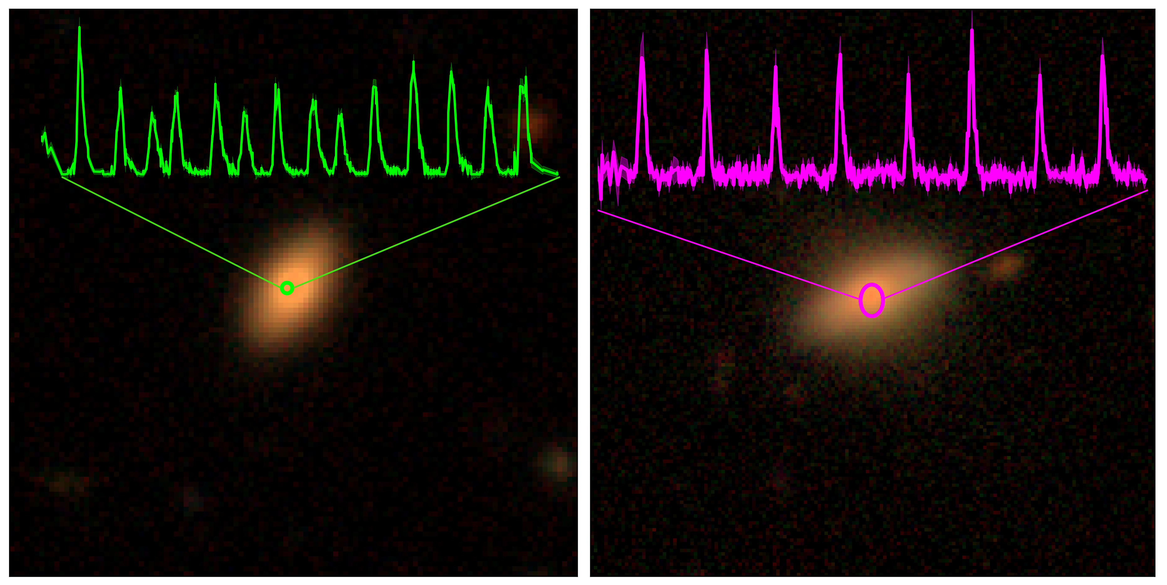
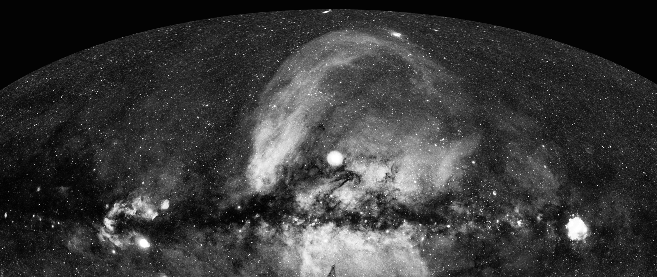

X-ray observations of exotic nuclear transients:
How could electromagnetic observations shed light on the population of I/EMRI?
Andrea Merloni (MPE)

Slide 2

Definitions and outline
‘Exotic’ nuclear transients: things that go ‘bang’ in galactic nuclei, but are not AGN, TDE, SNe
  Quasi Periodic Eruptions, Partial/repeating TDE, etc.
  This talk: Discoveries and epirical/observational facts (no theory)
X-ray power to access new discovery space
  eROSITA
  Einstein Probe
Many thanks to:
  Riccardo Arcodia (QPE)
  Adam Malyaly, Arne Rau, Iuliia Grotova, Zhu Liu (TDE group at MPE)
  Jane Dai, Chichuan Jin (EP)

Slide 3
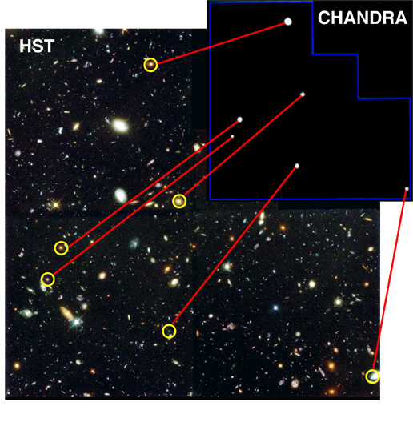
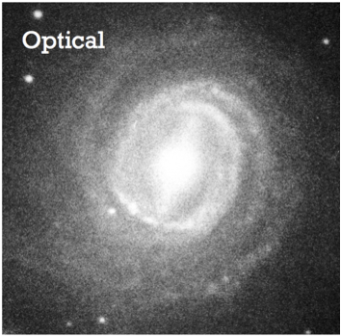
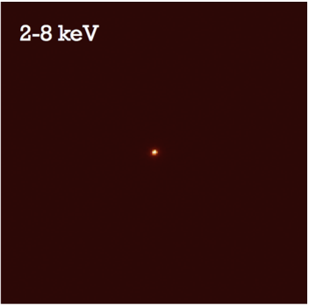
X-rays reveals massive black holes
For galaxies on the star-formation “Main sequence”, and for a fixed universal ratio of black hole to galaxy mass,
central AGN outshine star formation in X-rays for L/L_{EDD}> 10⁻⁴
In the X-ray band, the “contrast” between stellar sources and accretiononto MBH is maximized!
(Merloni 2016; Alexander & Hickox 2018)

Slide 4
“Elusive” AGN from survey fields
10-20% of all X-ray sources in a blank survey field (here, XMM-XXL North with spectroscopic redshifts) are “elusive”, i.e. do not show signs of “classical” AGN activity in the optical spectra
Fraction of ‘elusive’ X-ray AGN
Grey shaded area is an educated guess of how many of these can be TDE base on theoretical rates, L_{bol}~t^{-5/3} lightcurve evolution and empirical SED.
Merloni et al. 2015

Slide 5
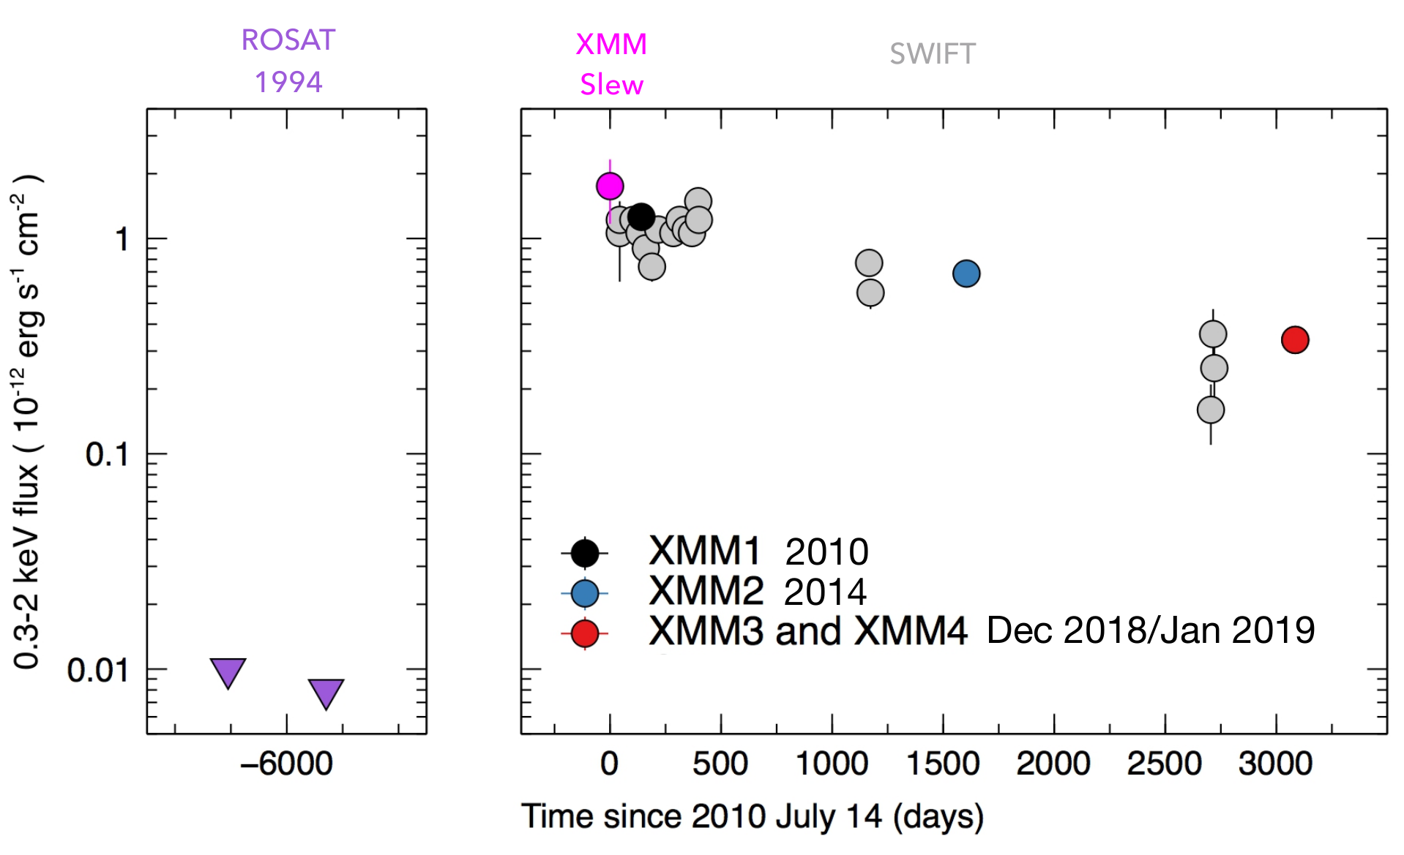
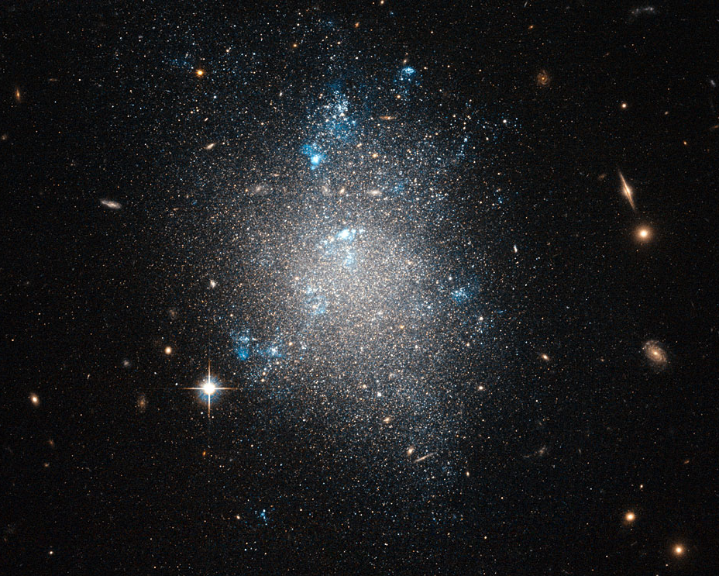
QPE discovery: GSN 069
At the end of 2018 this galaxy (z=0.018) was being monitored in X-rays (as an “elusive” AGN without BLR, associated with a large flux variation – TDE/‘Changing Look’?)
X-ray signal
??
Courtesy: G. Miniutti, M. Giustini & collaborators

Slide 6
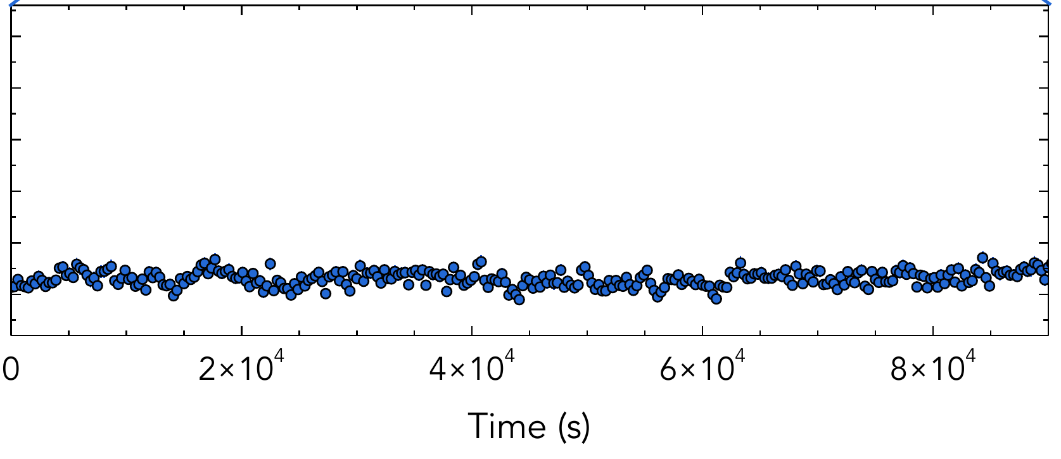
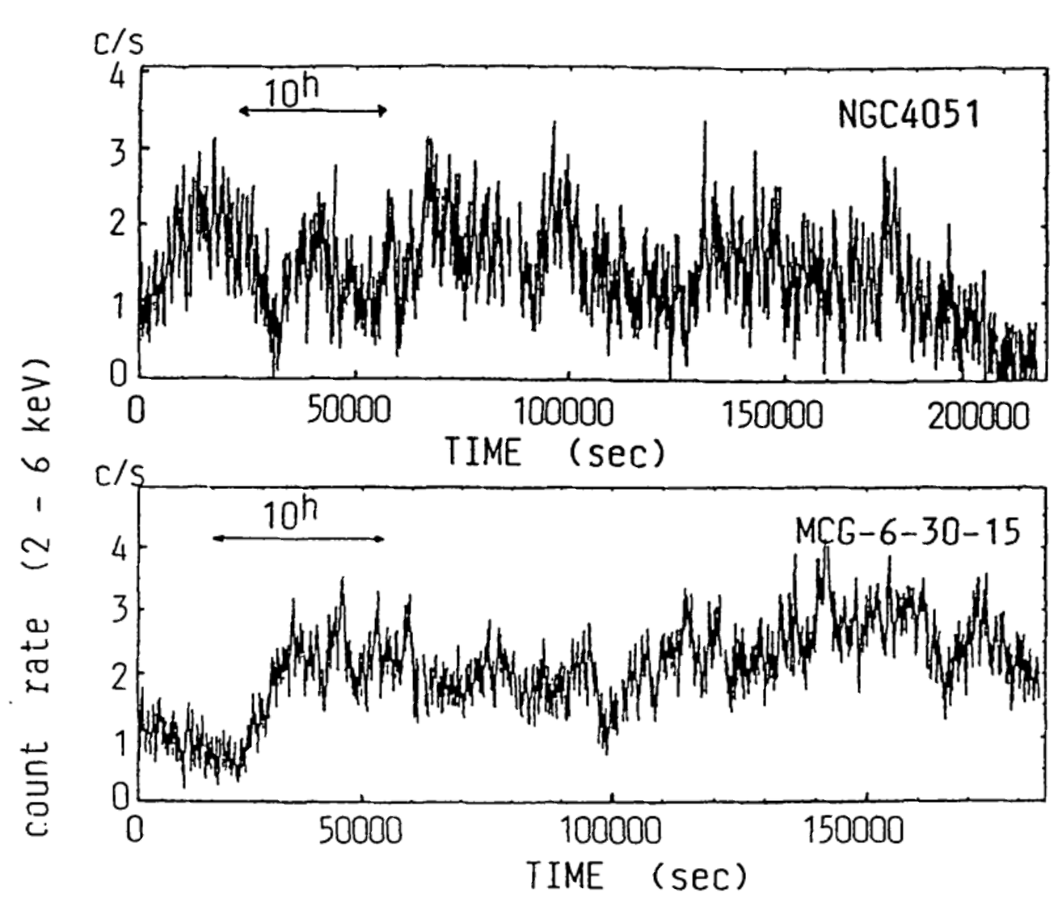
QPE discovery: GSN 069
At the end of 2018 this galaxy (z=0.018) was being monitored in X-rays (as an “elusive” AGN without BLR, associated with a large flux variation – ‘Changing Look’?)
X-ray signal
vs
Courtesy: G. Miniutti, M. Giustini & collaborators

Slide 7
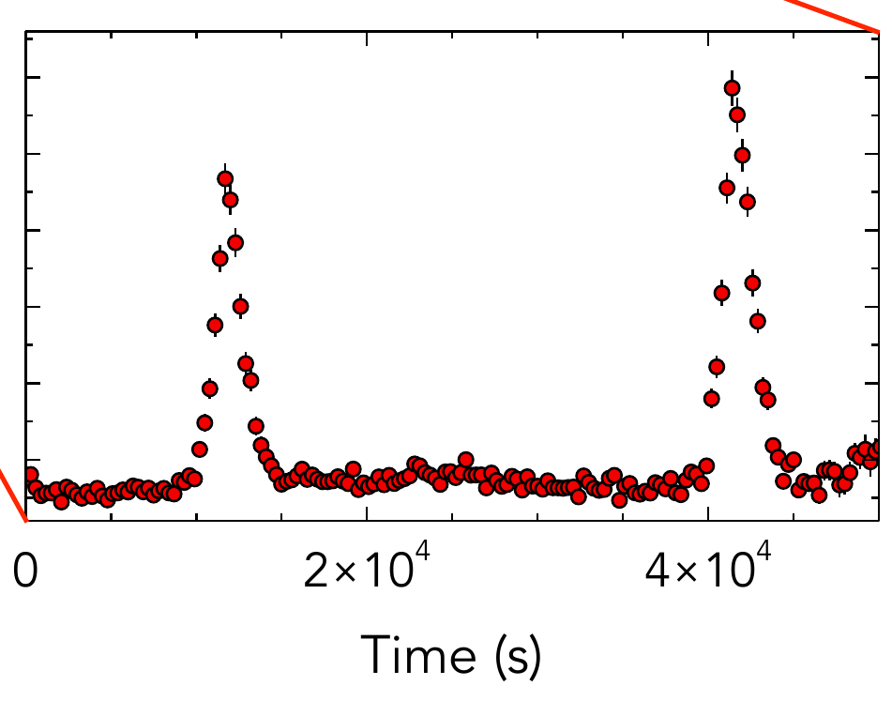
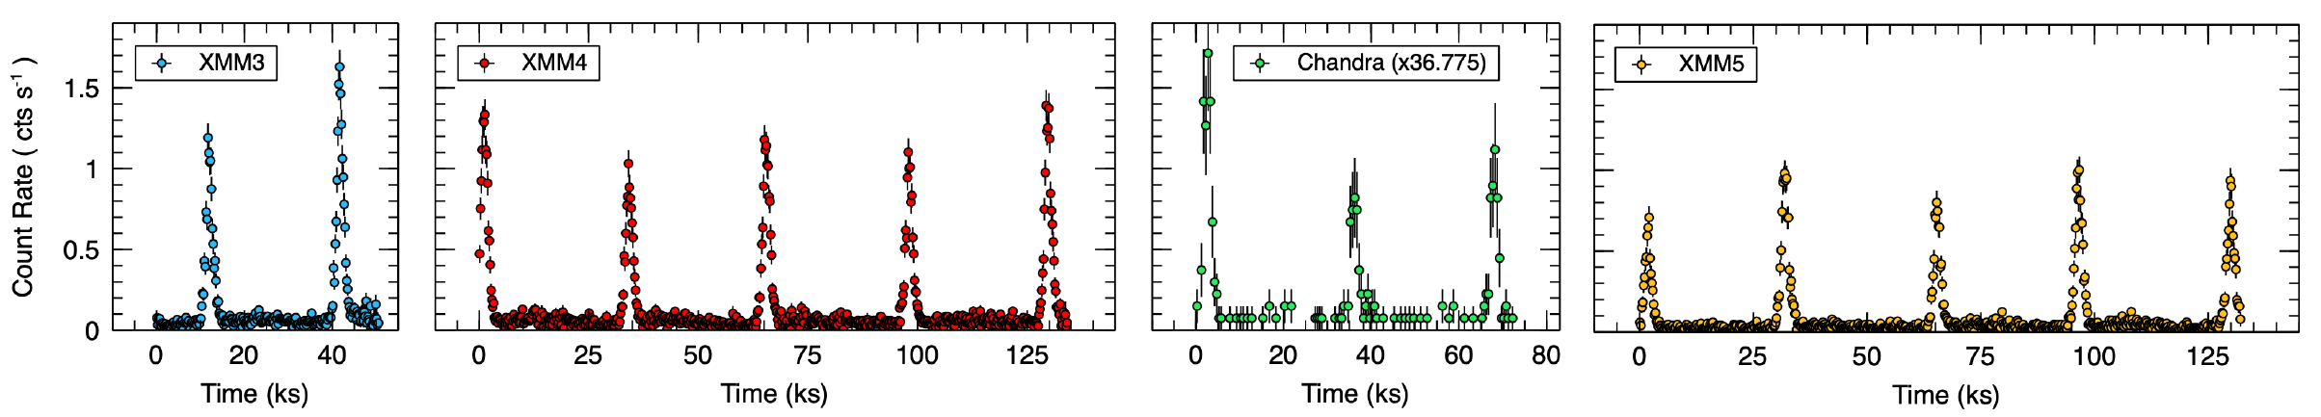
QPE discovery: GSN 069
Courtesy: G. Miniutti, M. Giustini & collaborators
X-ray signal
few hours!
~9 hours!

Slide 8
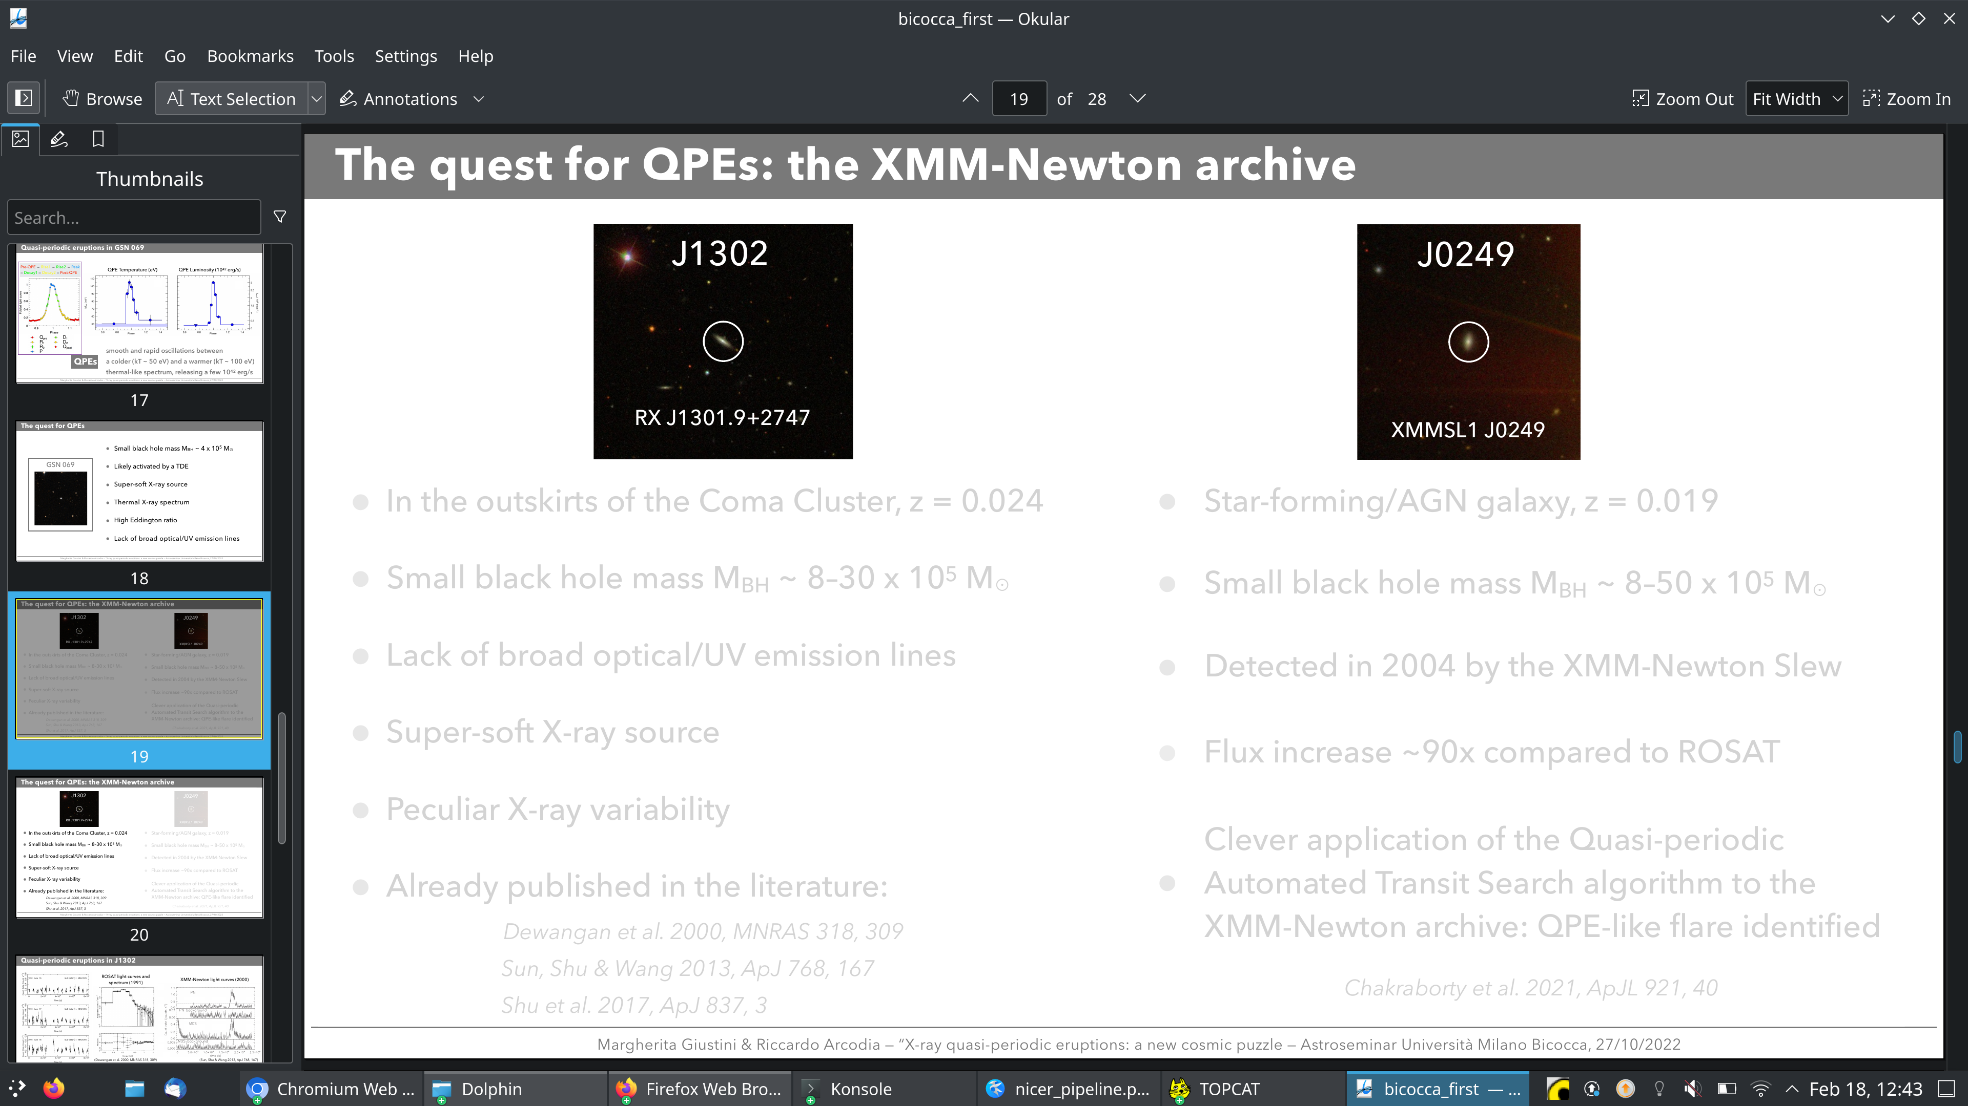
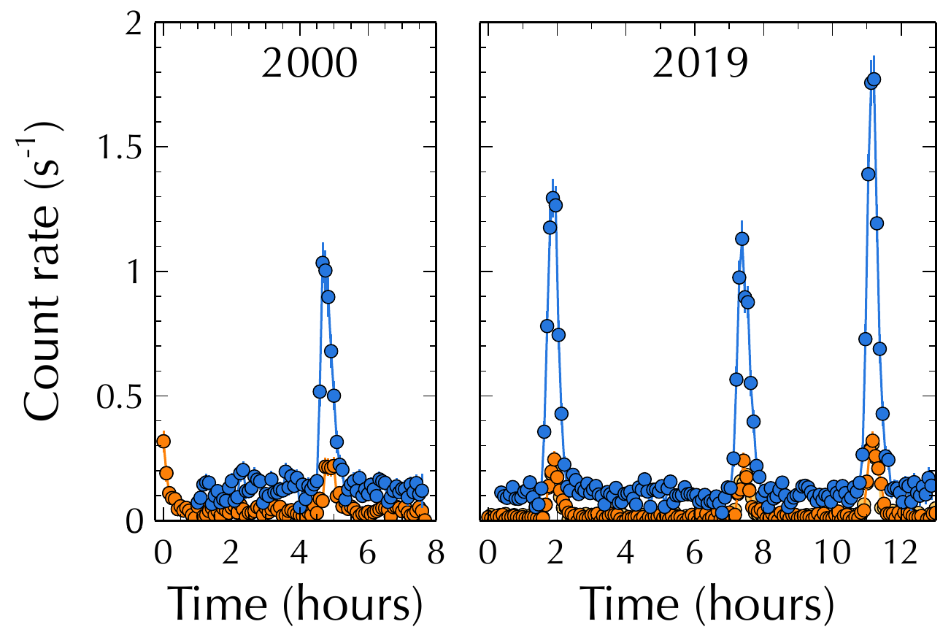
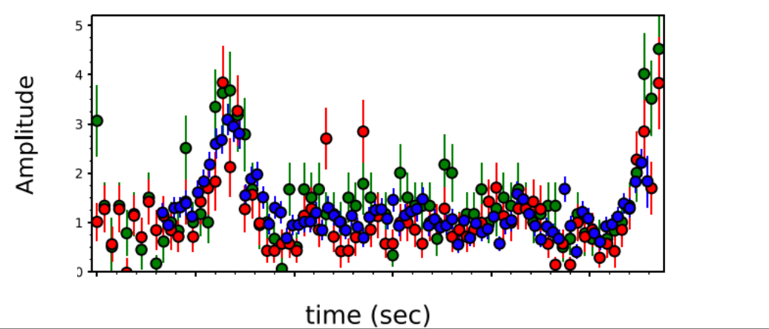
QPE: can we find more?
The X-ray archives were searched for more.. and 1 was found (+1 good candidate)
few hours!
2006
Chakraborty+21
Giustini+20

Slide 9
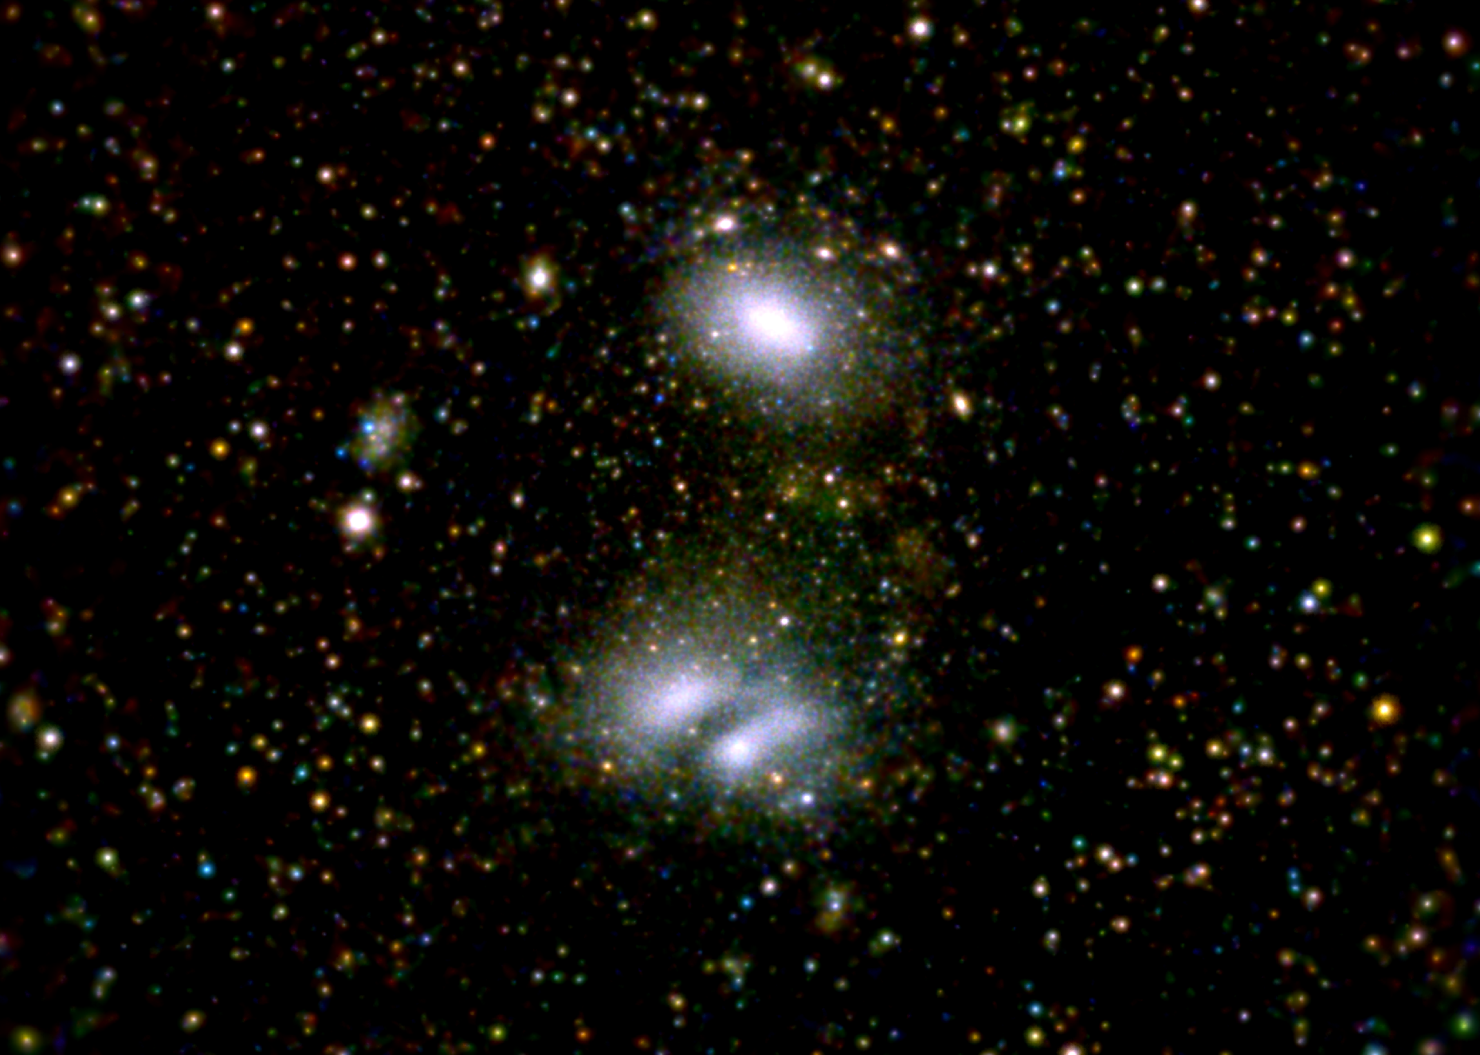

eROSITA’s advantage: large Field of View and Grasp
SRG/eROSITA 0.4-3.0 keV
Abell 3391/3395
30’
Moon diameter
30 arcmin
Grasp (= survey speed)
- 5 x XMM-Newton
- 100 x Chandra (today)
1 degree
eROSITA is a superb tool to image
Large Scale Structures
As Cluster finding machine, it is a Stage IV
Cosmology experiment
eROSITA
Field of view ~ 62 arcmin
XMM-Newton
Field of view ~ 30 arcmin
+
=
Chandra
Field of view ~ 17 arcmin
Scanning feature
3 Observing modes:
continuous scan (survey), field scan, pointing
SRG/eROSITA 0.2-2 keV image of A3391/3395
(Reiprich et al. 2021)
Gaussian adaptive smoothing
0.4-0.8: red
0.8-1.5: green
1.5-3.0: blue

Slide 10

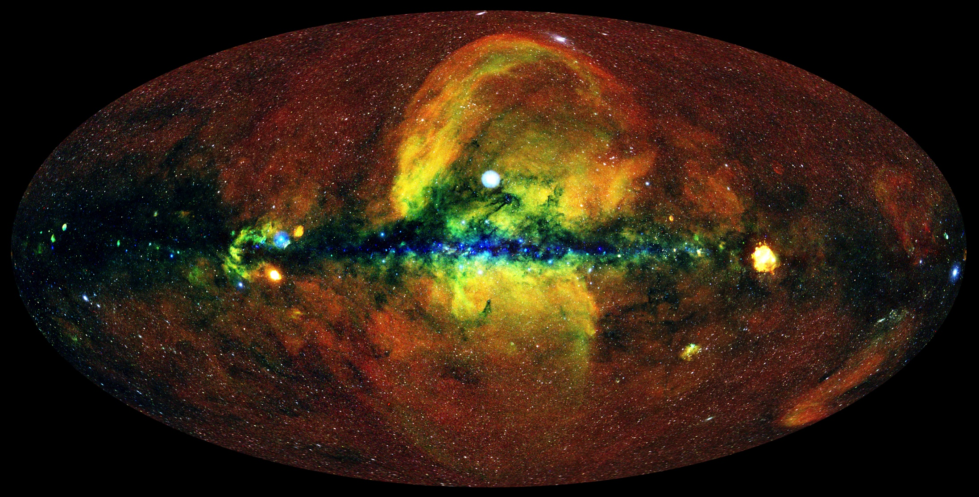
The eRASS1 X-ray sky
R: 0.3-0.6 keV
G: 0.6-1.0 keV
B: 1.0-2.3 keV
~10’ smooth.
IKI
J. Sanders, H. Brunner (MPE), E. Churazov, M. Gilfanov (IKI), and eSASS team
MPE

Slide 11
Fall 2023: eRASS1 data release
Software
Calibration DB
Attitude files
Exposure maps
Events
Count rate maps
Source catalogues
Light curves
Spectra
Candidate Counterparts
Merloni et al., submitted
MPE

Slide 12

eRASS in time domain
eRASS1 cts rate image
Movie courtesy
of J. Sanders (MPE)

Slide 13

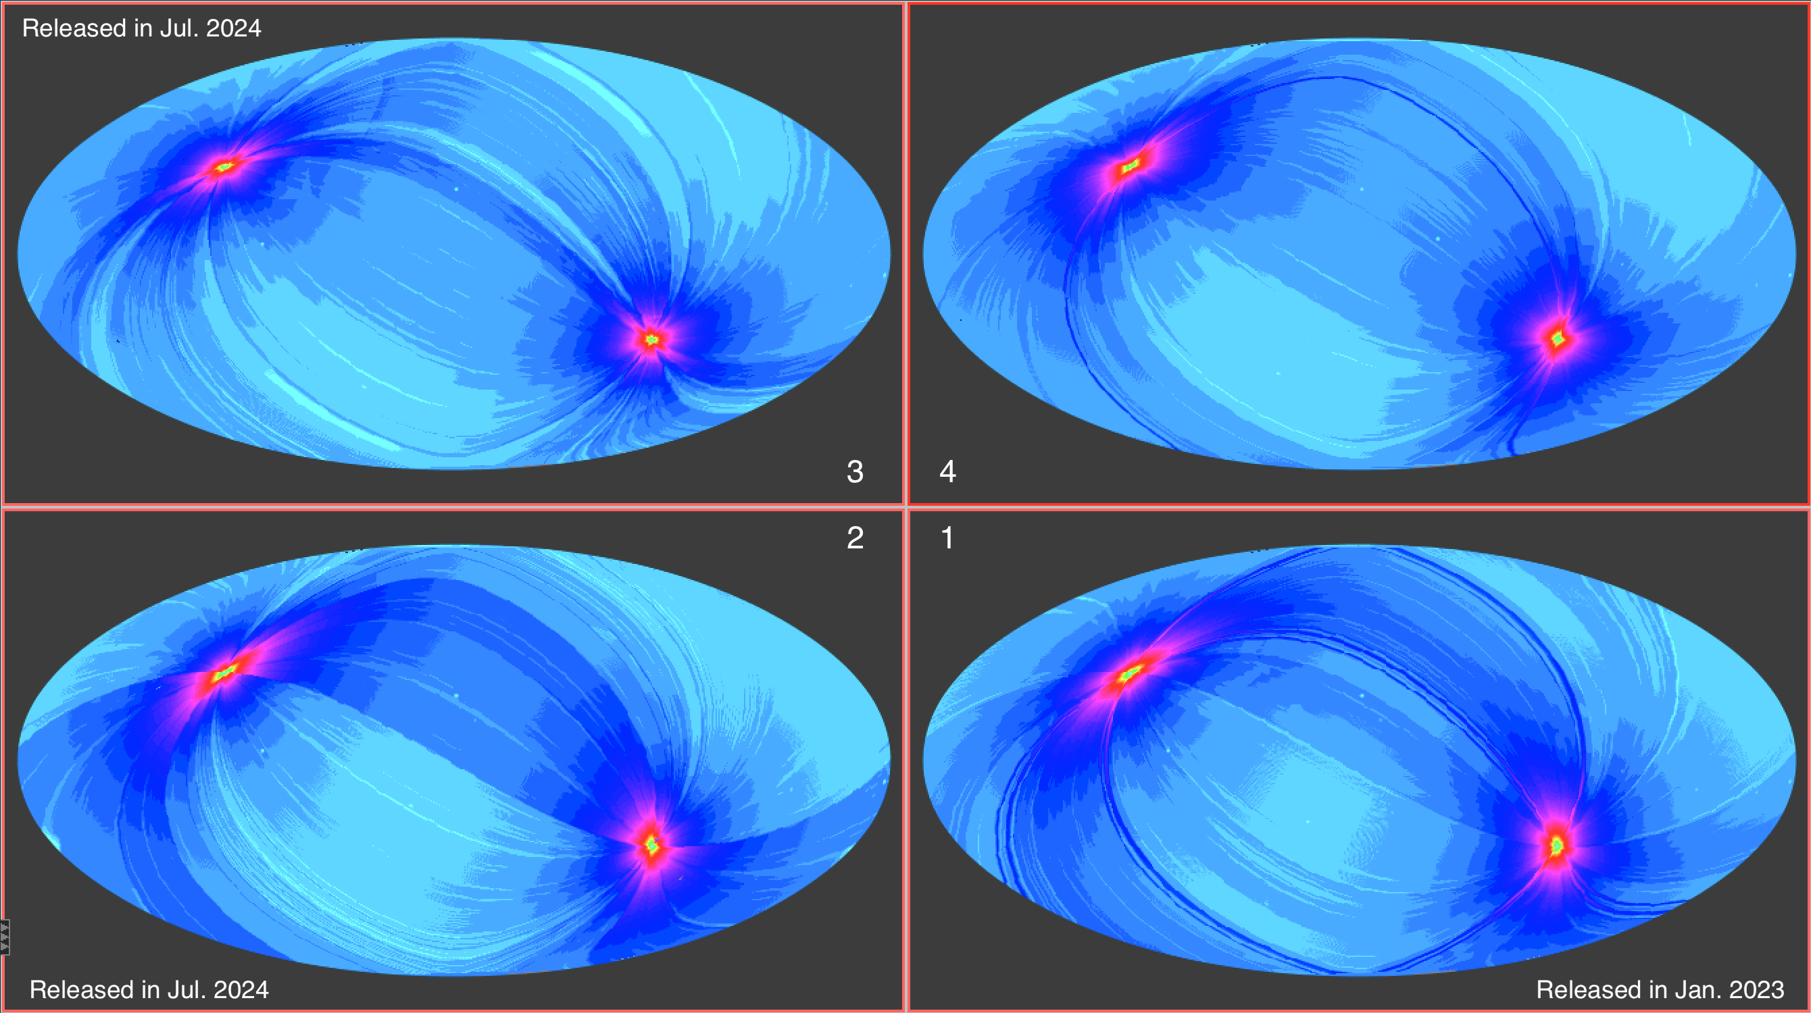

Four surveys
0.6-2.3 keV exposure maps of the first 4 eRASS, in seconds

Slide 14
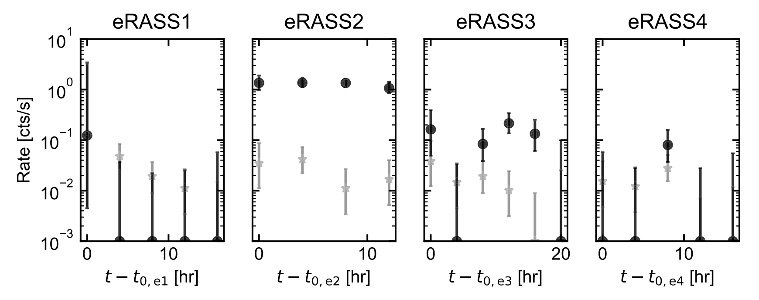
eROSITA’s time domain capabilities during its
4.3 all-sky surveys (Dec’19- Feb ’22)
total
background
(J0744; Malyali+23)
40s: scan over FoV

Slide 15
eROSITA’s time domain capabilities during its
4.3 all-sky surveys (Dec’19- Feb ’22)
4hr: SRG
rotation period
total
background
(J0744; Malyali+23)
40s: scan over FoV

Slide 16
eROSITA’s time domain capabilities during its
4.3 all-sky surveys (Dec’19- Feb ’22)
~1d
4hr: SRG
rotation period
total
background
(J0744; Malyali+23)
40s: scan over FoV

Slide 17
eROSITA’s time domain capabilities during its
4.3 all-sky surveys (Dec’19- Feb ’22)
~1d
4hr: SRG
rotation period
total
background
(J0744; Malyali+23)
40s: scan over FoV
180d: next survey

Slide 18
eROSITA’s time domain capabilities during its
4.3 all-sky surveys (Dec’19- Feb ’22)
~1d
4hr: SRG
rotation period
total
background
(J0744; Malyali+23)
40s: scan over FoV
180d: next survey
2.2yr: 4.3 surveys

Slide 19
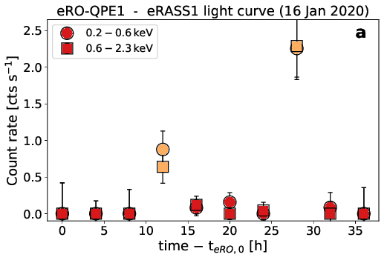
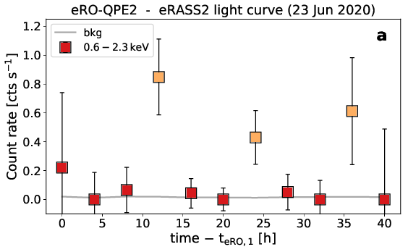
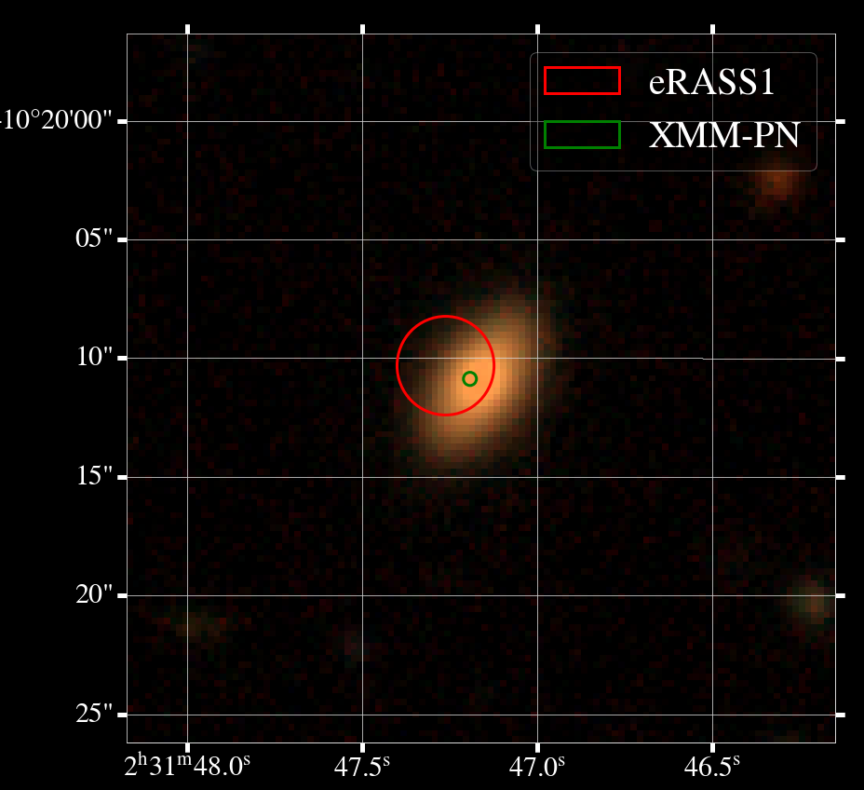
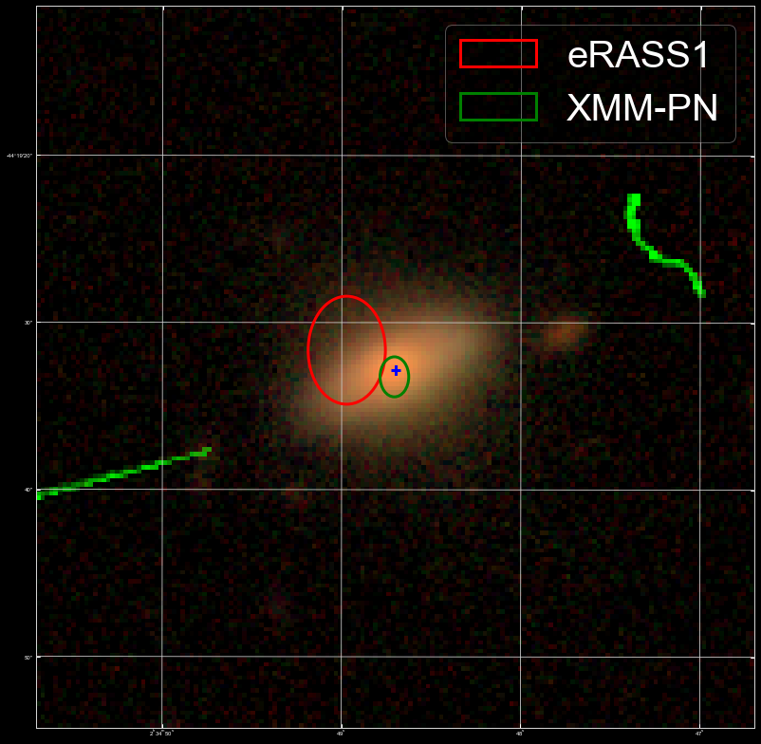

Searching for QPEs with eROSITA
In the first year of eROSITA operations we have found 2 more (Arcodia+21, Nature)
eRO-QPE1
eRO-QPE2
Arcodia+21
Arcodia+21
Consistent
with nuclear
Consistent
with nuclear

Slide 20
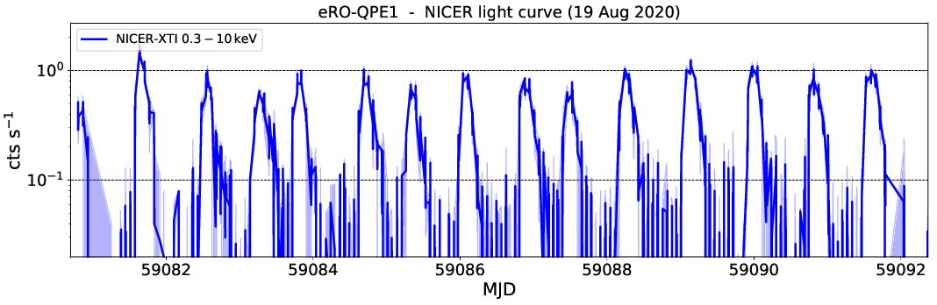
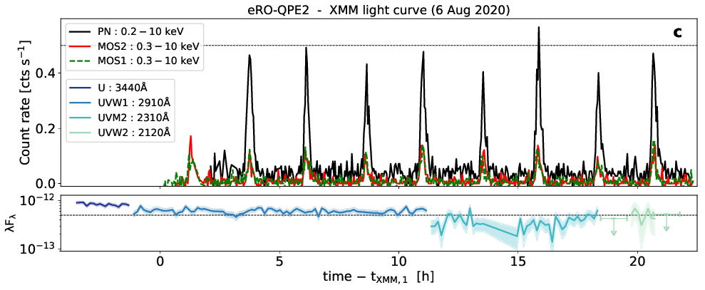
Searching for QPEs with eROSITA
In the first year of eROSITA operations we have found 2 more (Arcodia+21, Nature)
eRO-QPE1
eRO-QPE2
Arcodia+21
Arcodia+21
<P>~18.5h
<P>~2.5h
length ~ 11 days!
length ~ 1 day!

Slide 21
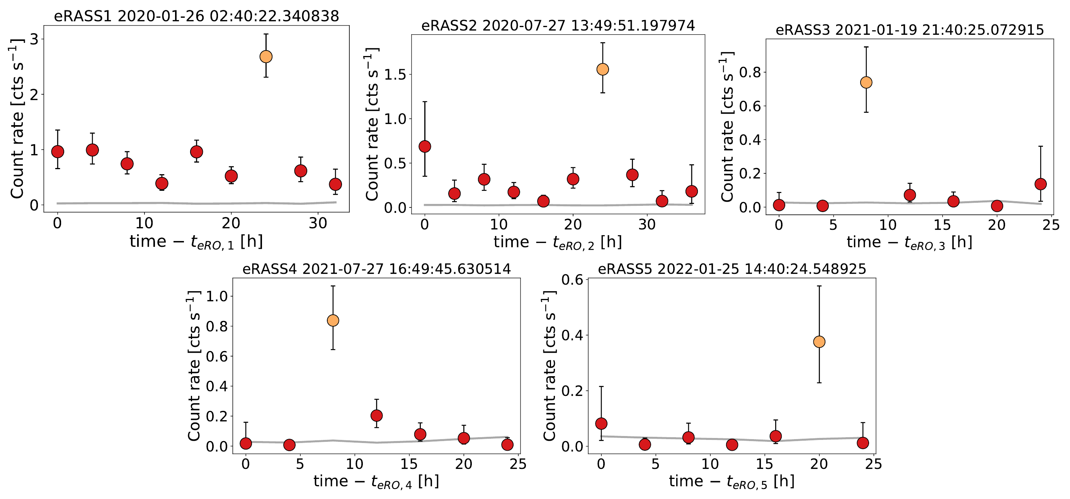
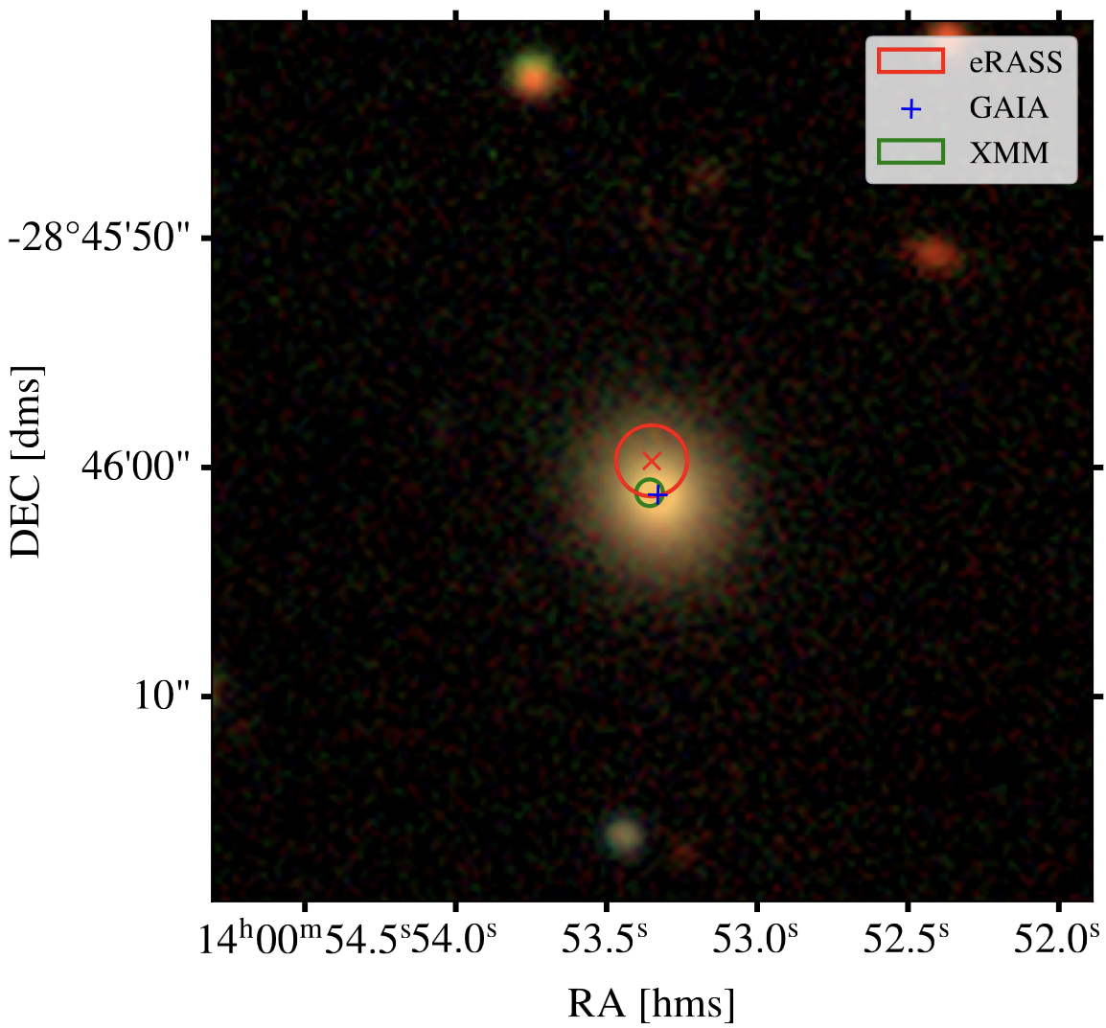
Searching for QPEs with eROSITA
Multiple surveys (4-5) can be used: eRO-QPE3!
eRO-QPE3
Arcodia e al., in prep.

Slide 22
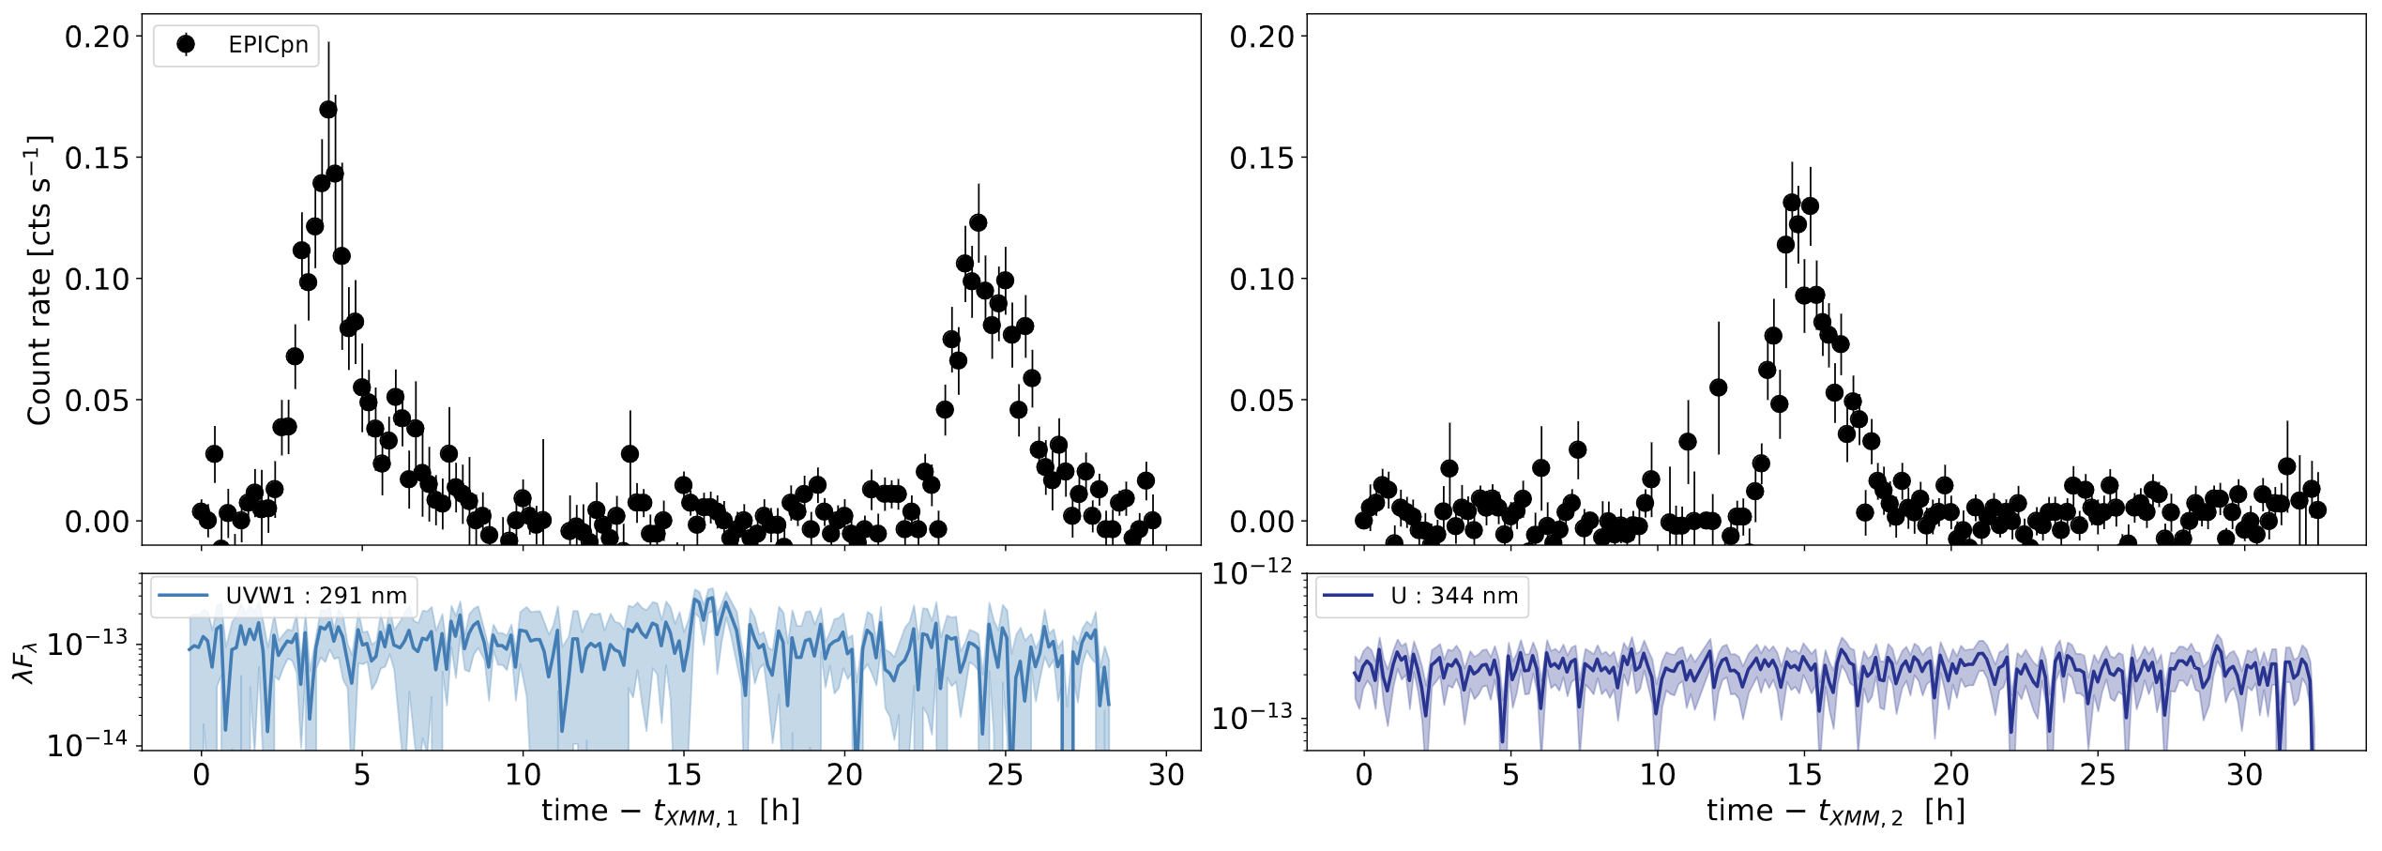
Searching for QPEs with eROSITA
Multiple surveys (4-5) can be used: eRO-QPE3!
eRO-QPE3
~20 hours!
X-ray
UV
Arcodia+ in prep.

Slide 23
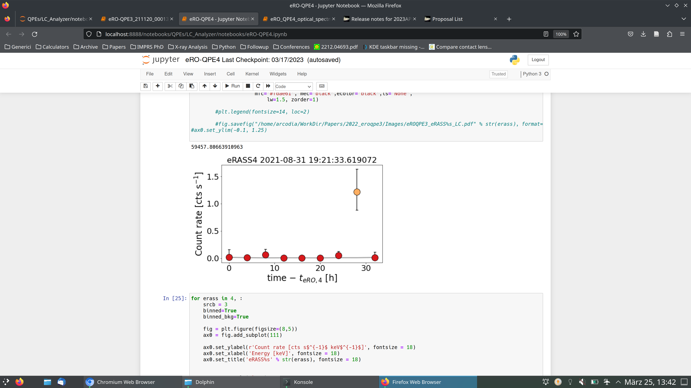
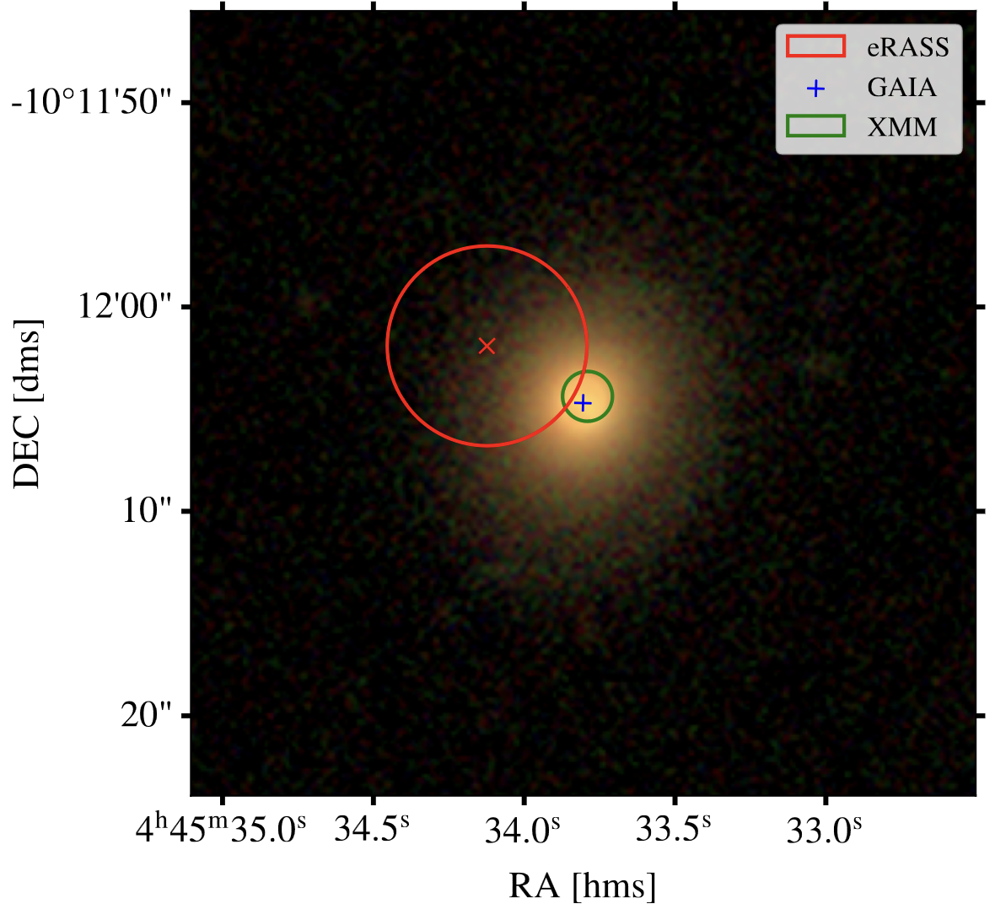
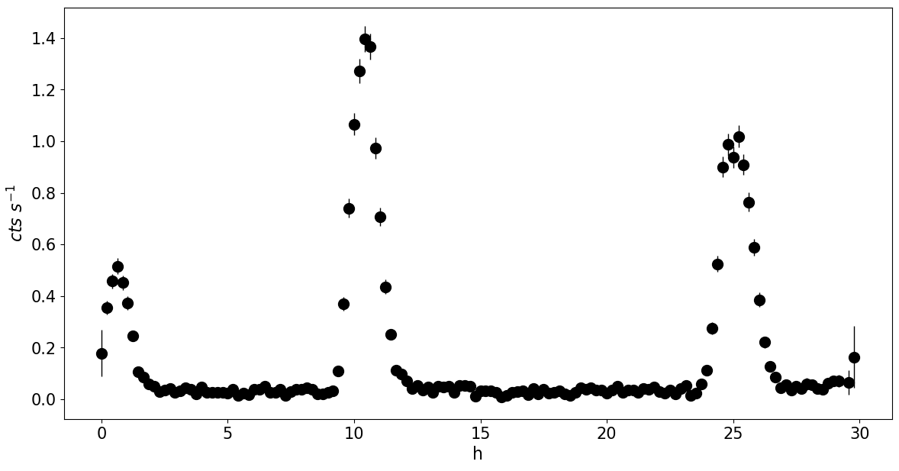
Searching for QPEs with eROSITA
Multiple surveys (4-5) can be used: eRO-QPE4!
eRO-QPE4
Undetected in eRASS1-3
~15 h
XMM X-ray
~10 h

Slide 24
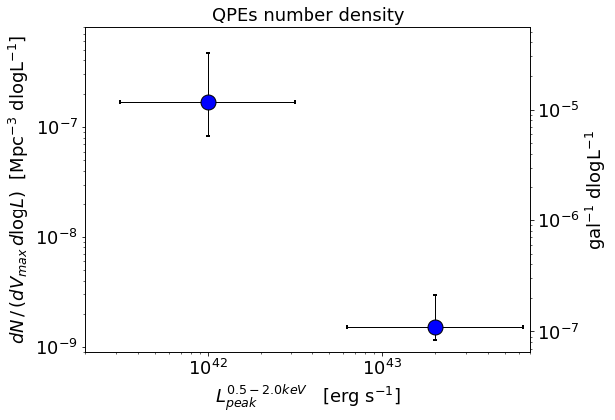


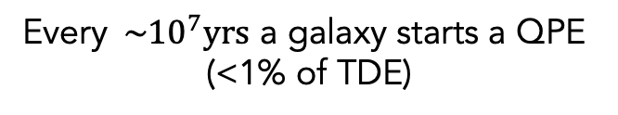
Intrinsic volumetric rates
Computing the rates of these events with eROSITA QPEs (Arcodia+ in prep.)
To be updated
$$1 every {10}^{5} gal has QPEs$$
$$(gal \sim {10}^{9}M_{∗})$$
Number density of QPEs
If a lifetime of ~100yr is assumed:
Every ${\sim 10}^{7}yrs$ a galaxy starts a QPE
(<1% of TDE)
Arcodia+ in prep.
Lower limit of EMRI rates!

Slide 25
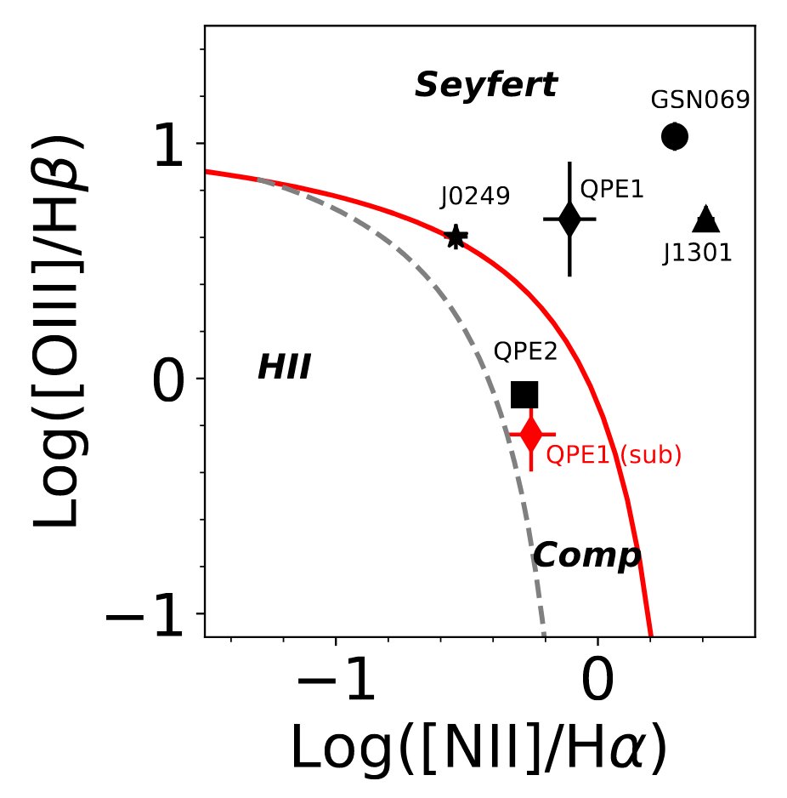
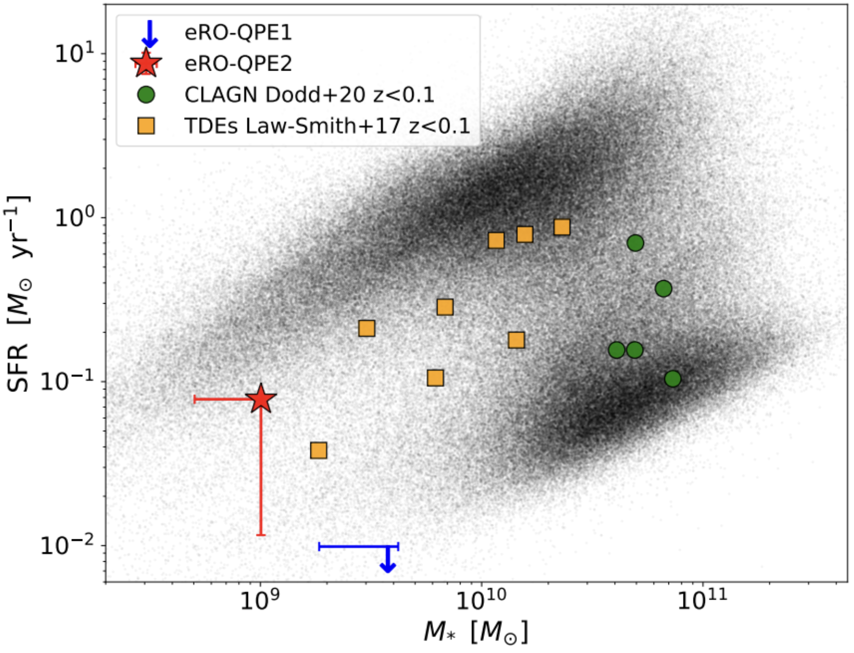
QPE hosts: low-mass inactive galaxies
QPE3
eRO-QPE3
eRO-QPE3
Wevers+22, Arcodia priv. comm.
z~0.024

Slide 26
QPE-TDE connection
GSN 069 X-ray lightcurve (Miniutti et al. 2023)

Slide 27
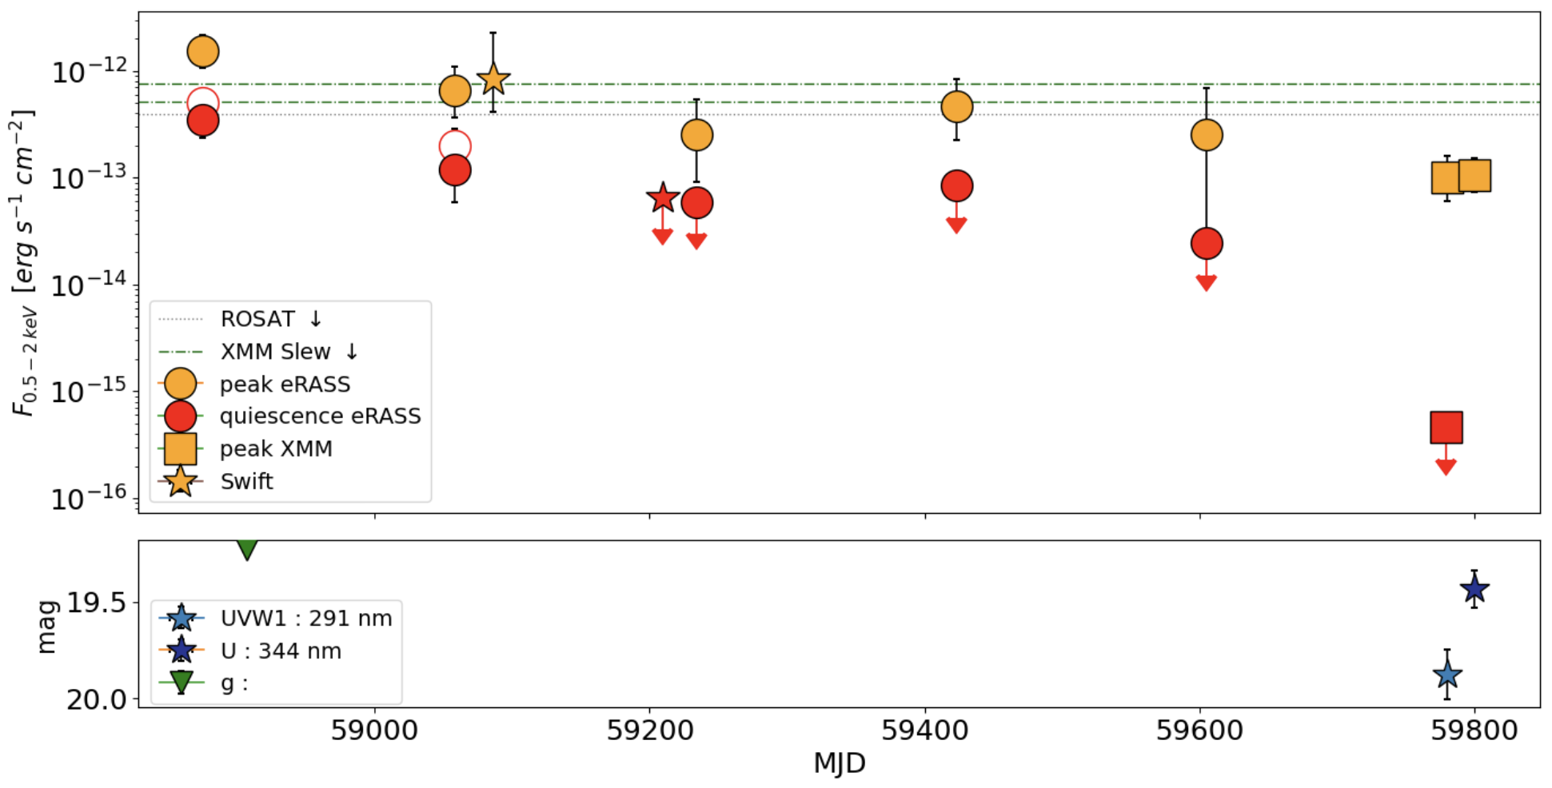
QPE-TDE connection
eRO-QPE3’s quiescence shows evidence of TDE-like decay in X-rays
eRO-QPE3
Arcodia e al., in prep.

Slide 28
QPE-TDE connection
eRO-QPE3’s quiescence shows evidence of TDE-like decay in X-rays
eRO-QPE3
-0.5
-2.4
Arcodia e al., in prep.

Slide 29
QPE-TDE connection
eRO-QPE3’s quiescence shows evidence of TDE-like decay in X-rays
Anywhere on the QPE: lower-limit for the peak
eRO-QPE3
QPE peak
Arcodia e al., in prep.
(Miniutti+23a,b)
Seen in GSN 069 too

Slide 30
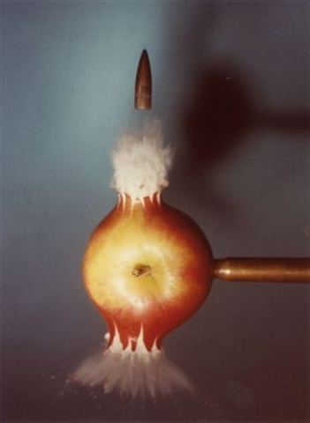
EMRI+TDE=QPE?
Linial & Metzger (2023)
QPE are produced by EMRIs, revealed by a TDE

Slide 31
Searching for TDE in eROSITA
Grotova et al. in prep.
Arne Rau
~25 with soft spectra (Golden sample)

Slide 32

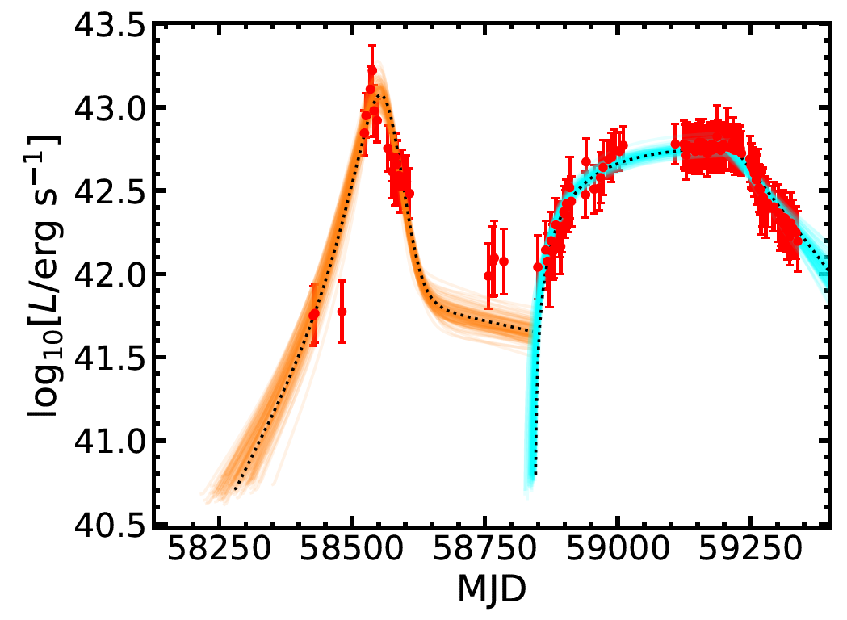
AT 2019avd: TDE with two-phase evolution
Malyali et al 2021
(J.-H. Chen et al. 2021, arXiv:2106.08835)
Double-peaked optical light curve modelled with two components:
  Succession of self-crossing, i.e. circularisation of debris stream (orange)
  Delayed accretion (cyan)
Consistent with X-ray peak coinciding with second optical peak.
Similar lightcurve now seen also in AT2021mhg (Munoz-Aranciba)
Optical/UV bolometric Luminosity

Slide 33
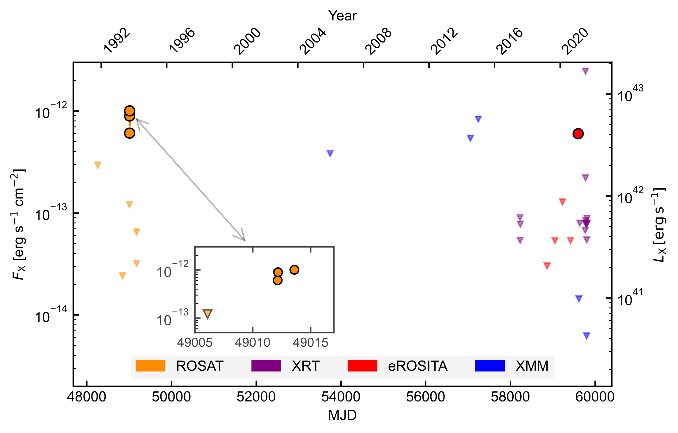
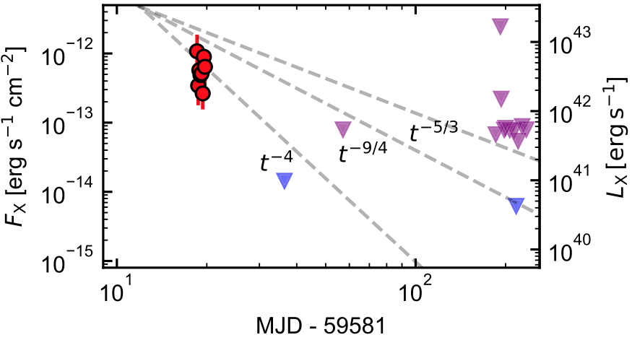
RX J133157.6−324319.7:
Reawakened ROSAT TDE (Malyali+23b)
eRASS5 discovery >30yr after ROSAT reported TDE (Reiprich & Greiner 01; Hampel+22)
z=0.052
Decay by >factor of 40 within ~17d revealed by XMM-Newton
No associated transient optical/UV emission
2nd TDE extremely unlikely (<5x10^{–6})
Favoured interpretation: partial, repeating TDE
Steep decay suggests a star on an elliptical orbit, in agreement with theory (Ryu+20)

Slide 34

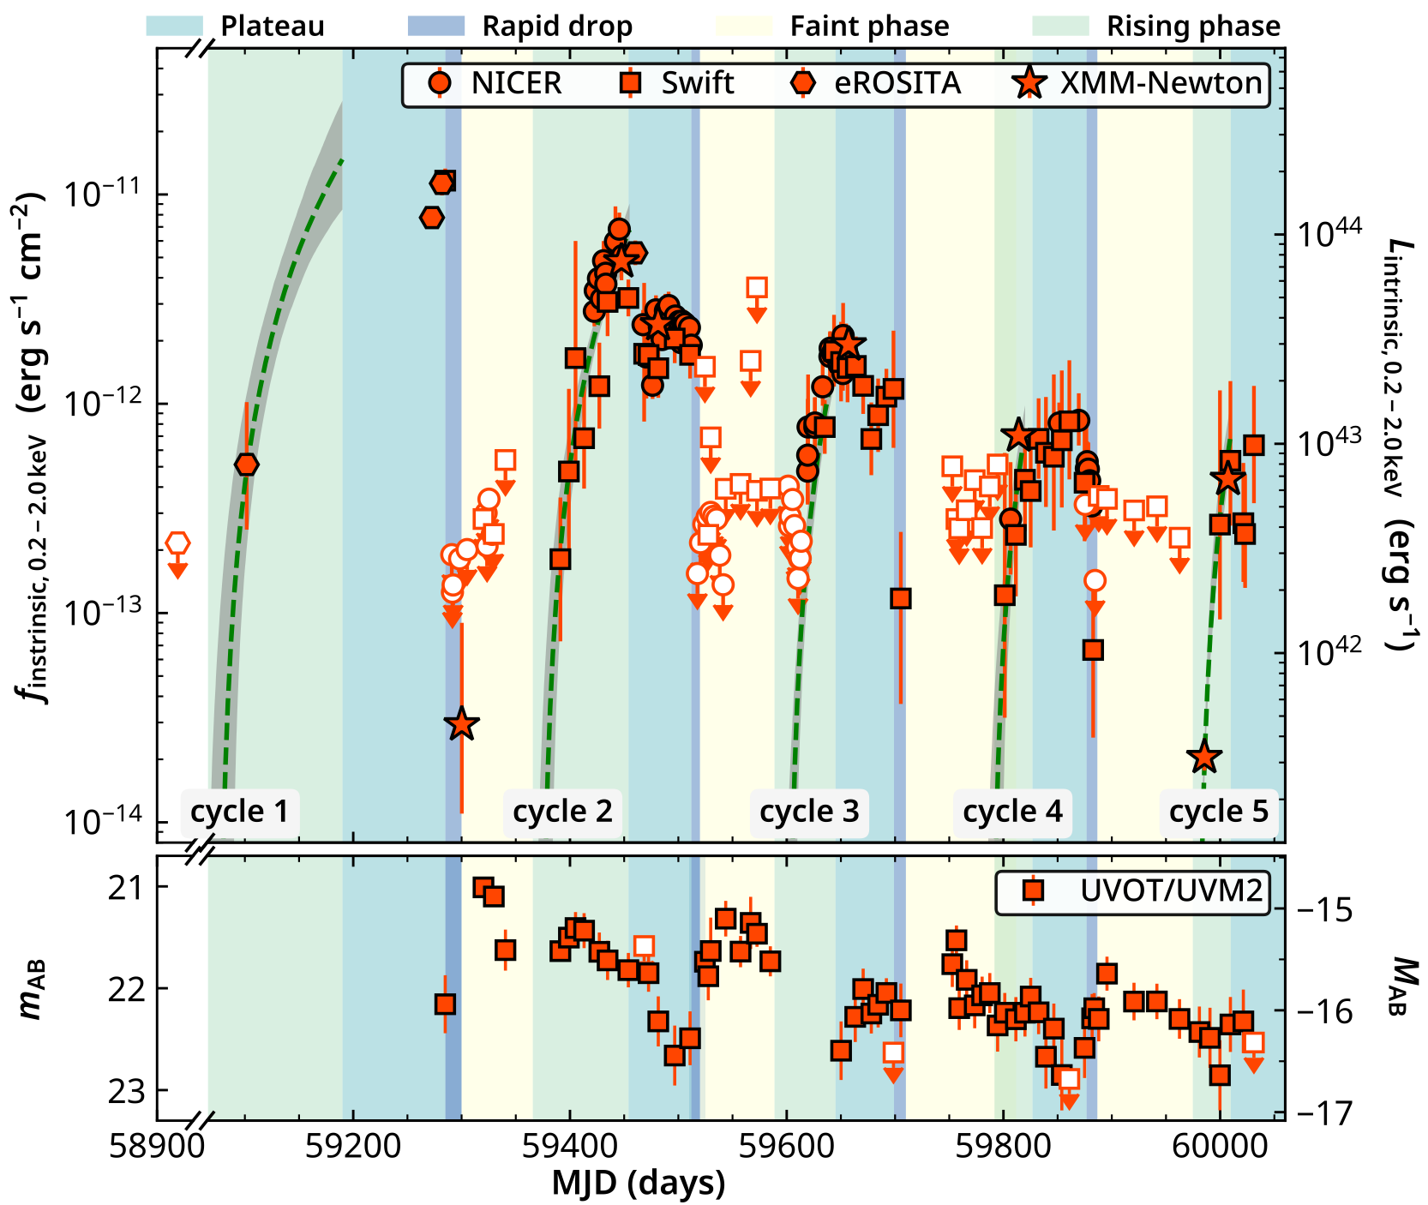
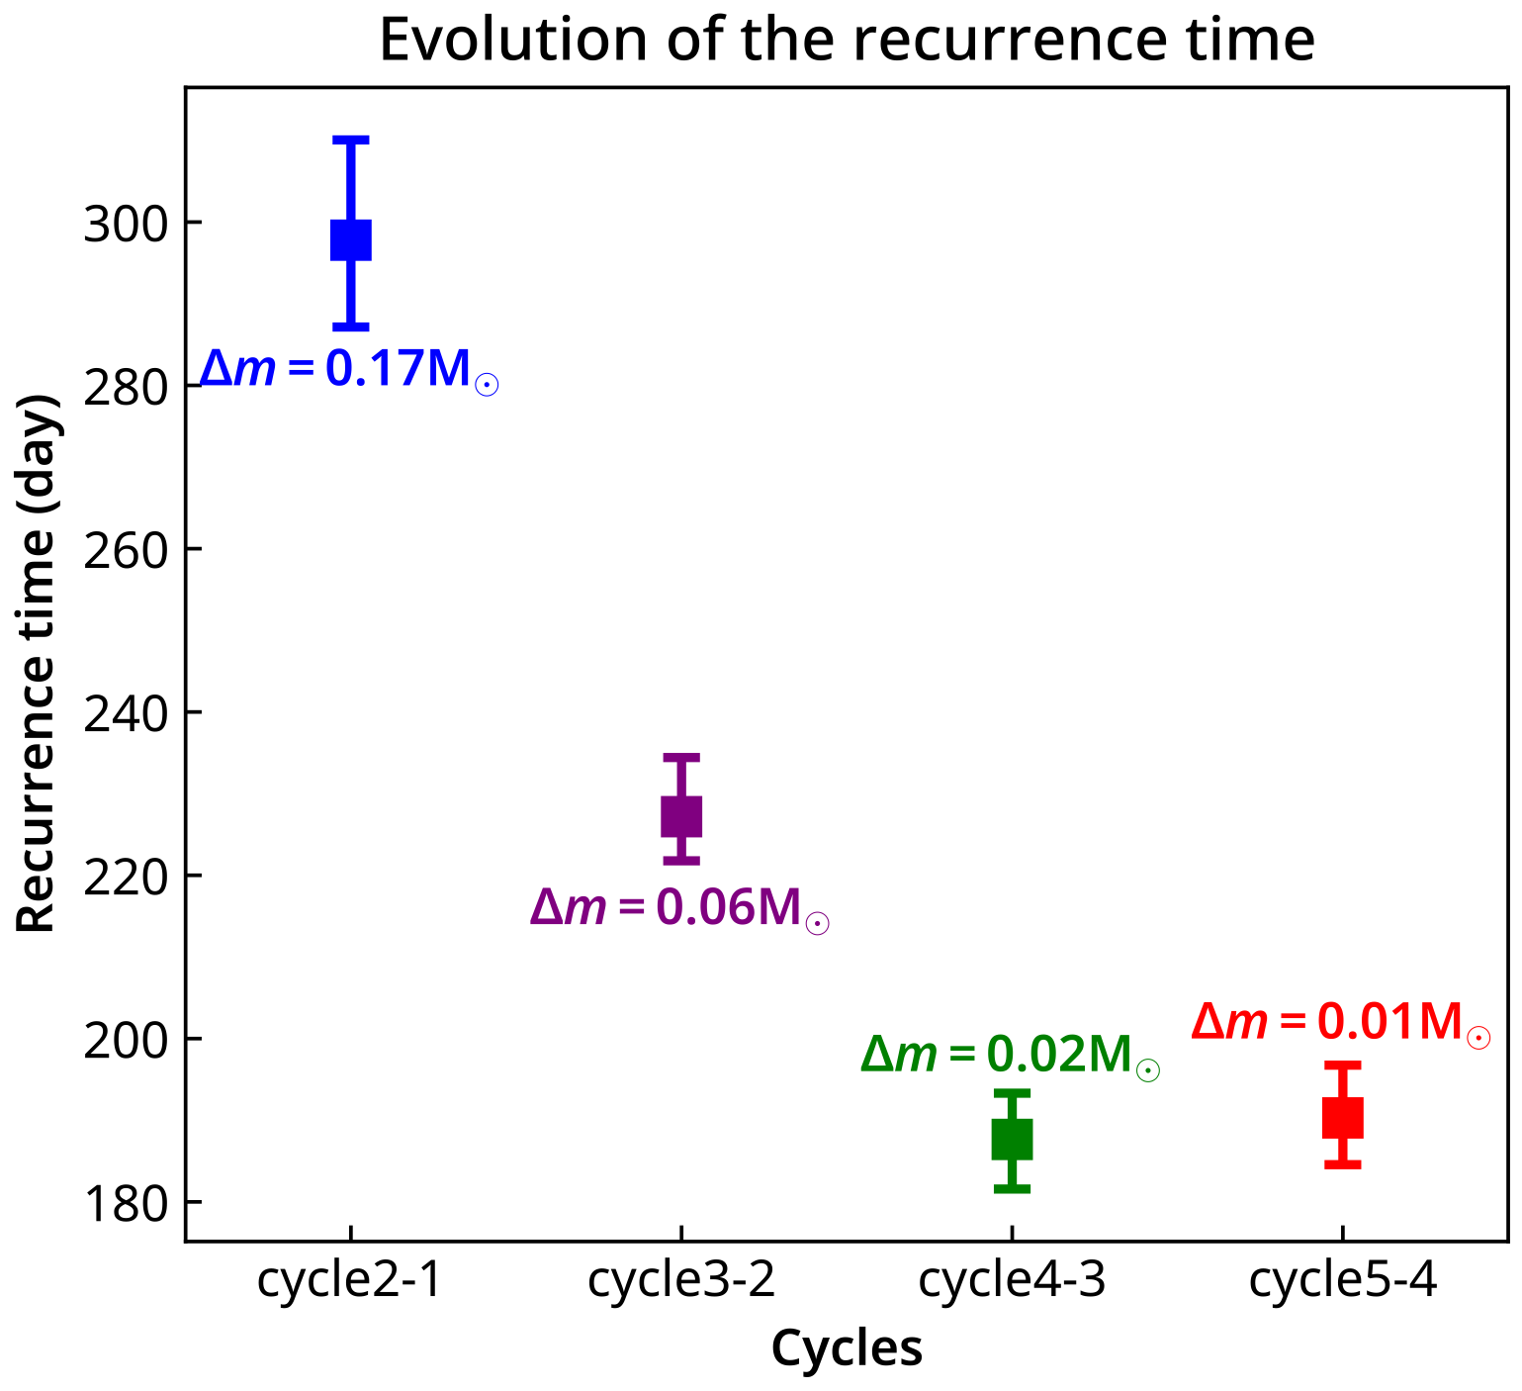
Long-term X-ray/UV variability of J0456-20
Liu et al. 2023, A&A, 669, A75; ESA, MPE press releases; Nature research highlight
Extremely variable and repeatedly flaring
Drastic X-ray flux drop: ~300 in 16 days
Repeating X-ray and UV flares
  Four phases: rising → plateau → drop → faint
  Recurrence time of ~220 days
Transient radio emission
  Decreased by a factor of a few in 2 weeks
A repeating pTDE as the most plausible explanation (4 in total, Payne et al. 2021, Malyali et al. 2023, Wevers et al. 2023)
J0456: Liu et al. in prep.

Slide 35

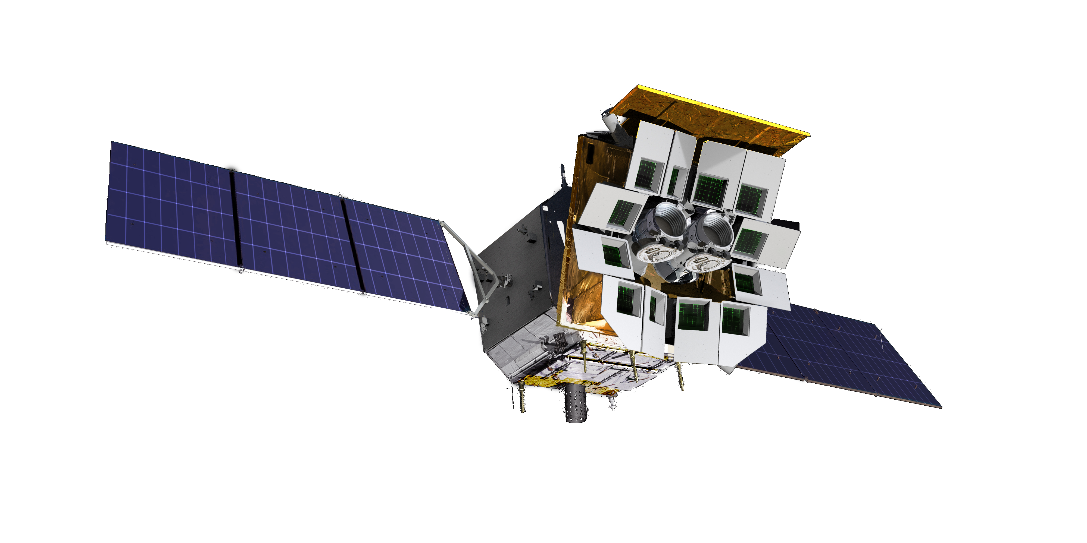

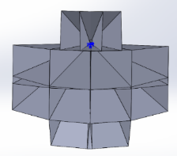
Einstein Probe (EP) mission
EP: A space mission for all-sky monitoring to discover & study high-energy transients and variability in soft X-rays
Satellite Capabilities:
On-board data reduction & transient search.
Autonomous follow-up obs.
Alert data rapid downlink
(BD & VHF)
Fast ToO uplink (BD)
WXT (12 modules)
FXT (2 modules)
lobster-eye MPO + CMOS
FoV: 3600 sq deg (1.1 sr)
band: 0.5 - 4 keV soft X-ray
eff. area: ~3 cm² @1keV
FWHM: ~ 5’, positioning <1’
Sensitivity: > 10 x increase
Field of View
Wolter-1 type + CCD
FoV: 38’
band: 0.3 - 10keV
eff. area: 2x 300cm² @1keV
angular FWHM: 30”
positioning accuracy: <10”

Slide 36
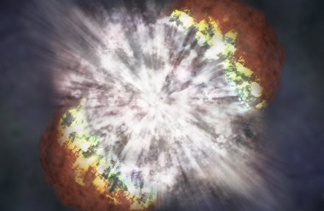
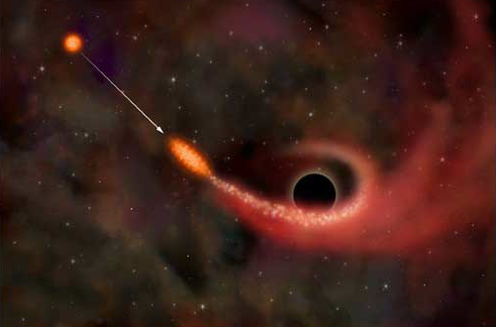
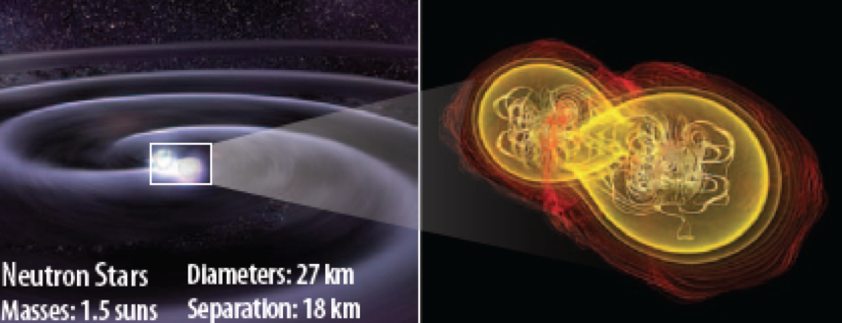
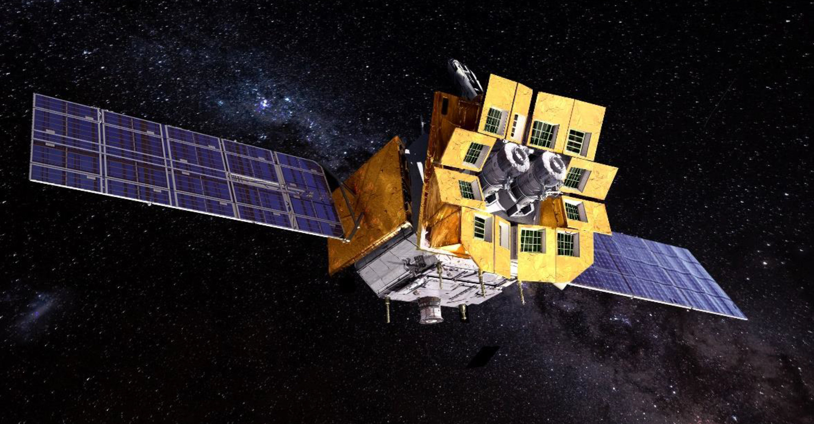
Main science goals
Einstein Probe (EP) mission
Carry out systematic survey of soft X-ray transients and variability of X-ray sources at unprecedented sensitivity and high cadence
Discover otherwise quiescent Black holes at all astrophysical mass scales and other compact objects by capturing their transient flares
Credit: NASA
Detect and localize the electromagnetic-wave sources of gravitational-wave events by synergy with gravitational-wave detectors
for more information please visit http://ep.bao.ac.cn

Slide 37
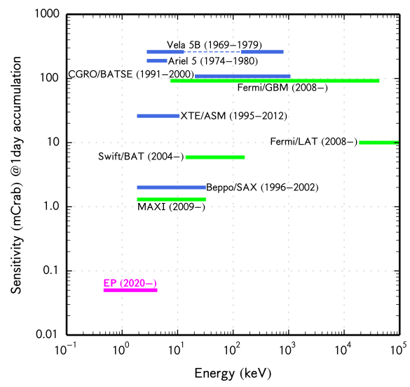
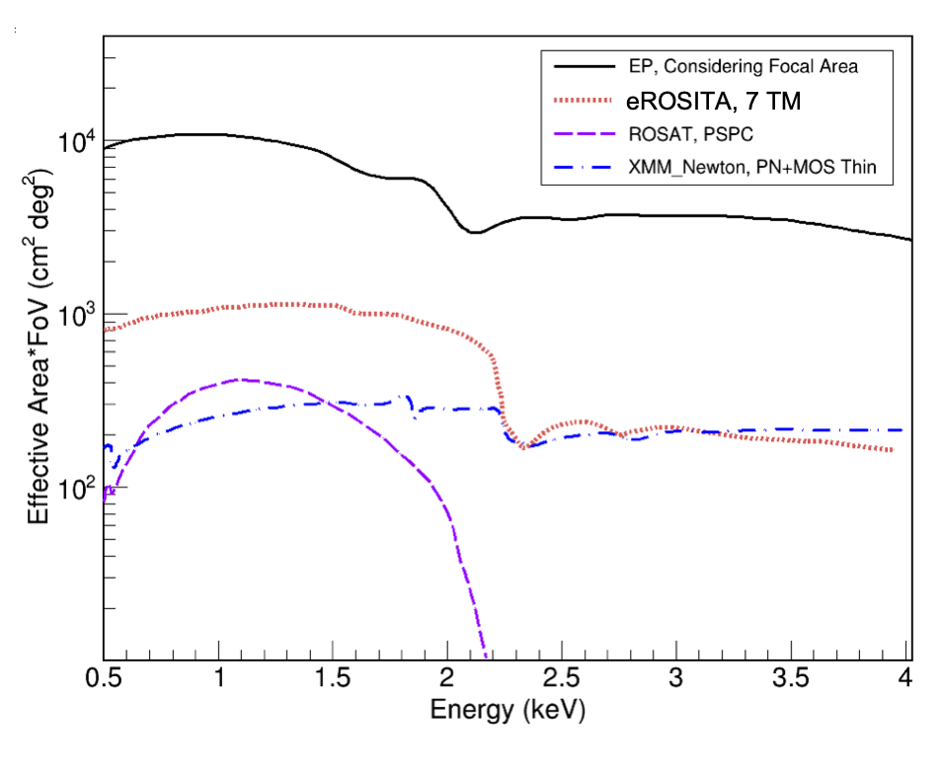
EP Wide-field X-ray Telescope (WXT)
GRASP
eROSITA, 7 TM
EP 2024-
> 1 order of magnitude increase in sensitivity!

Slide 38
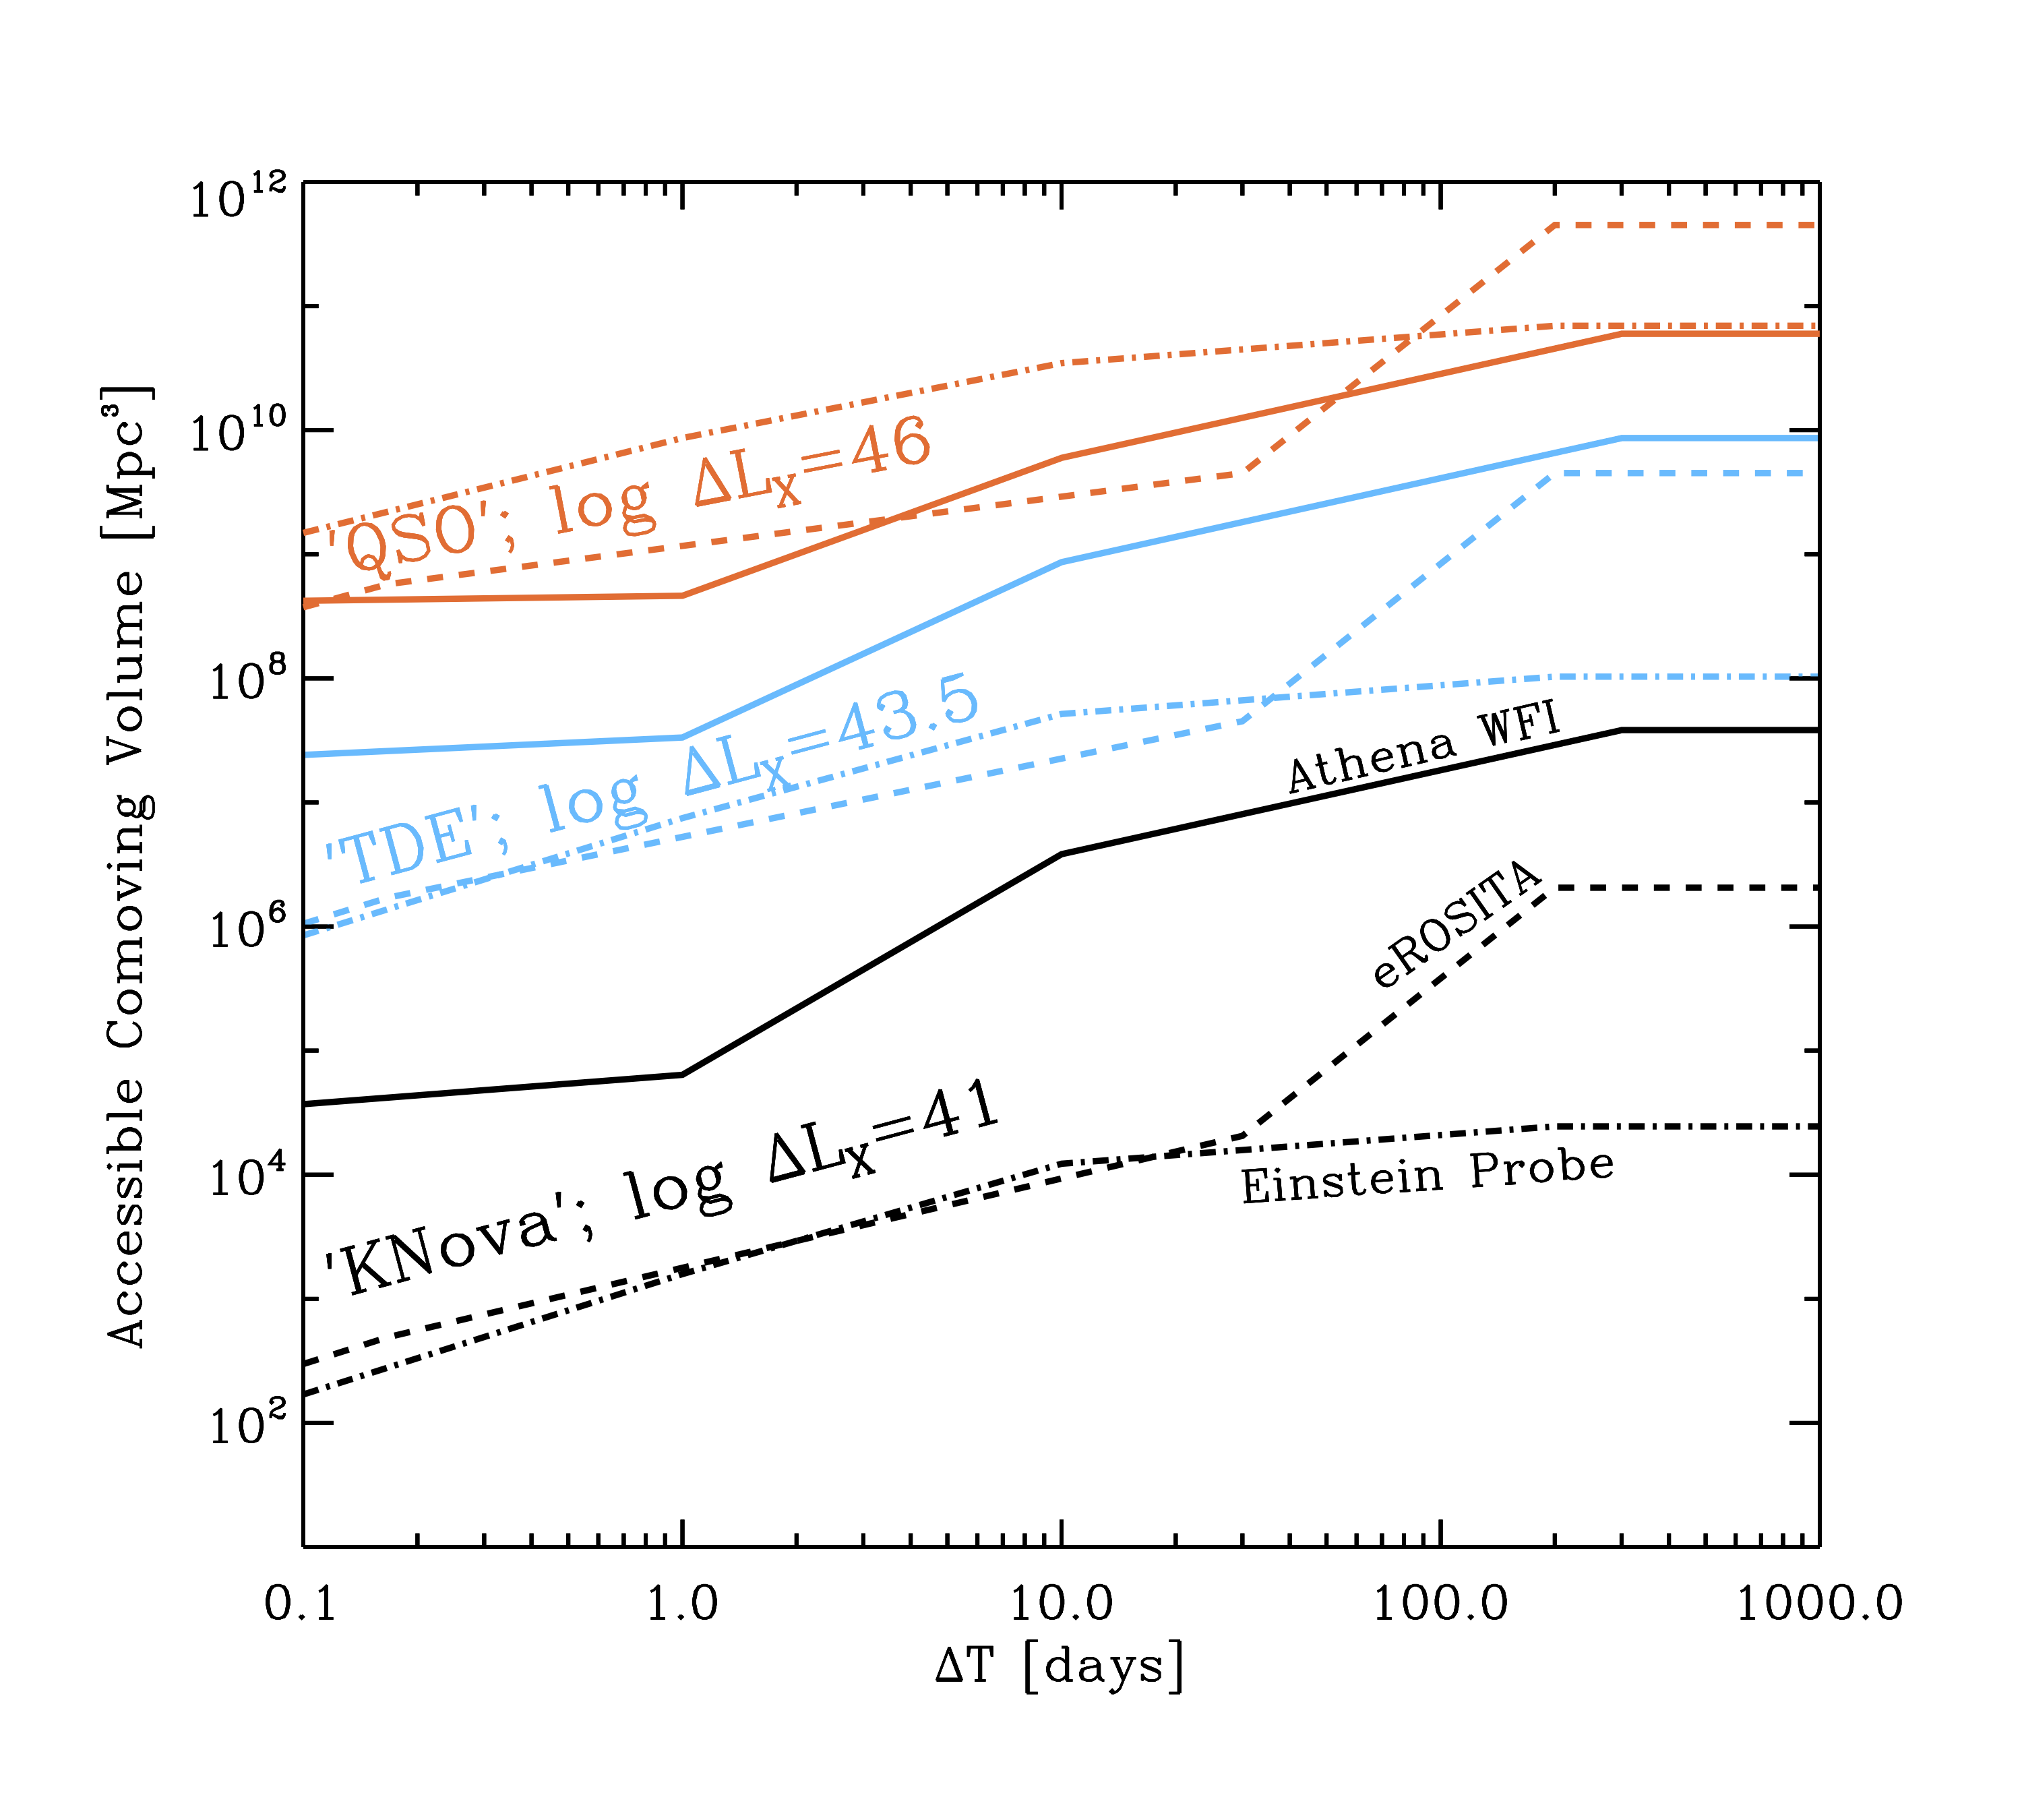
Accessible Volumes
Accessible Volume to detect a luminosity variation ΔL_{X} over a timescale ΔT.
Assumes a given survey plan (somewhat arbitrary for WFI)
STAR-X (NASA smex mission in final selection stage) will have capabilities intermediate between Athena and eROSITA
z=4.2
EP
eRO
WFI
WFI
z=0.42
eRO
EP
z=0.029
Solid: Athena WFI
Dashed: eROSITA
Dot-dashed: EP

Slide 39
Conclusions
New Wide-area, high-grasp X-ray surveys are opening up new parameter spaces for the discoveries of “exotic” transients in galactic nuclei
The first discoveries are all potentially connected with stellar dynamics around I/SMBH. This is just the tip of the iceberg
QPE sgow a quite diverse set of detailed characteristics, but some common features (spectral evolution, host galaxies). How much of this is due to selection effects?
We have a number of robust candidate Partial/repeating TDE
eROSITA data, even just the 4.4 surveys have not been fully exploited
Major bottleneck: X-ray followup, monitoring, calssification is resource limited. Crucial support from Swift-Gehrels, XMM-Newton, NICER
Future X-ray missions have huge potential for more discoveries and characterization:
  Einstein Probe (launch Dec. 2023); possibly STAR-X (launch ~2028) and Athena (launch >2035)

Slide 40










www.mpe.mpg.de/eROSITA
Thank you

