Slide 1
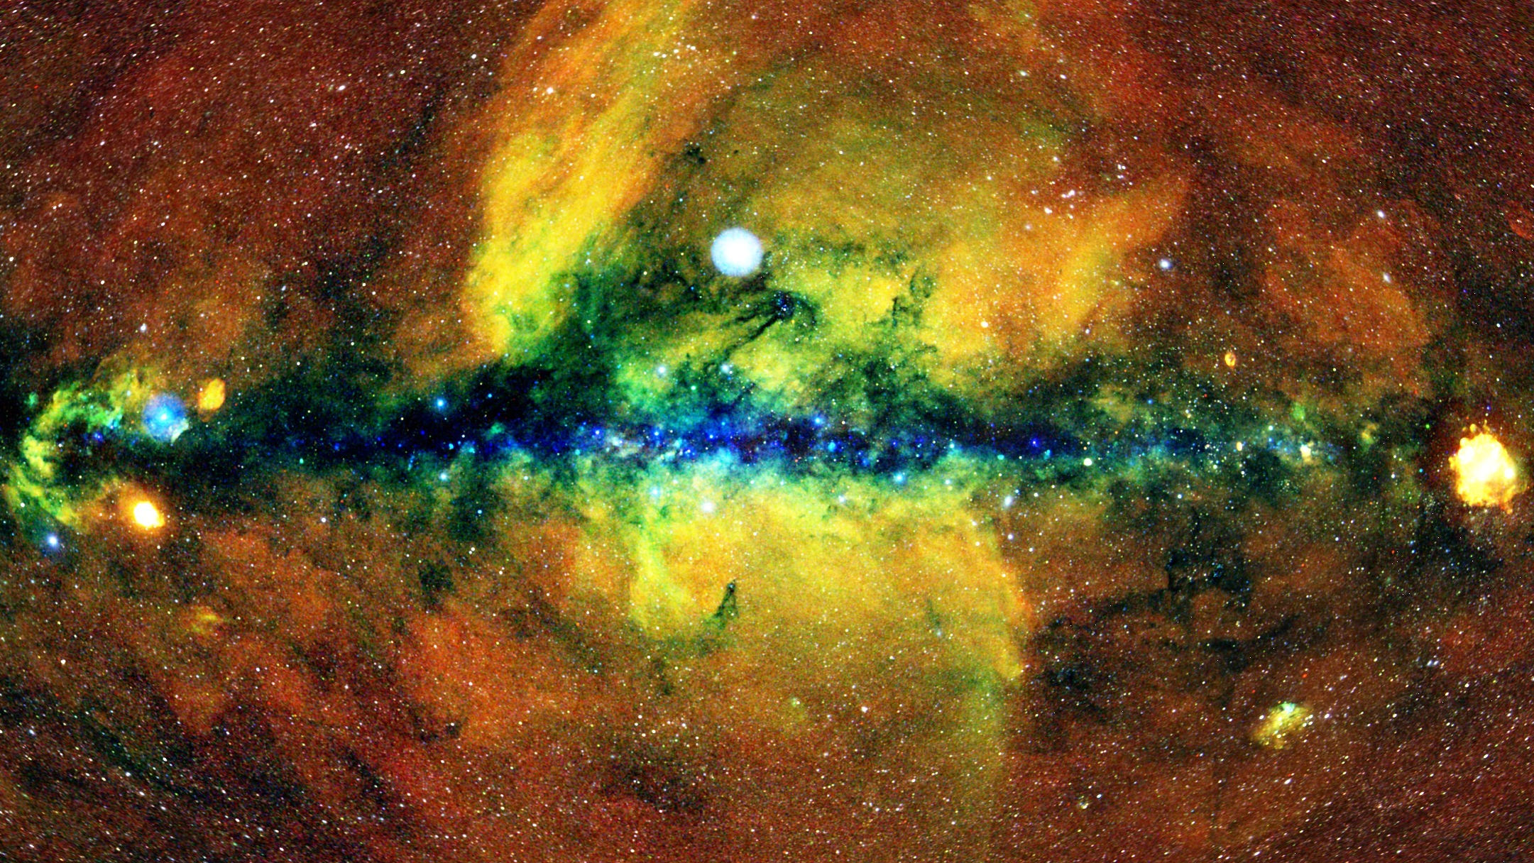


The eROSITA sky survey and its first data release
Jeremy Sanders and Miriam Ramos-Ceja
Max Planck Institute for Extraterrestrial Physics (MPE)
On behalf of the eROSITA-DE team

Slide 2
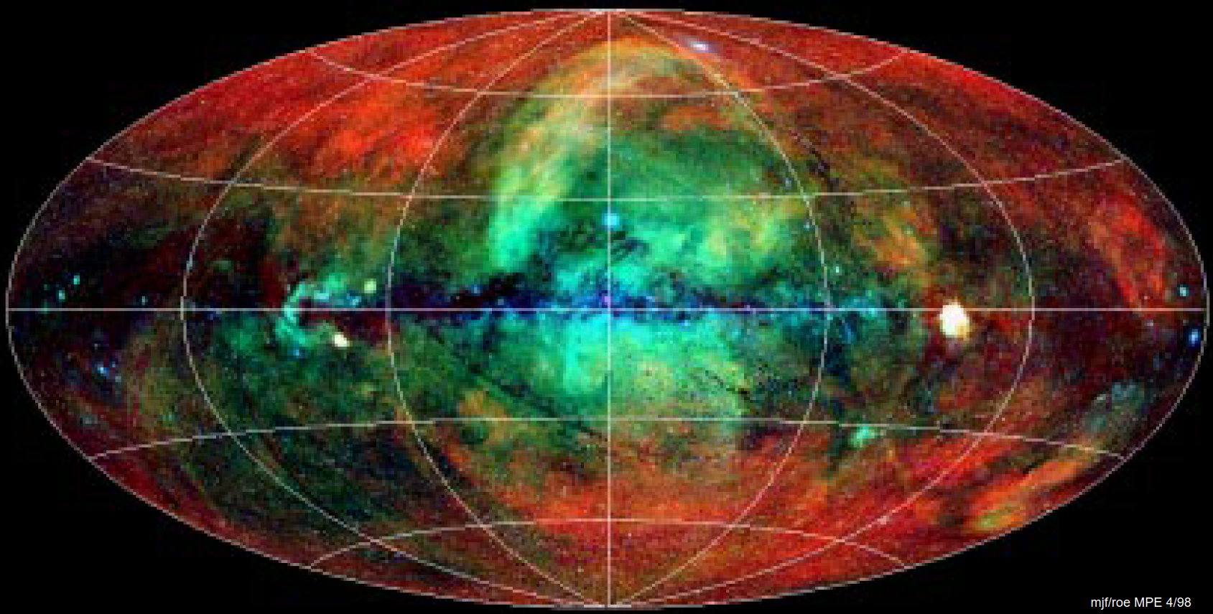
Introduction
The only all-sky X-ray survey of the sky before eROSITA was made by ROSAT in the 90s
It detected 10⁵ sources in its six months of survey
The Chandra and XMM-Newton telescopes are much more sensitive than ROSAT was, but the area of the sky covered by their observations is small
Many compelling reasons to launch an eROSITA-like telescope to make a deep X-ray survey, including to constrain cosmological parameters (Merloni et al. 2012)
ROSAT All-Sky Survey (RASS) RGB image (0.1-0.4, 0.5-0.9, 0.9-2.0 keV) in Galactic coordinates (MPE; Freyberg)

Slide 3
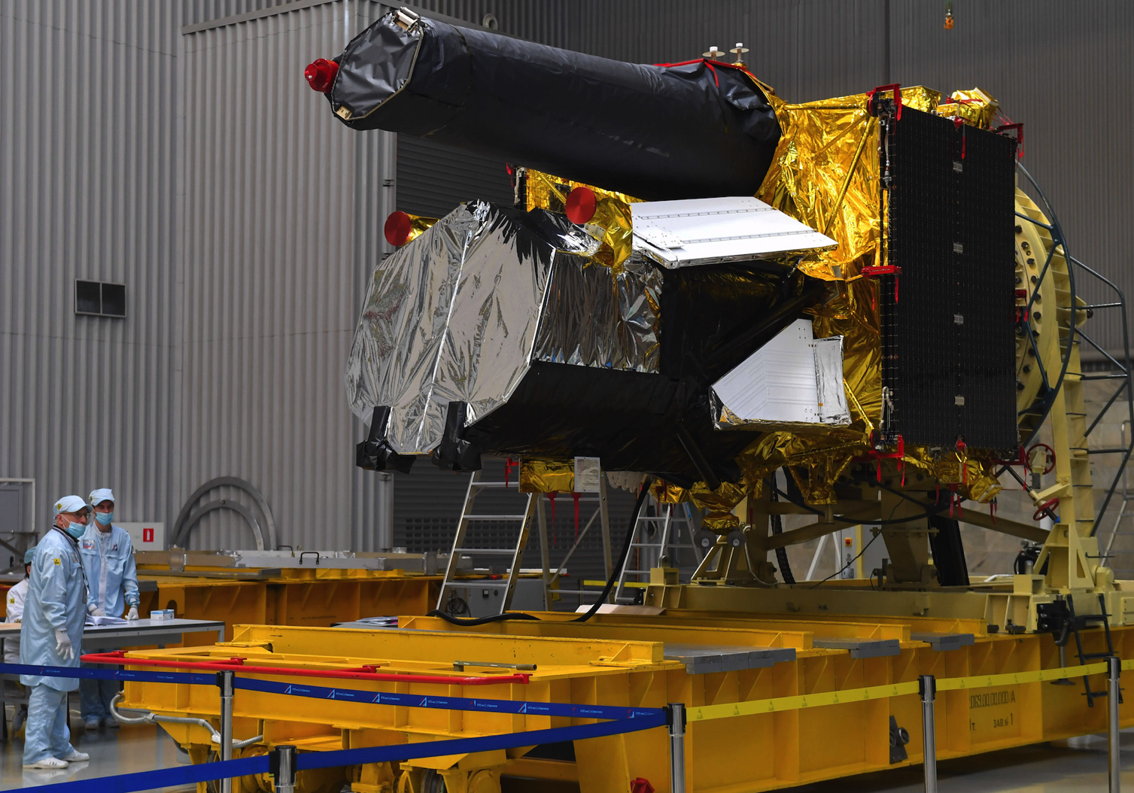

Mikhail Pavlinsky
ART-XC
‘Navigator’
platform
eROSITA is an X-ray telescope optimised for X-ray surveys, onboard the SRG observatory
SRG is a joint mission between Russian and German institutes and agencies
eROSITA is the German contribution to the mission
Spektr-RG (SRG) just before shipment to Baikonur. Photo credit: S. Mamontov, RIA Novosti.

Slide 4
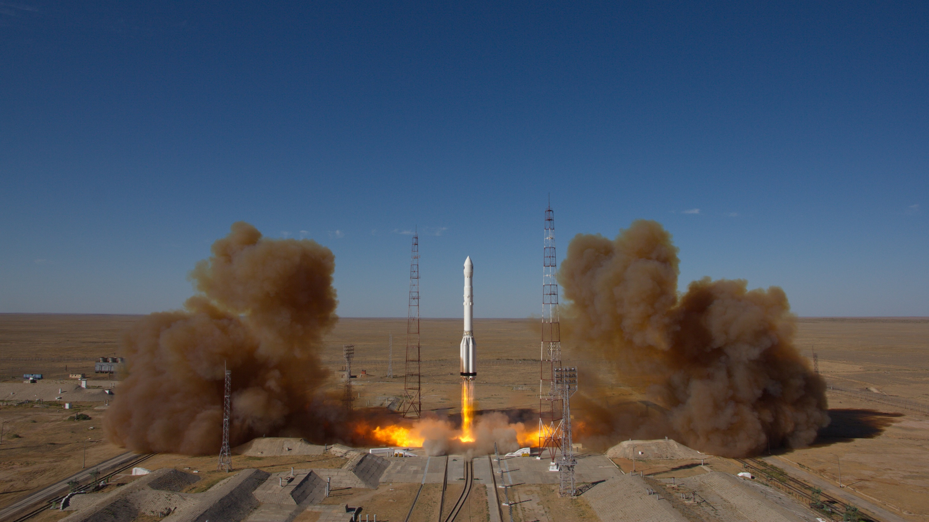
eROSITA onboard SRG was launched on a Proton rocket successfully from Baikonur on the 13th July, 2019

Slide 5
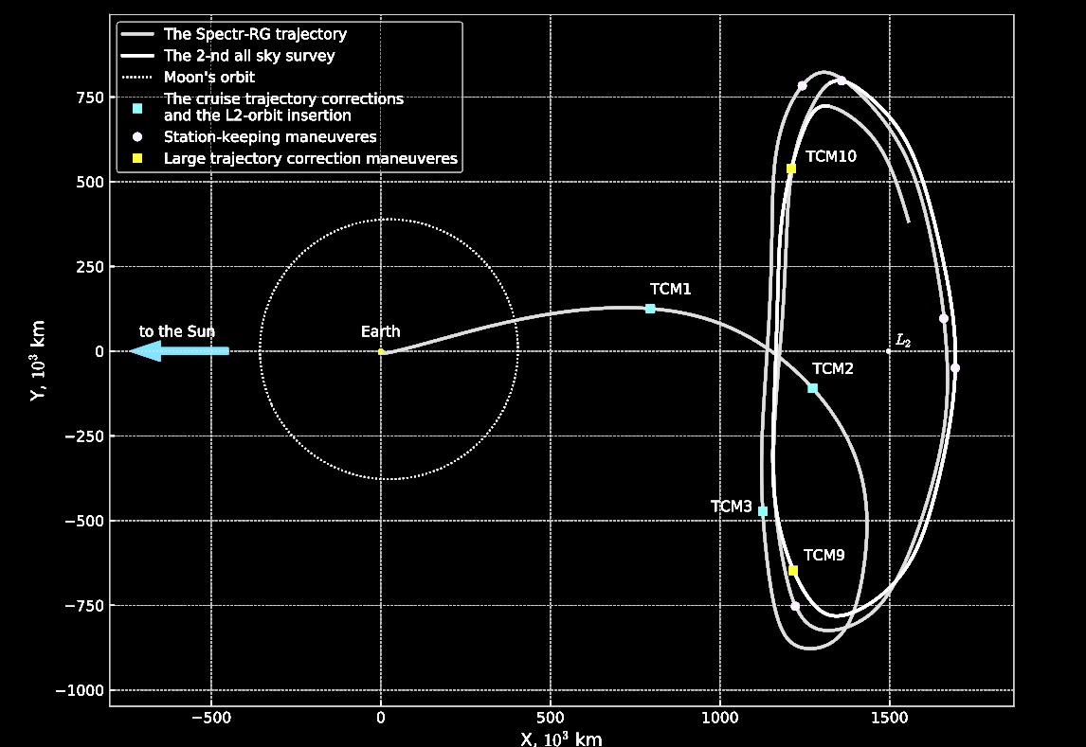

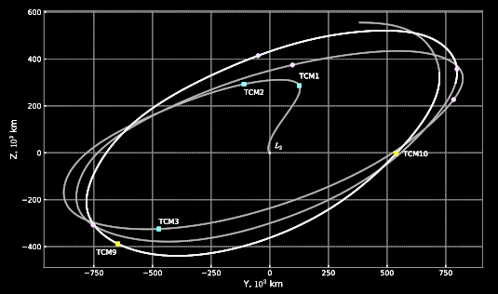
SRG orbit and survey
X, 10³ km
A large L2 halo orbit
Sunyaev et al. 2021
Survey progression in first 6 months (counts, 0.3-2.3 keV)

Slide 6
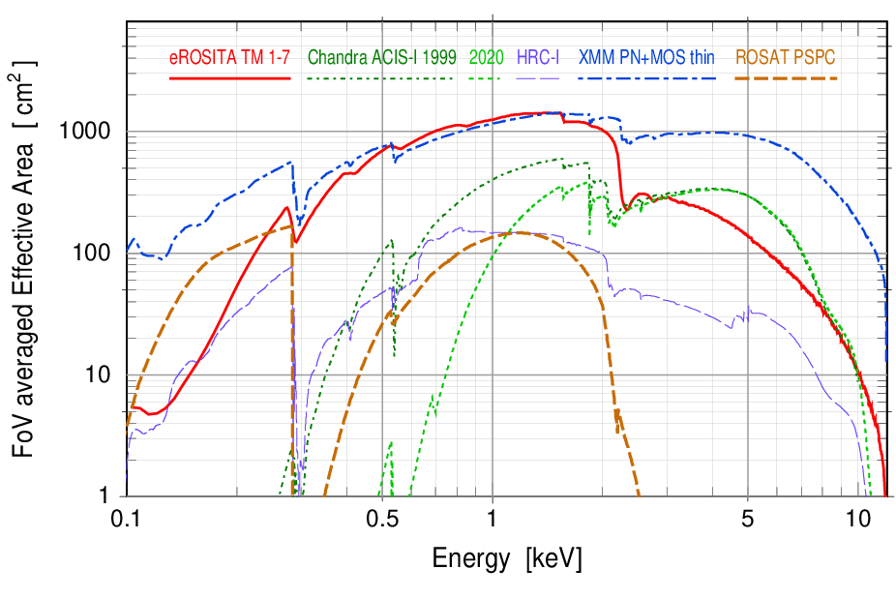
eROSITA’s advantage over existing X-ray telescopes
At 1 keV, eROSITA’s average effective area is the same as XMM-Newton but the field of view is much larger
Moon diameter
30 arcmin
XMM-Newton
Field of view ∼ 30 arcmin
Chandra
Field of view ∼ 17 arcmin
eROSITA
Field of view ∼ 62 arcmin
Scanning
+
Spinning every four hours means sources are visited 6 times on average every survey (6 months). Planned total of eight surveys.
5× faster survey speed
Easy to model, stable background

Slide 7
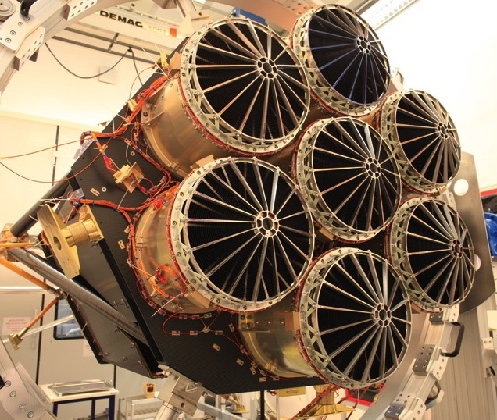
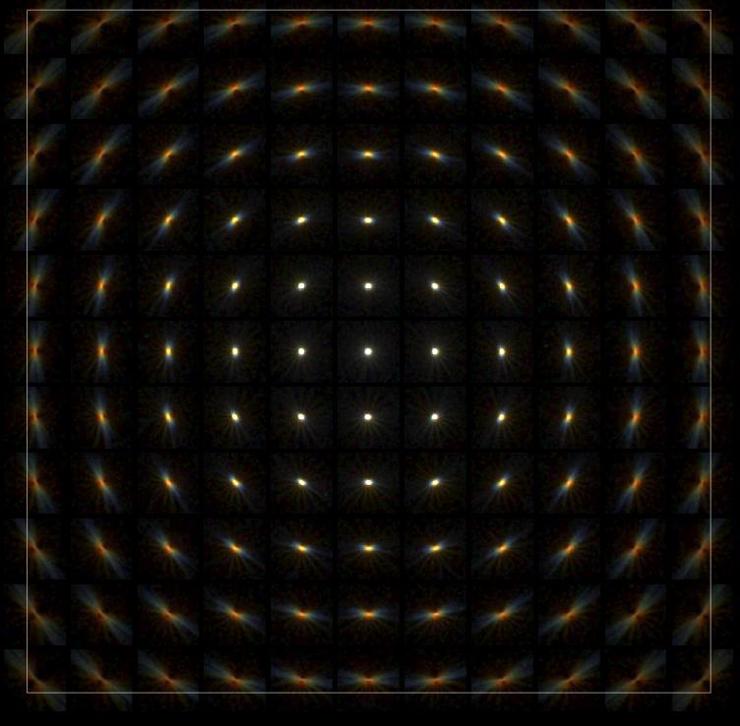
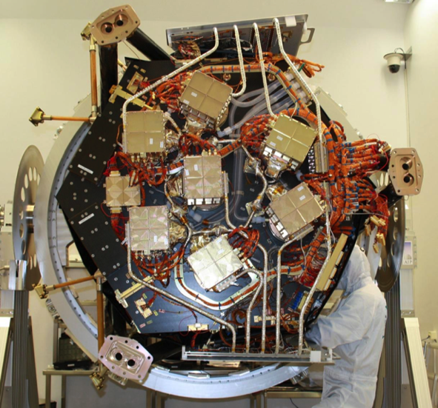
The telescope
Made up of seven telescope modules (containing telescopes and cameras)
Half-Energy width (HEW) ∼18” (on-axis, point.); ∼30” (FoV avg., survey)
  Positional accuracy: ∼4.5” (1σ)
X-ray baffle: 92% stray light reduction
pn-CCD with framestore: 384×384×7 ∼ 10⁶ pixels (9.4”), no chip gaps, no ‘out of time’ events
Spectral resolution at all measured energies good for CCD X-ray detector (∼ 80eV @1.5keV)

Slide 8
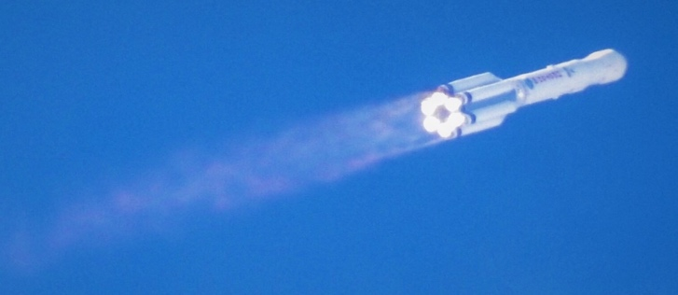
eROSITA timeline
eRASS = eROSITA All-Sky Survey
eRASSn – nth 6-month all-sky survey
eRASS:n – nth cumulative survey
CalPV:
Calibration and
Performance Verification
2022-02-26
eROSITA in safe mode
eRASS8
All-sky survey
eRASS1
eRASS3
eRASS2
eRASS4
eRASS5
eRASS6
eRASS7
2.5-years pointed observations
GTO/GO phase
2019
2020
2021
2022
2023
2024
2025
2026
Launch
July 1st 2021: EDR
CalPV data and
associated papers
DR1
eRASS1
Q3 2023
DR2
Q4 2024
TBC
DR3
Q1 2026
TBC
Early Data Release (EDR) in 2021: several fields, including eFEDS mini-survey
Preparation ongoing for DR1 in autumn 2023

Slide 9
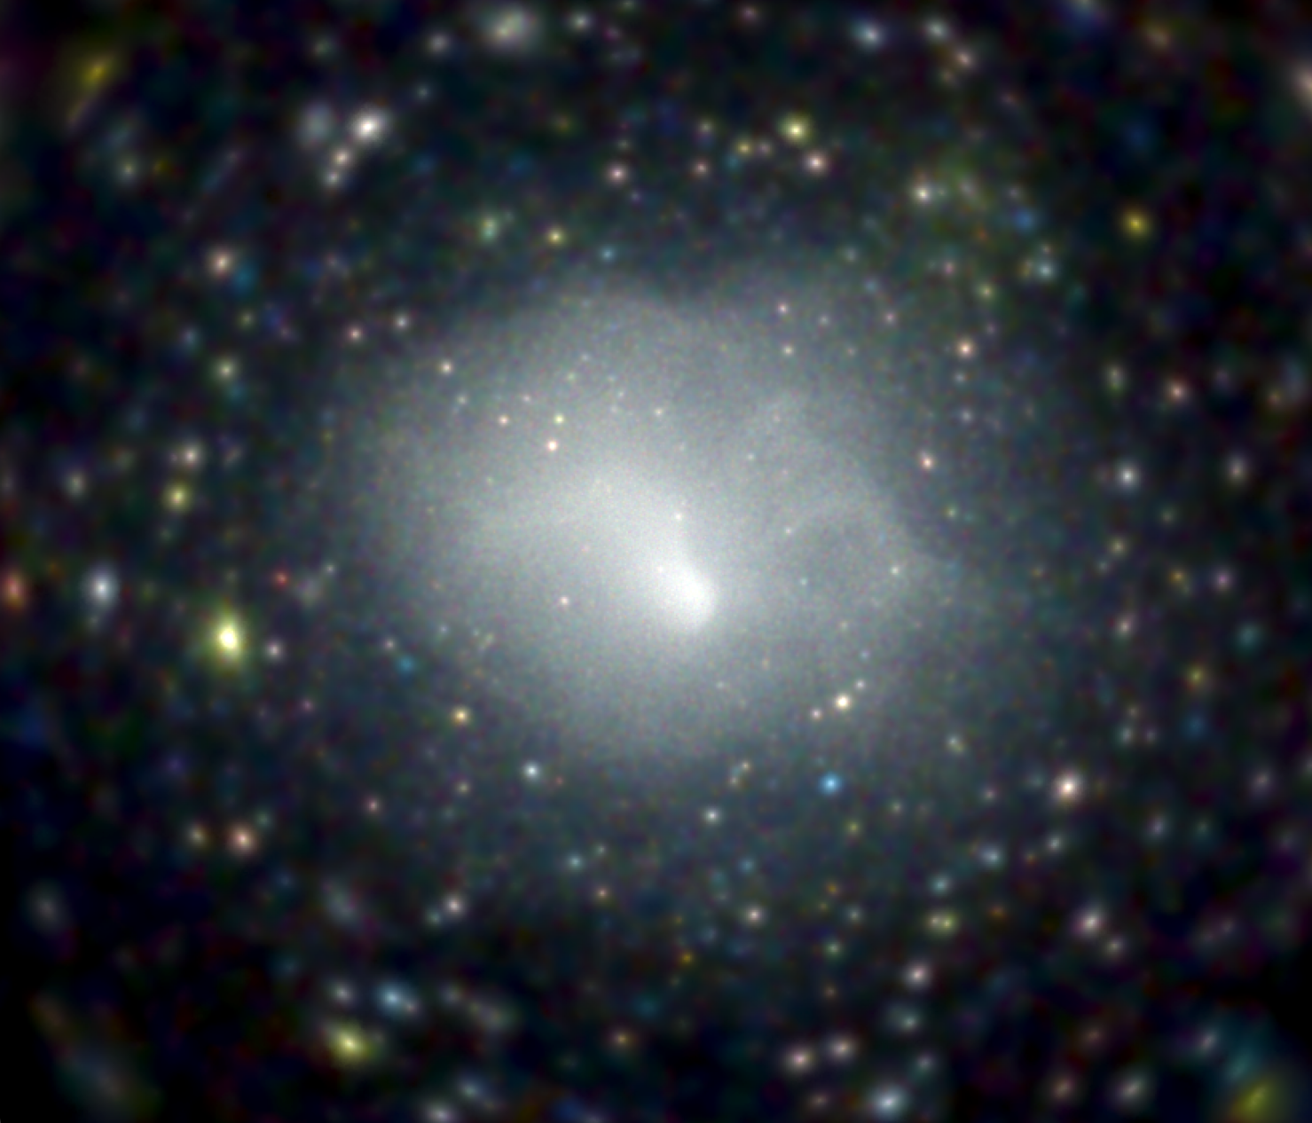
Calibration and performance verification (CalPV)
eFEDS mini survey to test data similar to the main survey
140 deg²
∼ 2.5ks exposure
∼ 27k X-ray sources
∼ 12k spec-z (SDSS-IV,V)
Flux limit (0.2-2.3 keV):
∼ 7×10⁻¹⁵ erg/s/cm²
The CalPV phase allowed us to test our software and calibration before processing the main survey
Pointed observation of Abell 3266 galaxy cluster for calibration
(Sanders et al. 2022)
Brunner et al. 2022
0.5-2.0 keV exposure corrected (H. Brunner, M. Ramos-Ceja)

Slide 10
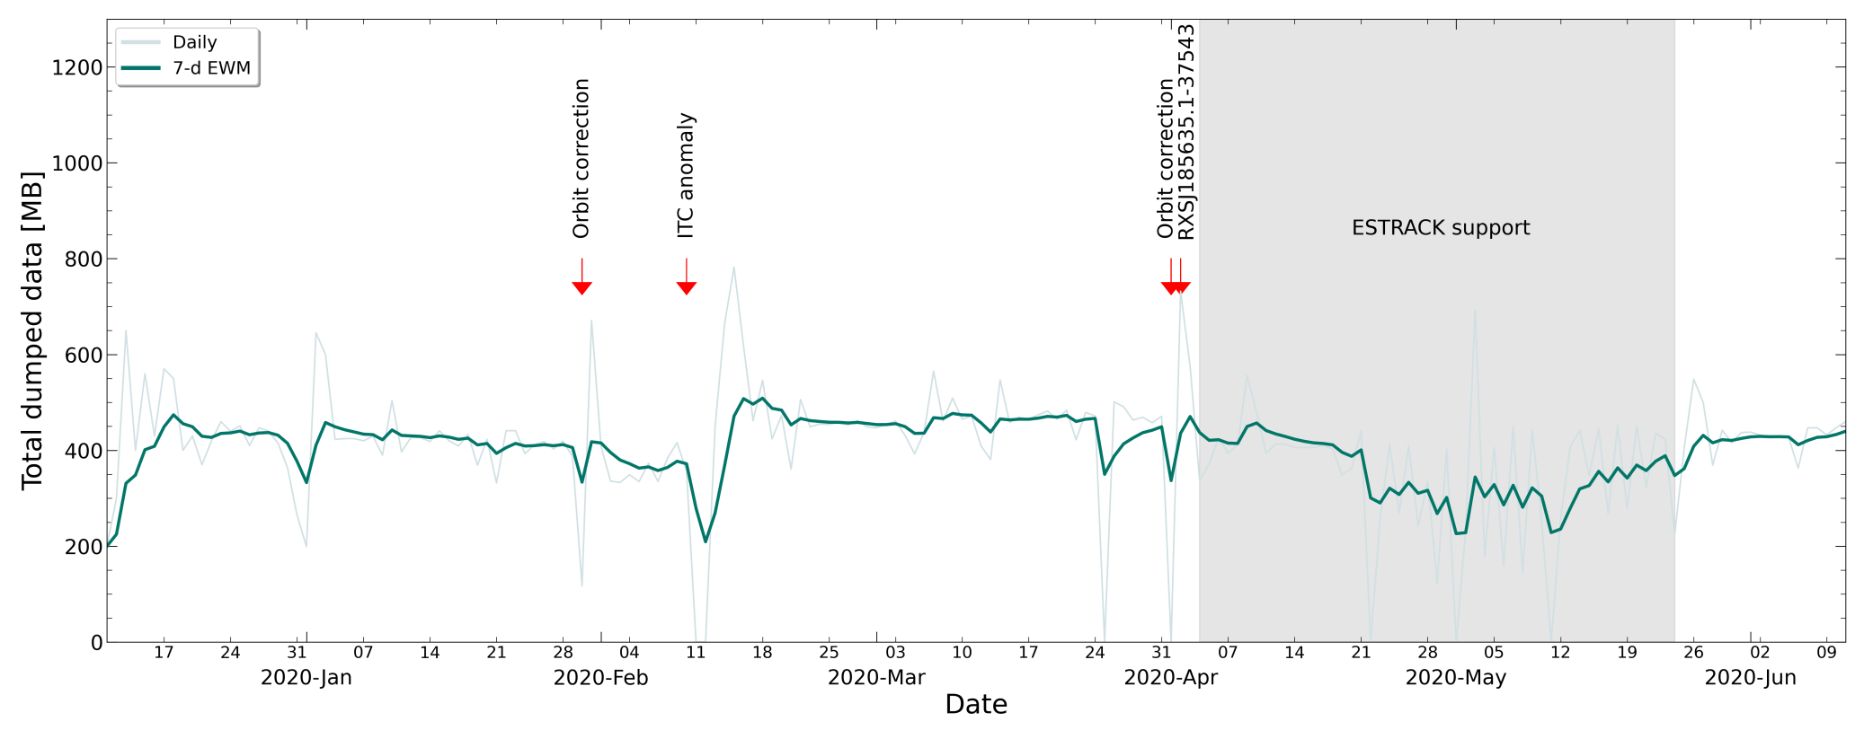
Spacecraft and eROSITA operations
Ground contact was made daily with SRG and eROSITA
Mission control centre at NPO Lavochkin used two space-antennas to contact the spacecraft (Ussuriysk and Bear Lakes)
eROSITA data received transferred from ground station to MPE via IKI (Space Research Institute of Russian Academy of Sciences)
Total of 75GB of telemetry in eRASS1 (∼407 MB per day)
Dumped data volume over eRASS1

Slide 11
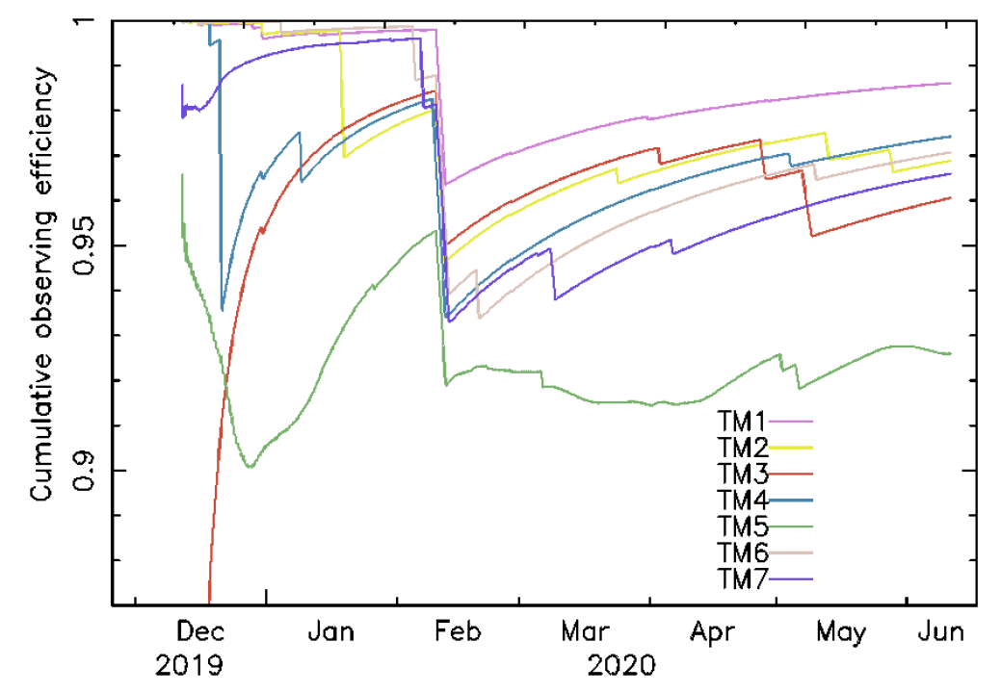
Spacecraft operations
eROSITA operations were done by MPE
  Team of ∼10 people
  Monitor health of cameras
  Downloading mass memory on spacecraft
  Special activities and observations to monitor health of instrument (e.g. look for contamination after orbit correction)
Issues encountered include
  Single Event Upsets (SEU) affect Instrument and Thermal Controller (ITC) and camera electronics, requiring resets
  Leak of optical light into two of the cameras, leading to increased background and problems with spectroscopy
Observing efficiency for each of the seven cameras. A malfunction in the ITC required a reset in Feb 2020.
The overall obs. efficiency was 96.5% during eRASS1.

Slide 12
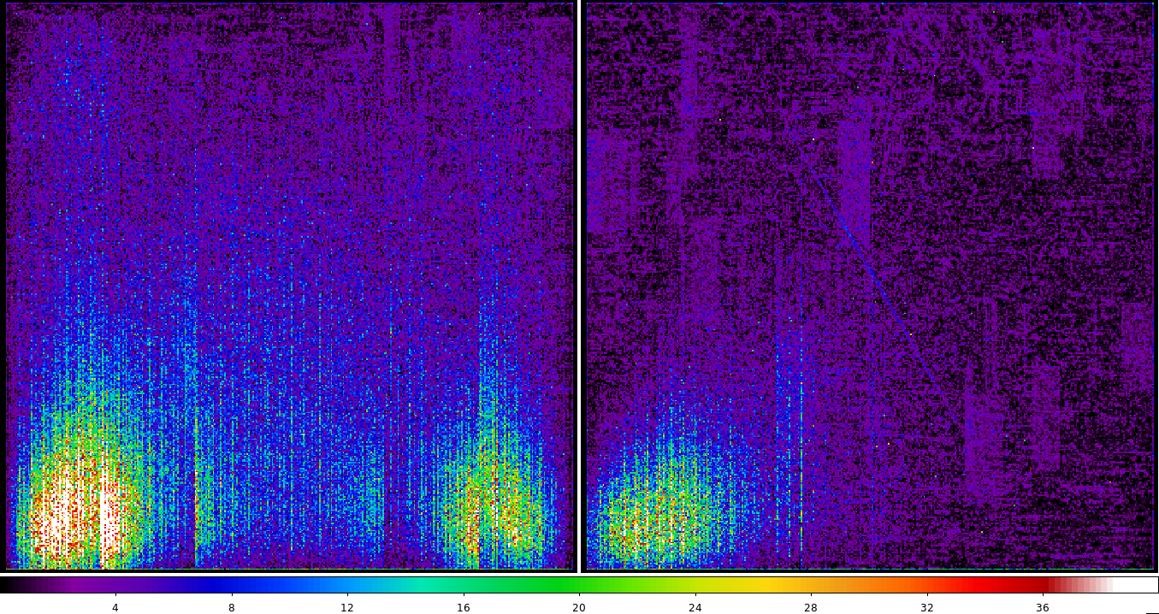
Spacecraft operations
eROSITA operations were done by MPE
  Team of ∼10 people
  Monitor health of cameras
  Downloading mass memory on spacecraft
  Special activities and observations to monitor health of instrument (e.g. look for contamination after orbit correction)
Issues encountered include
  Single Event Upsets (SEU) affect Instrument and Thermal Controller (ITC) and camera electronics, requiring resets
  Leak of optical light into two of the cameras, leading to increased background and problems with spectroscopy
Images of the light leak in the two affected cameras in detector coordinates, TM5 (left) and TM7 (right)

Slide 13
Data processing
Initially the data transferred from IKI are picked up by a pre-processing pipeline
  tmsplit task:
    Archive binary telemetry into archive
    Decode to FITS (using XML specification)
    Generate good-time-intervals (GTIs) based on data completeness
    Archive FITS files (organised by 4-hour “erodays”)
    Pass to Near Real Time Analysis (NRTA) [unfortunately no time to discuss this today]
The data are then processed by a pipeline, organised into “chains” as part of the eROSITA Science Analysis Software System (eSASS), controlled by the eropipe task.

Slide 14
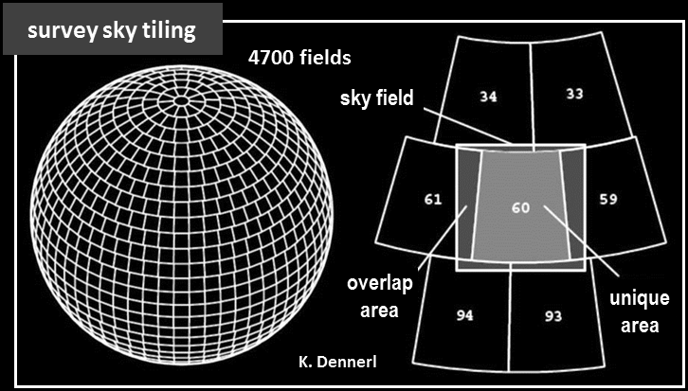
Data processing: TEL chain
TEL chain: event processing
  “events” are the individual detections of photons or background events consisting of time, position, energy and “pattern” of detection on CCD
  Number of events is referred to as “counts”
  Event file preparation: evprep and ftfindhotpix.
  Pattern recombination: pattern.
  Energy calibration: energy.
  Attitude calculation: attprep, telatt and evatt.
  Split data into tiles: telgti, telselect, telstage.
X-ray events can give rise to charge signal in multiple pixels (“pattern”). Need to compute position and total energy, accounting for noise.
Sky is split into 4700 overlapping sky tiles (3.6°×3.6°), numbered by RA and Dec

Slide 15
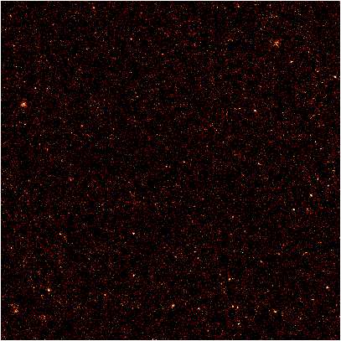
Data processing: EXP chain
EXP chain: event processing and image creation
  Event data collected in each sky tile are merged for each TM: expmerge
  Compute sky coordinates of events: radec2xy
  Combine all TM events together and make images: evtool
  Optional creation of GTIs based on detection of X-ray flares: flaregti (not used for eRASS1 due to lack of flares)
Example X-ray event count image of sky tile in the band 0.2-2.3 keV

Slide 16
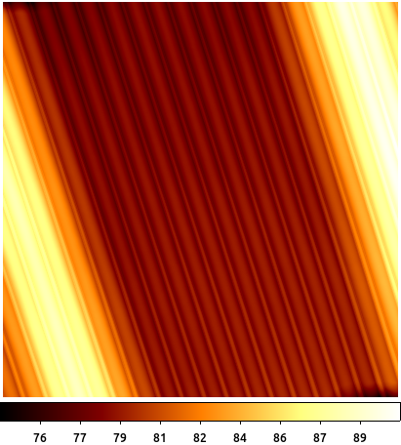
Data processing: DET chain
DET chain: exposure maps and source detection
  Calculate exposure time at each sky location (relative to on-axis full eROSITA), including effect of vignetting, bad pixels, GTIs: expmap.
  Make masks for source detection: ermask.
  Initial source finding: erbox.
  Background determination: erbackmap.
  PSF fitting of initial sources: ermldet.
  Aperture photometry : apetool
  Sensitivity maps: ersensmap.
  Catalogue creation: catprep.
Example exposure map for previous tile
(in seconds)

Slide 17
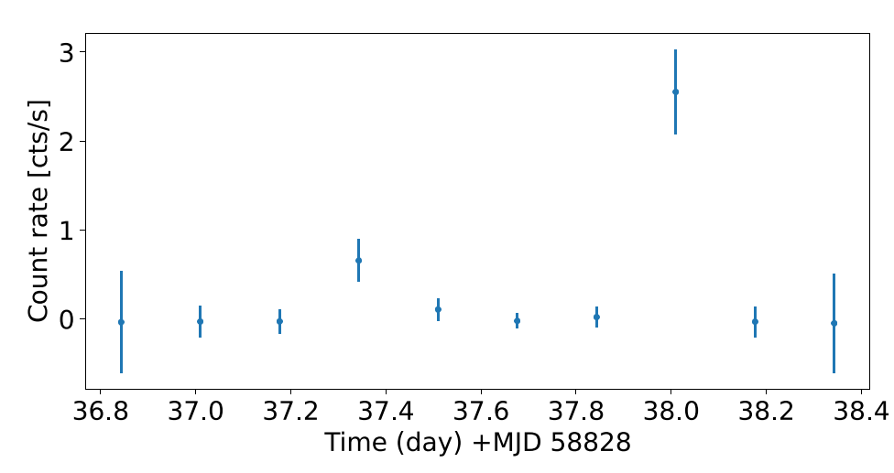
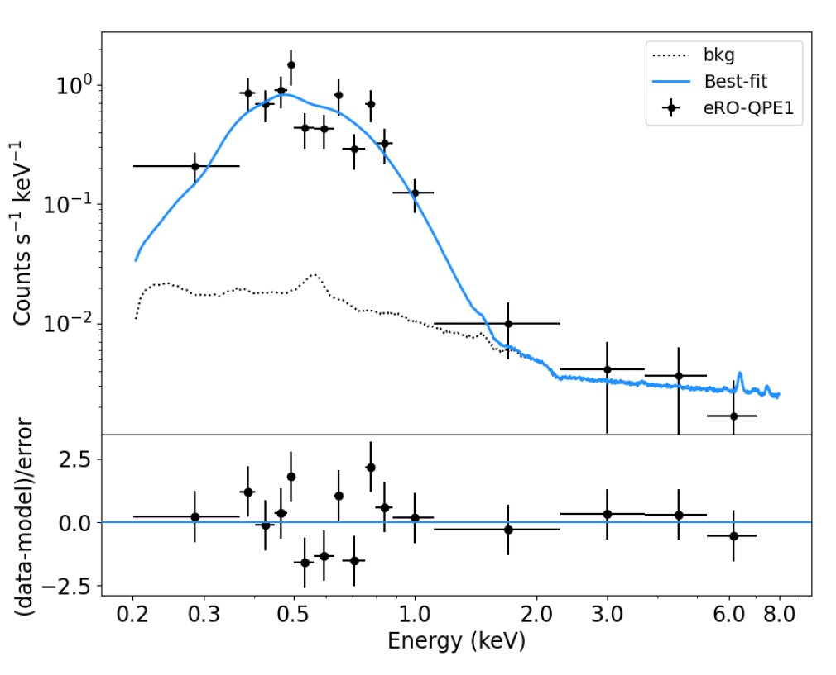
Data processing: SOU chain
SOU chain: source specific products
  Calculate lightcurves, spectra, background spectra and response matrices for the brightest sources (detection likelihood>20): srctool.
Light curve and spectrum of the ﬁrst eROSITA Quasi Periodic Eruptor (eRO-QPE1; Arcodia et al. 2021)

Slide 18
eROSITA Science Analysis Software System (eSASS)
Developed in modern Fortran 90+
  Choice was motivated by eSASS team ranging from scientists to software developers
Built on knowledge and experience from ROSAT and XMM-Newton data pipelines (some developers the same)
Aims to be standard-compliant in producing products for X-ray astronomy
Delivered as source (supported for Ubuntu Linux) and in Docker format for EDR and eRASS1
GPL Licence, with git version control
Additional web tools built by team
  DATool: web data delivery for collaboration (Fortran/Python + PHP)
  eROPub and eROSE: Publication and project database and sky viewer (Python + Django + PostgreSQL)

Slide 19

The eROSITA eRASS1 sky
eROSITA-DE sky half
and released data
Red: 0.3-0.6 keV
Green: 0.6-1.0 keV
Blue: 1.0-2.3 keV
J. Sanders, H. Brunner (MPE), E. Churazov, M. Gilfanov (IKI), and eSASS team

Slide 20
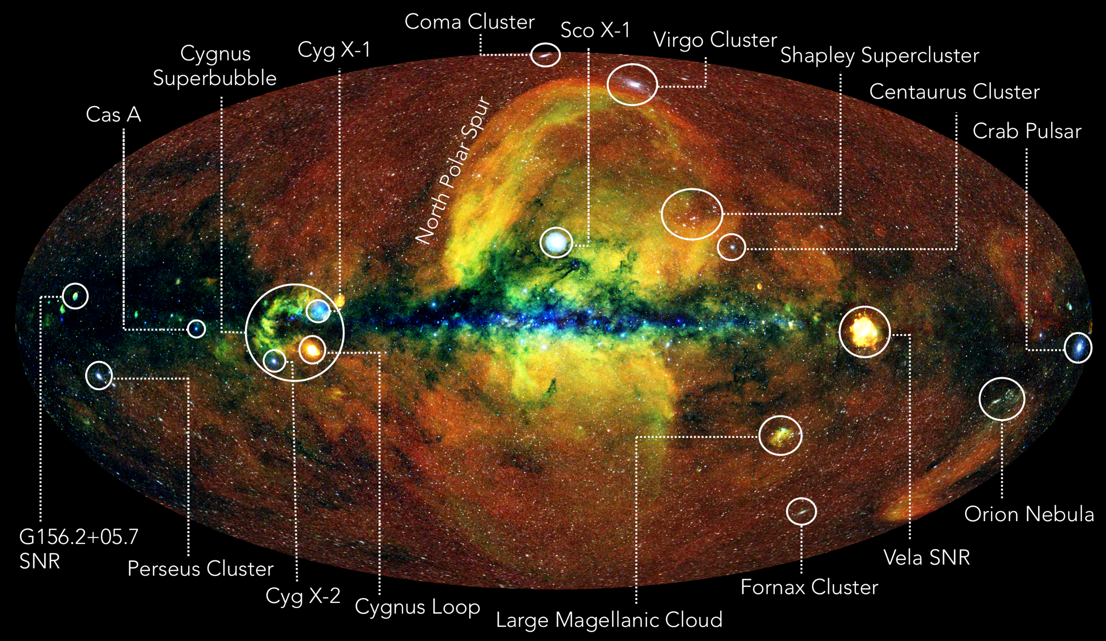
Annotated eRASS1 sky
A. Merloni

Slide 21
Characteristics of survey
Uniform exposure, avg. ∼ 800 s (eRASS:4); up to 120 ks at the Ecliptic Poles (confusion limited)
Typical (point-source) sensitivity:
  Single pass (eRASS1,2,3,4)
    ∼ 5×10⁻¹⁴ erg/s/cm² [0.2-2.3 keV]; 4-5x deeper than RASS
    ∼ 7×10⁻¹³ erg/s/cm² [2.3-5 keV]
  Cumulative (eRASS:4)
    ∼ 2×10⁻¹⁴ erg/s/cm² [0.2-2.3 keV]
    ∼ 2×10⁻¹³ erg/s/cm² [2.3-5 keV]
eRASS1 (half-sky): 0.9M point sources; ∼ doubles the number of known X-ray sources!
eRASS:4 (half-sky): 2.8M point sources; 87k extended; ∼ 45k confirmed clusters

Slide 22
Data release 1 (DR1)
In the autumn of this year, we plan to make the first public release of the eROSITA-DE data
This will consist of
  Catalogues (main catalogue, hard band, clusters and several others)
  For each tile:
    Calibrated event files
    Images (in seven bands)
    Exposure maps (in seven bands)
    Background images (from source detection)
    Sensitivity maps
    Source products (for bright sources with detection likelihood > 20)
  eSASS version used for processing
  Calibration inputs and background models

Slide 23
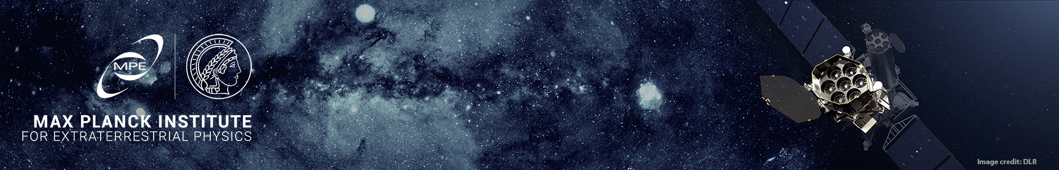
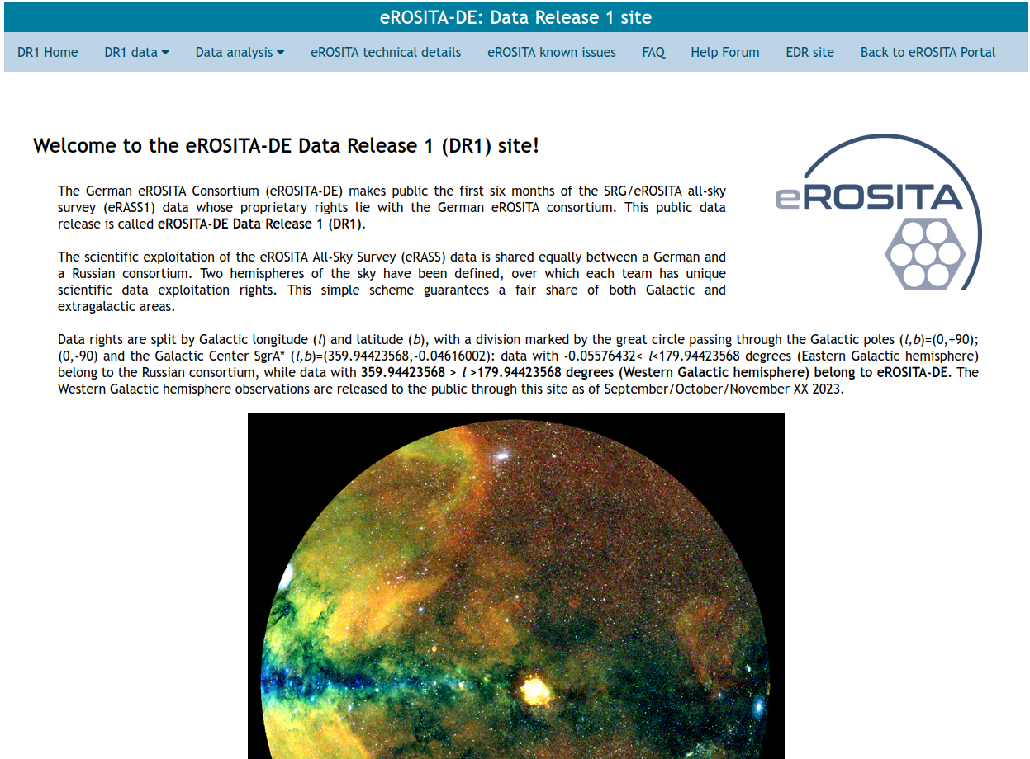
Constructed website for the DR1 release, containing
Information about data provided
Software installation instructions
Data analysis guides
Task documentation
Calibration information
Known issues with data
FAQs
Help forum

Slide 24
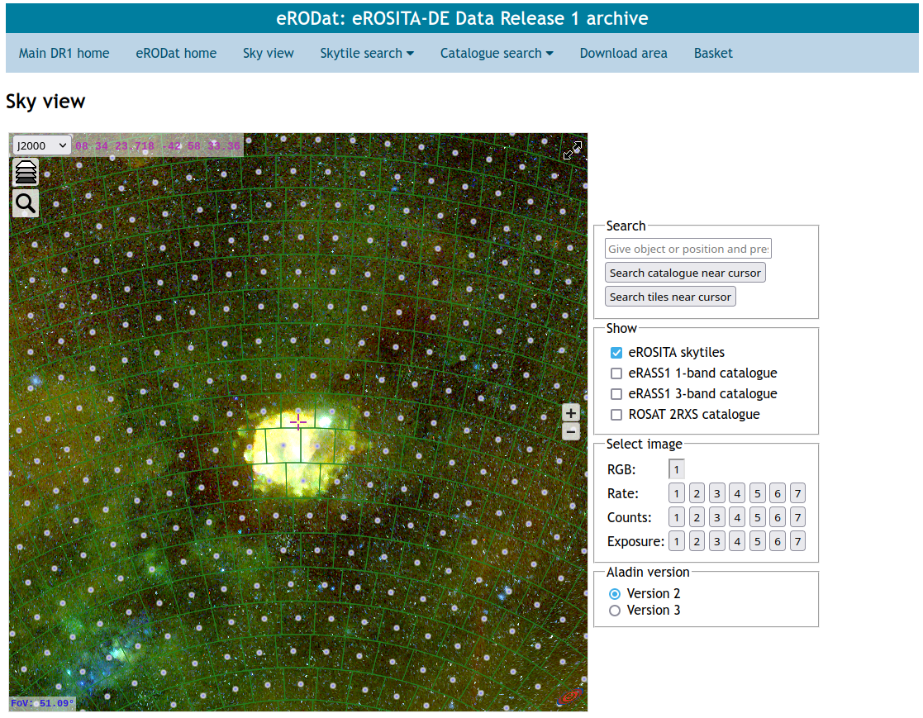
eRODat data archive website, constructed in Python/Django and a PostgreSQL database. Will allow:
Uses Aladin Lite for display
Browse map of eROSITA sky and access HiPS maps
Plot source catalogues
View and download sky tiles
Search for sources and products
Shopping basket for data download
Upper limit server (in progress)

Slide 25
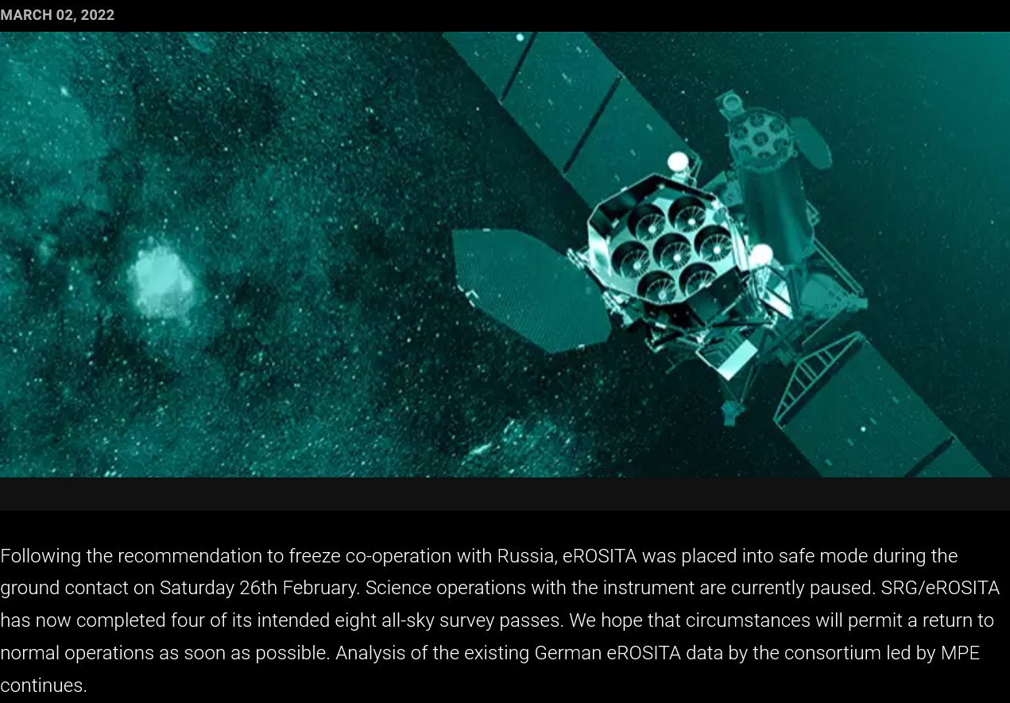
Statement on the status of the eROSITA instrument aboard Spektr-RG (SRG)
https://www.mpe.mpg.de/7856215/news20220303

Slide 26
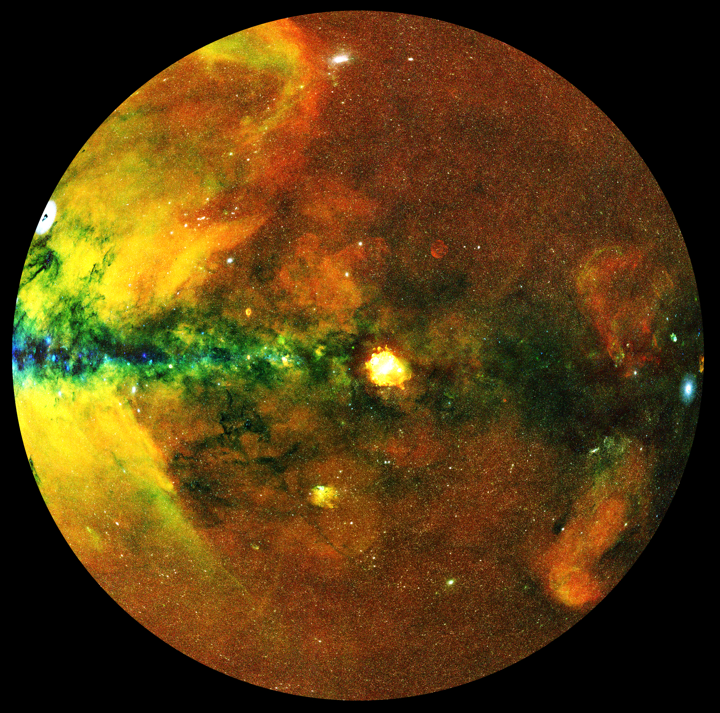
In the future…
Further data releases containing data from multiple surveys.
Timescales will be determined later.
eRASS:4
0.30-0.63 keV
0.63-1.04 keV
1.04-2.30 keV
∼52” resolution
ZEA projection

Slide 27
Planned future improvements to processing
Planning to make internal update of software and calibration before the end of the year and reprocess entire data archive
Software improvements
  Improved handling of bad frames
  Better treatment of GTIs
  Bug fixes and improvements in the source detection and characterisation
Calibration improvements
  Better energy calibration
  Updated response matrices
  Better detector thresholds
  Effective area updates
  Vignetting updates
  PSF updates

Slide 28
Conclusions
eROSITA has performed over 4 sky surveys with minimal problems
eROSITA is now in safe mode due to the Russian invasion of Ukraine. Unfortunately we don’t know when or if operations will resume.
Thanks to its large grasp and stable background, it’s opening up many interesting new areas of science
The completed surveys will be an amazing legacy dataset
eRASS1 DR1 is coming in the autumn of this year
We are improving our processing and calibration in the meantime
Dates of future DRs will be announced later

Slide 30
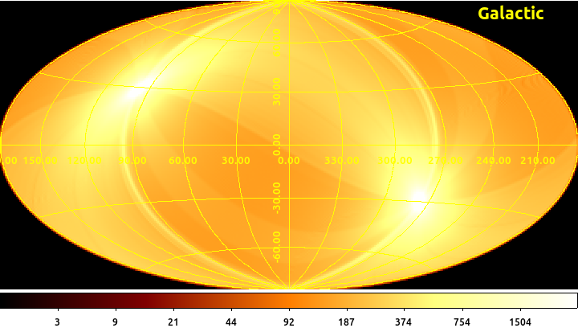
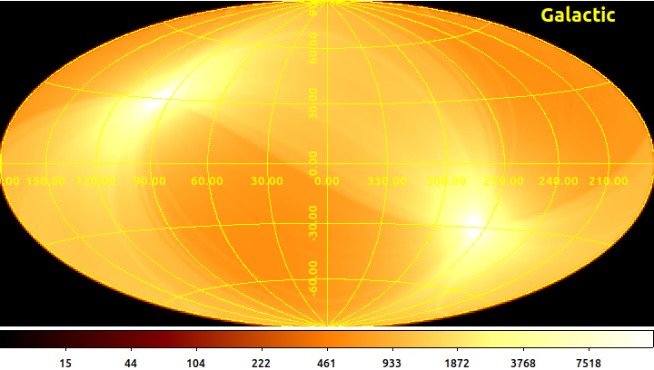
Exposure maps
eRASS1
eRASS:4
https://erosita.hs.uni-hamburg.de/hserosita/survey

